Slide 1
Deep Gradient Compression: Reducing the Communication Bandwidth for Distributed Training
Yujun Lin, Song Han, Huizi Mao, Yu Wang, William J. Dally
ICLR 2018

Slide 2
Distributed Deep Learning
Distributed training can decrease the computation time
Data Parallelism, Synchronous SGD
Gradient exchange is costly
RNN
Mobile Device (federated learning)
Approaches to overcome communication bottleneck
1-bit SGD, TernGrad
Gradient Dropping (99%), AdaComp (200x fc, 40x conv)

Slide 3
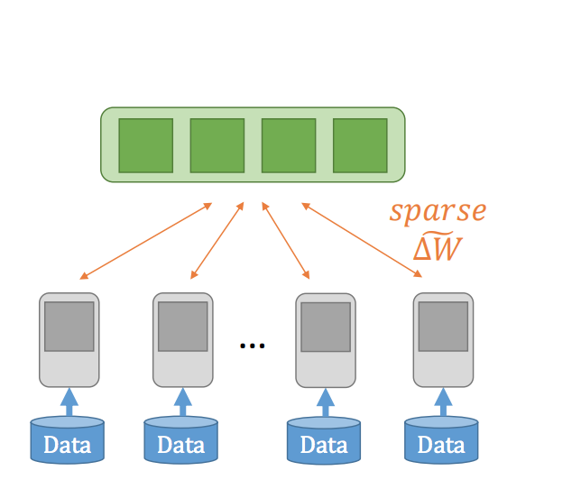
Deep Gradient Compression (DGC)
Sparsification
Gradient Sparsification
Momentum correction
Local Gradient clipping
Staleness Problem
Momentum factor Masking
Warmup training
Empirical results:
99.9% of the gradient exchange are redundant
Gradient compression ratio from 270x – 600x, no loss of accuracy
Speed up (64 nodes) 40x over 1Gbps, 60x over 10Gpbs

Slide 4
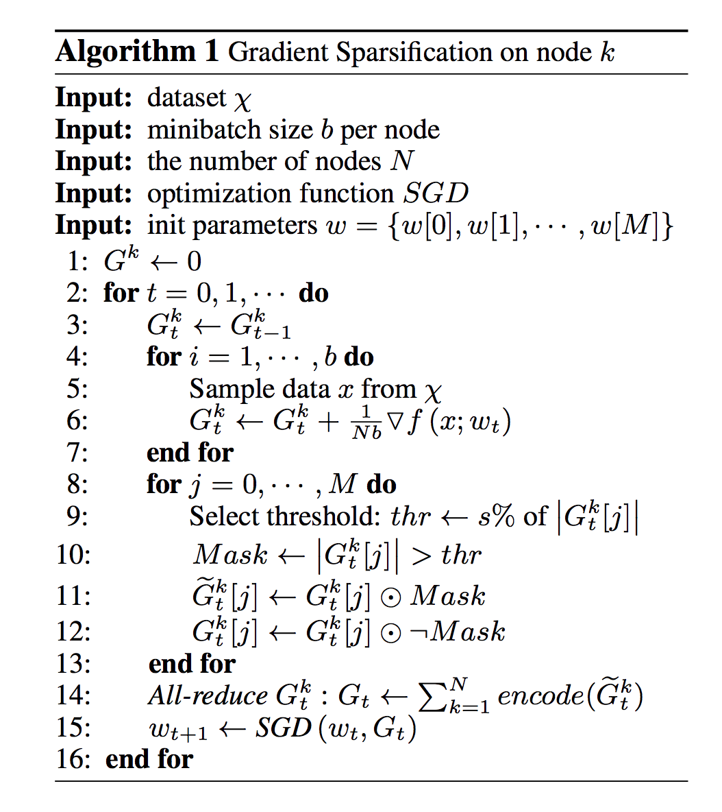
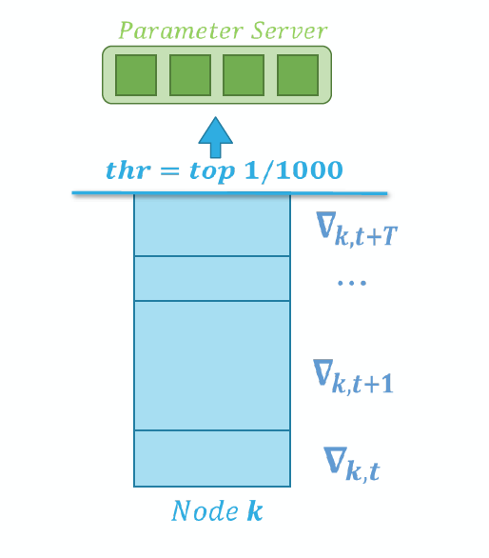
Gradient Sparsification
Sparse Update
Sending only important gradients (> threshold)
Accumulate rest of gradient locally
Local gradient accumulation is equivalent to increasing the batch size.

Slide 5
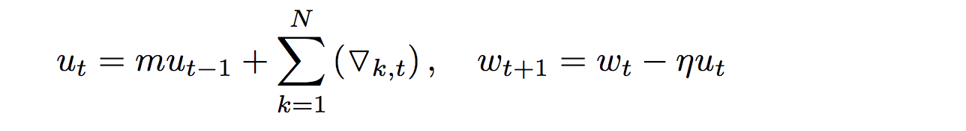
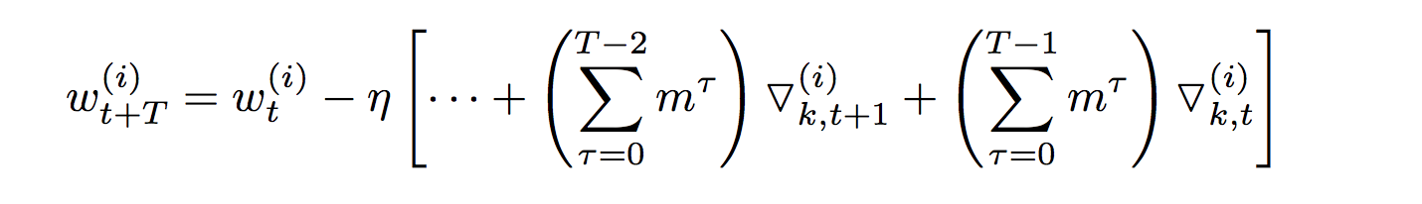
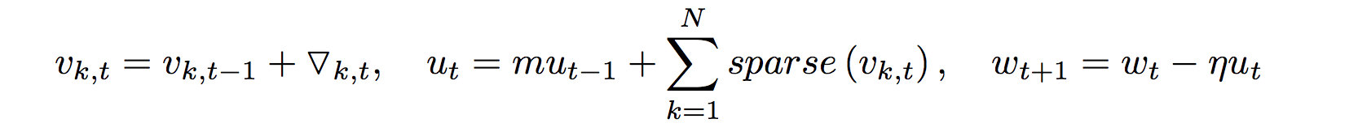
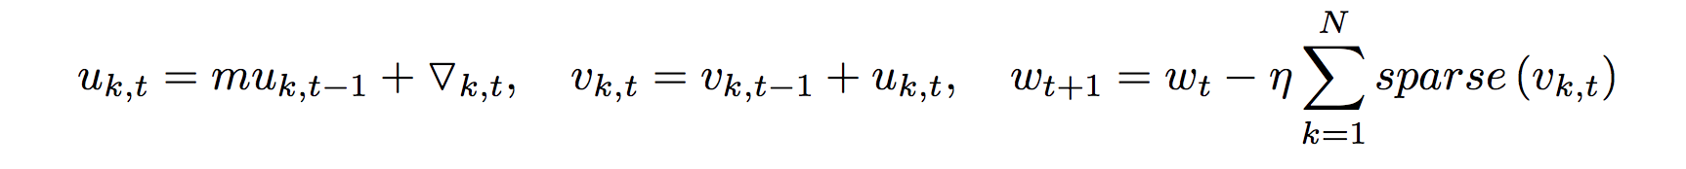
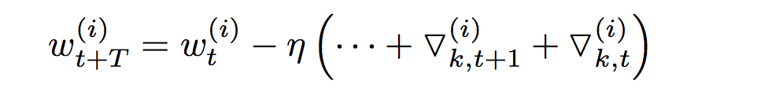
Momentum Correction
Vanilla momentum SGD
Flattened format
Momentum with sparse gradient
Flatten format

Slide 6
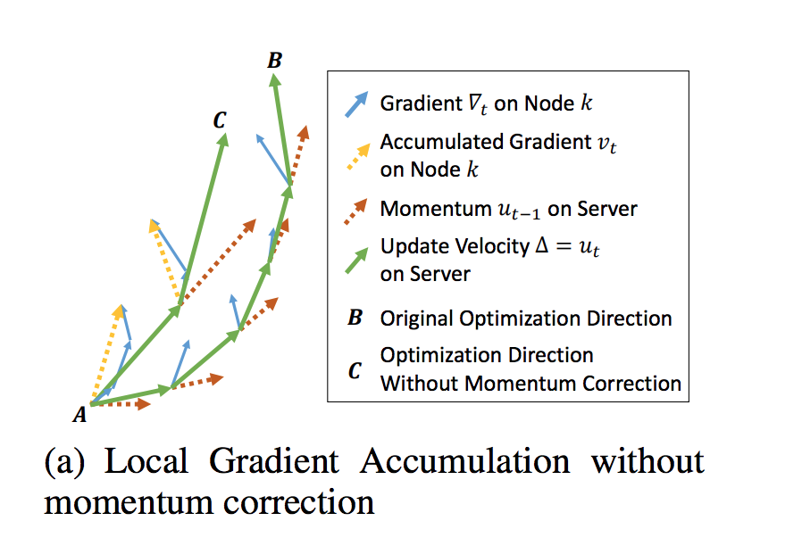
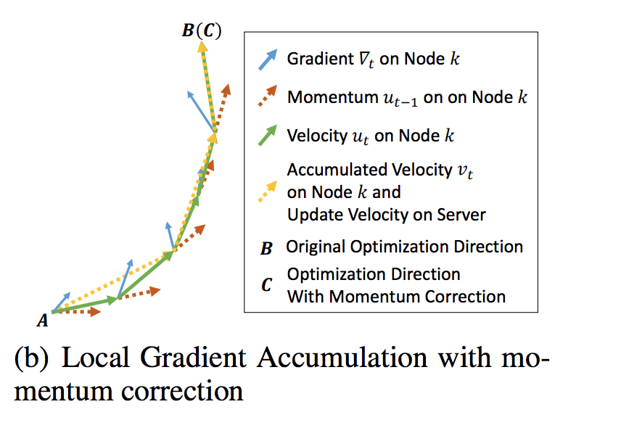
Momuntum Correction

Slide 7
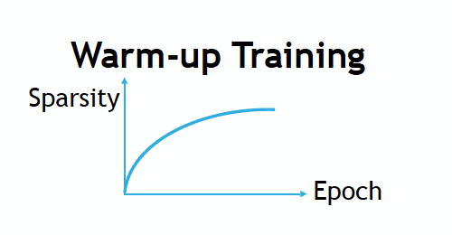
Other Tricks
Local Gradient Clipping
Rescale gradients whenever the sum of their L2-norms exceeds a threshold
Momentum Factor Masking
Warm-up Training
Less aggressive learning rate, less aggressive gradient sparsity
Linearly ramping up the learning rate, exponentially increase the gradient sparsity

Slide 8
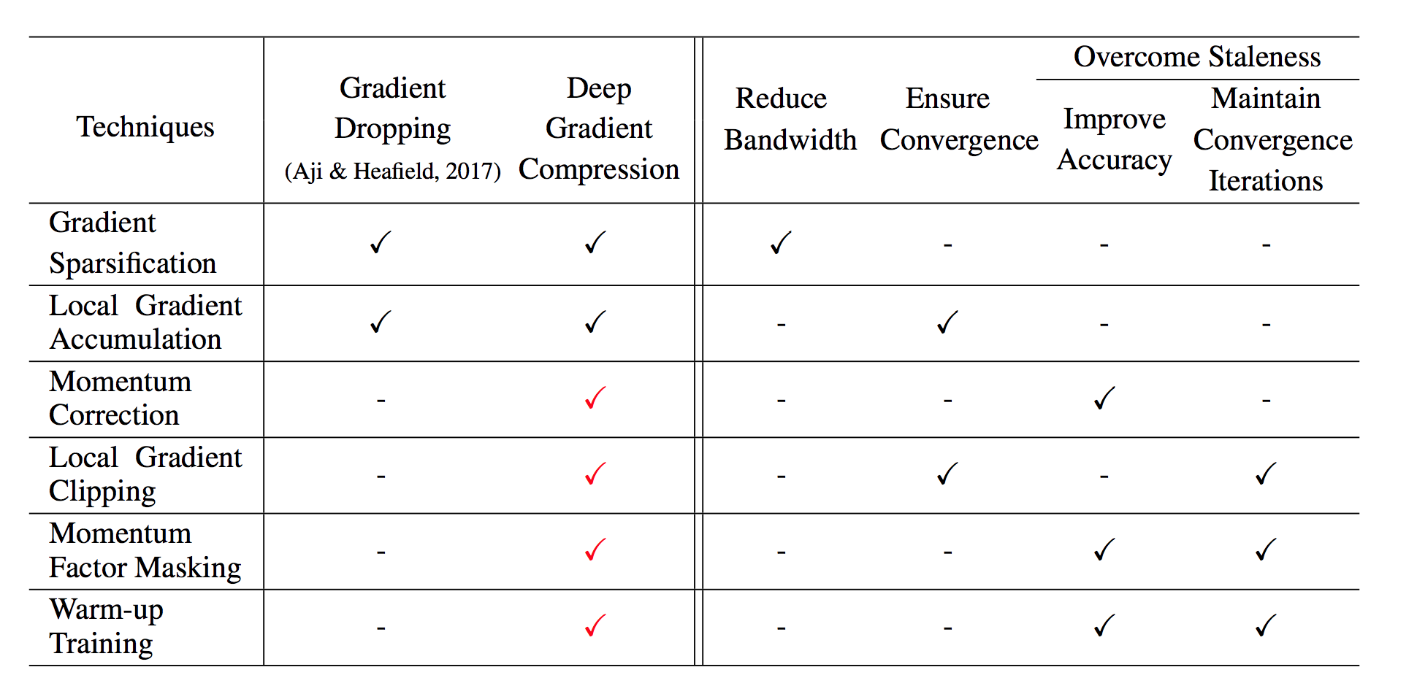
All Tricks

Slide 9
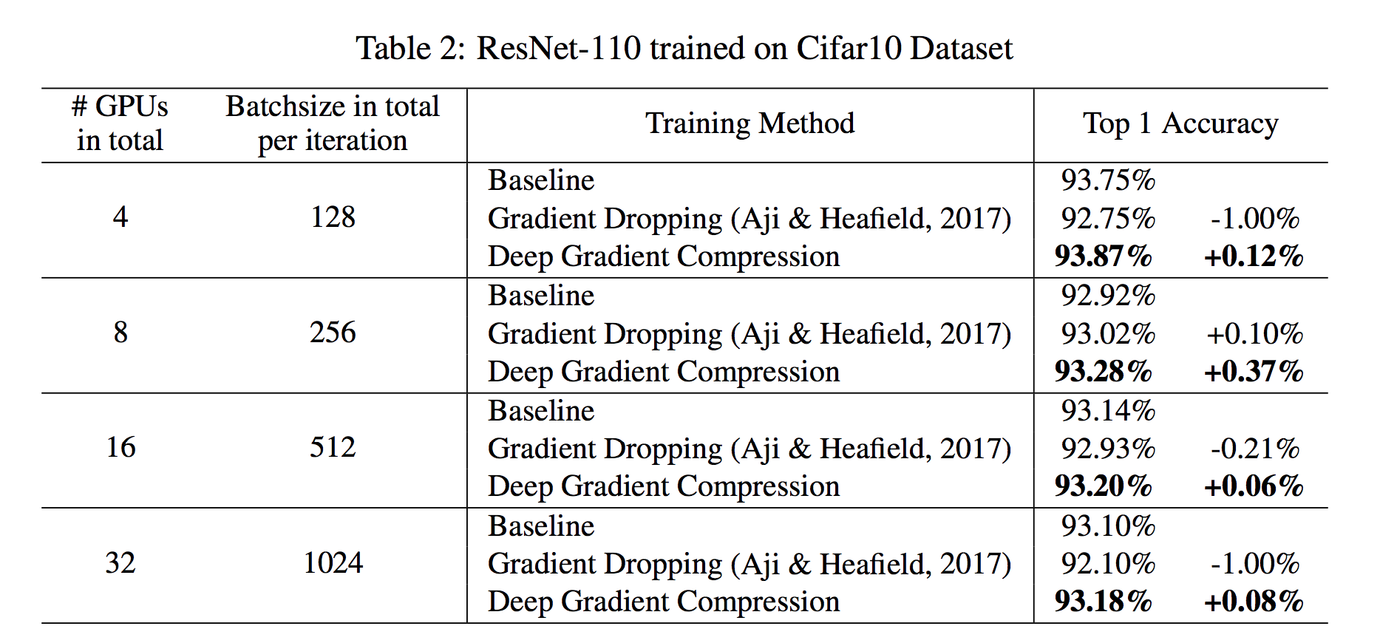
Accucary Experiments

Slide 10
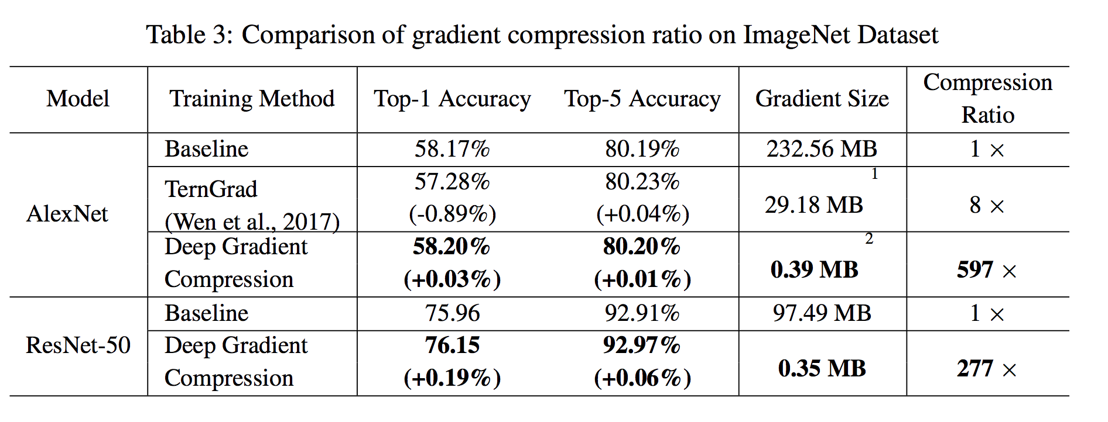
Accuracy Experiments

Slide 11
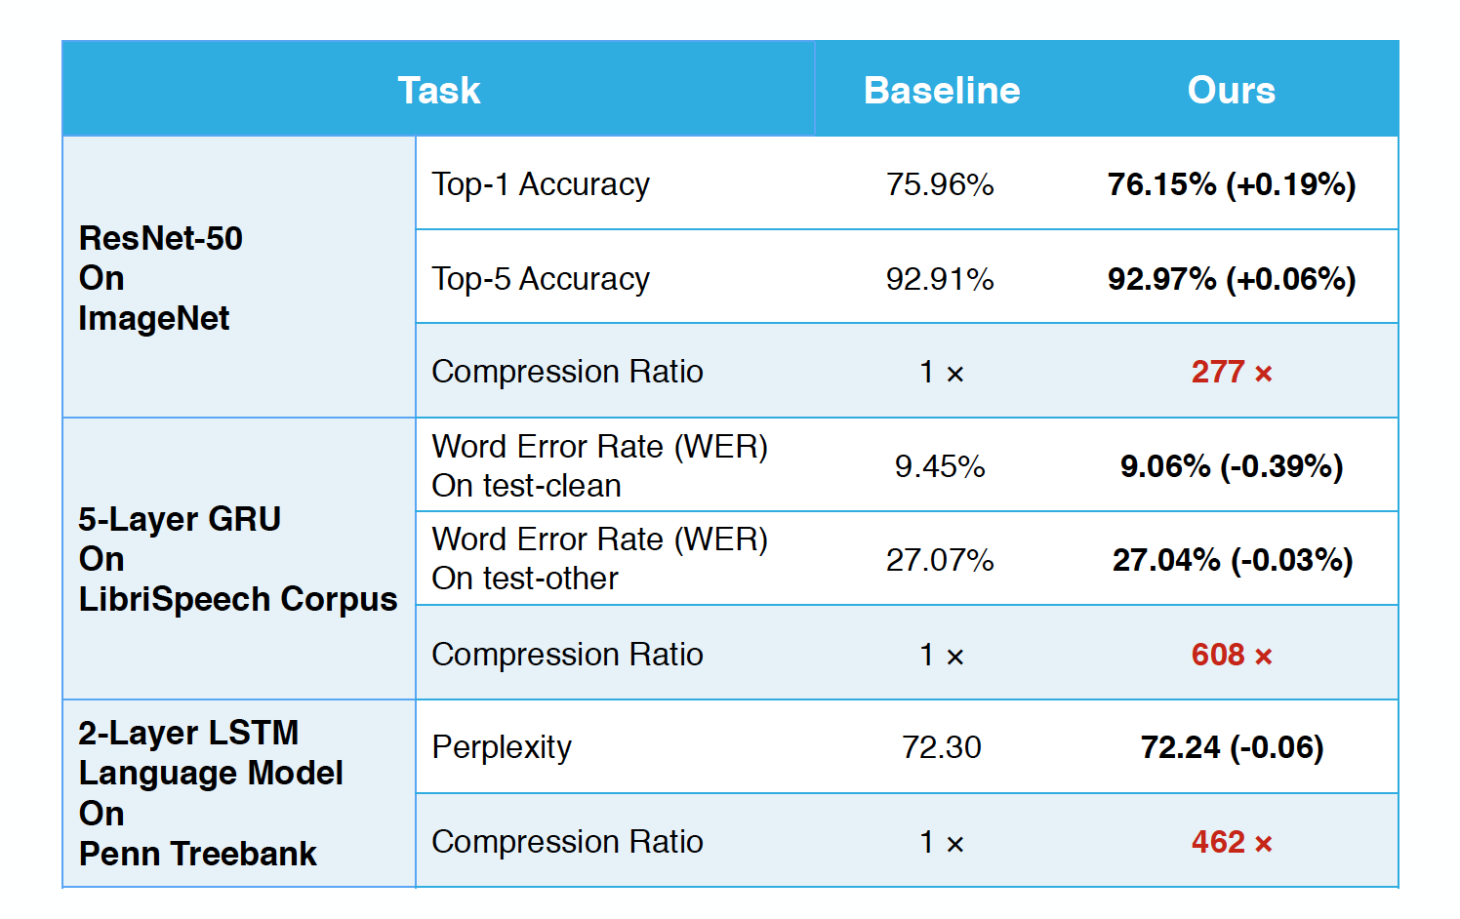
Accuracy Experiments
No loss of Accuracy,
200x-600x saving in communication cost

Slide 12
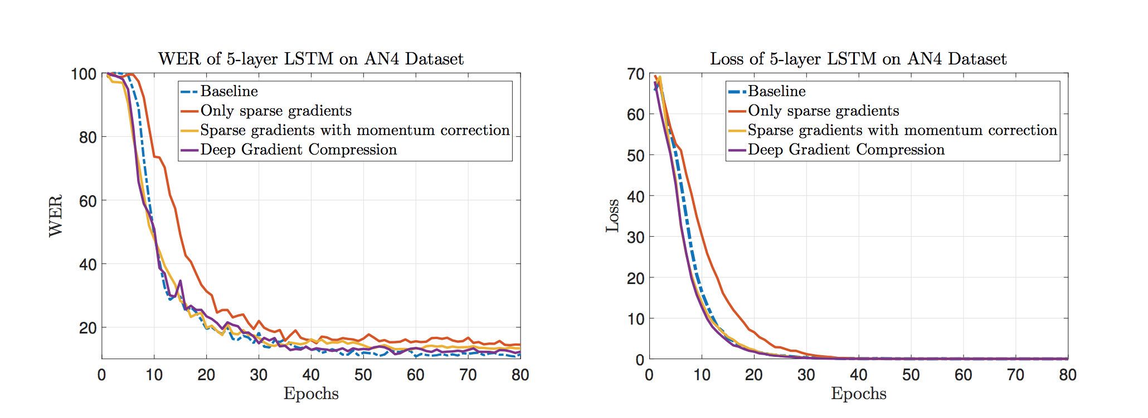
Speech Experiments

Slide 13
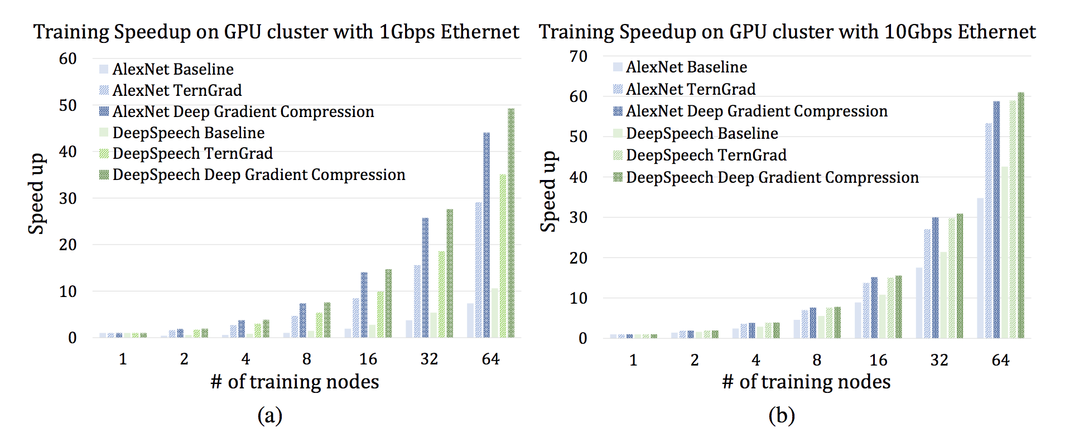
System Experiments

Slide 14
Open Review
Decision
The main stellar aspect of the work were the experimental results, and reviewers call them "thorough" and note they are convincing.
Many detail questions
how much warm up period do you need to use for each examples?
Once we applied momentum factor masking; the momentum correction becomes useless. The accumulated discounting factor in Eq(6) was masked and become the same as original way. It is not clear about momentum factor mask.
The paper just focuses on compression from workers to parameter server.
For All-reduce, since the sparse gradients may be of different size, the standard MPI All-reduce operation won't work for this. Do you implement your own All-reduce operation
What is the expected performance of the 1-bit SGD method proposed by Seide et al.?

