Slide 1
Rafiki: Machine Learning as an Analytics Service System
Wei Wang, Sheng Wang, Jinyang Gao, Meihui Zhang,
Gang Chen, Tech Khim Ng, Beng Chin Ooi
National University of Singapore

Slide 2
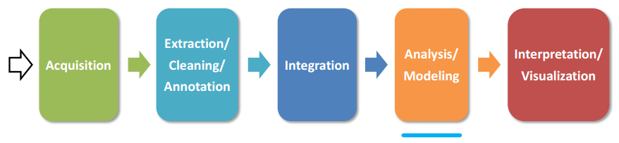
Problem
Database systems is used for the first 3 stages, ML system for the 4th.
Integrating ML into database application is difficult.
A better solution is cloud ML service.
Provide an API for each task, e.g., image classification, sentiment analysis.
Provide the training service.
Notes:
Amazon和Google用它们的数据训练的模型不一定适合用户的数据，准确率低
只支持少数的模型

Slide 3
Goal
Cover a wide range of models.
Easy-to-use, efficient, and effective services.
Select proper models for a given task.
Automatic hyper-parameter tuning.
Inference that ensembles multiple models.

Slide 4
Rafiki
Both training and inference services. Users upload their datasets and configure the service.
A unified framework for both the training and the inference services.
A general framework for distributed hyper-parameter tuning.
A RL based scheduling algorithm for the inference service.

Slide 5
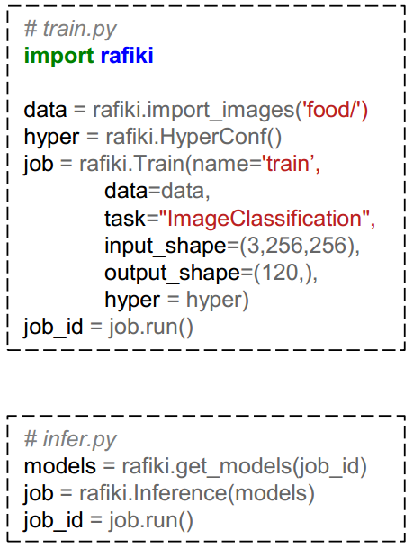
Rafiki User Code
RESTFul APIs or Python SDK.
Training code
Load data
Create configuration
Create training job
Submit the job
Inference code
Get model instance
Create inference job
Deploy the model

Slide 6
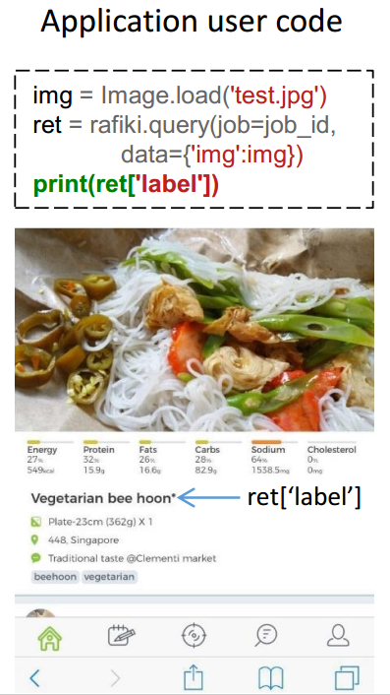
Application User Code
RESTFul requests.
Application users submit their requests to this job for prediction.
Applications send RESTFul requests to do the query.

Slide 7
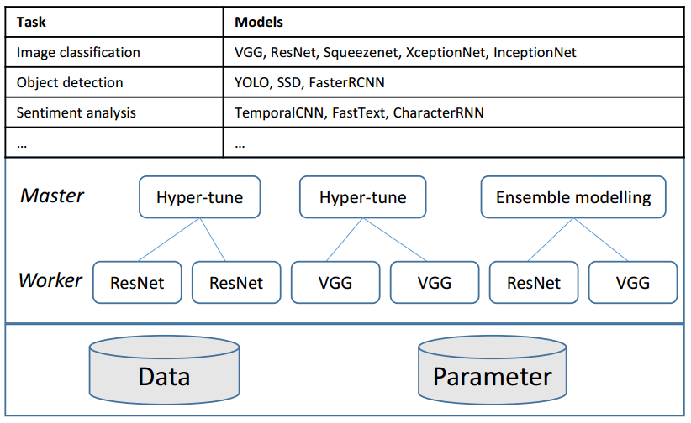
Overview of Rafiki
For each training job, Rafiki selects built-in models based on task type.
Master, Slave, Parameter server

Slide 8
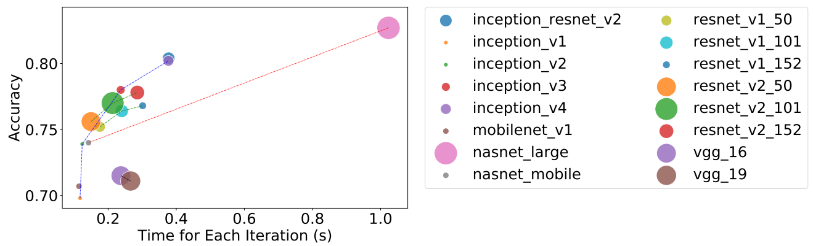
Training Services Model Selection
Every model is registered under a task.
Each model is associated with training cost, e.g., speed, memory.
A simple strategy: models with similar performance but with different architectures.

Slide 9
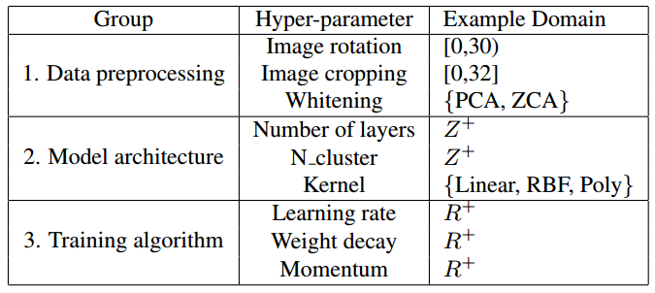
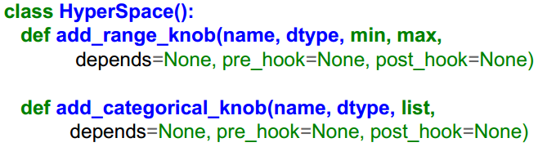
Training Services Distributed Hyper-parameter Tuning
Programming Model
Grid search, random search, Bayesian optimization.
Three groups of hyper-params.
A range, a list of numbers or categories.
Rafiki provides a HyperSpace

Slide 10
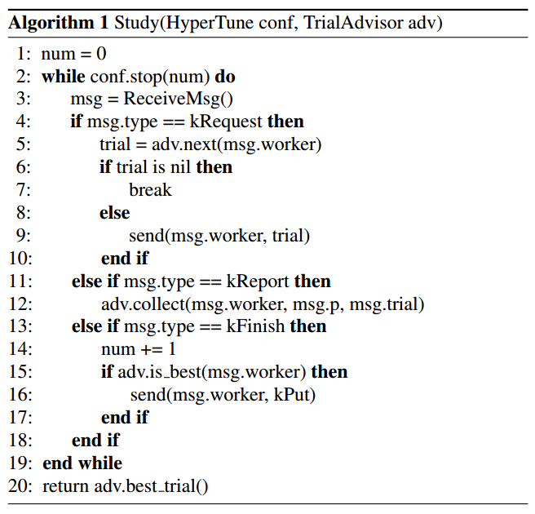
Training Services Distributed Hyper-parameter Tuning
Performance of trail h: <h, p, t>
A master generates trails.
The workers evaluate trails.

Slide 11
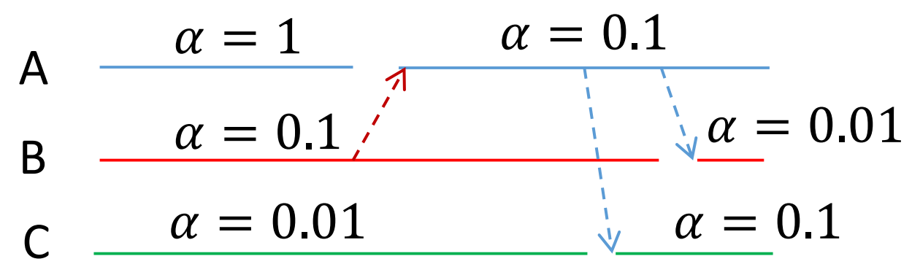
Training Services Distributed Hyper-parameter Tuning
Collaborative tuning
Select the parameters from the top performing trials.
The old trials are like pre-training.
A early stops and uses params from B.

Slide 12
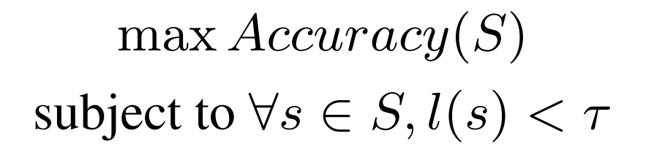
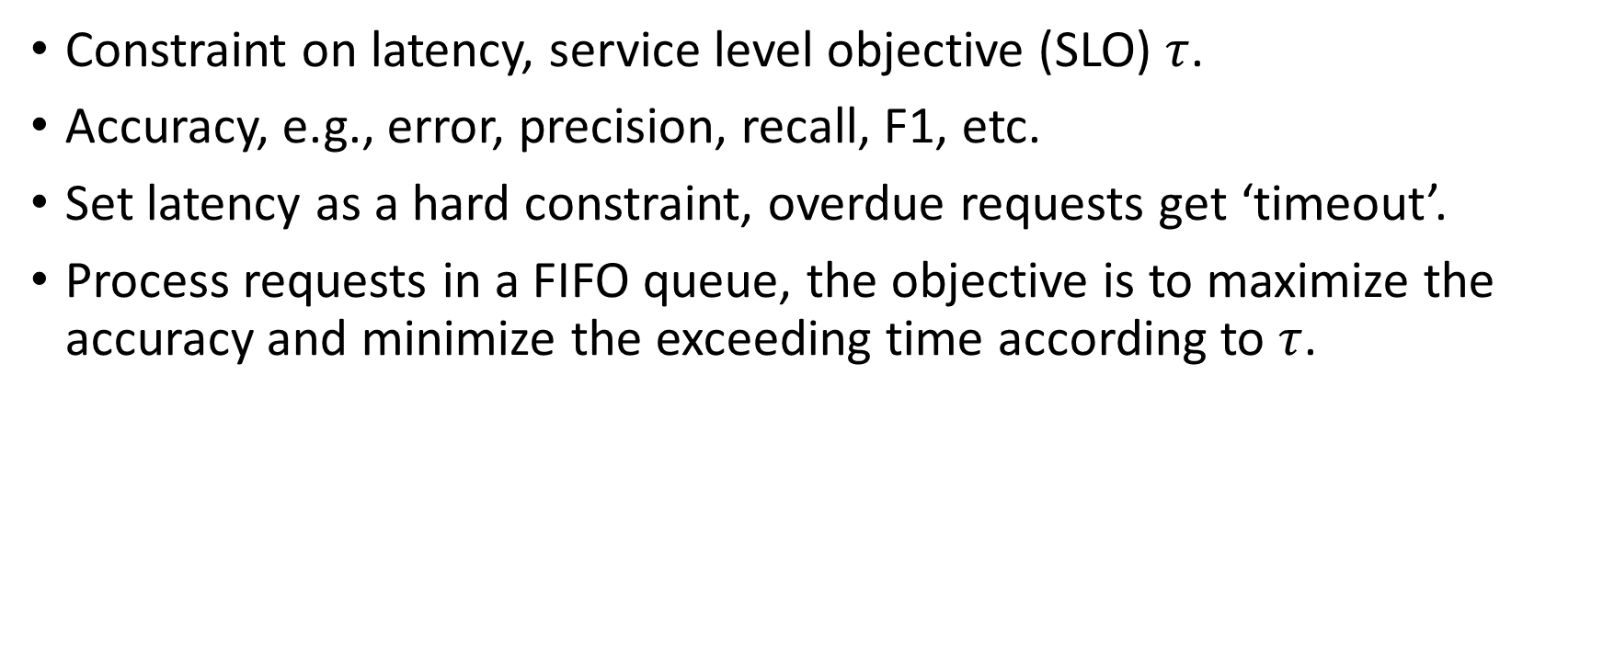
Inference Service
Constraint on latency, service level objective (SLO) $τ$.
Accuracy, e.g., error, precision, recall, F1, etc.
Set latency as a hard constraint, overdue requests get ‘timeout’.
Process requests in a FIFO queue, the objective is to maximize the accuracy and minimize the exceeding time according to $τ$.

Slide 13
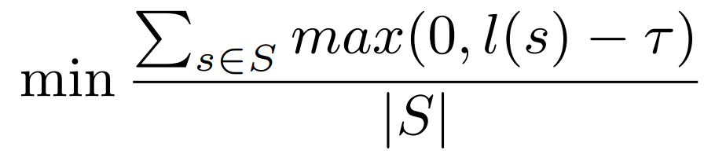
Inference Service Single Inference Model
The accuracy is fixed, the objective is to minimize the exceeding time.
l(s) is the latency of a request.
The inference time depends on the model complexity, hardware efficiency (FLOPS) and the batch size.
Once the model is deployed, the model complexity and hardware efficiency are fixed.
Rafiki tunes the batch size to optimize latency.

Slide 14
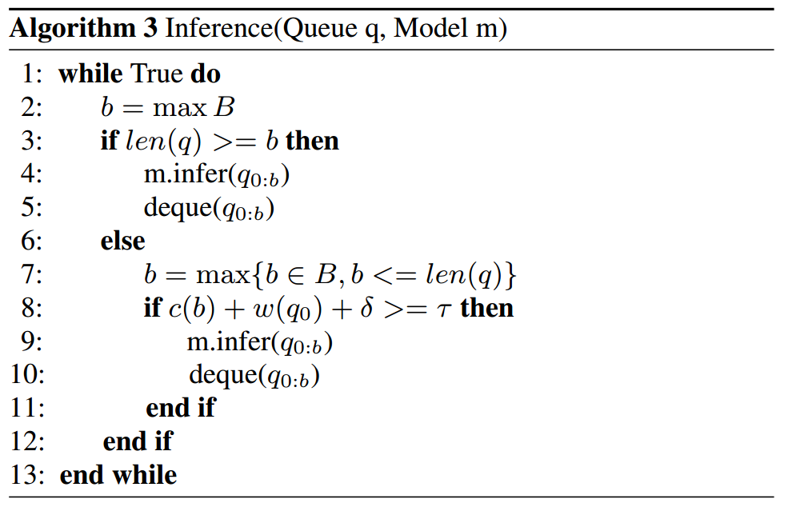
Inference Service Single Inference Model
Candidate batch size B={16, 32, 48, 64, …}
c(b): the latency of processing b requests.
A greedy solution: always applies the largest batch size possible.
Notes:
如果queue的长度大于最大的batch size，最老的b个requests被作为一个batch处理
否则等待，直到最老的request马上就要超时，

Slide 15
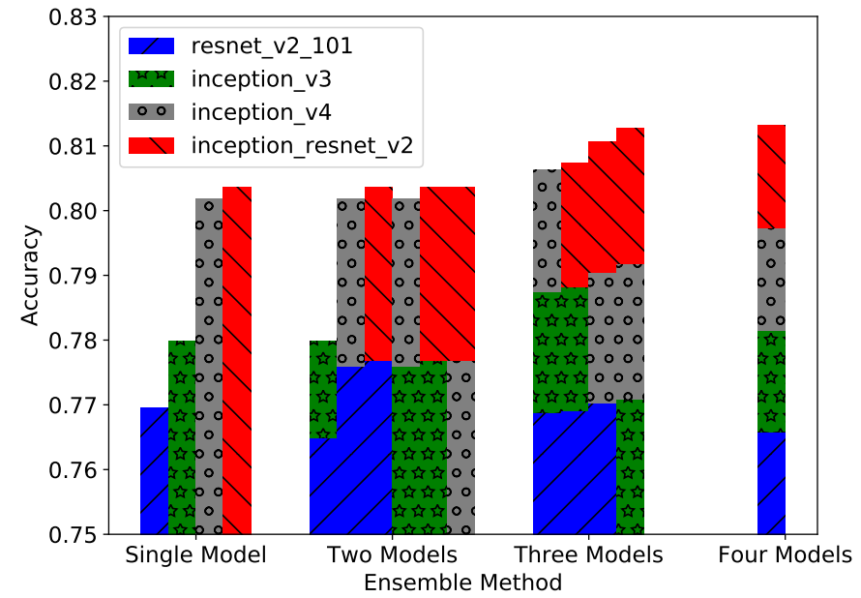
Inference Service Multiple Inference Model
Ensemble modeling can improve inference accuracy.
Ensemble of 4 ConvNets, majority voting.

Slide 16
Inference Service Multiple Inference Model
Running one model per node is straight-forward.
However, the latency could be high due to stragglers, ensemble modeling is also costly in terms of throughput.
There is a trade-off between latency (throughput) and accuracy.
If the requests arrive slowly, simply run all models for each batch to get the best accuracy.
If the requests arrive fast, select different models for different requests to increase the throughput and reduce the latency.
Optimization objective: maximizes a reward function R related to the prediction accuracy and penalizes overdue requests.

Slide 17
Inference Service Multiple Inference Model
Optimize both the model selection and batch size selection is complex.
Reinforcement learning approach.
State: queue status (waiting time), model status c(m, b) (inference time)
Action: the batch size b and model selection vector v of length |M|. The action space size is (2^{|M|}-1)*B.
Reward: a(M[v]) is the accuracy of the selected models.
Apply actor-critic algorithm.
Notes:
The waiting time of all requests form a feature vector.
the model status represented by a vector including the inference time for different models with different batch sizes
In the experiment, we use the ImageNet’s validation dataset to evaluate the accuracy of different ensemble combinations for image classification.

Slide 18
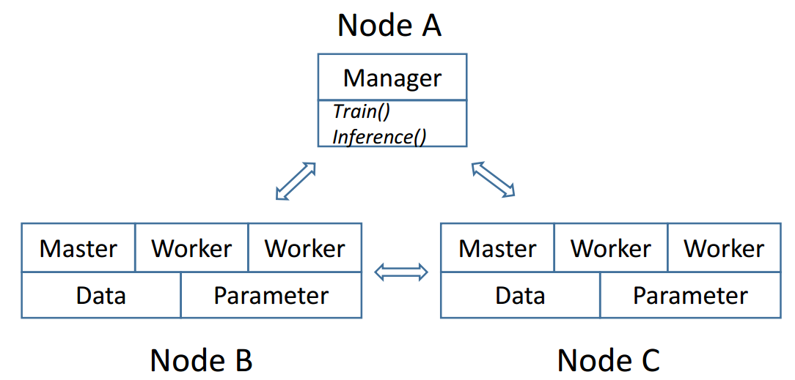
System Implementation
Rafiki uses Kubernetes to manage the Docker containers, which runs the masters, workers, data servers and parameter servers.
Hyper-parameter tuning and ensemble modeling are deployed as new Docker containers.
The manager accepts job from users.

Slide 19
System Implementation
Rafiki uses HDFS for data storage, where the ‘data nodes’ are also docker containers.
Users upload their datasets into the HDFS via Rafiki utility functions.
Rafiki has a parameter server optimized for training and inference.
Model parameters will be cached in memory if they are accessed frequently.
Otherwise, they are stored in HDFS.
Failure recovery
The workers are stateless. Rafiki manager can recover them.
The masters have state information. Rafiki checkpoints the state of masters.

Slide 20
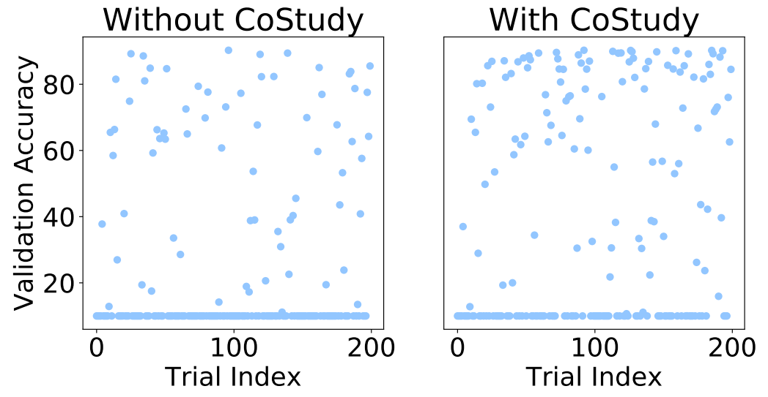
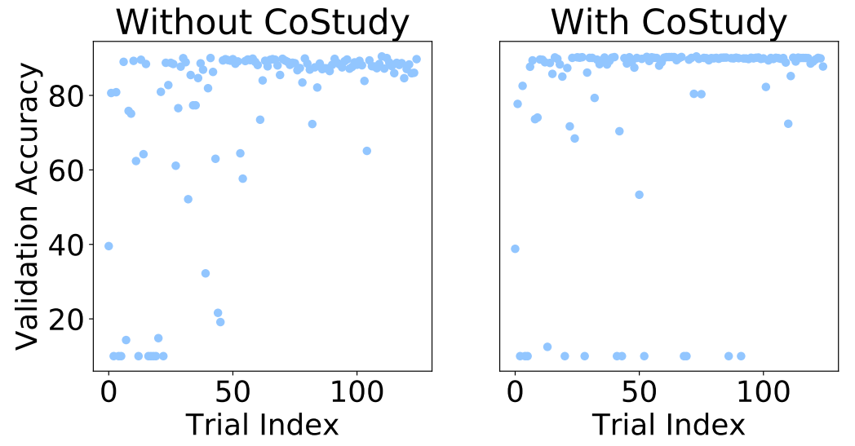
Experiments Hyper-parameter Tuning
Cifar10 dataset.
Momentum, learning rate, decay, dropout, weight initialization.
Random search & Bayesian optimization
Notes:
Naive distributed tuning
Collaborative tuning

Slide 21
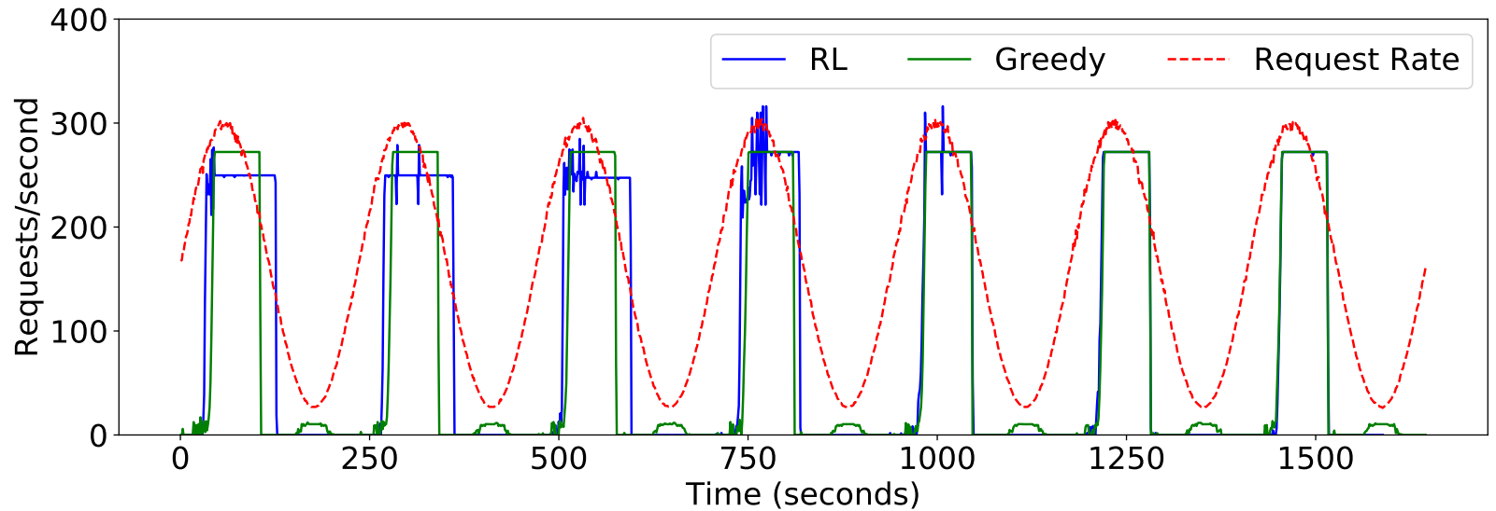
Experiments Single Inference Model
Greedy vs. RL.
When the arriving rate is high, RL performs similarly.
When the arriving rate is low, RL performs better.

Slide 22
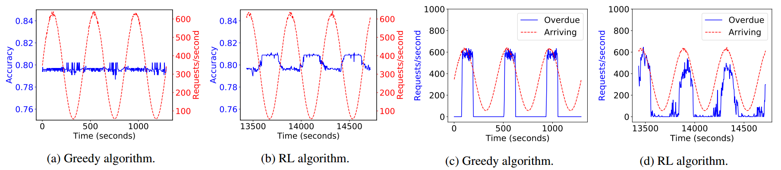
Experiments Multiple Inference Models
Greedy vs. RL.
RL has better accuracy and fewer overdue requests.

Slide 23
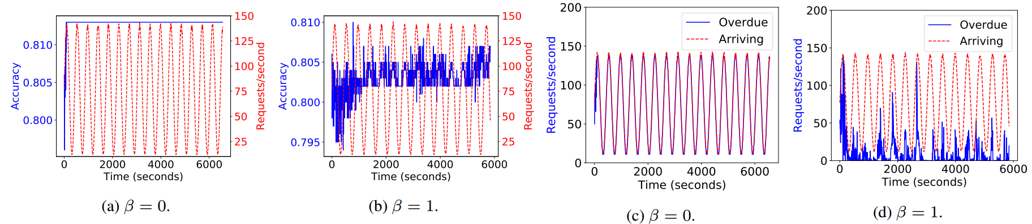

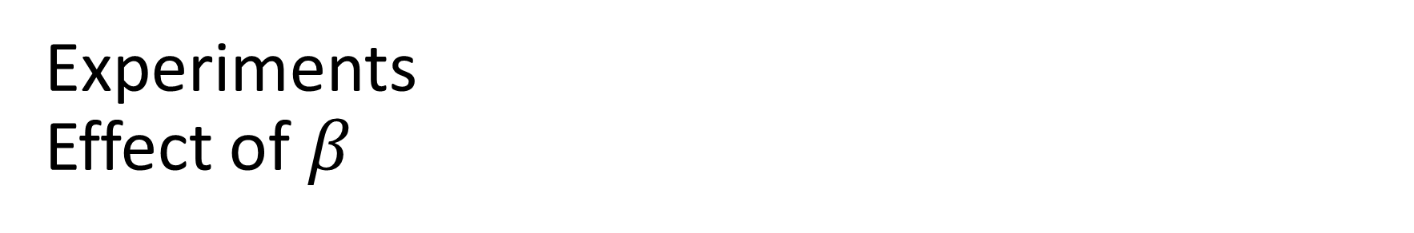
Experiments Effect of $β$
$β=0$, the accuracy is high, many overdue requests.
$β=1$, the accuracy and overdue requests are smaller.

Slide 24
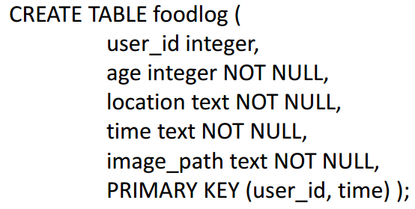
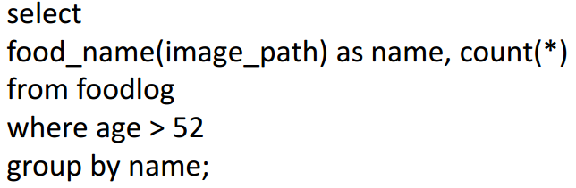
Database Case Study
An image recognition model for the food images.
Database users
Upload dataset.
Start training job.
Deploy the trained model.
Use UDF to send request to Rafiki.

Slide 25
Conclusion
Make AI more usable.
Rafiki provides the training and inference service of ML.
Distributed hyper-parameter tuning, ensemble modeling.
Limitations
A bunch of heuristics.
No in-depth algorithmic improvement.

