Slide 1
Weightless: Lossy Weight Encoding For Deep Neural Network Compression
Brandon Reagen et al. in ICML 2018
Presented by Fangcheng Fu
2018/05/28

Slide 2
Background
◆ Why do we compress neural networks
※ To run on new hardware/platforms, such as mobile phones and wireless sensors
※ To reduce model size to fit the storage capacity of edge devices
※ To reduce model size for easier distribution
◆ Related work
(1) Methods that modify loss function or network structure to reduce free parameters
※ low-ranked, structured matrices; distillation
(2) Methods that compress a given network by removing unnecessary information
※ Simplification (pruning, quantization, clustering); DGC; this work
◆ Comparison with state-of-the-art
※ DGC: lossy simplification (pruning & quantization) + lossless transformation (CSR)
※ This work: lossy simplification (pruning & clustering) + lossy encoding (Bloomier filter)

Slide 3
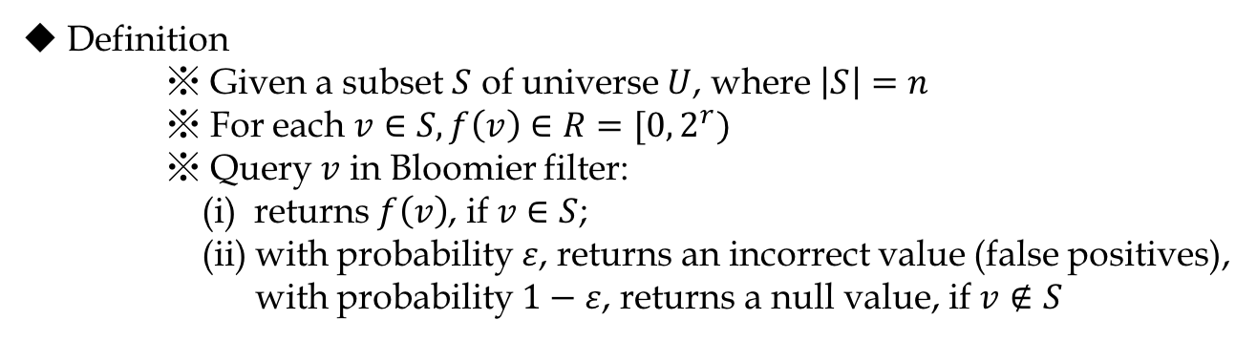
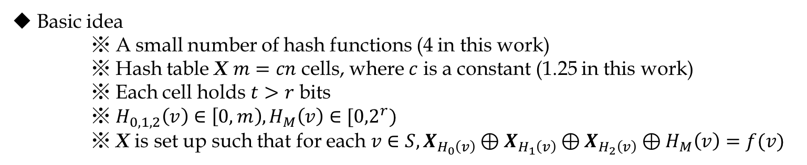
Bloomier Filter
◆ Definition
※ Given a subset $S$ of universe $U$, where $\left|S\right|=n$
※ For each $v∈S, f\left(v\right)∈R=[0, 2^{r})$
※ Query $v$ in Bloomier filter:
(i) returns $f\left(v\right)$, if $v∈S$;
(ii) with probability $ε$, returns an incorrect value (false positives),
with probability $1−ε$, returns a null value, if $v∉S$
◆ Basic idea
※ A small number of hash functions (4 in this work)
※ Hash table X $m=cn$ cells, where $c$ is a constant (1.25 in this work)
※ Each cell holds $t>r$ bits
※ $H_{0,1,2}\left(v\right)∈\left[0,m\right), H_{M}\left(v\right)∈[{0,2}^{r})$
※ X is set up such that for each $v∈S, X_{H_{0}\left(v\right)}⊕X_{H_{1}\left(v\right)}⊕X_{H_{2}\left(v\right)}⊕H_{M}\left(v\right)=f(v)$

Slide 4




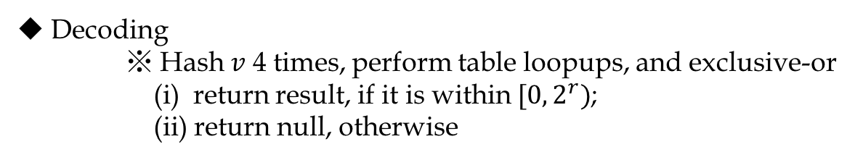
Bloomier Filter
◆ Decoding
※ Hash $v$ 4 times, perform table loopups, and exclusive-or
(i) return result, if it is within $[0, 2^{r})$;
(ii) return null, otherwise
$$v_{2}$$
$$v_{1}$$
$$t=5, r=3$$
0
1
1
1
0
0
0
1
1
0
1 | 0 | 1 | 1 | 1
0 | 1 | 0 | 0 | 1
1 | 0 | 0 | 1 | 0
0 | 0 | 1 | 0 | 1
0 | 1 | 1 | 1 | 0
0
0
0
1
1
0
0
1
0
1
return null
$$⊕$$
$$⊕$$
return 101

Slide 5
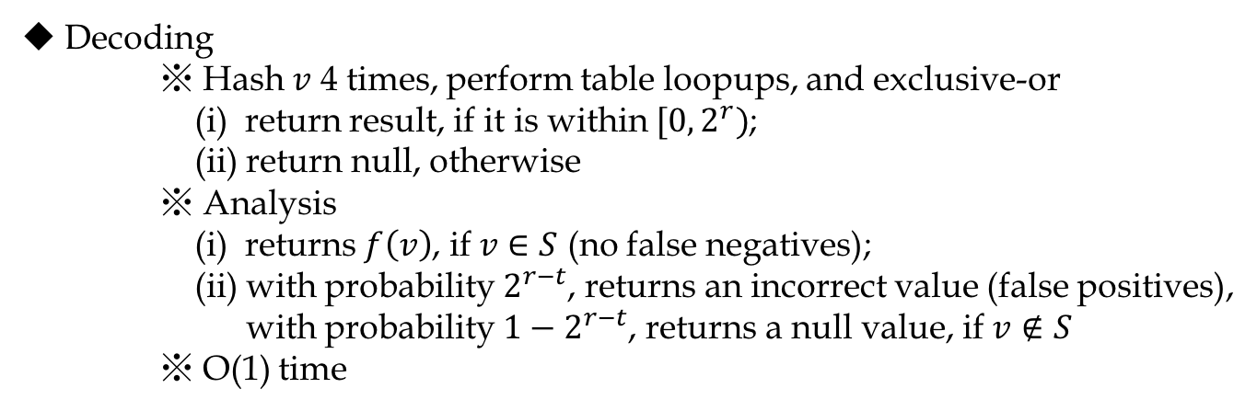
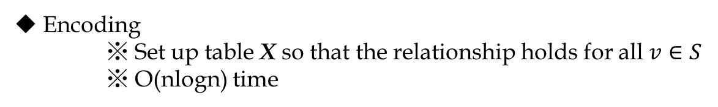
Bloomier Filter
◆ Decoding
※ Hash $v$ 4 times, perform table loopups, and exclusive-or
(i) return result, if it is within $[0, 2^{r})$;
(ii) return null, otherwise
※ Analysis
(i) returns $f\left(v\right)$, if $v∈S$ (no false negatives);
(ii) with probability $2^{r−t}$, returns an incorrect value (false positives),
with probability $1−2^{r−t}$, returns a null value, if $v∉S$
※ O(1) time
◆ Encoding
※ Set up table X so that the relationship holds for all $v∈S$
※ O(nlogn) time

Slide 6
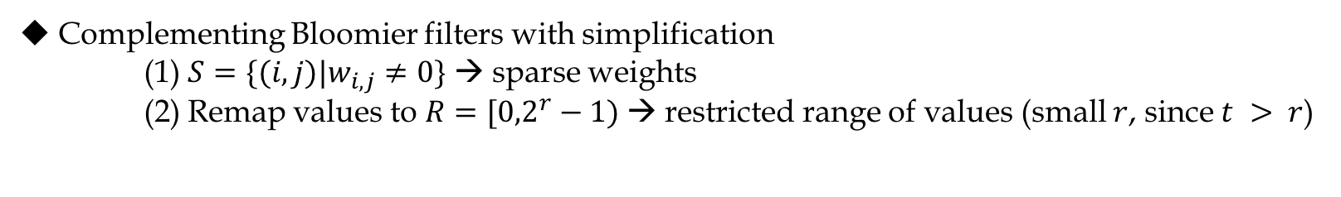
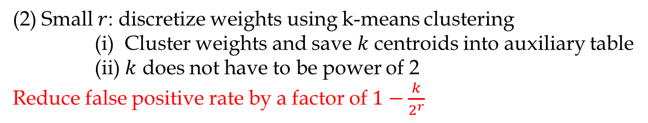
Approximate Weight Encoding
◆ Complementing Bloomier filters with simplification
(1) $S=\{(i,j)|w_{i,j}≠0\}$ → sparse weights
(2) Remap values to $R=[{0,2}^{r}−1)$→ restricted range of values (small $r$, since $t > r$)
(1) Sparse weights: enforce sparsity with pruning
(i) Magnitude threshold with retraining
(ii) Dynamic network surgery (DNS)
Improving sparsity reduces encoding size linearly with no effect on false positive rate
(2) Small $r$: discretize weights using k-means clustering
(i) Cluster weights and save $k$ centroids into auxiliary table
(ii) $k$ does not have to be power of 2
Reduce false positive rate by a factor of $1−\frac{k}{2^{r}}$
Notes:
False positive rate 2^(r-t)

Slide 7
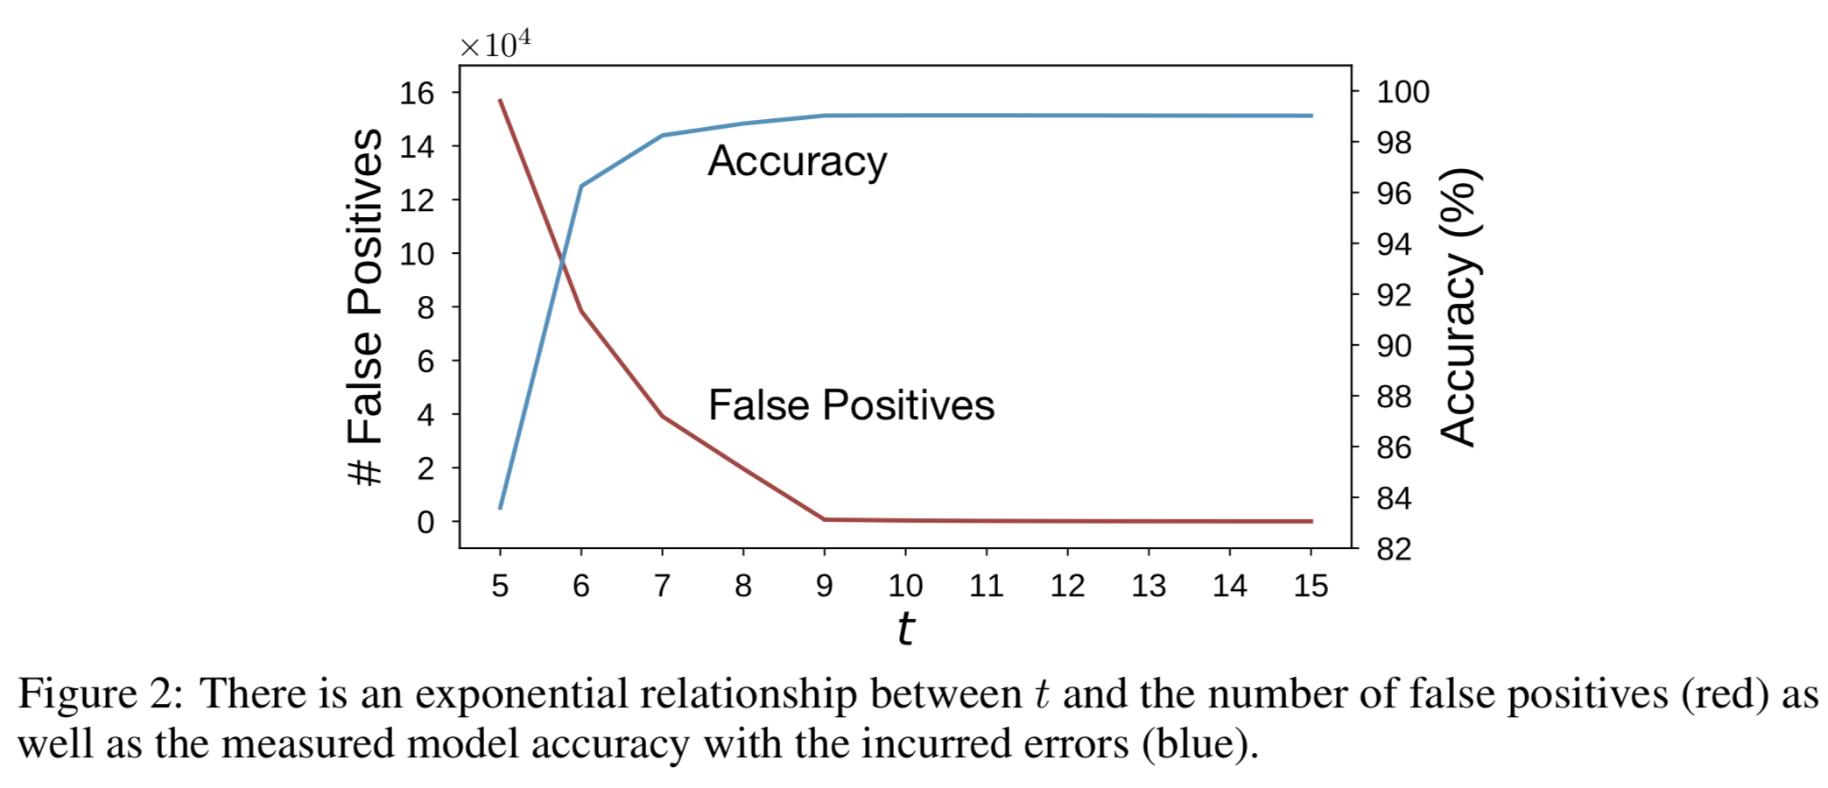
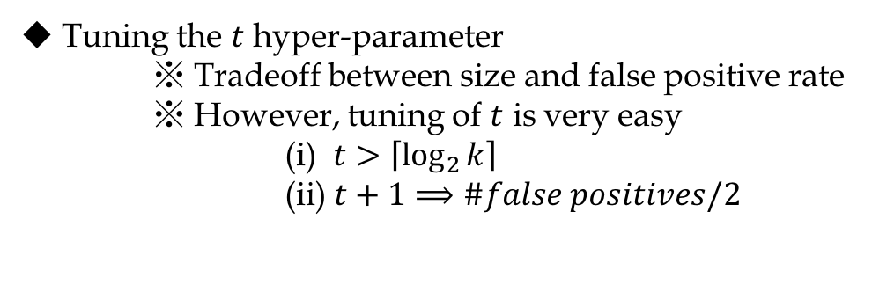
Approximate Weight Encoding
◆ Tuning the $t$ hyper-parameter
※ Tradeoff between size and false positive rate
※ However, tuning of $t$ is very easy
(i) $t>\left\lceil \log_{2}{k}\right\rceil$
(ii) $t+1⟹\#false positives/2$

Slide 8
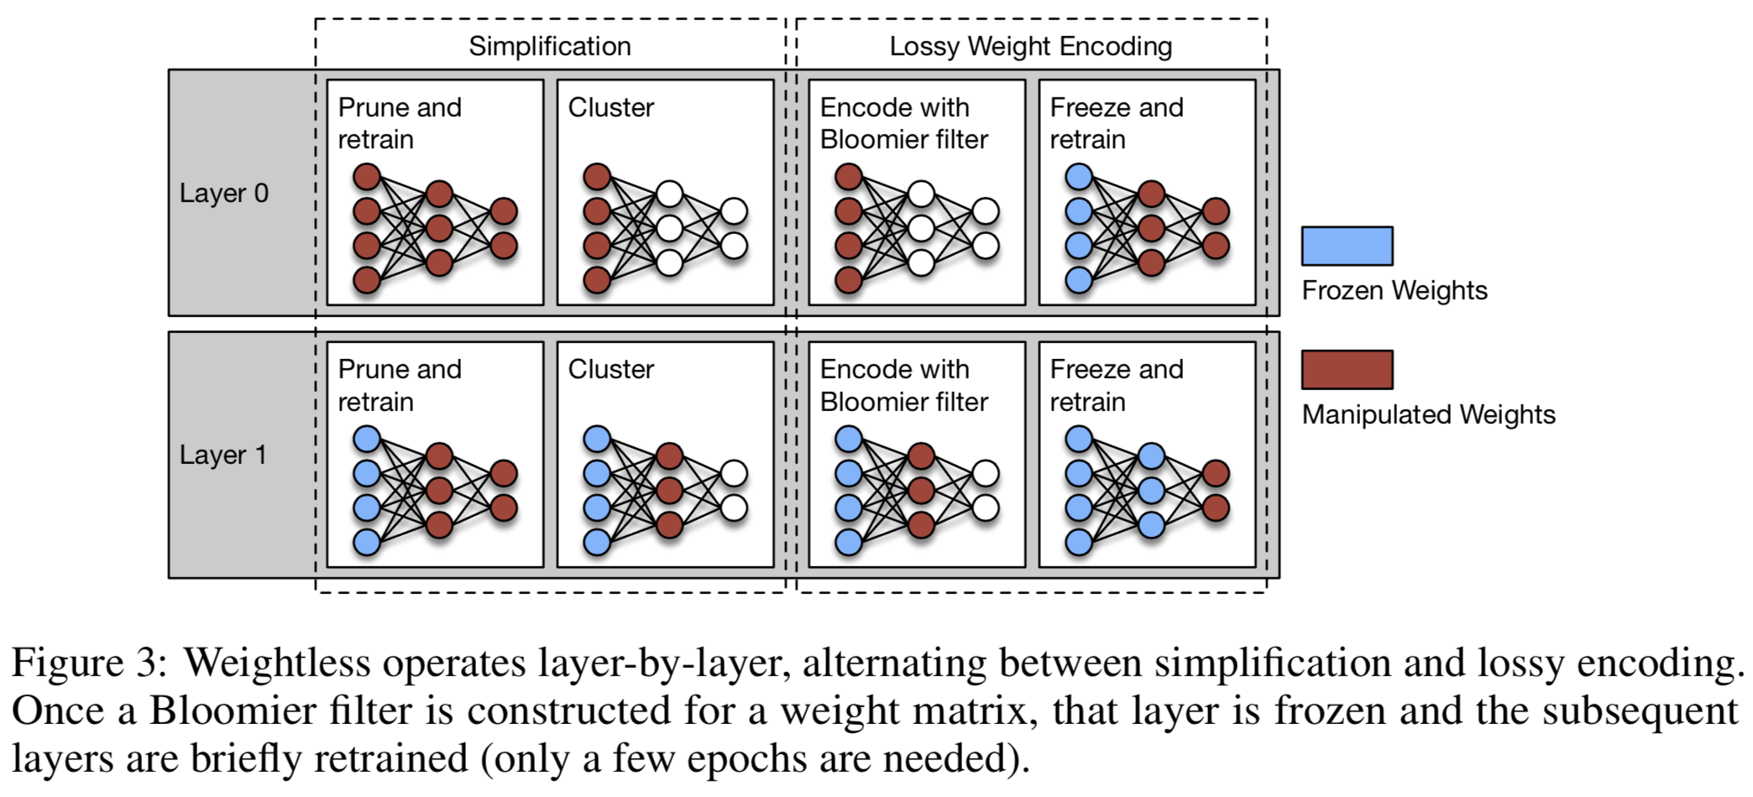
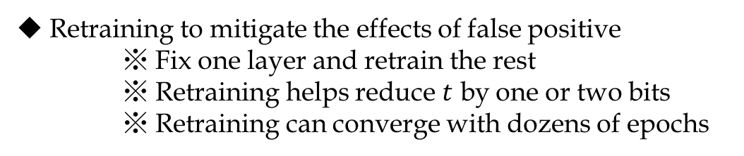
Approximate Weight Encoding
◆ Retraining to mitigate the effects of false positive
※ Fix one layer and retrain the rest
※ Retraining helps reduce $t$ by one or two bits
※ Retraining can converge with dozens of epochs

Slide 9
Approximate Weight Encoding
◆ Compressing Bloomier filters
※ Further reduce the size when sending over network or saving to disk
※ Arithmetic coding (DGC uses Huffman encoding)

Slide 10
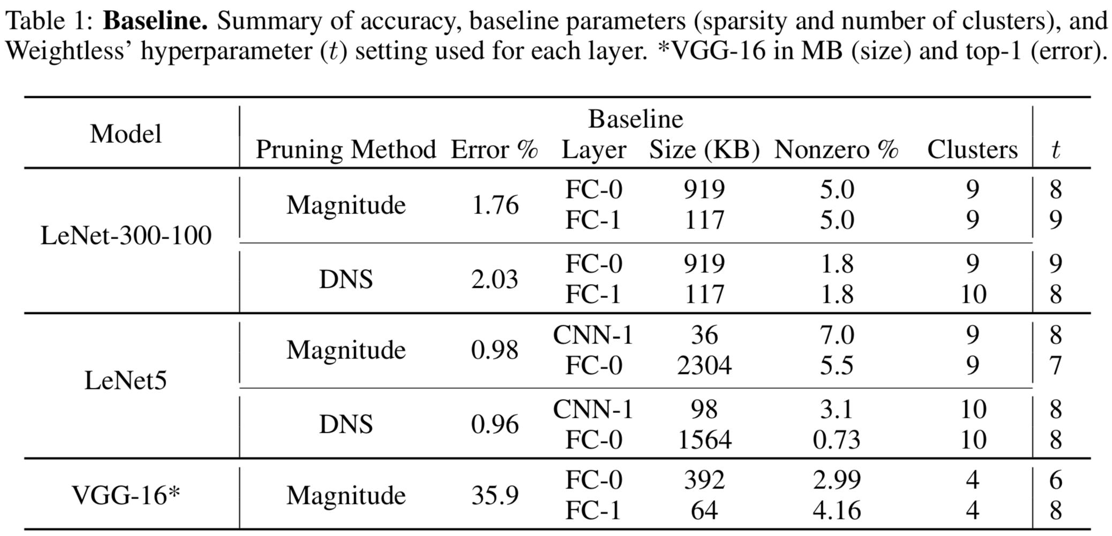
Experiments
◆ Baselines
※ Compression: Deep Compression (DGC)
※ Error: all test errors are the same as (never worse than) Table 1

Slide 11
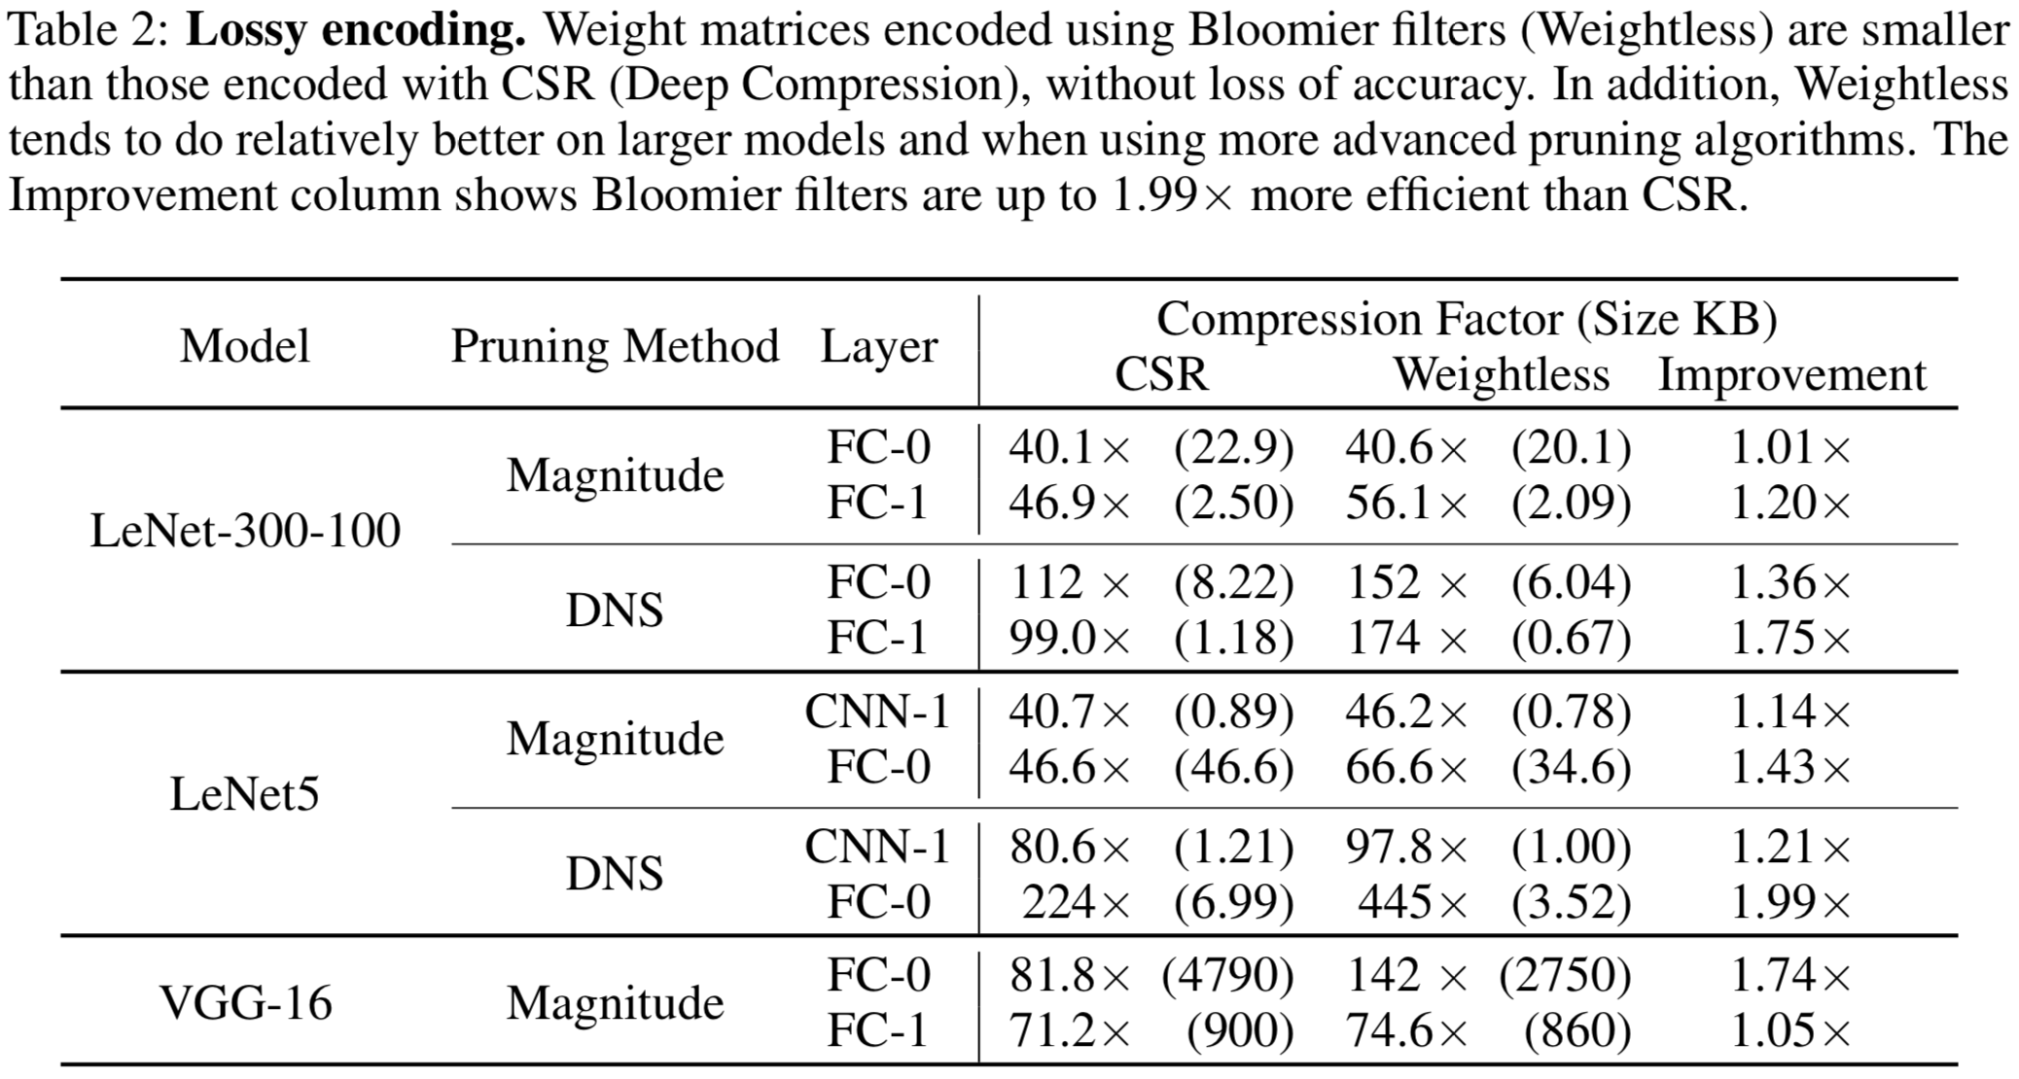
Experiments
◆ Weight encoding

Slide 12
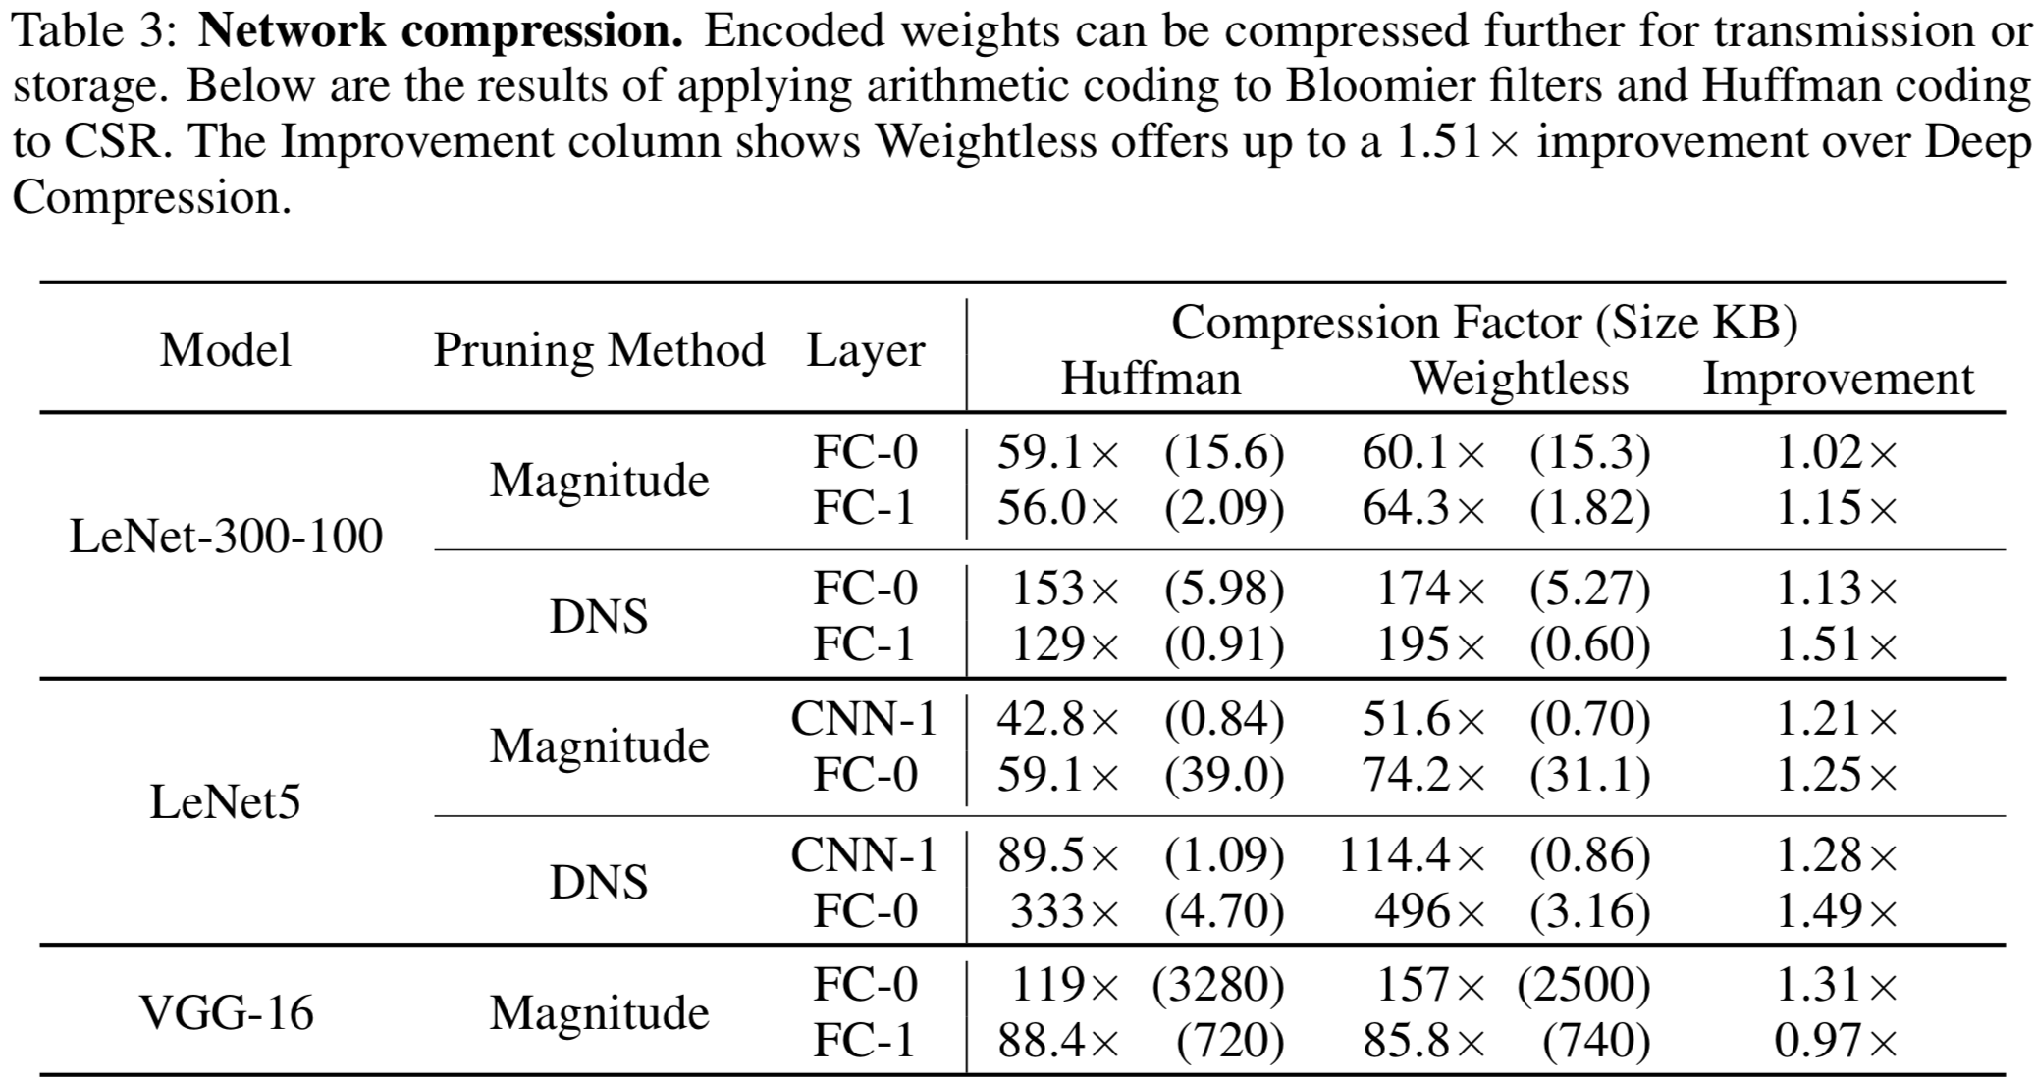
Experiments
◆ Compressing weight encodings

Slide 13
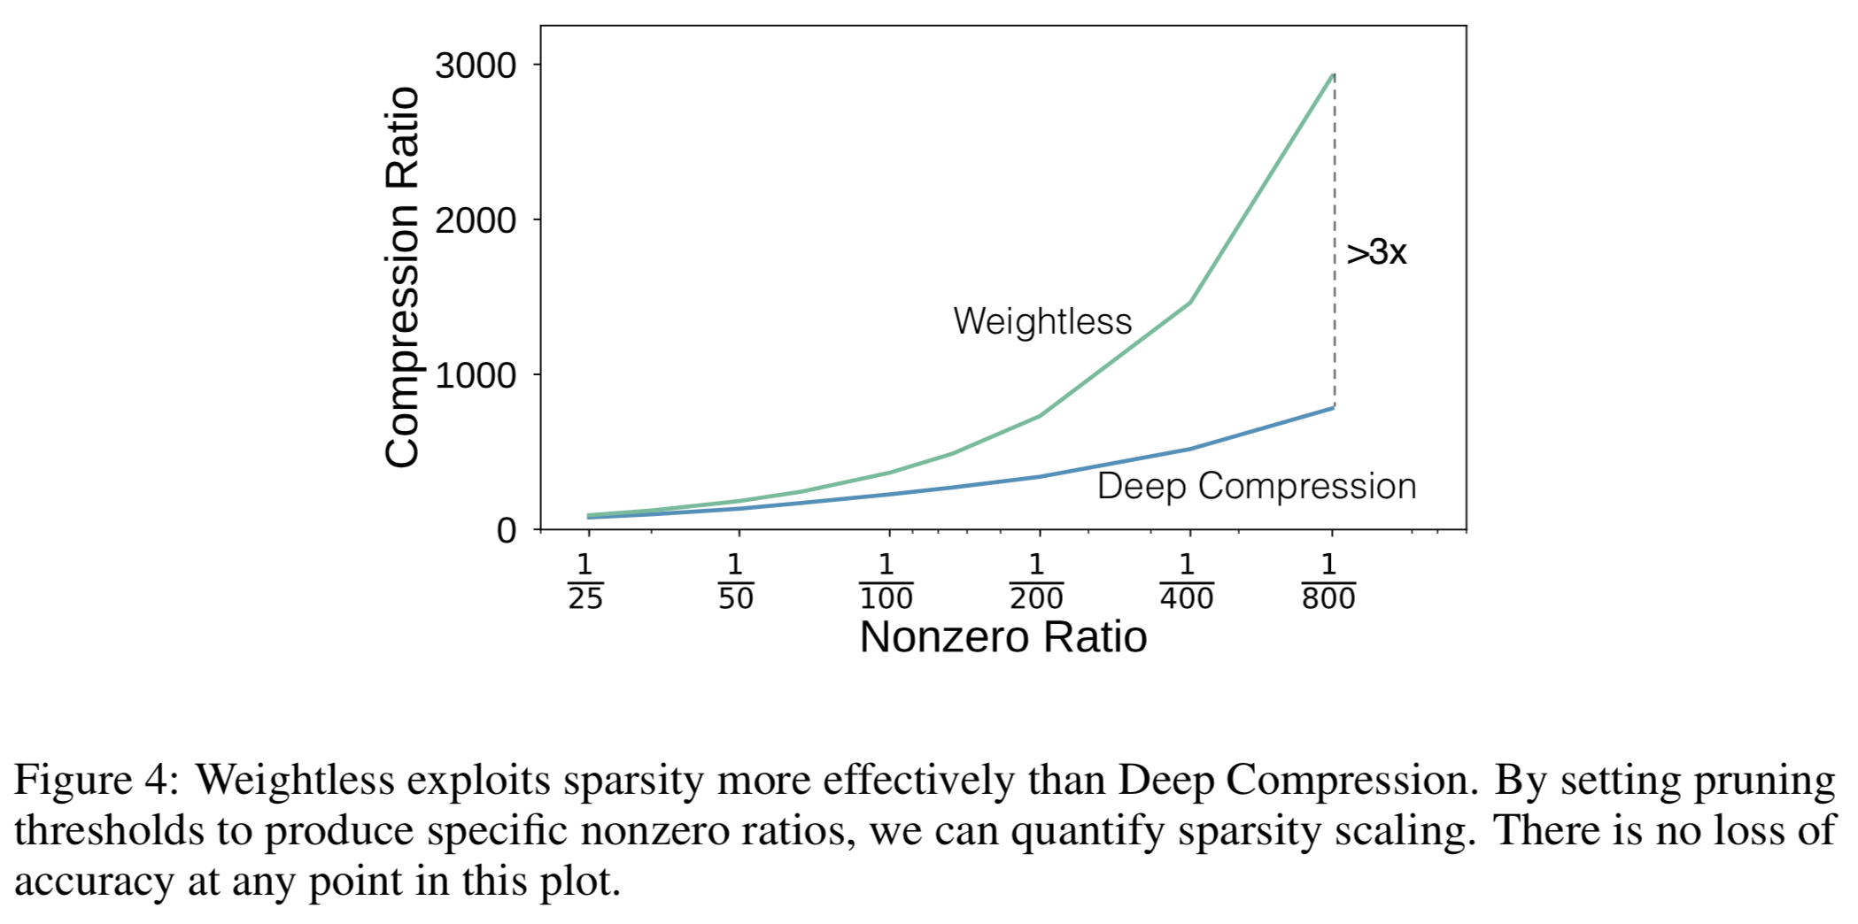
Experiments
◆ Scaling with sparsity
※ Set threshold for magnitude pruning to vary sparsities for LeNet5 FC-0
※ Guarantee no loss in accuracy

