Slide 1


Fast Automated Selection of Learning Algorithm
And its Hyperparameters by Reinforcement Learning
—— ICML 2017 AutoML Workshop
薛焕然 1701214297
2018.5.21

Slide 2

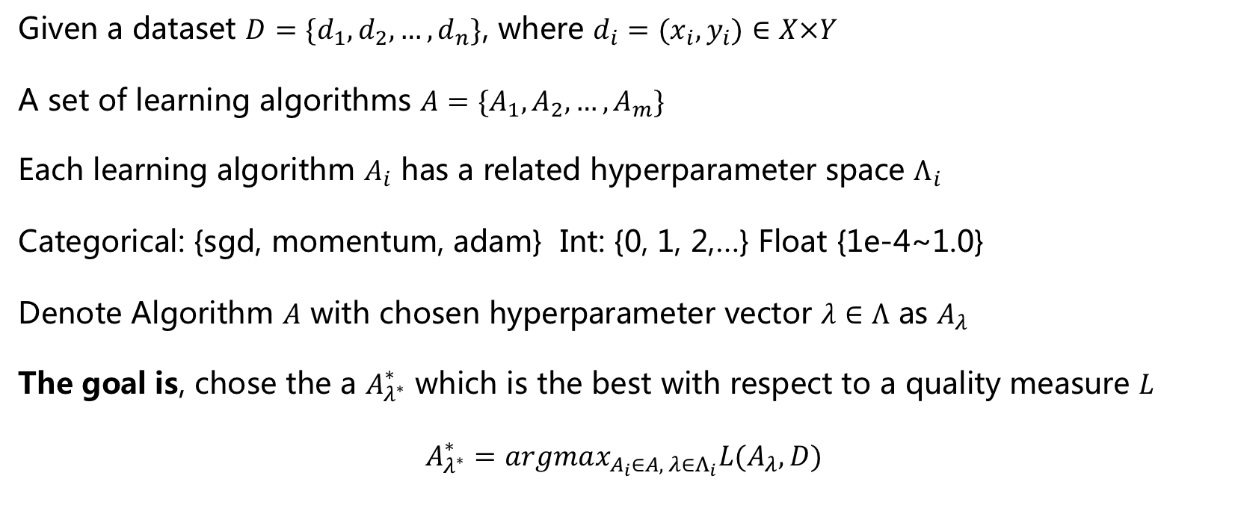
Problem Formulation
Peking University
Given a dataset $D=\{d_{1},d_{2},…,d_{n}\}$, where $d_{i}=(x_{i},y_{i})∈X×Y$
A set of learning algorithms $A=\{A_{1},A_{2},…,A_{m}\}$
Each learning algorithm $A_{i}$ has a related hyperparameter space $Λ_{i}$
Categorical: {sgd, momentum, adam} Int: {0, 1, 2,…} Float {1e-4~1.0}
Denote Algorithm $A$ with chosen hyperparameter vector $λ∈Λ$ as $A_{λ}$
The goal is, chose the a $A_{λ^{∗}}^{∗}$ which is the best with respect to a quality measure $L$
$A_{λ^{∗}}^{∗}=argmax_{A_{i}∈A, λ∈Λ_{i}}L(A_{λ},D)$

Slide 3
Related Work
Peking University
Grid Search
Random Search
Bayesian Optimization including Sequential Model-Based Optimization (SMBO)
Sequential Model-Based Algorithm Configuration (SMAC)

Slide 4
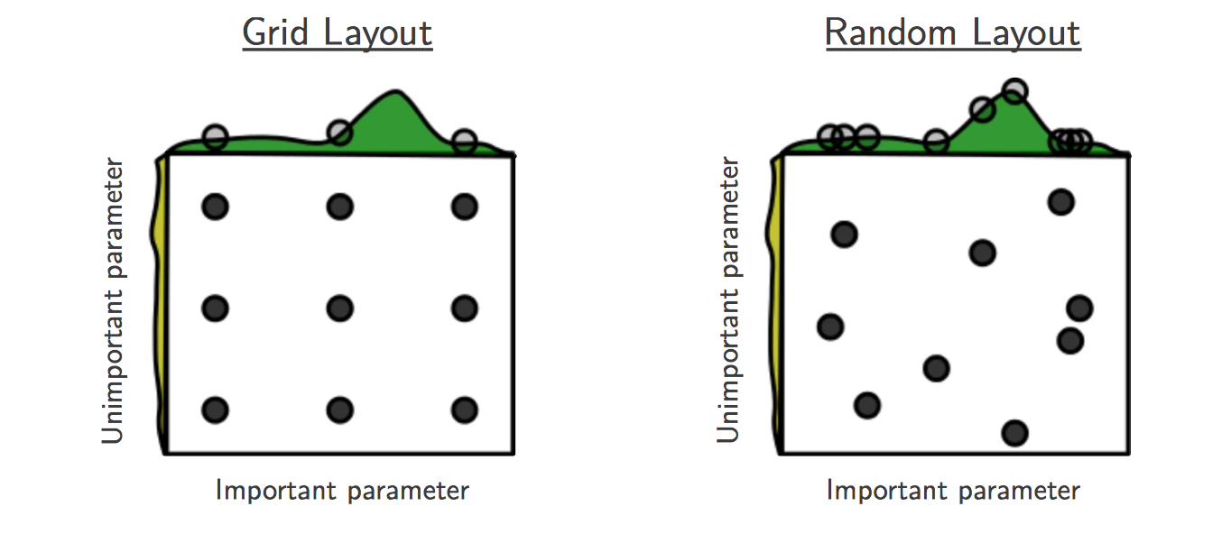
Grid Search / Random Search
Peking University
Random Search for Hyper-Parameter Optimization
Journal of Machine Learning 2012

Slide 5
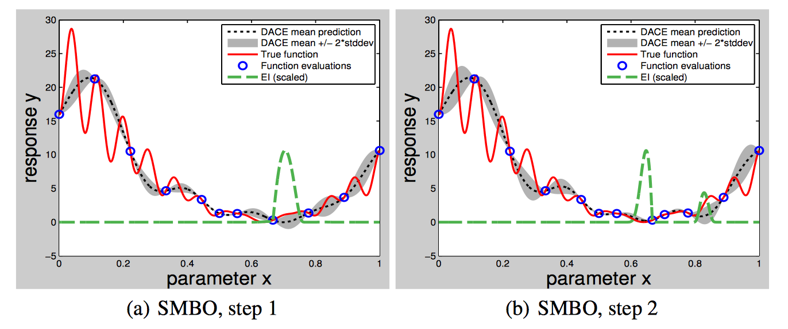
Sequential Model-Based Algorithm
Peking University
Practical bayesian optimization of machine learning algorithms NIPS 2012

Slide 6
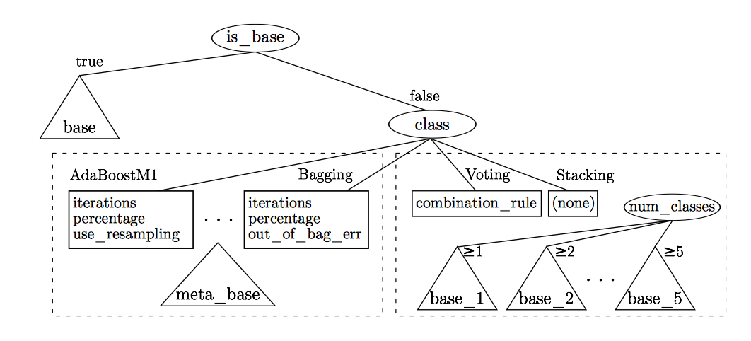
SMAC (state-of-the-art)
Peking University
Sequential model-based optimization for general algorithm configuration
International Conference on Learning and Intelligent Optimization 2011
Auto-Weka
Auto-Sklearn

Slide 7
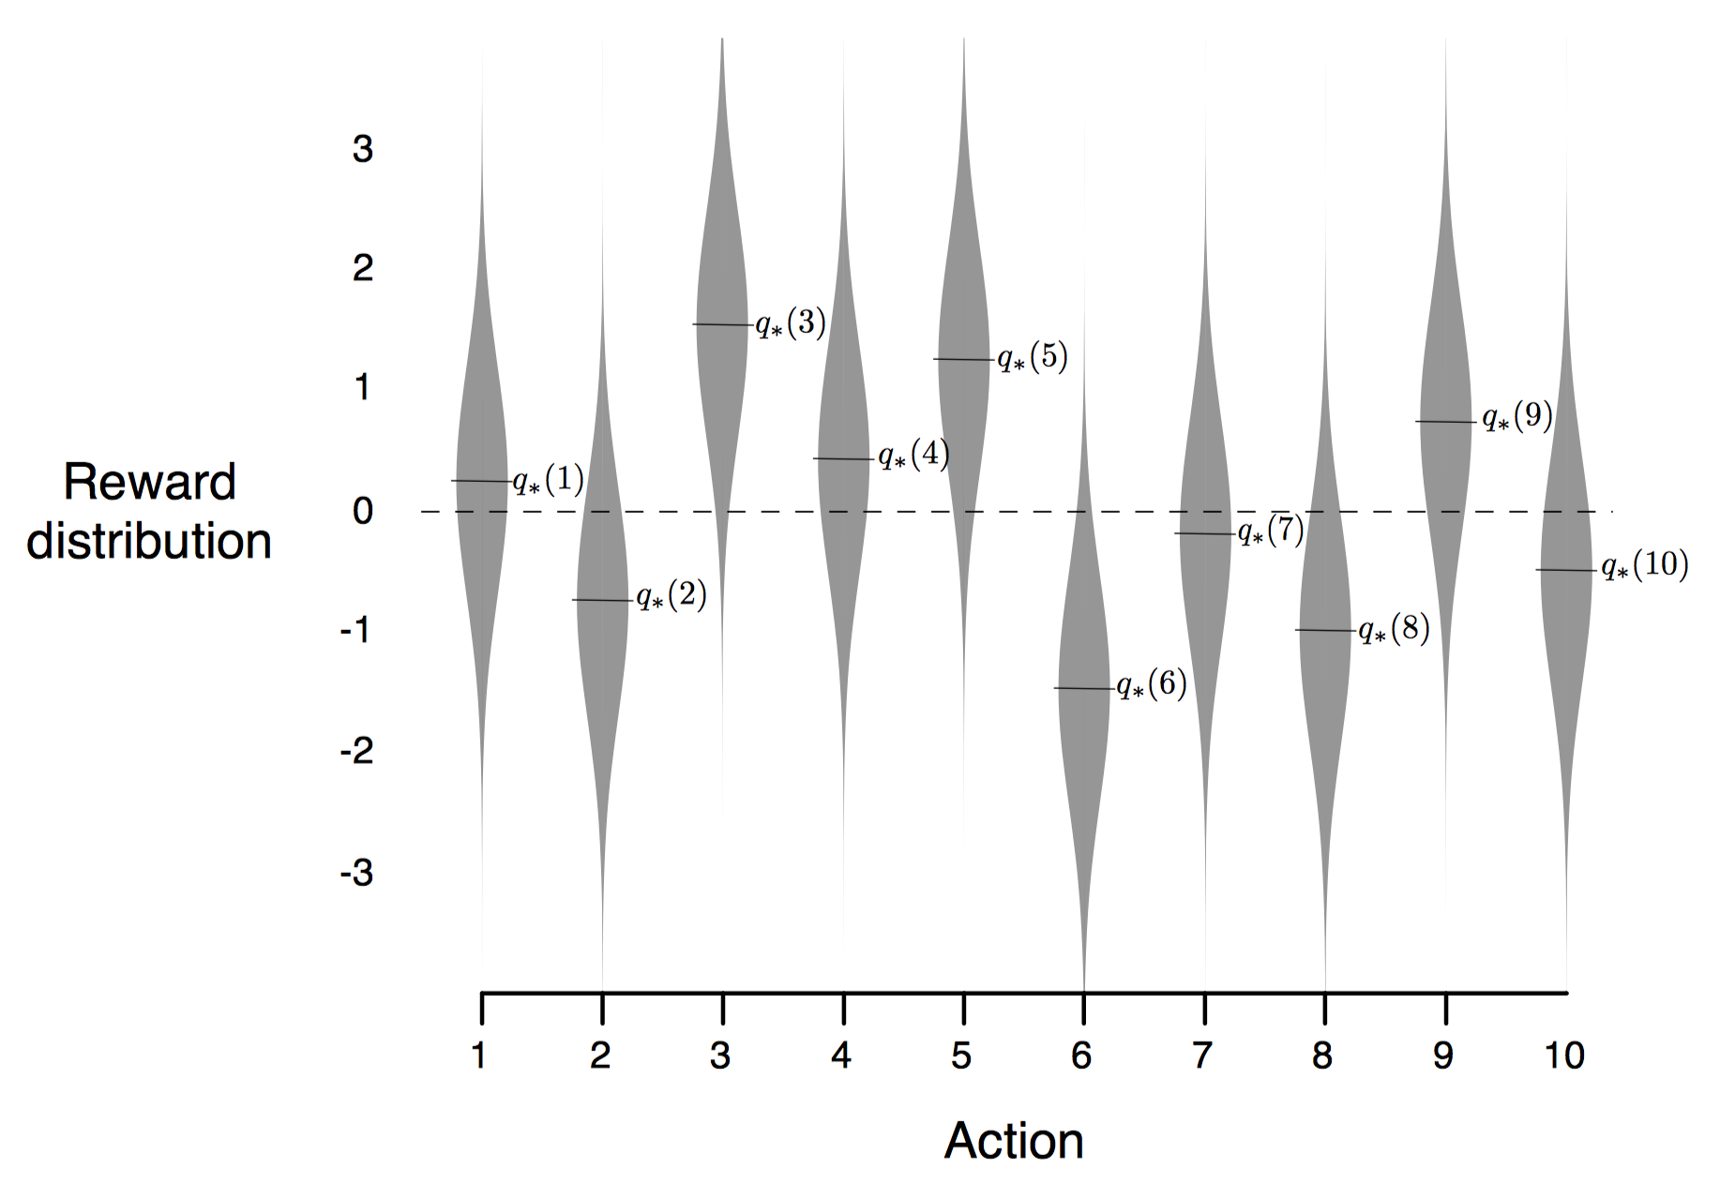
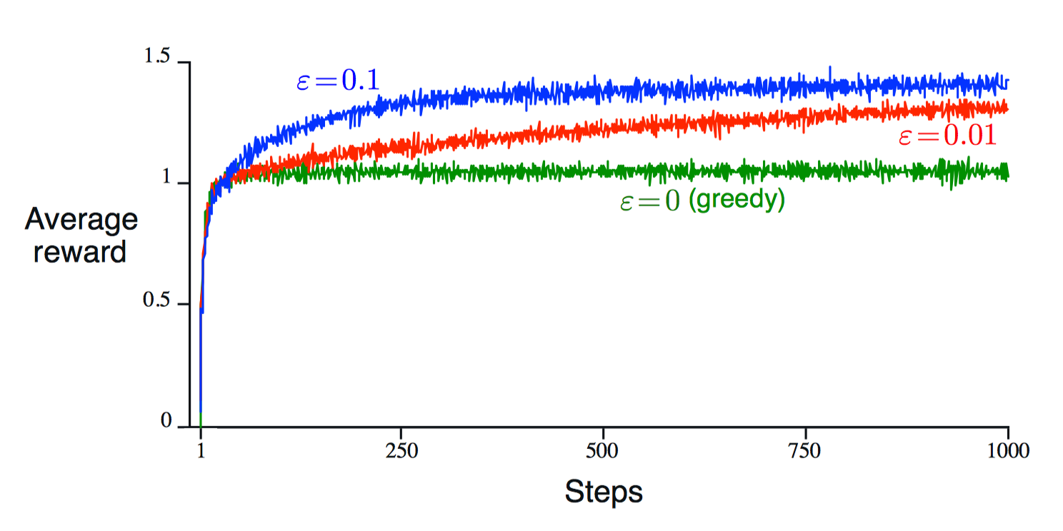
Multi-Armed Bandit Problem
Peking University
A k-armed Bandit Problem
Repeatedly choose one among k different actions. After each choice, Receive a
numerical reward that depends on the action has been selected.
The objective is maximize the expected total reward over some time period.

Slide 8
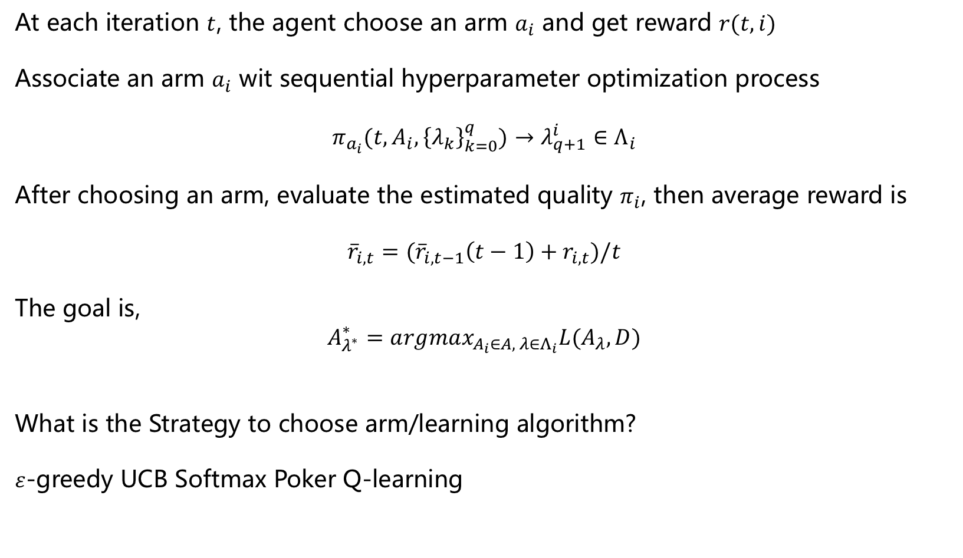
Approach in this Paper
Peking University
At each iteration $t$, the agent choose an arm $a_{i}$ and get reward $r(t,i)$
Associate an arm $a_{i}$ wit sequential hyperparameter optimization process
$$π_{a_{i}}(t,A_{i},{\left\{λ_{k}\right\}}_{k=0}^{q})→λ_{q+1}^{i}∈Λ_{i}$$
After choosing an arm, evaluate the estimated quality $π_{i}$, then average reward is
$${\overline{r}}_{i,t}=({\overline{r}}_{i,t−1}\left(t−1\right)+r_{i,t})/t$$
The goal is,
$A_{λ^{∗}}^{∗}=argmax_{A_{i}∈A, λ∈Λ_{i}}L(A_{λ},D)$
What is the Strategy to choose arm/learning algorithm?
$ε$-greedy UCB Softmax Poker Q-learning

Slide 9
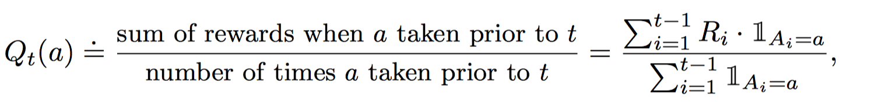
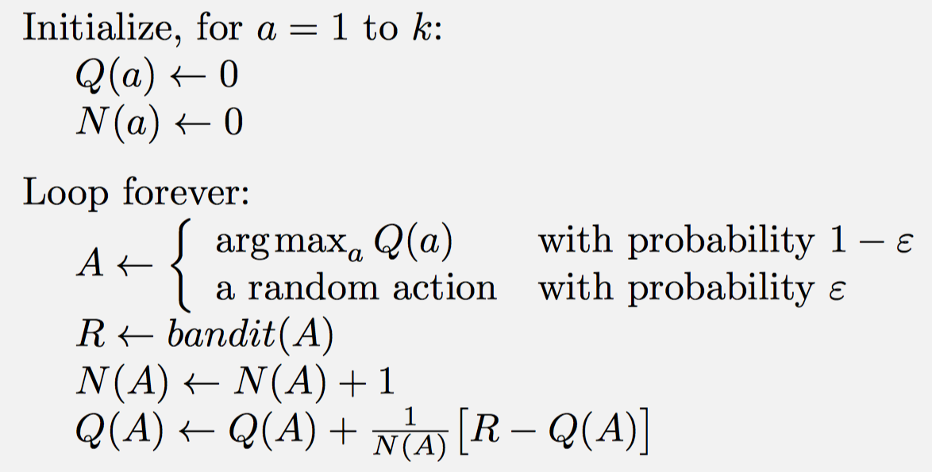

$$ε−greedy$$
Peking University

Slide 10
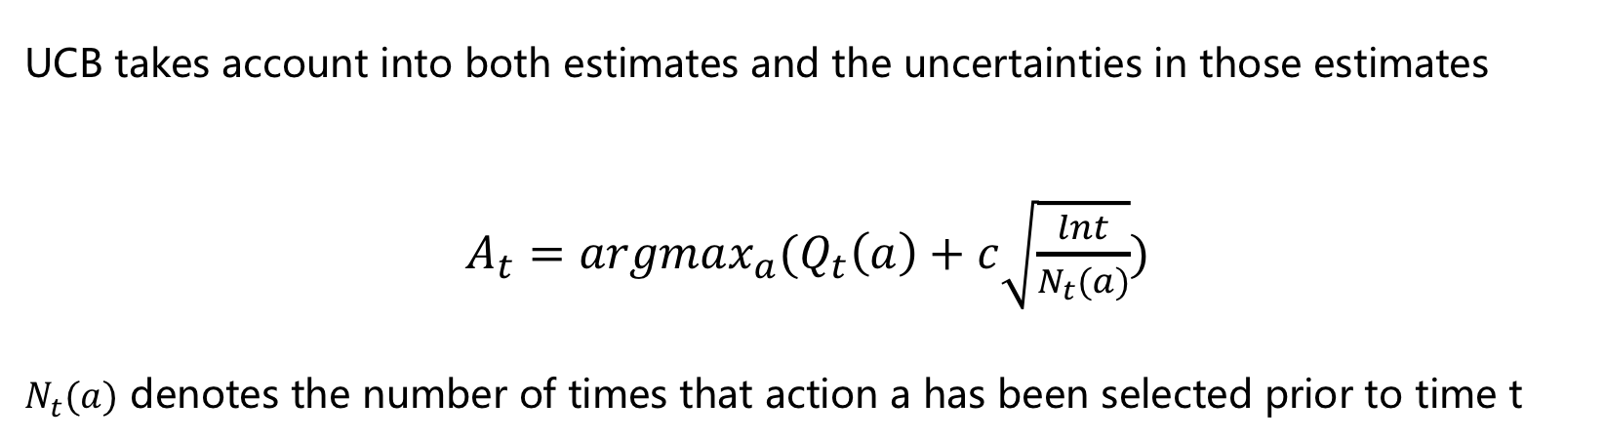
Upper-Confidence-Bound(UCB)
Peking University
UCB takes account into both estimates and the uncertainties in those estimates
$A_{t}=argmax_{a}(Q_{t}\left(a\right)+c\sqrt{\frac{lnt}{N_{t}(a)}})$
$N_{t}(a)$ denotes the number of times that action a has been selected prior to time t

Slide 11
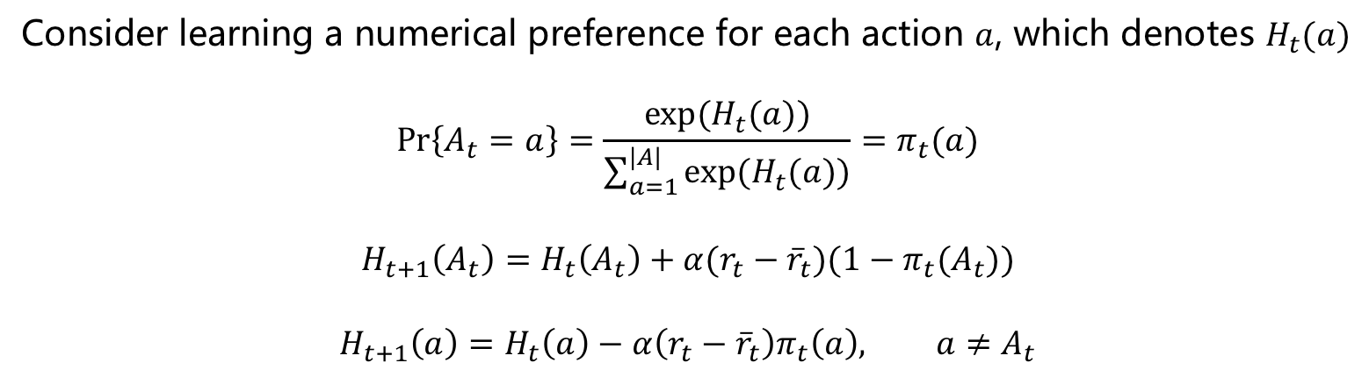
Gradient Bandit (Softmax)
Peking University
Reinforcement Learning: An Introduction, 2nd
Consider learning a numerical preference for each action $a$, which denotes $H_{t}(a)$
$$\operatorname{Pr}\left\{A_{t}=a\right\}=\frac{exp⁡(H_{t}(a))}{\sum_{a=1}^{|A|}{exp⁡(H_{t}(a))}}=π_{t}(a)$$
$$H_{t+1}\left(A_{t}\right)=H_{t}\left(A_{t}\right)+α(r_{t}−{\overline{r}}_{t})(1−π_{t}(A_{t}))$$
$$H_{t+1}\left(a\right)=H_{t}\left(a\right)−α\left(r_{t}−{\overline{r}}_{t}\right)π_{t}\left(a\right), a≠A_{t}$$

Slide 12
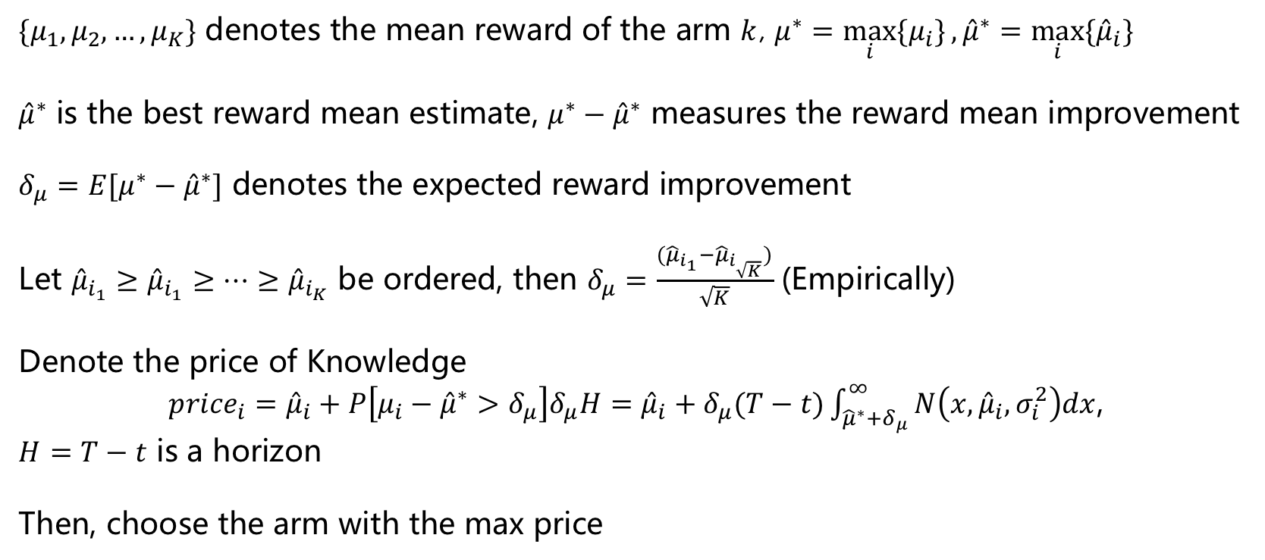
Poker(Price of Knowledge and Estimated Reward)
Peking University
Multi-armed bandit algorithms and empirical evaluation.
European conference on machine learning. 2005.
$\{μ_{1},μ_{2},…,μ_{K}\}$ denotes the mean reward of the arm $k$, $μ^{∗}=\max_{i}{\{μ_{i}\}},{\hat{μ}}^{∗}=\max_{i}{\{{\hat{μ}}_{i}\}}$
${\hat{μ}}^{∗}$ is the best reward mean estimate, $μ^{∗}−{\hat{μ}}^{∗}$ measures the reward mean improvement
$δ_{μ}=E[μ^{∗}−{\hat{μ}}^{∗}]$ denotes the expected reward improvement
Let ${\hat{μ}}_{i_{1}}≥{\hat{μ}}_{i_{1}}≥…≥{\hat{μ}}_{i_{K}}$ be ordered, then $δ_{μ}=\frac{{(\hat{μ}}_{i_{1}}−{\hat{μ}}_{i_{\sqrt{K}}})}{\sqrt{K}}$ (Empirically)
Denote the price of Knowledge
${price}_{i}={\hat{μ}}_{i}+P\left[μ_{i}−{\hat{μ}}^{∗}>δ_{μ}\right]δ_{μ}H={\hat{μ}}_{i}+δ_{μ}(T−t)\int_{{\hat{μ}}^{∗}+δ_{μ}}^{∞}{N\left(x,{\hat{μ}}_{i},σ_{i}^{2}\right)dx}$,
$H=T−t$ is a horizon
Then, choose the arm with the max price

Slide 13
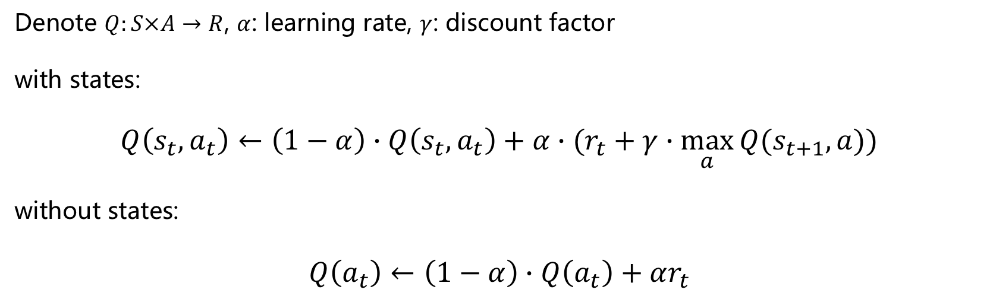
Q-learning
Peking University
Denote $Q:S×A→R$, $α$: learning rate, $γ$: discount factor
with states:
$$Q\left(s_{t},a_{t}\right)←\left(1−α\right)∙Q\left(s_{t},a_{t}\right)+α∙(r_{t}+γ∙\max_{a}{Q(s_{t+1},a)})$$
without states:
$$Q\left(a_{t}\right)←\left(1−α\right)∙Q\left(a_{t}\right)+αr_{t}$$

Slide 14
Experiments
Peking University
Learning algorithms:
k Nearest Neighbors(4, 1)
Support Vector Machine(4, 6)
Logistic Regression(0, 1)
Random Forest(2, 3)
Perceptron(5, 2)
C4.5 Decision Tree(6, 2)
Datasets:
10 different datasets from UCI repository

Slide 15
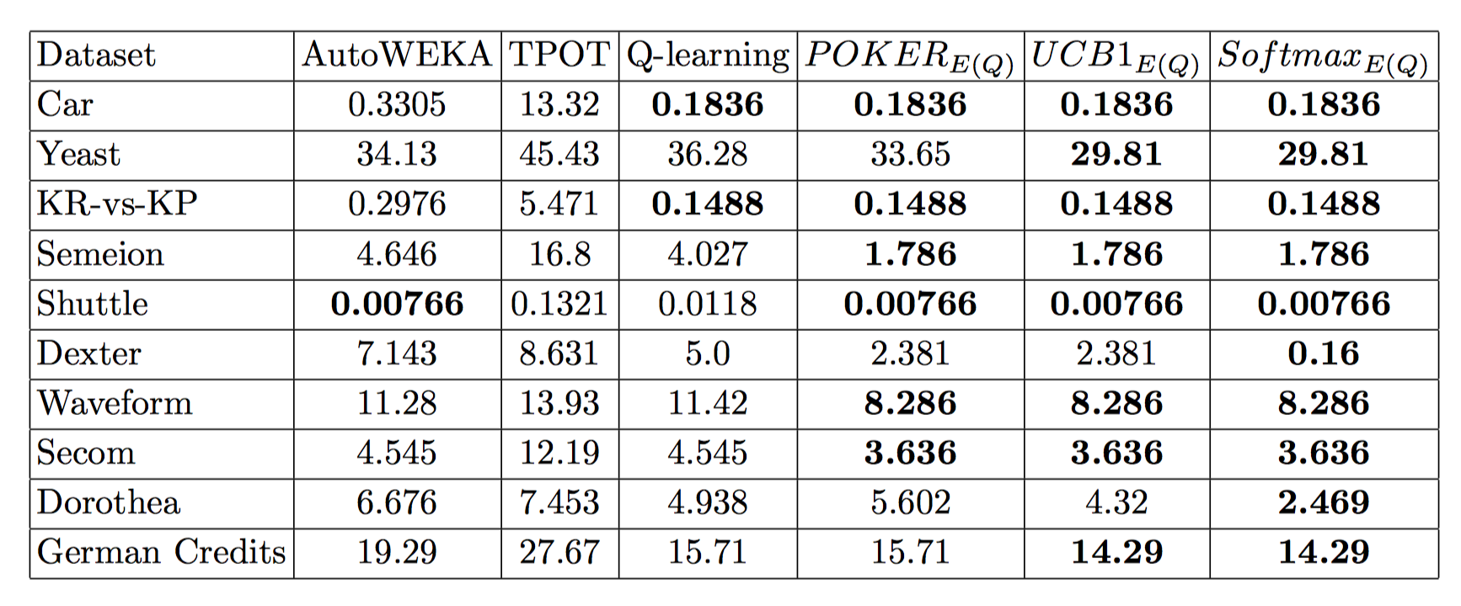
Experiments
Peking University

Slide 16
Conclusion
Peking University
1 The idea is new, few work using reinforcement learning to solve algorithm selection and hyperparameter tuning
2 All the methods in the paper has existed
3 The section of experiment is not sufficient, the dataset is too small

Slide 17
Our Work
Peking University
tuner
selector
model
params = select(X, y, task_type, total_time, …)

Slide 18
Our Work
Peking University
1 Neural Network model: AlexNet GoogleNet Vgg16....
2 task type: image recognition, NLP
3 Based on SMAC for now...
4 Test the reinforcement algorithms on the neural network and compare the performance with SMAC
5 Use Reinforcement Learning to tune hyperparameters

Slide 19
Peking University
Q & A

