Slide 1
Exploring Hidden Dimensions in Parallelizing Convolutional Neural Networks
Zhihao Jia Sina Lin Charles R. Qi Alex Aiken
ICML 2018

Slide 2
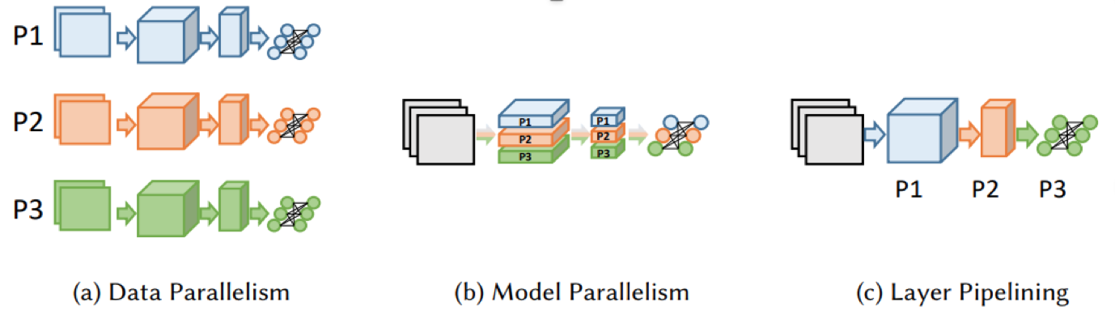
Ways of parallelism
Data parallelism: partition input data
Model parallelism: partition neurons inside one layer
Pipeline: partition layers
Hybrid: OWT parallelism

Slide 3
Layer-wise parallelism
Inception-v3 16 GPUs
Data parallelism & Model parallelism: 11.2x at most
Layer-wise parallelism: 15.5x
Speedup: 1.5-2.9x
Reduce communication costs: 1.3-23.0x

Slide 4
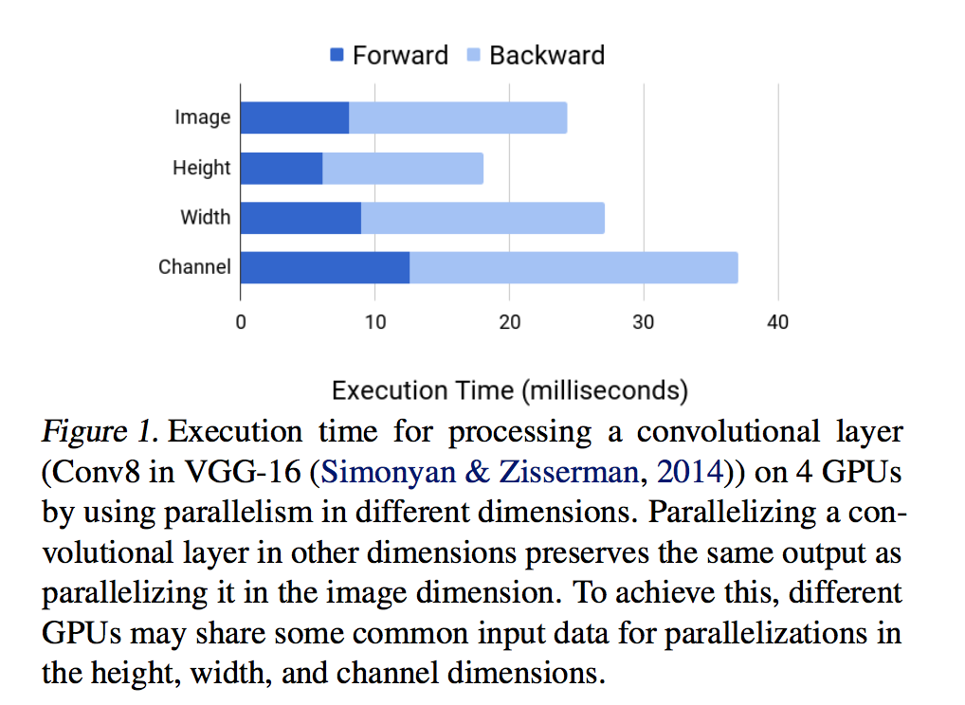
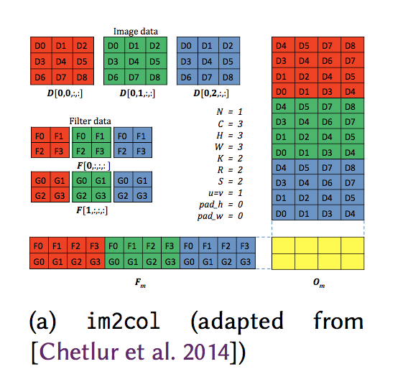
Hidden Dimensions in Parallelizing a Layer

Slide 5
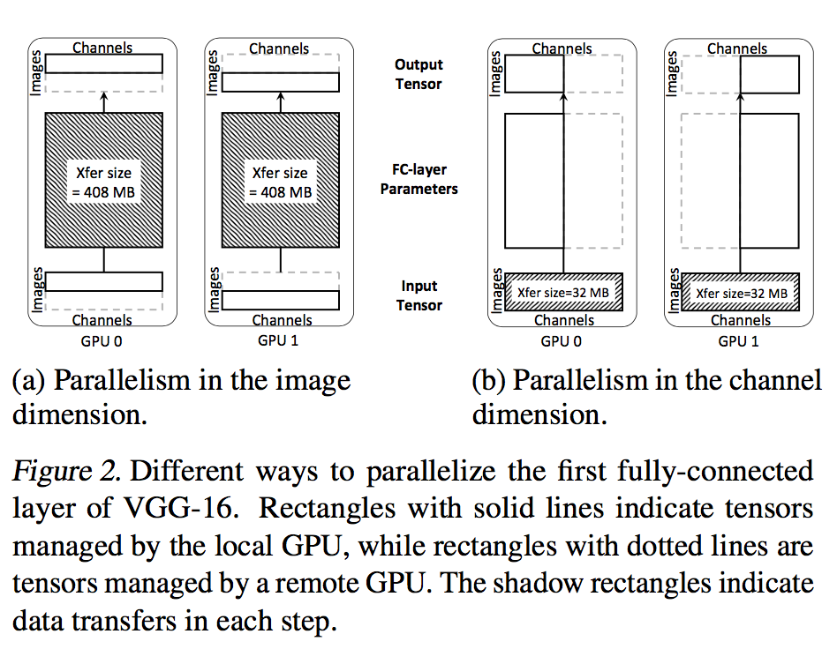
Hidden Dimensions in Parallelizing a Layer

Slide 6
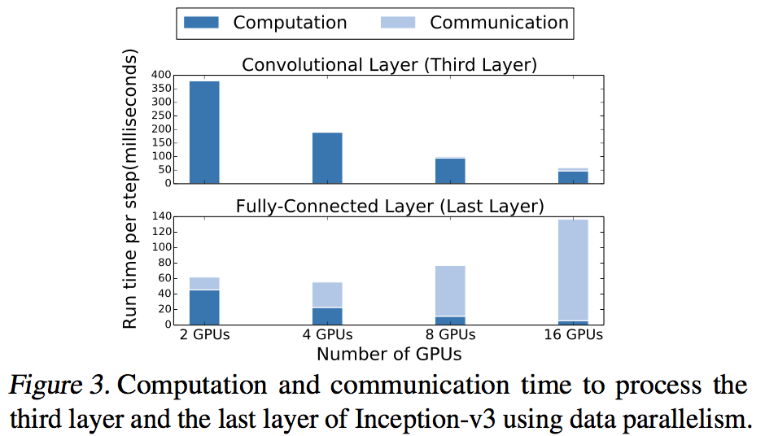
Hidden Dimensions in Parallelizing a Layer

Slide 7






Problem Definition
Device graph:
Node: a device
Edge: an connection between devices
Computation graph:
Node: a layer in neural network
Edge: a tensor

Slide 8

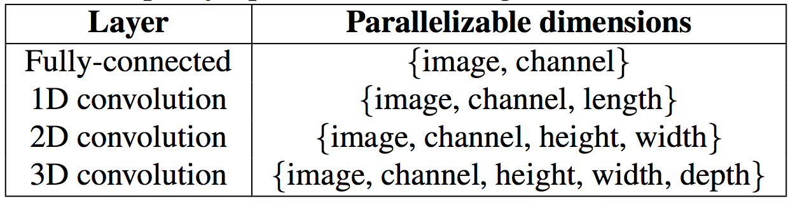

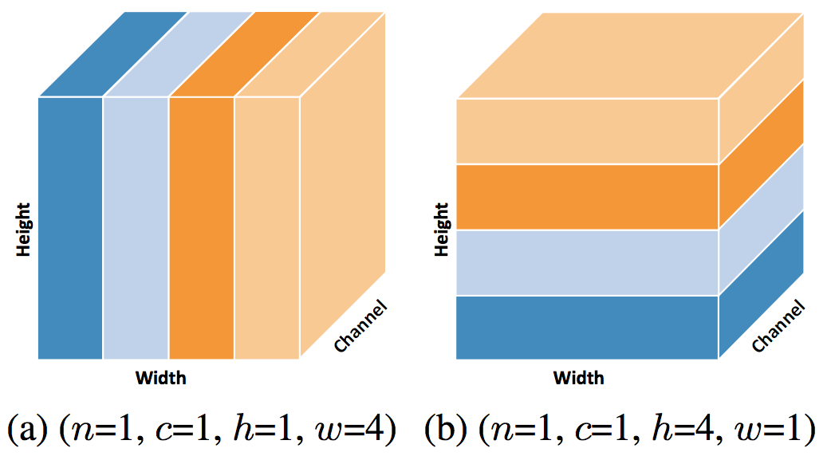
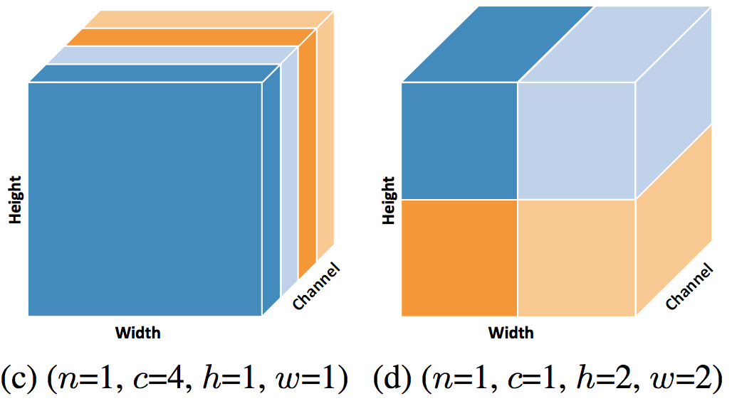
Problem Definition

Slide 9


Problem Definition
Find a to minimize the execution time
Assumptions：
The time to process each layer is predictable with low variance.
The communication bandwidth can be fully utilized.
The runtime system has negligible overhead.

Slide 10





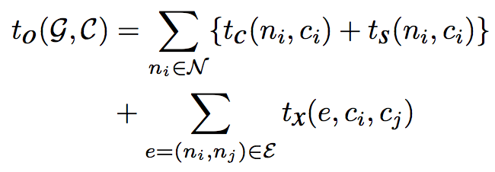

Cost Model for Parallelism Configurations

Slide 11
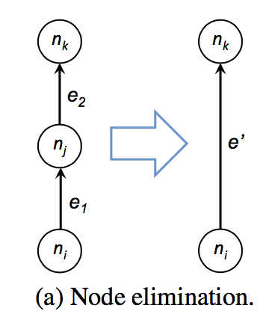
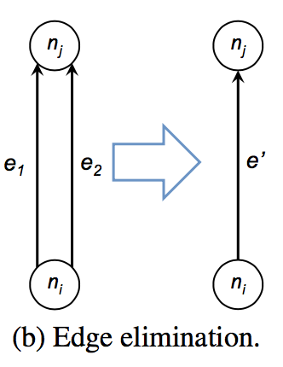
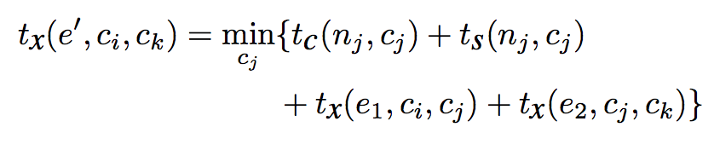

Graph Algorithm
Observation: each node is only connected to a few nodes with similar depths in a computation graph

Slide 12
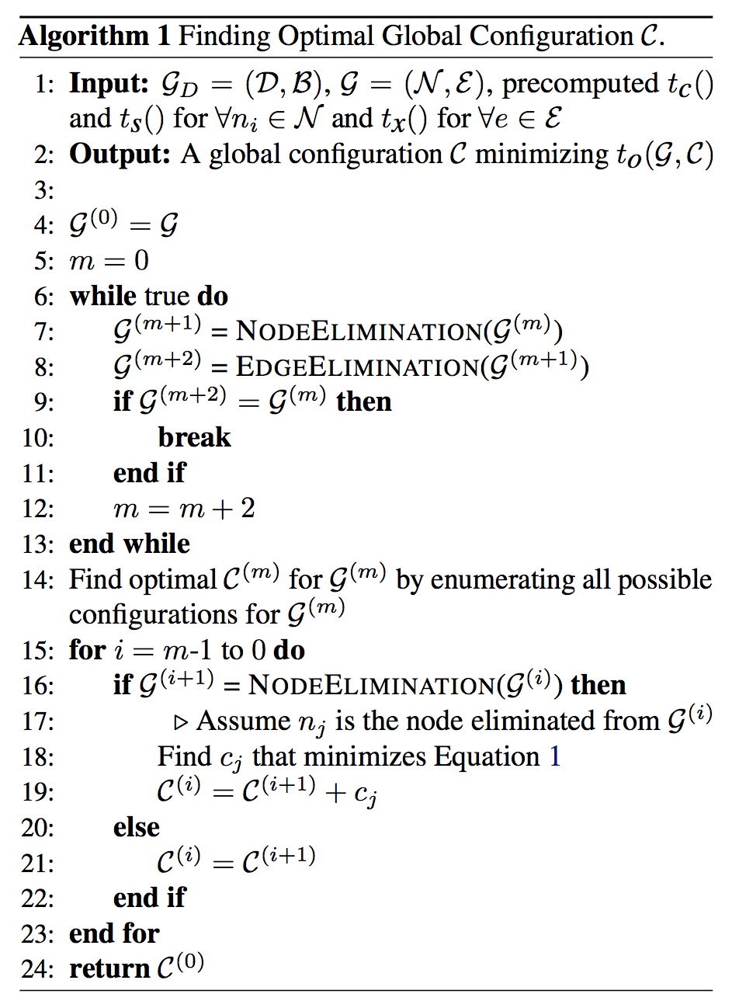
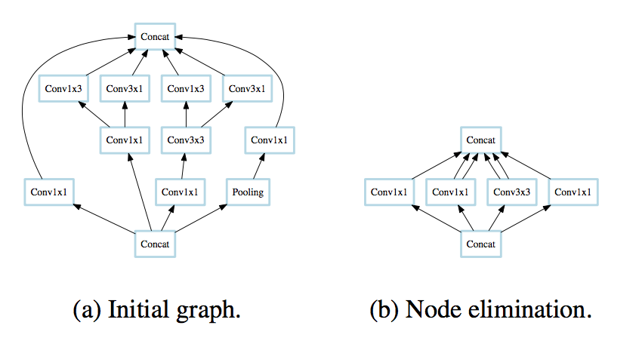
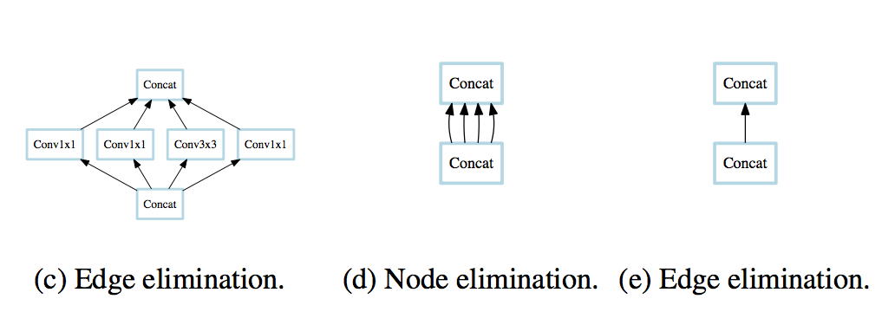
Graph Algorithm

Slide 13
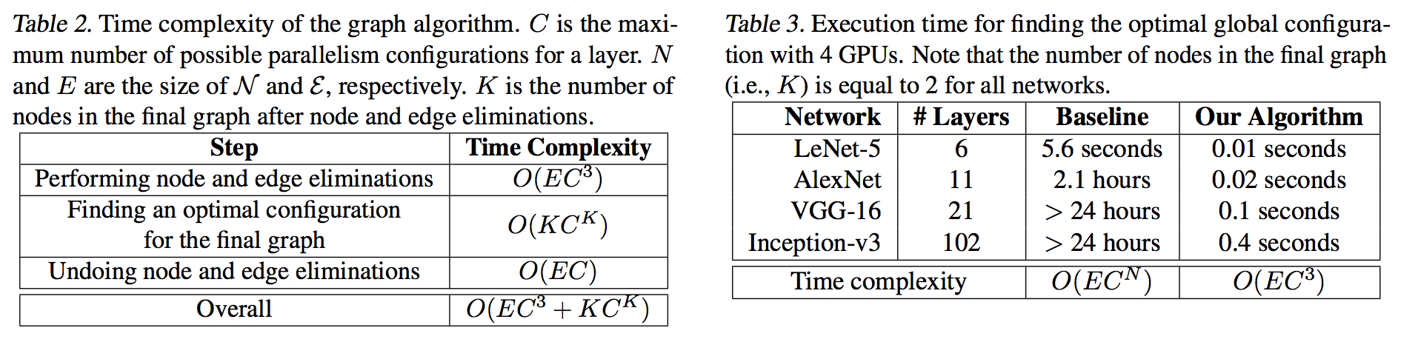
Graph Algorithm

Slide 14
Experiments
AlexNet, VGG-16, Inception-v3
ImageNet-1K 1.2 million images for 1,000 categories
4 machines for each:
2 x Intel 10-core E5-2600 CPUs, 256 GB RAM
4 x NVIDIA Tesla P100 GPUs
NVLink
100 GB/s EDR Infiniband
Batch size: 32
TensorFlow r1.4 PyTorch v0.3

Slide 15
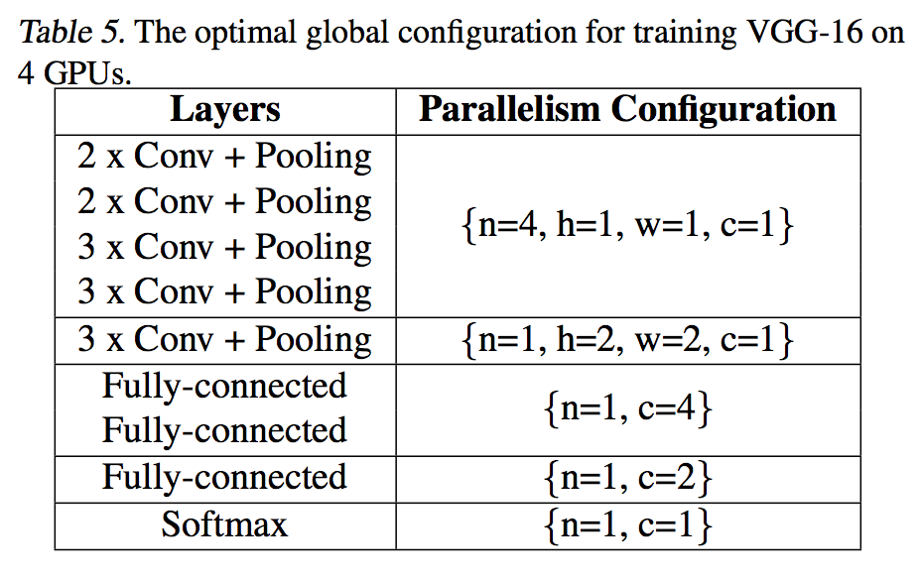
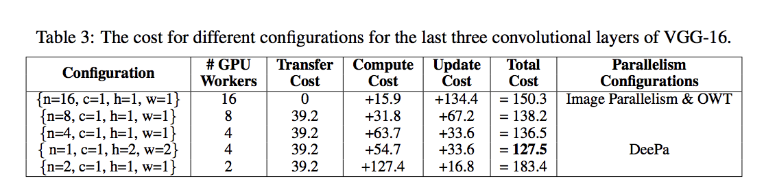
Experiments

Slide 16
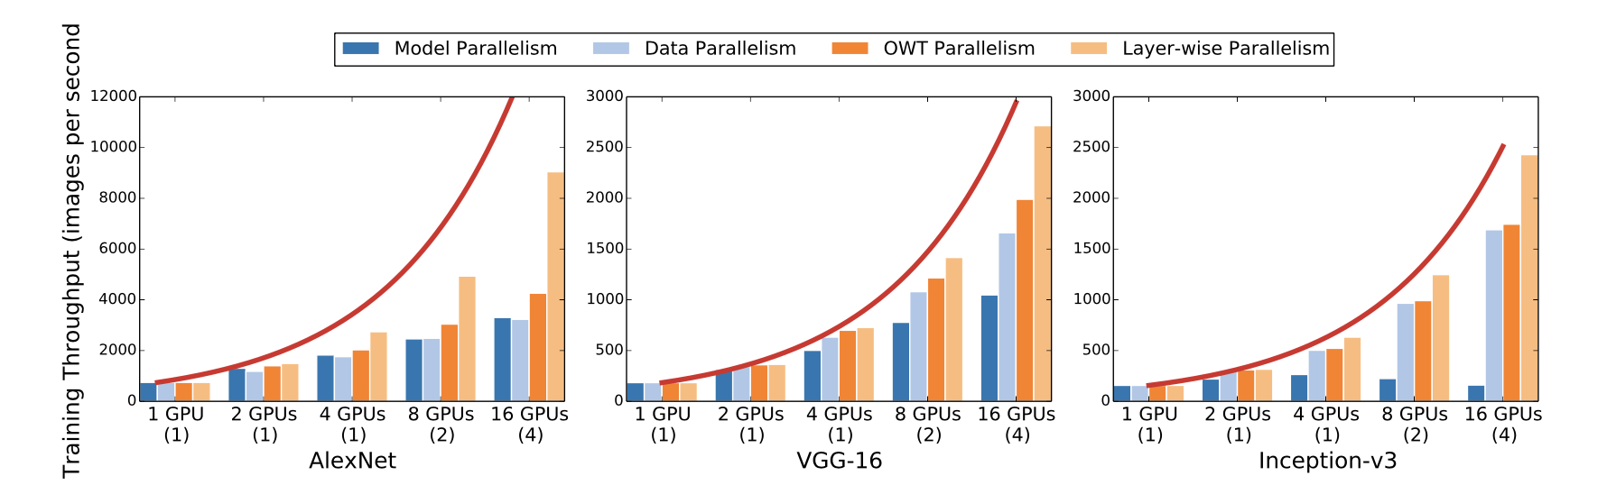
Experiments

Slide 17
Q&A

