Slide 1

Help Box: A Life and Body Locator System through a Designed TV Box and Mobile Application for Post-Disaster Rescue Mission in A City
Presented by: Alas, Katrina Isabela A.
Gerolaga, John Paul Simon A.
Magno, Marx Lenin P.
Peralta, Camille M.

Slide 2

Overview
Philippines has a vast history about natural disasters
Many residents get stranded and fatalities could be found during disasters
There are already a number of approaches in dealing with these disasters.
Help Box has a ‘distress button’ that sends a distress signal

Slide 3
Statement of the Problem
Why did the researchers choose Malabon as the Locale of the Study?
What is the socio-demographic profile of the residents in Malabon?
What are the factors that contribute to the effectiveness of the research study “Help Box: A Life and Body Locator System through a Designed TV Box and Mobile Application for Post-Disaster Rescue Mission in A City”?

Slide 4
Research Paradigm
Theoretical Framework
Inner workings of Global Positioning System
Radio Frequency Transmission
2.4 GHz Wifi Module
Water Resistance

Slide 5
Research Paradigm
Conceptual Framework
Knowledge in:
1. Rescue Operations
2. Mobile Application Development
3. Website Development
4. Electronics
5. Data Communications
Hardware:
1.Water Resistant Materials
2. GPS Module and 2.4 GHz Transmitter
3.Smartphone
4. Arduino Uno
5. RF Transmitter and Receiver
6. Raspberry Pi
Software
1. Android Studio
2. Arduino IDE
3. Java Programming Language
4. C++
Peopleware
1. Respondents
2. Rescuers
3. Researchers
Device
Activation
Transmission of Signal
Receiving the Signal to Command Center
Sending the Signal from the Command Center
Relaying the Location of the Help Box to the Rescuers
HELP BOX: A LIFE AND BODY LOCATOR DEVICE THROUGH A DESIGNED TV BOX AND MOBILE APPLICATION FOR POST-DISASTER RESCUE MISSION IN A CITY
USER MANUAL
FEEDBACK

Slide 6
Scope and Limitation
Scope | Limitation
Help Box has GPS to get its location. Even without internet, Help Box will be able to communicate to the GPS satellite. | Help Box cannot detect the state of consciousness of a victim
Help Box has RF Transmitter to send its location to the Command Center | The 2.4 GHz Transmitter has a range of approximately 8 meters.
Help Box also has a 2.4 GHz Transmitter that will serve as a hotspot for additional functionality, adding more accuracy to the rescue operation. | GPS Receivers can only receive data from satellites, and cannot transmit data back to the satellites.
Help Box has a compact size that will be able to fit anywhere, and it also has its own battery, making it portable. | In times of disaster, Help Box must be carried by the user upon activation in order for the device to update the Command Center of its latest location.
Help Box is easy to operate; one push of a button will immediately send a distress signal to the Command Center.
Help Box is water resistant and shockproof.

Slide 7
Significance of the Study
For the community | For the residents at the target area | For the future researchers
The study will serve as a rescue tool that can help rescue stranded persons The study will help decrease the number of casualties in every disaster | As the main beneficiary, the resident where the Help Box is deployed can be easily found to be evacuated | The study will state additional functions that can be integrated with a compact box

Slide 8
Block Diagram
Help Box
Command Center
Rescuers
Close-Range Tracking Module
Smartphone’s wifi
Battery Module
Dashboard
Charging Module
Microcontroller
RF Module
Mobile Application
Raspberry Pi
Location Module

Slide 9
System Process
GPS Satellites
Headquarters
RF Receiver
Raspberry Pi
Help Box
GPS Receiver
RF Transmitter
Dashboard
Arduino Uno
Button
Rescuers
WIFI Hotspot
Smartphone’s WIFI
Mobile App

Slide 10
Costing
QUANTITY | ITEM NAME/PARTS/COMPONENT | UNIT PRICE | AMOUNT | ITEM DESCRIPTION
1 | Adafruit FONA 808 Mini Cellular GPS GSM Breakout | ₱2,609.00 | ₱2,609 | GSM and GPS Module
1 | Lithium Polymer Battery 2500mAh | ₱650.00 | ₱650 | Power Source
1 | GPS Antenna | ₱247.00 | ₱247 | Component
- | Electric Components | - | ₱500 | Circuit Component
1 | Raspberry Pi 3B | ₱2500 | ₱2500 | Server
1 | Sintra Board | ₱120 | ₱120 | Temporary Casing
1 | ESP8266 WiFi Module | ₱350 | ₱350 | WiFi Transmitter
1 | Arduino Uno | ₱400 | ₱400 | Microcontroller
1 | RF Transmitter and Receiver | ₱100 | ₱100 | RF Module
Total: ₱7,476.00

Slide 11

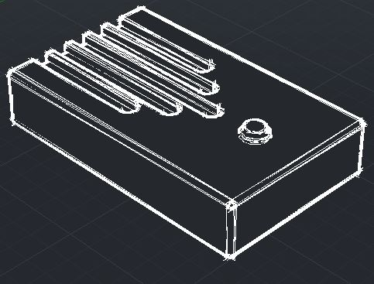
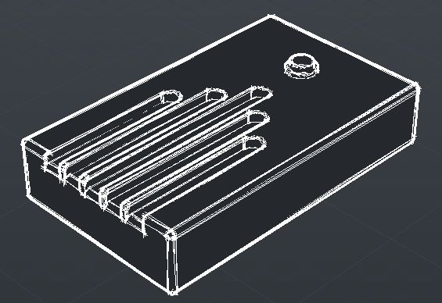
Prototype Design

Slide 12
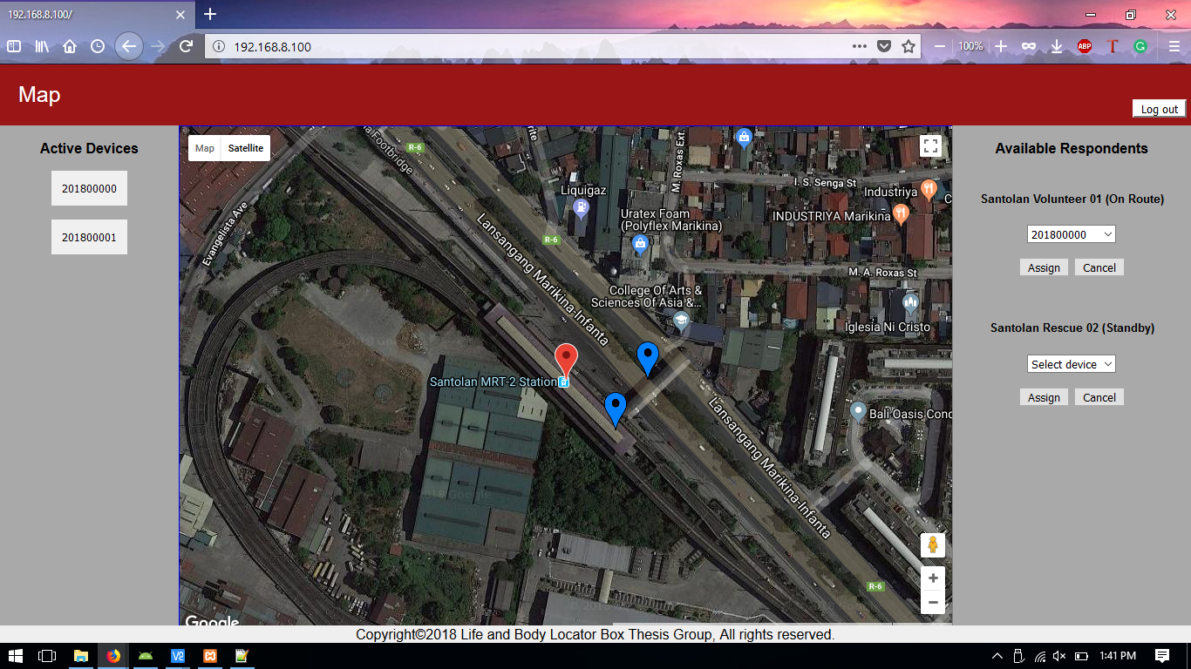
Dashboard

Slide 13
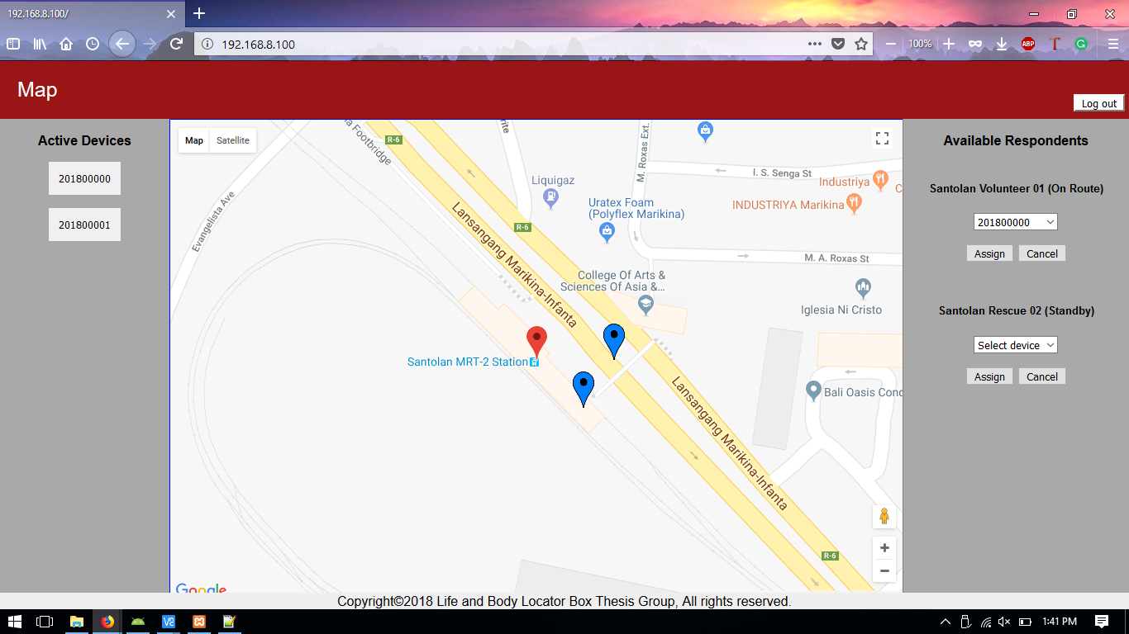
Dashboard

Slide 14
Help Box: A Life and Body Locator System through a Designed TV Box and Mobile Application for Post-Disaster Rescue Mission in A City
End of Presentation
Thank you!

Slide 15
Survey Questionnaire
Questions | 5 | 4 | 3 | 2 | 1 | Mean
 | Strongly Agree | Agree | Neutral | Disagree | Strongly Disagree
Sa iyong tingin, ligtas ba ang inyong lugar kung magkakaroon man ng iba’t ibang kalamidad?
Natitiyak mo ba ang iyong kaligtasan tuwing may sakuna?
Mabilis bang bahain ang inyong lugar? Kung hindi, tukuyin ang kalamidad na madalas mangyari.

Slide 16
Survey Questionnaire
Questions | 5 | 4 | 3 | 2 | 1 | Mean
 | Strongly Agree | Agree | Neutral | Disagree | Strongly Disagree
May nakikita ka bang hakbang na ginagawa ng mga opisyal sa inyong lugar para mabawasan ang epekto ng kalamidad?
Mabilis bang makarating ang tulong sa inyong lugar sa oras ng sakuna?

Slide 17
Survey Questionnaire
Questions | 5 | 4 | 3 | 2 | 1 | Mean
 | Strongly Agree | Agree | Neutral | Disagree | Strongly Disagree
Kung mayroong device na magbibigay ng lokasyon mo sa mga rescuers, gagamitin mo ba ito?
Sa tingin mo ba makakatulong ang device na ito para mabawasan ang mga taong namamatay at nawawala dahil sa mga kalamidad?
Sa iyong palagay, makakatulong din ba ang pagbibigay ng lokasyon ng isang tao sa mga rescuers sa iba’t ibang kalamidad katulad ng paglindol, pagbaha at iba pa?

