Slide 1




Early Stopping Based on Unlabeled Samples in Text Classification
HongSeok Choi¹, Dongha Choi¹, and Hyunju Lee^{1,2}
¹School of Electrical Engineering and Computer Science, ²Artificial Intelligence Graduate School, Gwangju Institute of Science and Technology (GIST), Gwangju 61005, South Korea
{hongking9,hyunjulee}@gist.ac.kr, dongha528@gm.gist.ac.kr

Slide 2
Why do we need Early Stopping Based on Unlabeled Samples?
(i) This early stopping enables to train all the labeled samples.
(ii) The large number of unlabeled samples can provide more generalized criterion.

Slide 3
Let’s consider early stopping based on a separate validation set.
😩ne drawback is that the validation-based early stopping requires a fraction of the labeled samples.

Slide 4
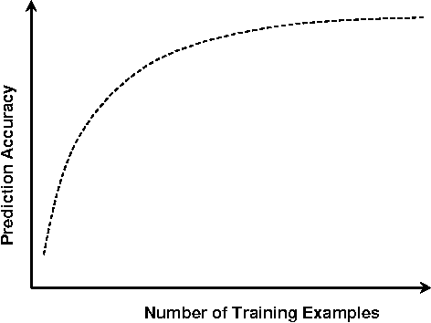
Learning Curve
low resource setting
large resource setting
(= labeled samples)

Slide 5


When we have enough data…
$$Δ Acc_{\begin{aligned}in large \\ resource \\ settings\end{aligned}}=$$
A lot of labeled data available
Training
Validation
(= labeled samples)

Slide 6



But, in low resource settings…
$$Δ Acc_{large}=$$
$$Δ Acc_{low}=$$
A lot of labeled data available
Training
Validation
Lack of labeled data
(= labeled samples)

Slide 7
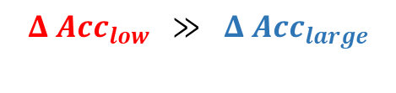


So, validation-based stopping…
$$Δ Acc_{large}=$$
$$Δ Acc_{low} ≫ Δ Acc_{large}$$
The performance gap is much larger in low resource settings!
$$Δ Acc_{low}=$$
Thus, validation-based stopping can cause performance degradation, particularly in low resource settings.
(= labeled samples)

Slide 8
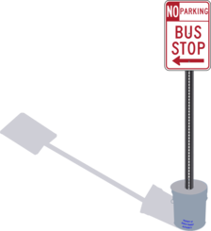

The proposed method
To overcome the drawback of validation-based stopping, we propose an early stopping method Based on Unlabeled Samples, which is named BUS-stop.
…!

Slide 9
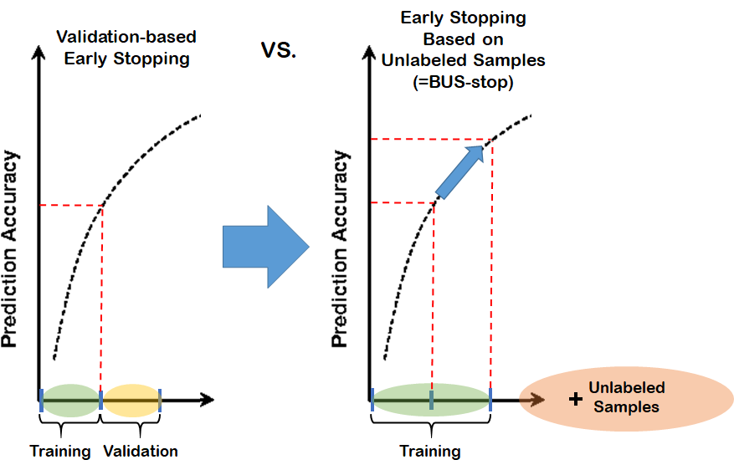
Main Advantages
- Advantages -
BUS-stop can improve the performance by using all the labeled samples for training.
BUS-stop can provide more reliable stopping point by using large unlabeled samples (than using a small validation set).
BUS-stop method is related to performance metric such as accuracy (described in method section).

Slide 10
Related Works
There are several non-validation early stopping methods.
EB-criterion & Nonparametric variational inference (NVI) use gradient-related statistics of the training samples.
Local Intrinsic Dimensionality (LID) calculates local statistics of the unlabeled samples.
Pre-Estimated training epoch (PE-stop-epoch) considers the training epoch as a hyper-parameter, and pre-estimates it with cross-validation.

Slide 11
Method
…!

Slide 12



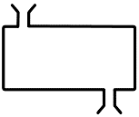




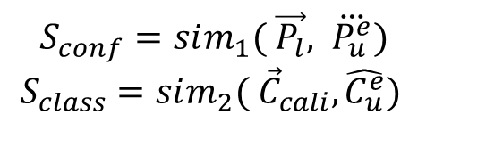

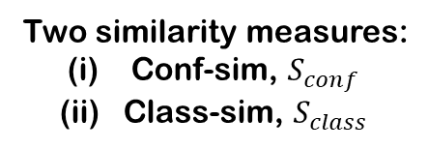


Overview
Main stage
For epoch $e$ in $\left\{1,2,3,…\right\}:$
Train the model $M$ one epoch on $D_{l}$. Feed $D_{u}$ into $M$ and obtains the confidences, $\overset{⃛}{P_{u}^{e}}$, and the output class distribution, $\hat{C_{u}^{e}}$. $S_{conf}=sim_{1}\left( \vec{P_{l}}, \overset{⃛}{P_{u}^{e}}\right)$ $S_{class}=sim_{2}\left( {\vec{C}}_{cali}, \hat{C_{u}^{e}}\right)$ BUS-stop($S_{conf}$, $S_{class}$) → stop? if stop==yes → $M_{best}=M$
else stop==no → continue training
BUS-stop
Two similarity measures:
Conf-sim, $S_{conf}$
Class-sim, $S_{class}$
$S_{conf}=sim_{1}( \vec{P_{l}}, \overset{⃛}{P_{u}^{e}})$
$S_{class}=sim_{2}( {\vec{C}}_{cali}, \hat{C_{u}^{e}})$
Preliminary stage
$$D_{l}$$
Before main stage, we need the following two:
$\vec{P_{l}}=$ pre-calculated confidences on $D_{l}$ ${\vec{C}}_{cali}=$ pre-estimated class distribution for $D_{u}$
$D_{trn}$, $D_{val}$
$$D_{u}$$
N-times re-training
E.g. CV
$${\vec{C}}_{cali}$$
$$\vec{P_{l}}$$

Slide 13
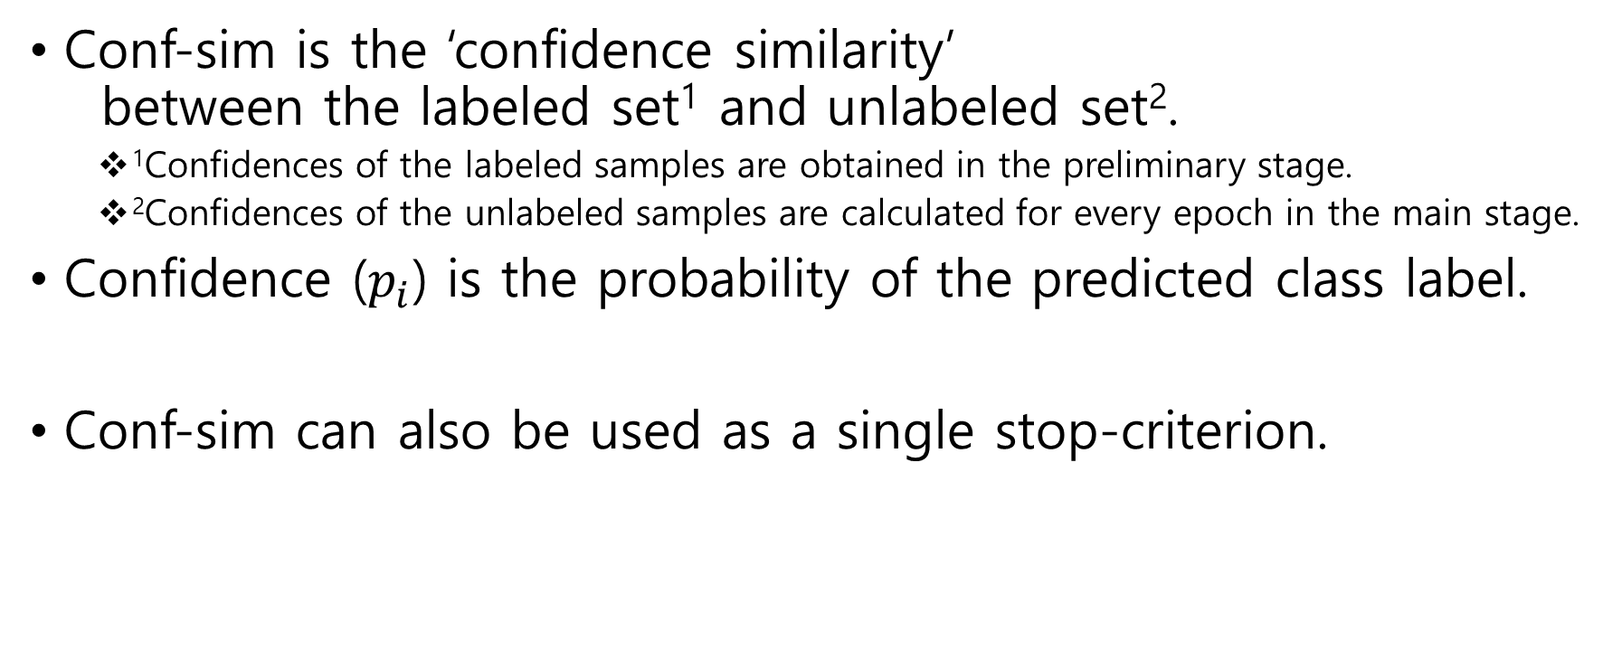


Conf-sim, $S_{conf}$
Conf-sim is the ‘confidence similarity’ between the labeled set¹ and unlabeled set².
¹Confidences of the labeled samples are obtained in the preliminary stage.
²Confidences of the unlabeled samples are calculated for every epoch in the main stage.
Confidence ($p_{i}$) is the probability of the predicted class label.
Conf-sim can also be used as a single stop-criterion.
※ $\text{sample} x_{i}→ p_{i}=\max_{j}\left(p_{ij}\right), ∀j∈\{1, …, n_{c}\}$

Slide 14
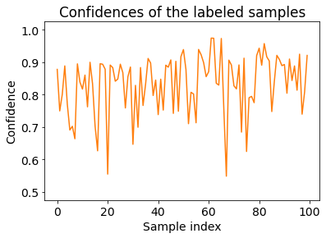
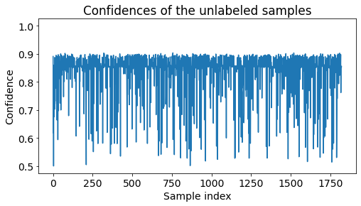
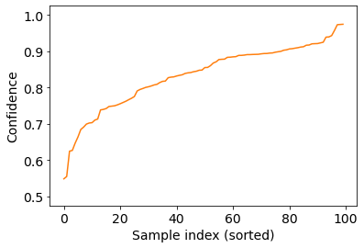
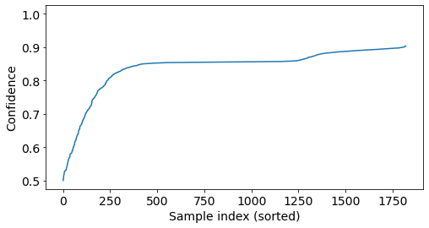

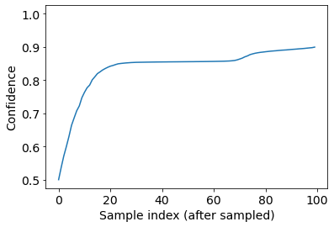










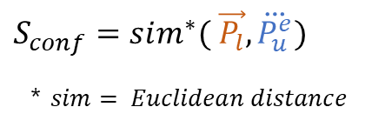
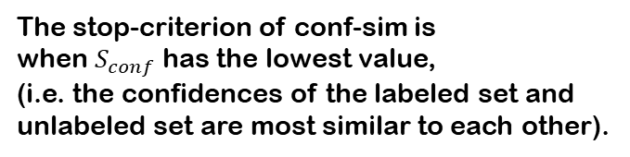
Conf-sim, $S_{conf}$
Preliminary Stage
Main Stage (for every epoch)
In Main Stage
e.g. epoch, $e=6$
$$P_{l}$$
$$P_{u}^{e}$$
sorting
sorting
$$\vec{P_{u}^{e}}$$
$$\vec{P_{l}}$$
$$\vec{P_{l}}$$
$$\vec{P_{l}}$$
$$\overset{⃛}{P_{u}^{e}}$$
$$\overset{⃛}{P_{u}^{e}}$$
sampling at regular interval
The stop-criterion of conf-sim is when $S_{conf}$ has the lowest value, (i.e. the confidences of the labeled set and unlabeled set are most similar to each other).
$$S_{conf}=sim^{∗}( \vec{P_{l}}, \overset{⃛}{P_{u}^{e}})$$
* $sim= Euclidean distance$
$$\overset{⃛}{P_{u}^{e}}$$

Slide 15

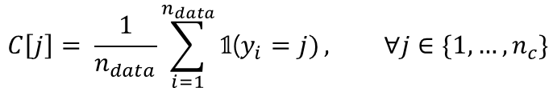
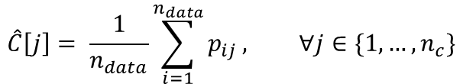
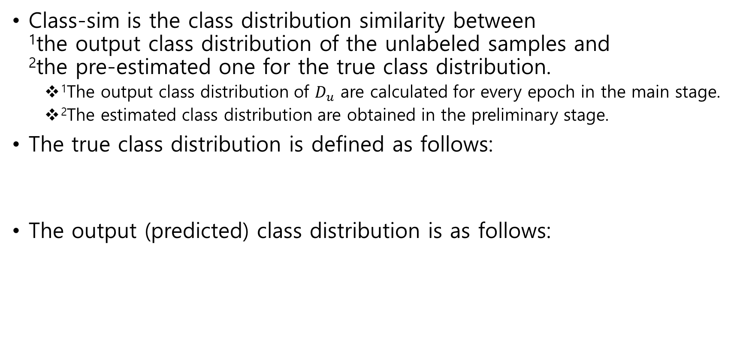
Class-sim, $S_{class}$
Class-sim is the class distribution similarity between ¹the output class distribution of the unlabeled samples and ²the pre-estimated one for the true class distribution.
¹The output class distribution of $D_{u}$ are calculated for every epoch in the main stage.
²The estimated class distribution are obtained in the preliminary stage.
The true class distribution is defined as follows:
The output (predicted) class distribution is as follows:
$$C\left[j\right]= \frac{1}{n_{data}}\sum_{i=1}^{n_{data}}{\text{𝟙}\text{(}y_{i}=j)}, ∀j∈\{1, …, n_{c}\}$$
$$\hat{C}\left[j\right]= \frac{1}{n_{data}}\sum_{i=1}^{n_{data}}{p_{ij}}, ∀j∈\{1, …, n_{c}\}$$

Slide 16
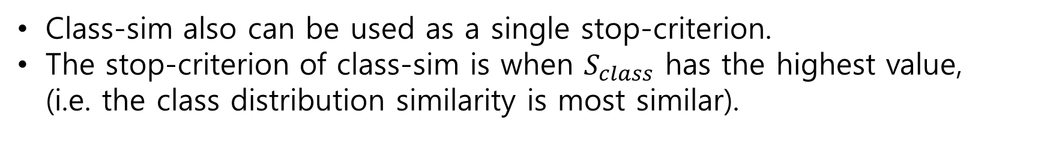



Class-sim, $S_{class}$
Class-sim is the class distribution similarity between ¹the output class distribution of the unlabeled samples and ²the pre-estimated one for the true class distribution.
¹The output class distribution of $D_{u}$ are calculated for every epoch in the main stage.
²The estimated class distribution is obtained in the preliminary stage.
$$S_{class}=sim^{∗}( {\vec{C}}_{cali}, \hat{C_{u}^{e}})$$
* $sim=Cosine similarity$
Class-sim also can be used as a single stop-criterion.
The stop-criterion of class-sim is when $S_{class}$ has the highest value, (i.e. the class distribution similarity is most similar).

Slide 17

Calibration of predicted class distribution
We also propose a calibration method to better estimate the class distribution of the unlabeled samples.
${\hat{C}}_{pred} \underset{→}{ \text{calibration} } {\vec{C}}_{cali}, \text{∴} {\vec{C}}_{cali} is more similar to C_{true} than {\hat{C}}_{pred}$.

Slide 18


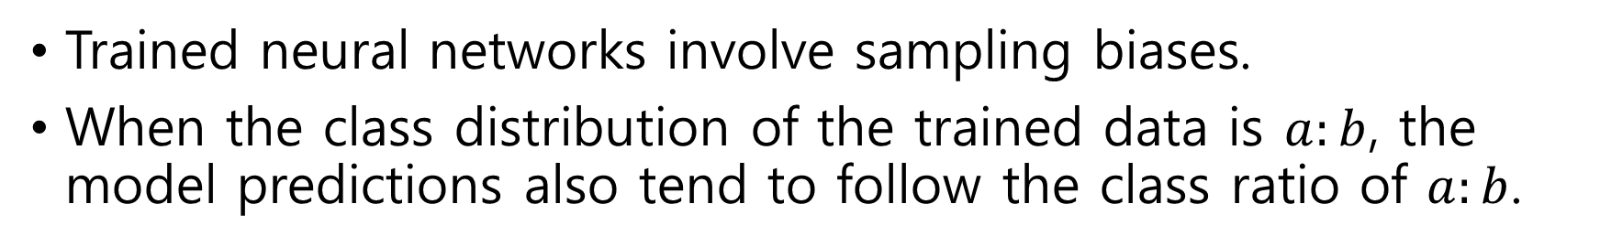





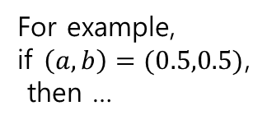



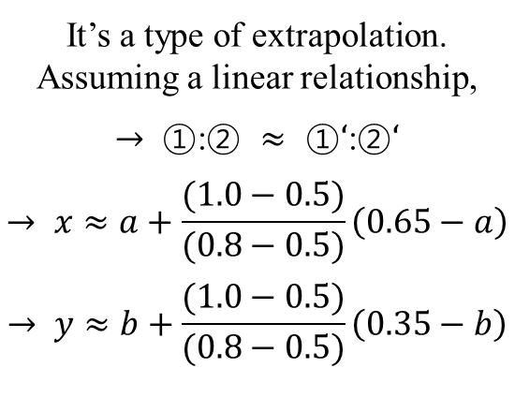
Calibration of predicted class distribution
Trained neural networks involve sampling biases.
When the class distribution of the trained data is $a:b$, the model predictions also tend to follow the class ratio of $a:b$.
$${Acc}_{max}=1.0$$
$$C_{true}=(x,y)$$
For example, in binary classification,
It’s a type of extrapolation.
Assuming a linear relationship,
$$→ \text{①}\text{:}\text{②} ≈ \text{①}‘\text{:}\text{②}‘$$
$$→ x≈a+\frac{(1.0−0.5)}{(0.8−0.5)}\left(0.65−a\right)$$
$$→ y≈b+\frac{(1.0−0.5)}{(0.8−0.5)}\left(0.35−b\right)$$
In the preliminary stage,
For example,
if $\left(a,b\right)=(0.5,0.5)$, then …
$${Acc}_{val}=0.8$$
$${\hat{C}}_{pred}=(0.65,0.35)$$
$$\text{①}$$
●
●
$$\text{①}‘$$
$$\text{②}$$
$$\text{②}‘$$
$${Acc}_{min}=0.5$$
$$B=(a,b)$$

Slide 19


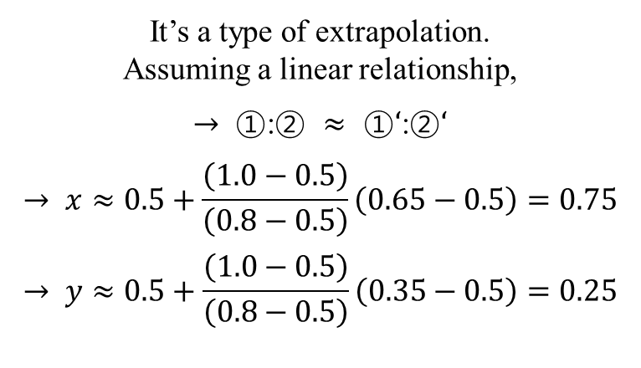
Calibration of predicted class distribution
Trained neural networks involve sampling biases.
When the class distribution of the trained data is $a:b$, the model predictions also tend to follow the class ratio of $a:b$.
$${Acc}_{max}=1.0$$
$$C_{true}=(x,y)$$
It’s a type of extrapolation.
Assuming a linear relationship,
$$→ \text{①}\text{:}\text{②} ≈ \text{①}‘\text{:}\text{②}‘$$
$$→ x≈0.5+\frac{\left(1.0−0.5\right)}{\left(0.8−0.5\right)}\left(0.65−0.5\right)=0.75$$
$$→ y≈0.5+\frac{\left(1.0−0.5\right)}{\left(0.8−0.5\right)}\left(0.35−0.5\right)=0.25$$
$${Acc}_{val}=0.8$$
$${\hat{C}}_{pred}=(0.65,0.35)$$
$$\text{①}$$
●
●
$$\text{①}‘$$
$$\text{②}$$
$$\text{②}‘$$
$${Acc}_{min}=0.5$$
$$B=(0.5,0.5)$$
$${\hat{C}}_{pred}=(0.65,0.35) \underset{→}{ \text{cali} } {\vec{C}}_{cali}=(0.75, 0.25)$$

Slide 20
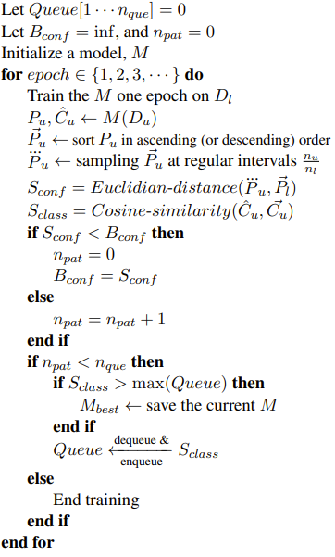
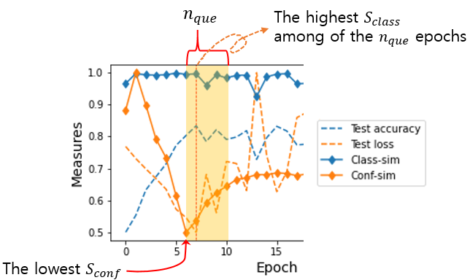




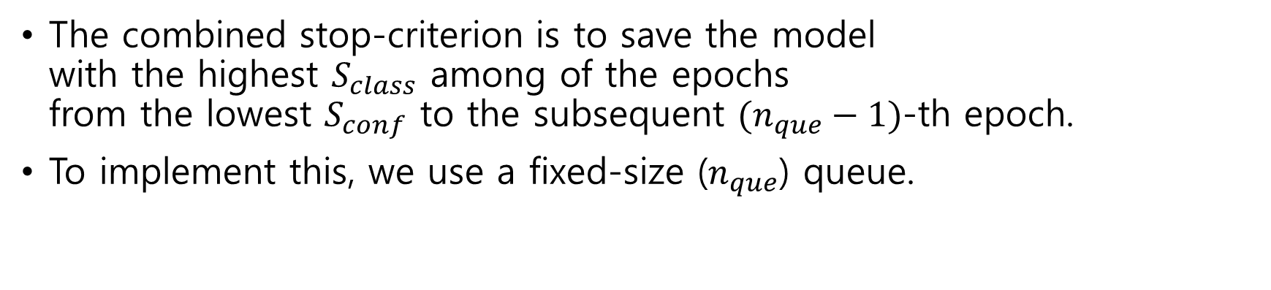

BUS-stop = $S_{conf}+S_{class}$
$S_{conf}=Euc_dist( \vec{P_{l}}, \overset{⃛}{P_{u}^{e}})$
+
$$S_{class}=Cos_sim({\vec{C}}_{cali}, \hat{C_{u}^{e}})$$
The combined stop-criterion is to save the model with the highest $S_{class}$ among of the epochs from the lowest $S_{conf}$ to the subsequent $(n_{que}−1)$-th epoch.
To implement this, we use a fixed-size ($n_{que}$) queue.
…
$$S_{class}$$
$$Queue (n_{que}=5)$$

Slide 21

Results
…!

Slide 22
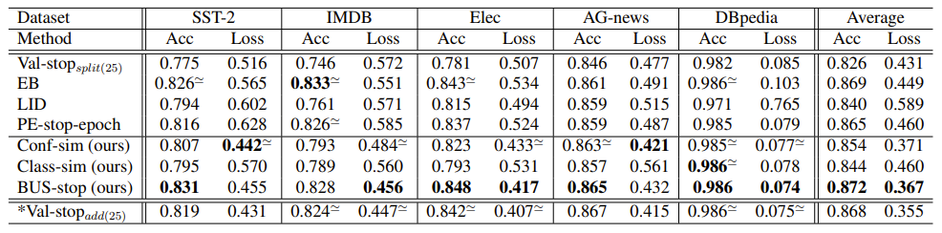

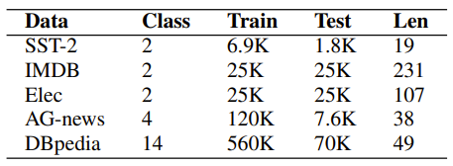
Results – in Balanced Classification
When combined, it is better than each
We used BERT-base as our text encoder.
Five text classification datasets were experimented.
Number of training samples is 50 samples per class.
We used the test set as the unlabeled set (transductive setting).
All datasets have balanced class distribution.
*Val-stop_{add(25)} is the validation-based stopping that uses additional 25 labeled samples per class, which is an unfair advantage.
Obv (1) BUS-stop (=Conf-sim+Class-sim) > Conf-sim (or Class-sim)

Slide 23
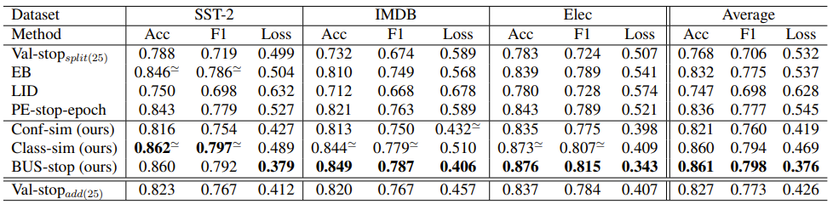
Results – in Imbalanced Classification
Number of training samples is 50 samples per class. The class distributions of the test sets were adjusted to 2:8 (negative:positive) *Val-stop_{add(25)} is the validation-based stopping that uses additional 25 labeled samples per class, which is an unfair advantage.
Obv (1) BUS-stop performance is much better in imbalanced classification and SOTA. (BUS-stop outperformed other methods with bigger margin.)
Obv (2) Class-sim is more effective in imbalanced classification.

Slide 24
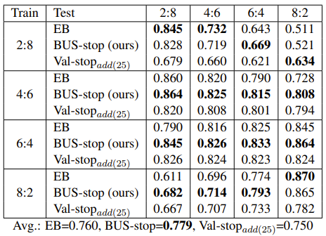
Results – various imbalanced settings
In SST-2 dataset
※ The number of training samples was fixed to 100 for the different class-distribution settings.

Slide 25
How can the BUS-stop prevent overfitting?

Slide 26
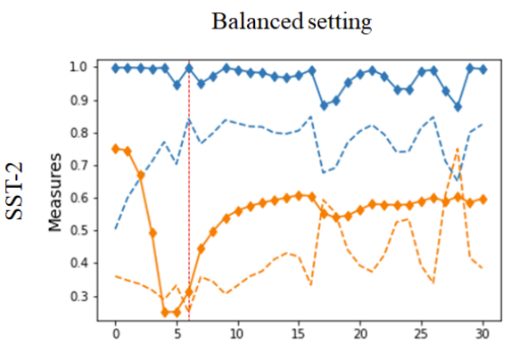
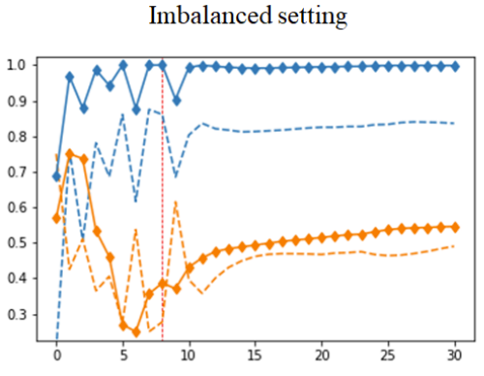
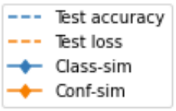





Results – Examples
$$n_{que}$$
$$n_{que}$$
The highest $S_{class}$ among of the $n_{que}$ epochs
The highest $S_{class}$ among of the $n_{que}$ epochs
The lowest $$S_{conf}$$
The lowest $$S_{conf}$$
※ The red vertical line denotes the best model selected by the BUS-stop method.
※ The loss and conf-sim were scaled between 0.25-0.75 for easy comparison.
Obv (1) The BUS-stop enables fine-stopping. It skillfully avoids the pointes where the performance is decreased by fluctuations.

Slide 27
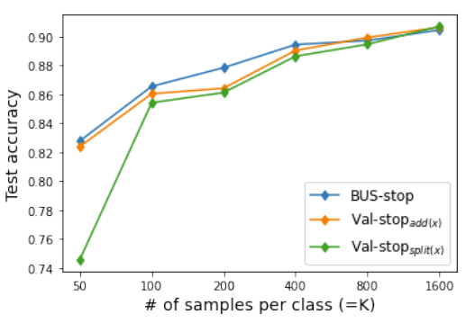
Results – with respect to the training size
In IMDB dataset

Slide 28
Conclusion
We propose a combined early stopping method, BUS-stop, that is based on unlabeled samples.
We also propose a calibration method to better estimate the true class distribution of the unlabeled samples, which is used in the BUS-stop method to improve the performance.
The BUS-stop outperformed the existing stop-criteria, particularly better in imbalanced data.
Advantages: the proposed BUS-stop method enables the training of all the available samples and presents a better stopping point using large unlabeled samples.

Slide 29

Thank you!
Q&A
hongking9@gist.ac.kr

