Slide 1

SnapSponsor
Team - Kloud
Rebecca Biju - 002768633
Vaibhav Mahajan - 002766753

Slide 2
Problem Statement
Organizers struggle to secure financial support for events
Sponsors find it challenging to identify suitable events
Disconnect leads to missed opportunities and limited impact
SnapSponsor aims to bridge this gap by providing a seamless platform that facilitates meaningful partnerships between sponsors and events

Slide 3
Objectives
Facilitate Seamless Connections
Enhance Sponsorship Visibility and Engagement
Foster Sustainable Partnerships

Slide 4
Proposed Solution
Intuitive platform for event organizers to showcase events
Efficient sponsorship discovery and connection for sponsors
Advanced search, streamlined communication, transparent transactions
Criteria-based search: location, industry, sponsorship budget

Slide 5
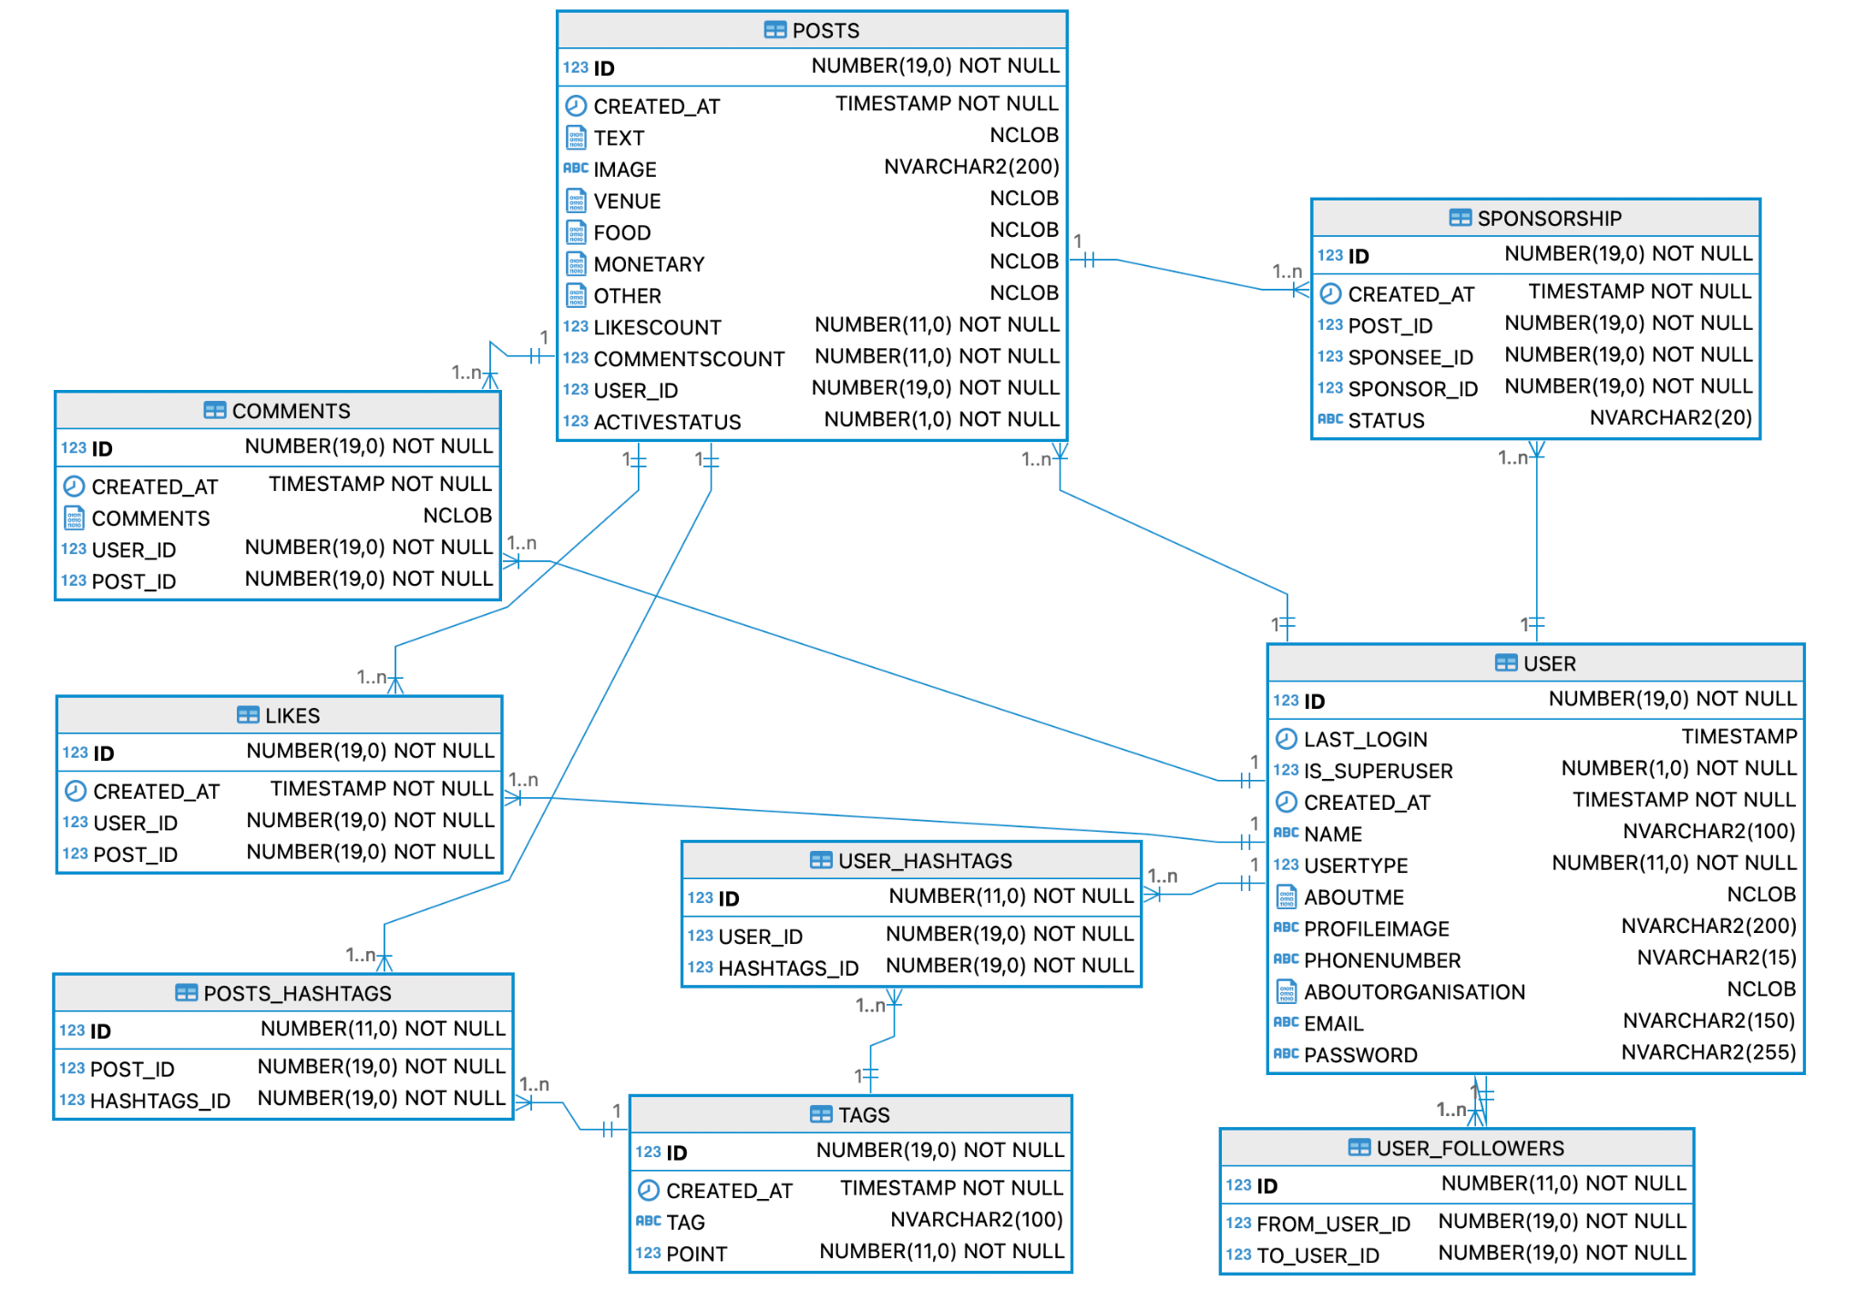
ER Diagram

Slide 6
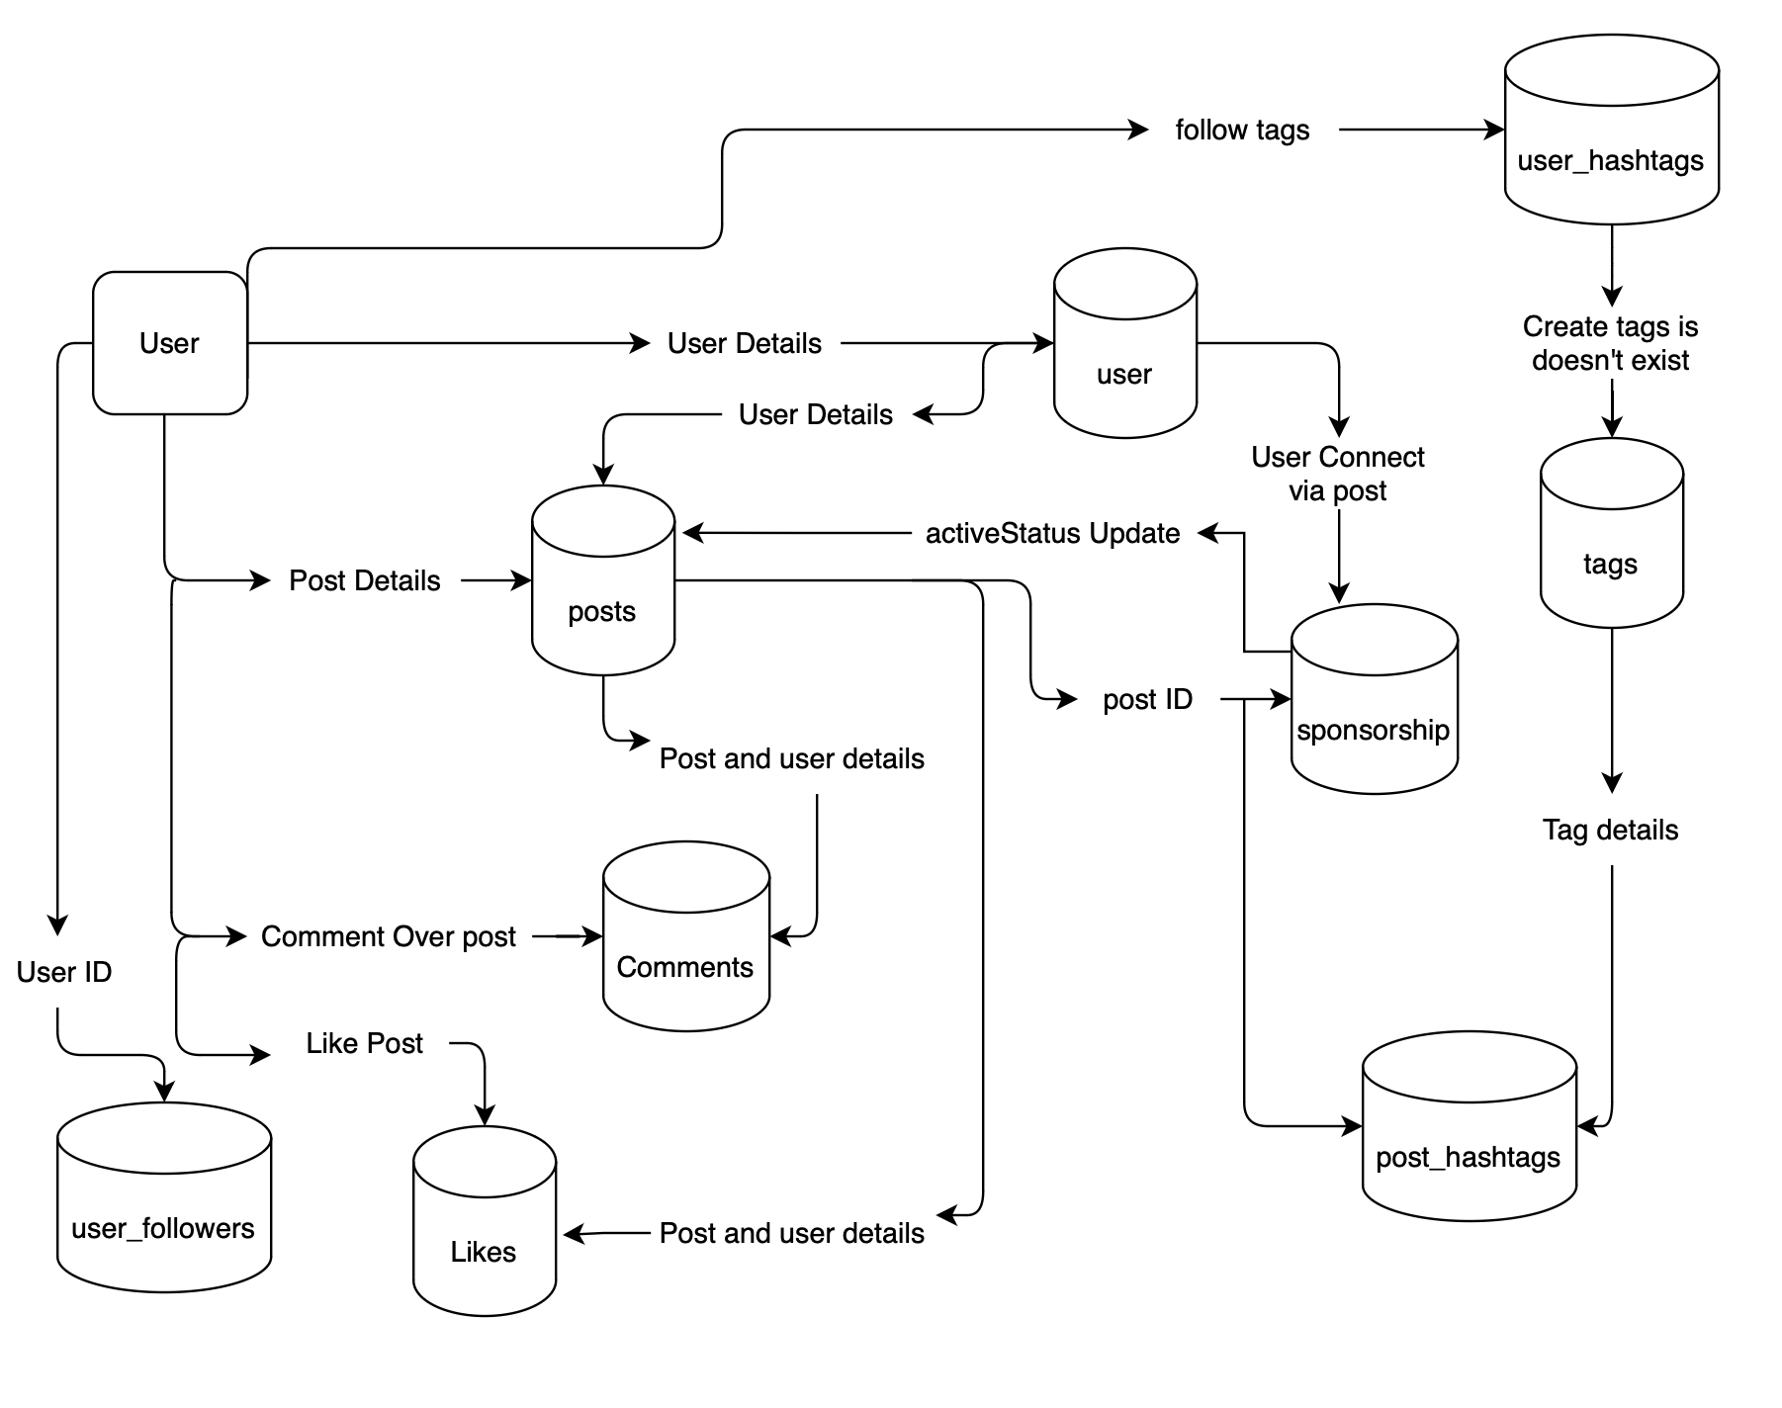
Data Flow Diagram

Slide 7
User Roles
Admin Role
Unrestricted access and privileges across all functionalities and tables
Responsible for creating and maintaining all tables
Creates and manages user roles and permissions
User Manager
Has CRUD (Create, Read, Update, Delete) rights for the user, posts, comments, followers tables
Has read access to the sponsorship table
1
2

Slide 8
User Roles
Sponsorship Manager
Has CRUD rights for the sponsorship table
Has read access to the user and post tables
Business Analyst
Has read access to all tables and views within the SnapSponsor system
Can query and analyze data for reporting and decision-making purposes
3
4

Slide 9
Business Rules
Event-Sponsor Connection:
Users (both Sponsors and Sponsees) can like and comment on the posts that interests them, enabling them to further connect with each other for a sponsorship deal.
Sponsorship Management
Each sponsorship package can offer different benefits and tiers, based on the post for the event. Event organizers must approve sponsorship requests before they are finalized.

Slide 10
Business Rules
Payment and Transaction Status
Sponsorship agreements are considered valid only after successful payment and confirmation from both parties. Sponsorship statuses include SUCCESSFUL, PENDING, and CANCELLED
Event and Sponsor Profile Requirements
Event organizers must provide detailed information about their events, including event type, target audience, and sponsorship benefits. Sponsors must provide information about their brand, sponsorship interests, and target audience demographics

Slide 11
Contributions
Rebecca: DDL, Stored Procedures, Functions, Views, Reports
Vaibhav: Admin & User script, DML, Triggers, Stored Procedures, Functions
Collaborated Effort:
Business problem & solution
ER Diagram
Business rules/constraints
Data Flow Diagrams
Logical Diagrams,
Relational Diagrams

Slide 12
Thank you!

