Slide 1


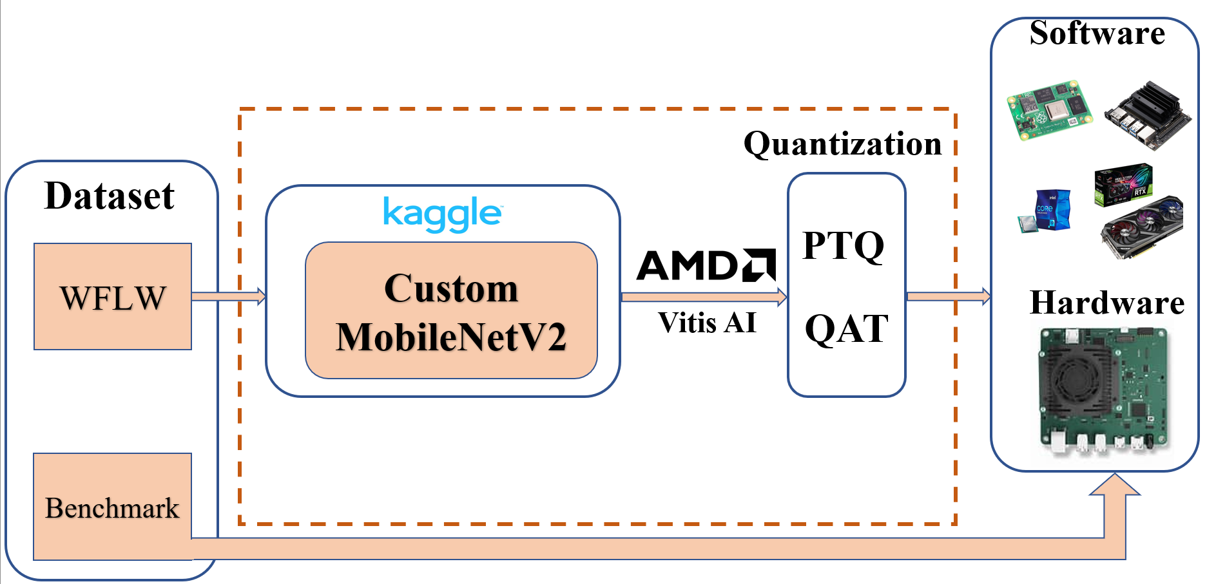
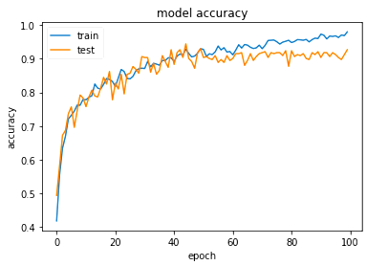
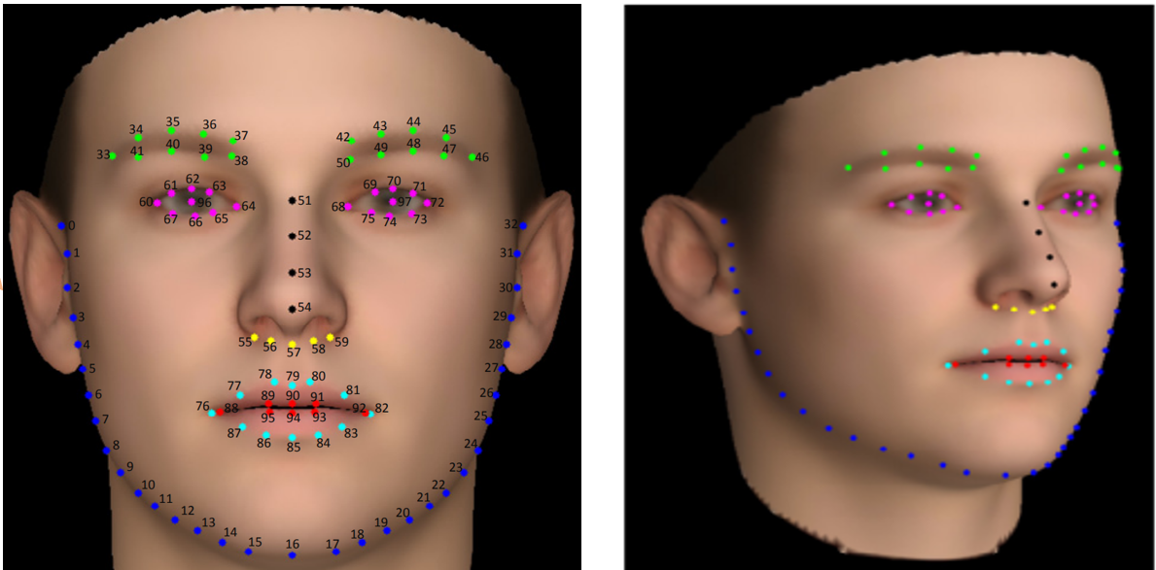
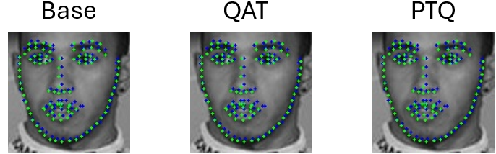
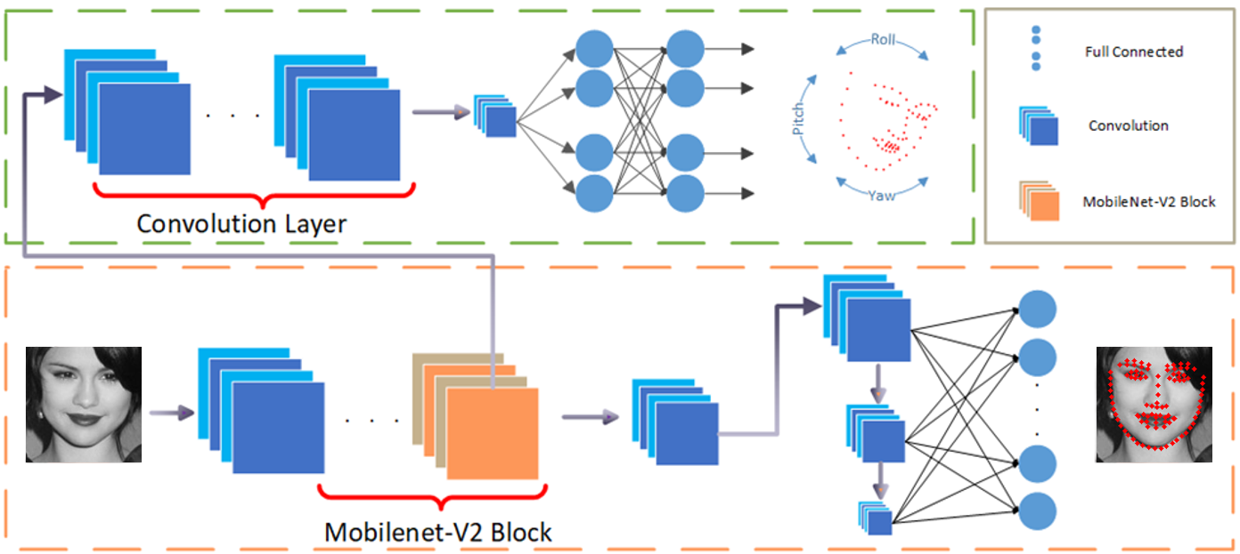
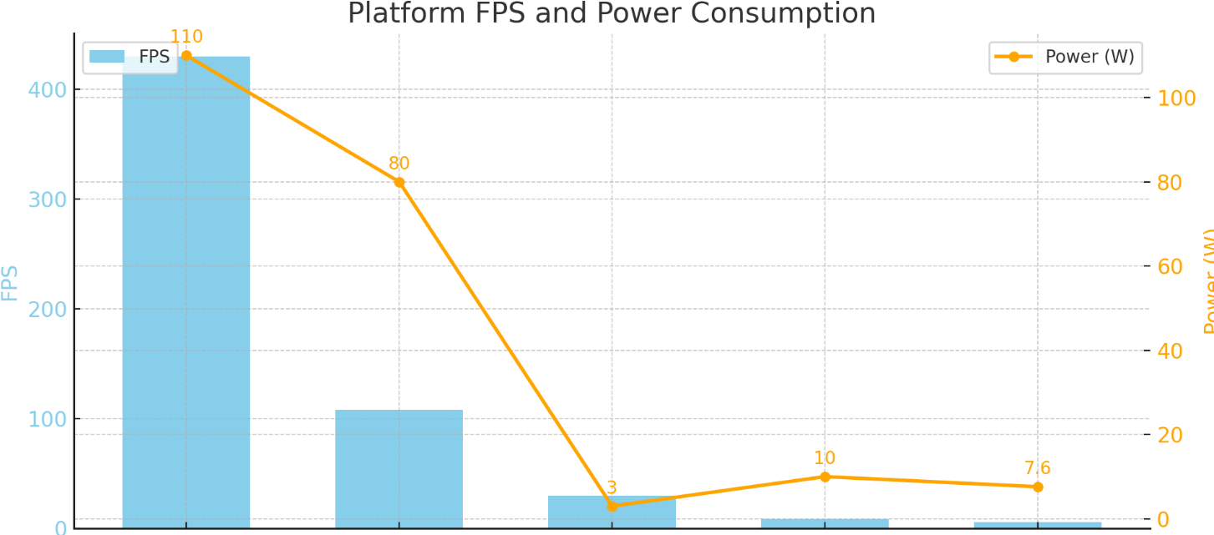
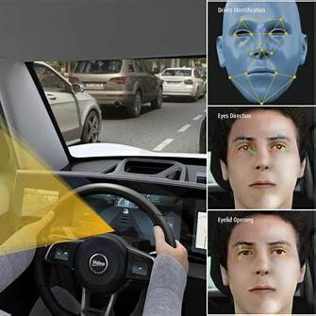

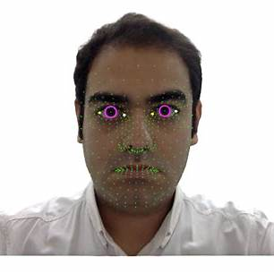

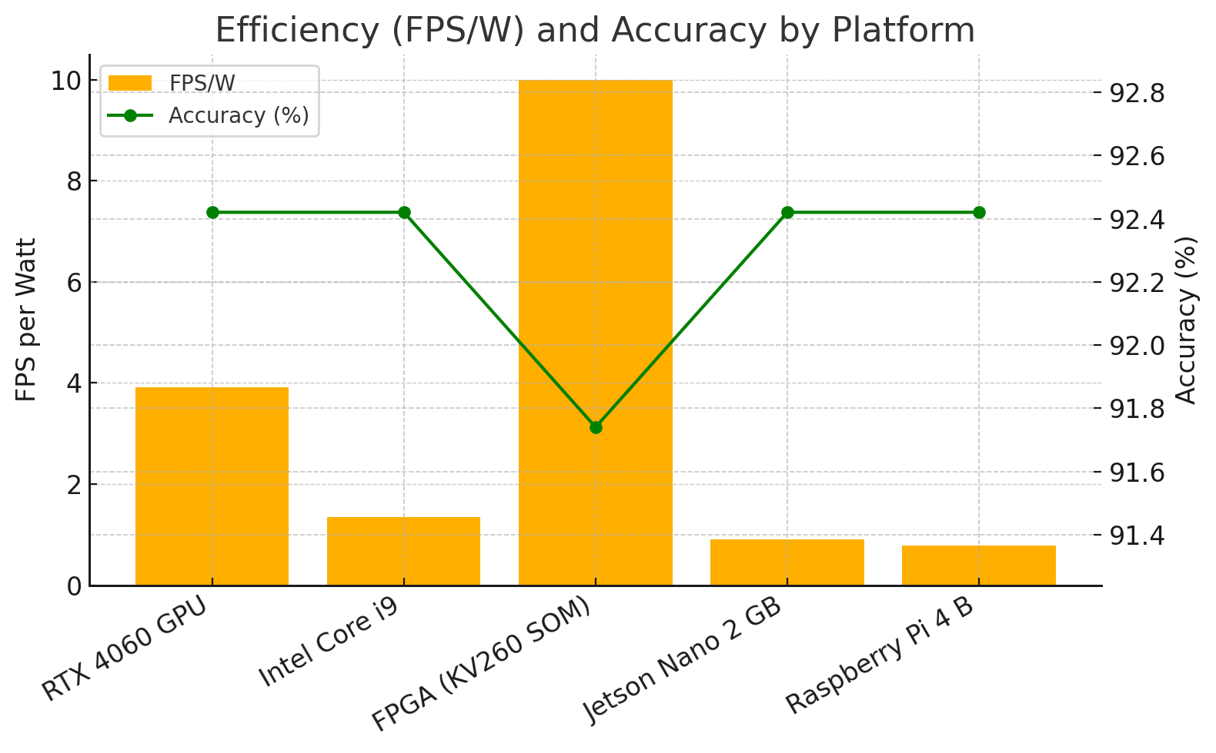
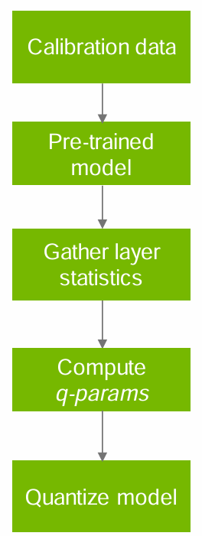
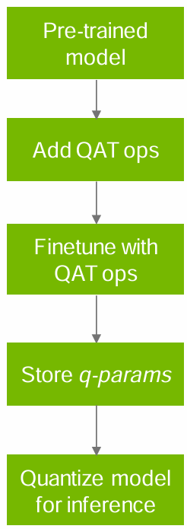
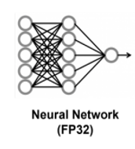
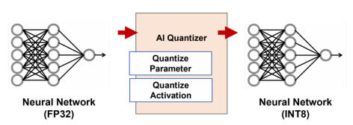
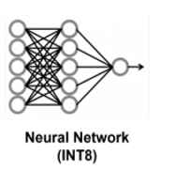
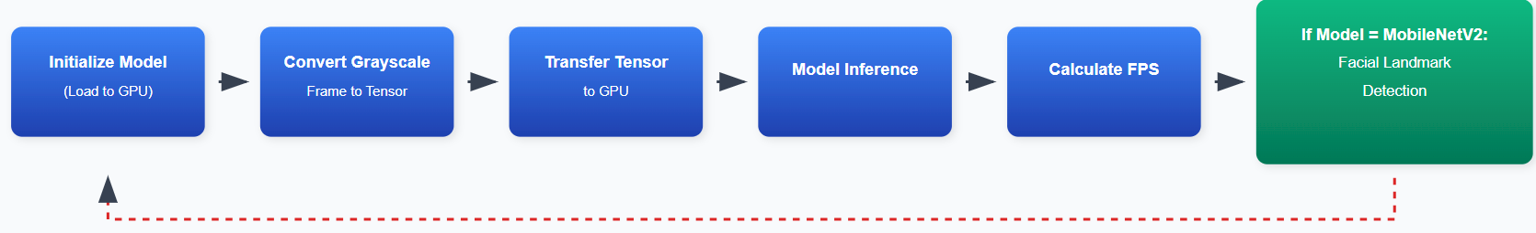
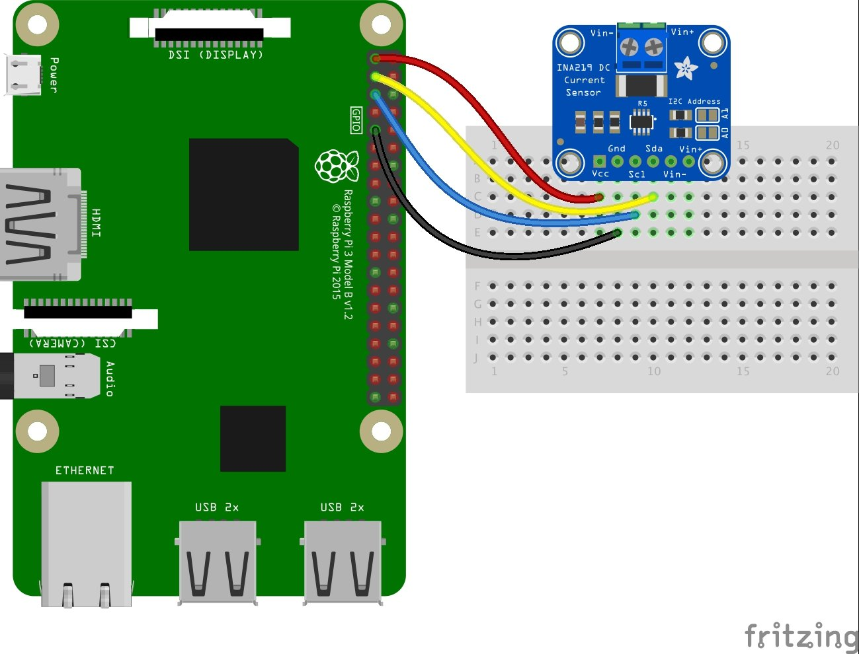
FACIAL LANDMARK DETECTION
ON MULTIPLE PLATFORMS USING QUANTIZED MOBILENETV2 FOR EDGE AI APPLICATIONS
Do Manh Dung, Dang Trung Nghia, Faculty of International Education, HCMC University of Technology and Education
Supervisor: PhD. Pham Van Khoa
MOTIVATION
PROBLEM SOLVING
RESULTS
In the area of Edge AI, facial landmark detection enables diverse real-time applications: driver monitoring (drowsiness alerts), biometric face unlock, gaze tracking, conferencing eye-contact correction, and security surveillance. Each scenario demands low latency, high FPS, robust accuracy under varied conditions, and minimal power consumption to run on devices like Jetson, FPGA, or Raspberry Pi. These challenges drive the creation of lean, fast, energy-efficient, and reliable Edge AI solutions.
Proposed Design
Training result with baseline FP32
AI model deployment pipeline:
WFLW dataset feeds into MobileNetV2 model on Kaggle
AMD Vitis AI optimization with PTQ/QAT quantization
Deploying to various hardware platforms for benchmarking performance evaluation.
Learning Rate: 1e-4 (0.0001)
Optimizer: Adam with weight decay of 1e-5
Batch Size: 64
Epochs: 100
Framework: Pytorch
A conservative learning rate suitable for fine-tuning, Adam optimizer with light regularization, and a specialized loss function for pose/landmark detection
PROBLEM STATEMENT
Dataset
WFLW
Quantization Results
Use to train MobileNetV2 model.
Image size: 112x112 pixels.
Total images: 10000 face images
(7500 for training – 2500 for validation).
Each image contains 98 manually labeled facial landmarks.
Method | Accuracy (%) | Model Size (MB) | Compression Ratio
Original (FP32) | 92.42 | 6.59 | 1x
QAT (INT8) | 91.74 | 1.65 | 4x
PTQ (INT8) | 90.94 | 1.65 | 4x
Apply PTQ & QAT to 4x model compression with 90,94% and 91.74%, respectively
Edge Computing Evolution
IoT Growth: Increasing connected devices with computing capabilities.
Paradigm Shift: From cloud dependency to local edge processing
Real-time Requirements: Critical applications need immediate response
CNN Architecture and Backbone design
Benmark results
Critical Safety Issues
The auxiliary one for estimating geometric information
GPU achieving highest FPS ~400 with maximum power consumption ~110W,
while KV260 delivers much lower FPS ~10 but significantly reduced power consumption ~10W.
Drowsiness
Mask Detection
RTX 4060
Gaze Tracking
Face Unlock
The backbone Network for predicting
landmark coordinates
Facial landmark detection with geometric estimation
I9
Jetson nano
Current Solution Limitations
KV260
Rasp
⚡
⏰
💰
⚠️
Quantization is a technique that reduces the numerical precision of parameters and computations in AI models.
Quantization
Significant power consumption
High processing latency
Costly hardware requirements
Poor performance on constrained devices
Main Purposes in Edge AI:
PTQ
QAT
🏆FPGA KV260
KV260
Model Size Reduction
Faster Processing Speed
Energy Efficiency
Hardware Optimization
Energy Efficiency: 10 FPS/W, ~10× better than GPU.
Latency: 33ms, suitable for real-time applications.
Trade-off: Slight accuracy drop (0.68%) due to INT8 quantization.
Proposed Edge AI Solution
RTX 4060
🎯 Facial Landmark Detection Approach
Quantization: Reduced model size and computational load
Real-time Analysis: Blink frequency, mouth opening, head tilt
Early Detection: Identifies drowsiness signs before accidents
Jetson nano
I9
Rasp
⚡ Lightweight CNN Architecture
Optimization Techniques:
CONCLUSION
Keduced model size and computational load
Eliminates unnecessary network connections
Identifies drowsiness signs before accidents
⚖️
AI Quantizer converting a full-precision FP32 neural network to an optimized INT8 network by reducing parameter and activation precision.
Develop a light weight CNN for 98-point facial landmark detection.
Achieved real-time inference with 30 FPS and 3W power.
Established benchmark performance for edge AI deployment across 5. platforms: RTX 4060, Intel i9, Jetson Nano.
Raspberry Pi 4B, and Xilinx Kria KV260 FPGA.
🚀
🔋
Edge Computing Benefits:
Benmark platform
Power measurement
Optimal power efficiency
🚫
🏷️
FPS calculation
INA219
Minimal latency with immediate response
No cloud connectivity required
Cost
effective deployment
Future Developments
Expected Impact
Develop a dedicated hardware accelerator for efficient CNN execution on FPGA platforms.
Explore ultra-low precision quantization techniques (INT4 or INT2) to further reduce latency and power consumption.
Enhanced road safety through effective driver monitoring.
Foundation for real-time computer vision on edge devices.
Autonomous operation for safety-critical systems

