Slide 1
Do differences in acoustic features allow for reliable individual identification of field crickets?

Slide 2
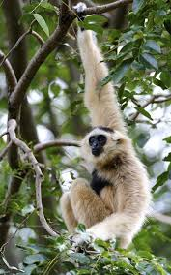
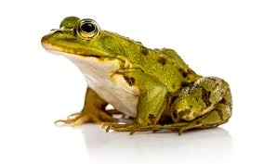
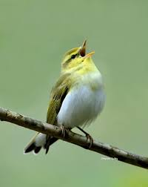
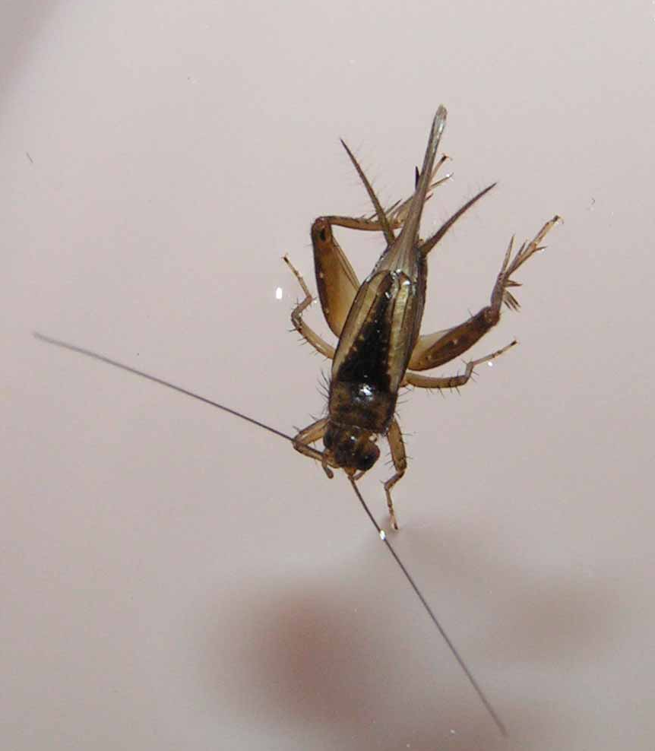
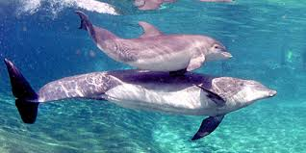
Motivation

Slide 3
Field cricket Pleibeiogryllus guttiventris
42 males captured from a natural population, marked and released
Calls of marked individuals recorded multiple times within and across nights
Nandi & Balakrishnan, Animal Behaviour 2013
Notes:
26 on 2 nights 16 on 3

Slide 4
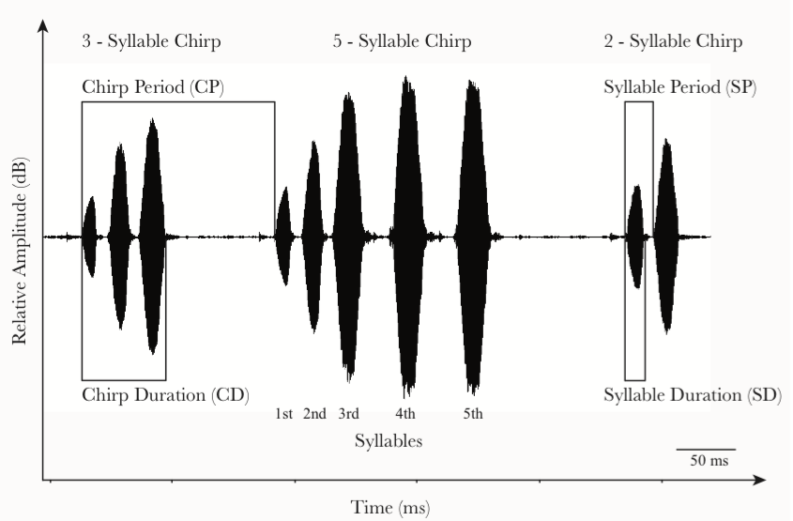
Syllables | 1 | 2 | 3 | 4 | 5 | 6
% | 0.3 | 8 | 9 | 17 | 62 | 4
Notes:
Mean duration 5-syll 150ms, carrier frequency 6kHz

Slide 5
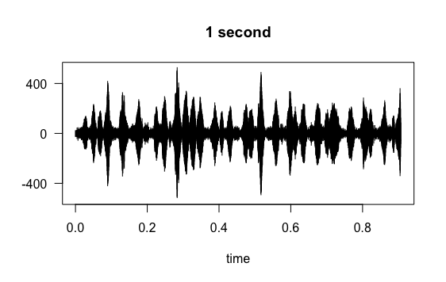
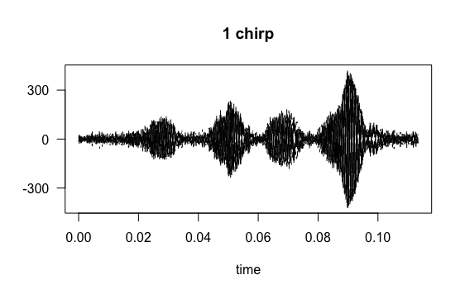
Night 1
Predictive models
Night 2
70% for model training
Night 3
temp | spec | id
t₁ | s₁ | a
t₂ | s₂ | a
t₃ | s₃ | a
Extract
chirps
For each recording
t₄ | s₄ | a
t₅ | s₅ | a
30% for model testing

Slide 6
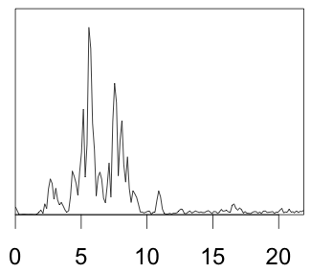
Temporal features
Syllable duration
Syllable gap
Spectral features
F0
Mel-filtered cepstral coeffs
Lee, Chou, Han & Huang (2006)
Frequency (kHz)

Slide 8
Accuracy across all nights
 | Features
 | Temporal | Spectral | Both
LDA | 58 | 70 | 91
Bagging | 81 | 95 | 98
Random Forest | 85 | 98 | 99.4

Slide 9
Accuracy between nights
 |  | Test data
 |  | Night 1 | Night 2
Training data | Night 1 | 100 | 42
 | Night 2 | 51 | 99.5
 | % correct
2-syllable chirps | 99
2/3-syllable chirps | 99
2/3/4-syllable chirps | 99
Equal chirps/cricket (28)
99% correct

Slide 10
Motivation:
Density estimation with passive acoustic arrays
X
X
Same frog?
X
X
X
X

Slide 11
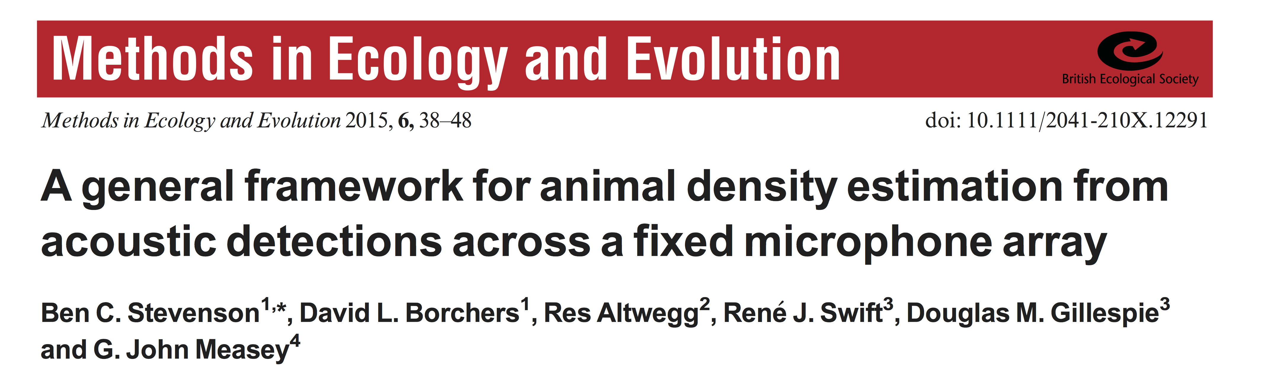
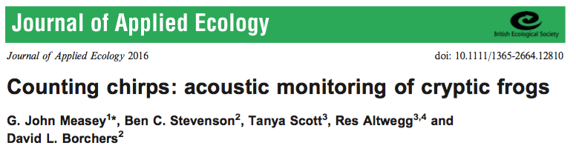
Estimate call density X External estimate of call rate = Density of calling animals

