Slide 1
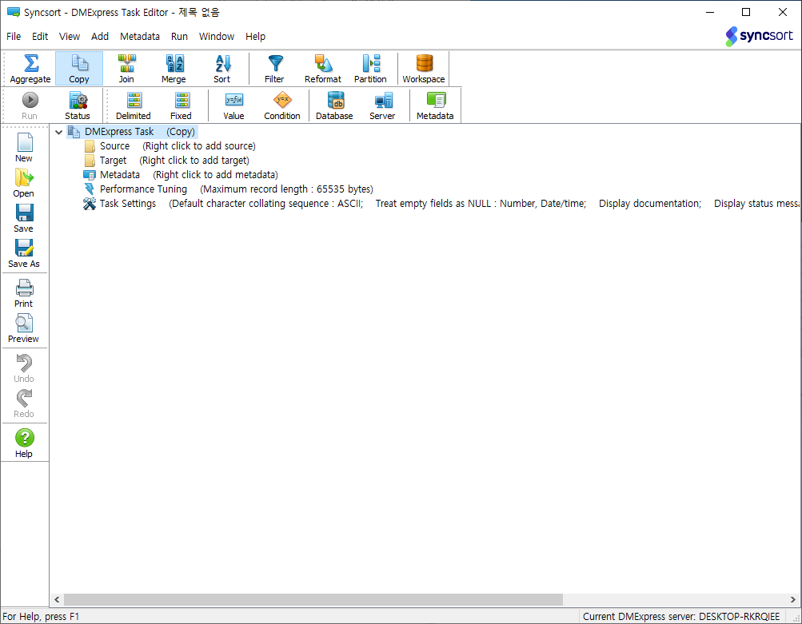
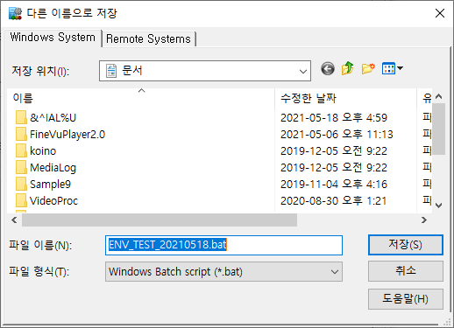
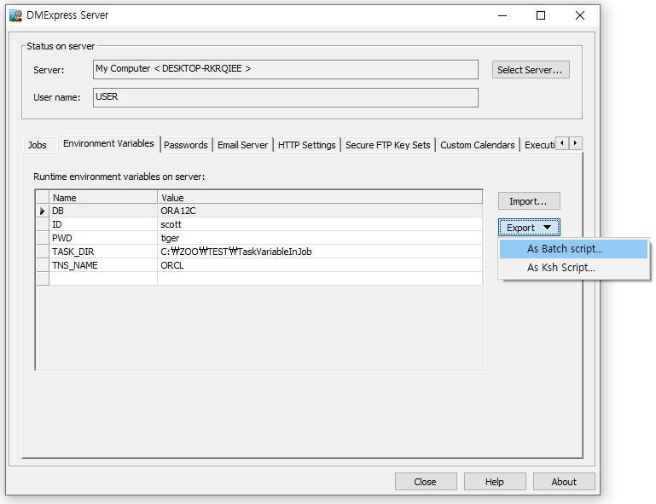
❶
❹
❺
❷
❸
❶❷❸❹❺❻❼❽❾❿

Slide 2
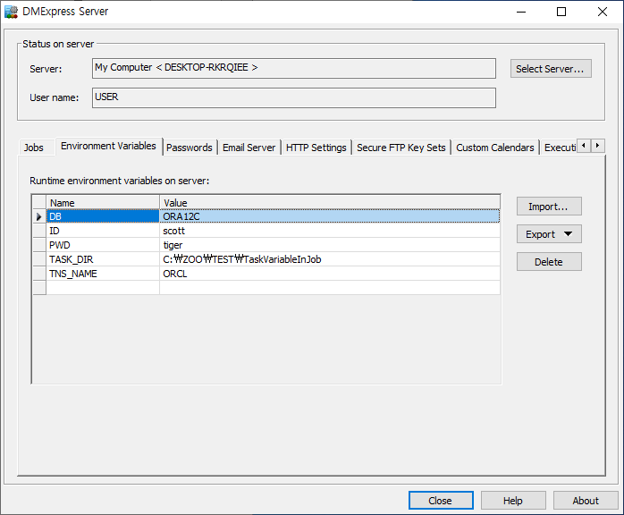
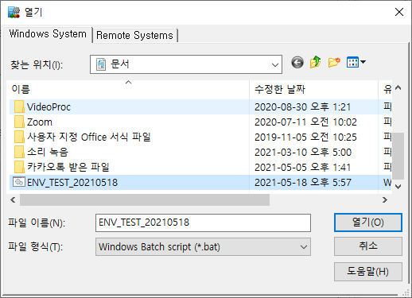
❶
❷
❸
❹
❺

Slide 3
❶❷❸❹❺❻❼❽❾❿

