Slide 1

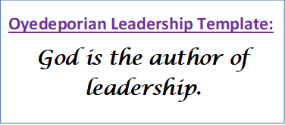
DLD121 Leadership Development: The Force of Character
Dr. Lanre Amodu
Department of Mass Communication

Slide 2

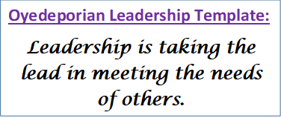
Introduction
“A leader is one who knows the way, goes the way, and shows the way.” – John C. Maxwell
Leadership without character development is a disaster in the waiting. It will happen sooner or later.

Slide 3


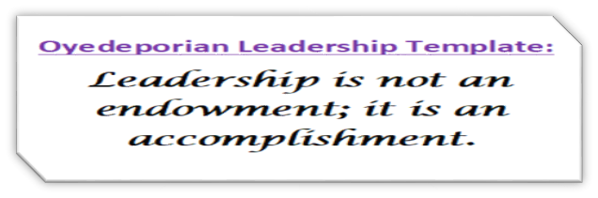
Leadership has two sides- competence and credibility. Character is the capacity that carries the responsibility.
What do you look like under your Leadership position?

Slide 4
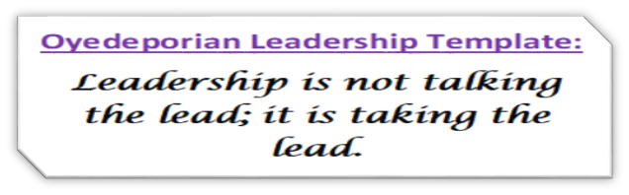
Let’s Meet Some Leaders

Slide 5
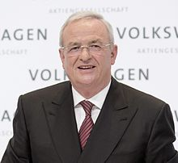
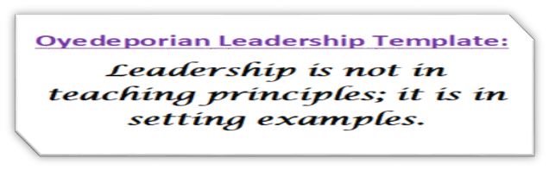
Martin Winterkorn
German former business executive
Chairman, Board of Management, Volkswagen AG & Porsche Automobil Holding SE
Chairman, Supervisory Board, Audi

Slide 6
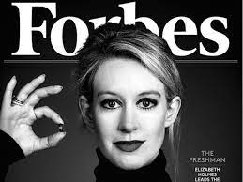
Elizabeth Holmes
American former biotechnology entrepreneur
Chief Executive Officer (CEO) of Theranos
Claimed to have revolutionized blood testing
Holmes was recognized for forming "the most illustrious board in U.S. corporate history" over the next three years.

Slide 7
By the end of 2014, her name appeared on 18 U.S. patents and 66 foreign patents.
By 2015, Forbes had named Holmes the youngest and wealthiest self-made female billionaire in America on the basis of a $9-billion valuation of her company.

Slide 8
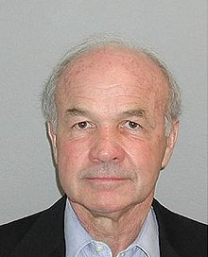
Kenneth Lay
Founder, CEO and Chairman of Enron
Member of the Board of Directors of Eli Lilly and Company (1993-2001)
Director at Texas Commerce Bank
Was mentioned as a possible candidate for United States Secretary of the Treasury under George W. Bush

Slide 9
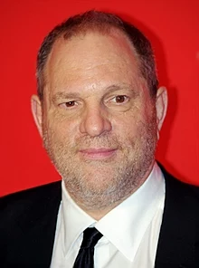
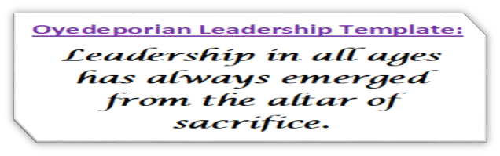
Harvey Weinstein
American former film producer
Co-founded of the entertainment company Miramax
Won an Academy Award for producing Shakespeare in Love
Won seven Tony Awards for plays and musicals, including The Producers, Billy Elliot the Musical, and August: Osage County

Slide 10

^{Matt 12: 33} “A tree is identified by its fruit. If a tree is good, its fruit will be good. If a tree is bad, its fruit will be bad”.
^{John 8: 44 “}For you are the children of your father the devil, and you love to do the evil things he does. He was a murderer from the beginning. He has always hated the truth, because there is no truth in him. When he lies, it is consistent with his character; for he is a liar and the father of lies.”

Slide 11
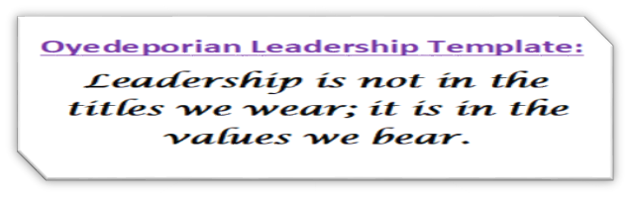
Importance of Character in Leadership Development
Leadership is an amplifier: it magnifies whatever character you are made of. 1 Sam 13:13-14
“That was a foolish thing to do,” Samuel said to Saul. “If you had kept the appointment that our God commanded, by now God would have set a firm and lasting foundation under your kingly rule over Israel.

Slide 12
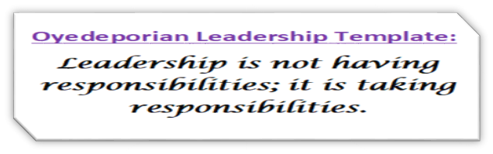
As it is, your kingly rule is already falling to pieces. God is out looking for your replacement right now. This time he’ll do the choosing. When he finds him, he’ll appoint him leader of his people. And all because you didn’t keep your appointment with God!”

Slide 13
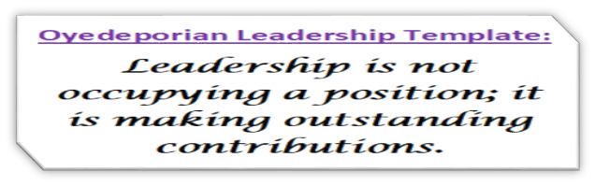
2. Leadership is a revealer: it is no longer about your results but HOW you achieve them. 1 Kings 21:1-2
“… a man named Naboth, from Jezreel, who owned a vineyard in Jezreel beside the palace of King Ahab of Samaria. ² One day Ahab said to Naboth, “Since your vineyard is so convenient to my palace, I would like to buy it to use as a vegetable garden…”

Slide 14
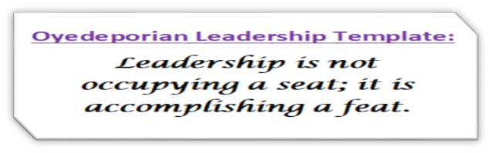
Vs 13-14
Then the two scoundrels came and sat down across from him. And they accused Naboth before all the people, saying, “He cursed God and the king.” So he was dragged outside the town and stoned to death. ¹⁴ The town leaders then sent word to Jezebel, “Naboth has been stoned to death.”

Slide 15
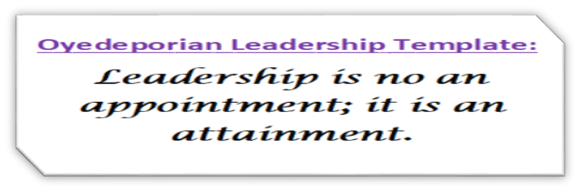
3. Leadership involves people doing as you do: when there is a conflict between what you say and do, people follow your actions. Judges 7: 17-18
“Then he said to them, “Keep your eyes on me. When I come to the edge of the camp, do just as I do. As soon as I and those with me blow the rams’ horns, blow your horns, too, all around the entire camp, and shout, ‘For the Lord and for Gideon!’”

Slide 16
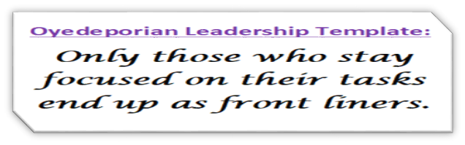
4. Leadership is a journey, watch how you get there: if you were never a good follower, you will never make a good leader. 2 Kings 5: 20-21
“But Gehazi, the servant of Elisha, the man of God, said to himself, “My master should not have let this Aramean get away without accepting any of his gifts. As surely as the Lord lives, I will chase after him and get something from him.” So Gehazi set off after Naaman.”

Slide 17
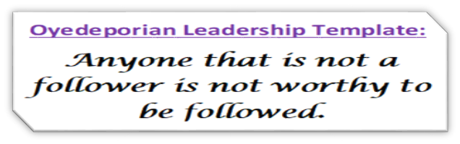
Let’s Meet the Leaders Again

Slide 18
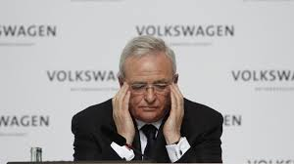
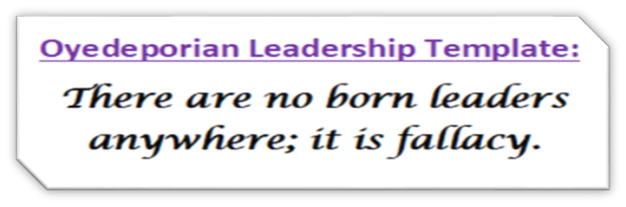
Martin Winterkorn
In September 2015, Winterkorn apologized for Volkswagen AG having installed software in its diesel cars to allow the vehicles to pass emissions tests by decreasing emissions when the vehicle detected it was undergoing testing but otherwise pollute at amounts well beyond legally allowed limits.

Slide 19
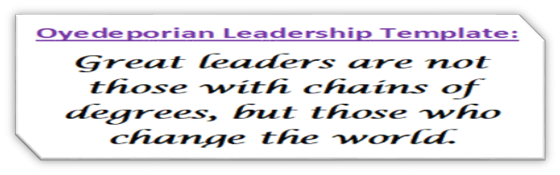
Winterkorn resigned from Volkswagen on 23 September 2015
Charged in a United States indictment with fraud and conspiracy
Charged in Germany of fraud, violating laws prohibiting unfair competition as well as defalcation.

Slide 20
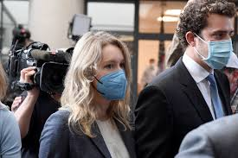
Elizabeth Holmes
Convicted of criminal fraud
Forbes revised its estimate of Holmes's net worth to zero
Fortune named her in its feature article on "The World's 19 Most Disappointing Leaders”
She faced up to 20 years in federal prison

Slide 21
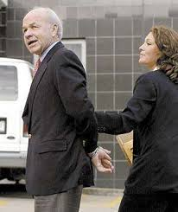
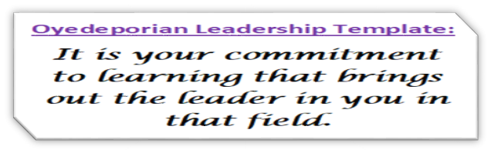
Kenneth Lay
Heavily involved in the Enron scandal, a major accounting scandal
Had the largest bankruptcy ever to that date
Found guilty of 10 counts of securities fraud
Died in 2006, three months before his scheduled sentencing
Ranked in 2009 by Portfolio.com as the third-worst American CEO of all time

Slide 22
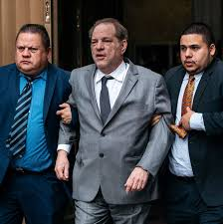
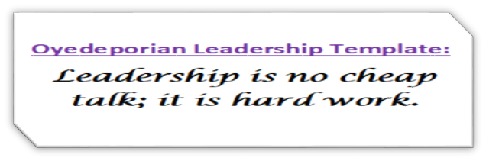
Harvey Weinstein
More than 80 women had made sexual allegations against him
The allegations sparked the #MeToo social media campaign
Was dismissed from his company and expelled from the Academy of Motion Picture Arts and Sciences
Was found guilty of two of five felonies in February 2020 and sentenced to 23 years in prison

Slide 23

Conclusion
A well developed leader is a product of good character. Remember, diligence may make you successful, but character is what makes you worth following. Character keeps you in leadership.

Slide 24

Questions?
Lanre.amodu@covenantuniversity.edu.ng
@lanreamodu
www.olanreamodu.com

