Slide 1
Hardware & Plywood Store Analytics System

Slide 3
SLIDE 1: Title Slide
Hardware & Plywood Store Marketing ROI & Analytics System
Complete Web-Based Analytics Solution
Technology: Flask + MySQL + Machine Learning

Slide 4
SLIDE 2: Project Overview
Business Problem:
Manual inventory tracking
No sales analytics or insights
Unknown marketing ROI
Stock-outs and overstocking issues
Our Solution:
Web-based dashboard with real-time data Interactive charts and visualizations
ML-powered sales predictions Multi-format file upload support

Slide 5
SLIDE 3: Technology Stack
Backend:
Python 3.10 - Core language Flask 3.0 - Web framework MySQL 8.0 - Database pandas - Data processing
scikit-learn - Machine learning
Frontend:
Bootstrap 5.3 - Responsive UI
Chart.js 4.4 - Interactive charts
JavaScript ES6 - Client interactivity

Slide 6
SLIDE 4: Database Structure
5 Main Tables:
users - Login credentials (admin users)
products - Product master list
stock_entries - Daily transaction log
monthly_stock_summary - Aggregated monthly data
marketing_spend - Daily marketing expenses
Features:
Foreign key constraints with CASCADE delete Indexes on join columns for performance
Normalized schema (3NF)
~400 rows of initial data

Slide 7
SLIDE 5: Login Page
How It Works:
User enters username & password
Backend validates against database
Password verified using bcrypt hash
Session created on success
Redirects to dashboard
Security Features:
PBKDF2-SHA256 password hashing SQL injection prevention
Session encryption
Login-required decorator on all pages

Slide 8
SLIDE 6: Dashboard - Product Management
Purpose: Central hub for quick actions
Tab 1 - Products & Overview:
Stock overview table (all products) Add new product form
Delete products (with confirmation) Current stock levels & values

Slide 9
Tab 2 - Navigation Hub:
Links to Stock Log, Monthly History Upload Data, Predictions
Database cleanup (danger zone)
Available months quick list

Slide 10
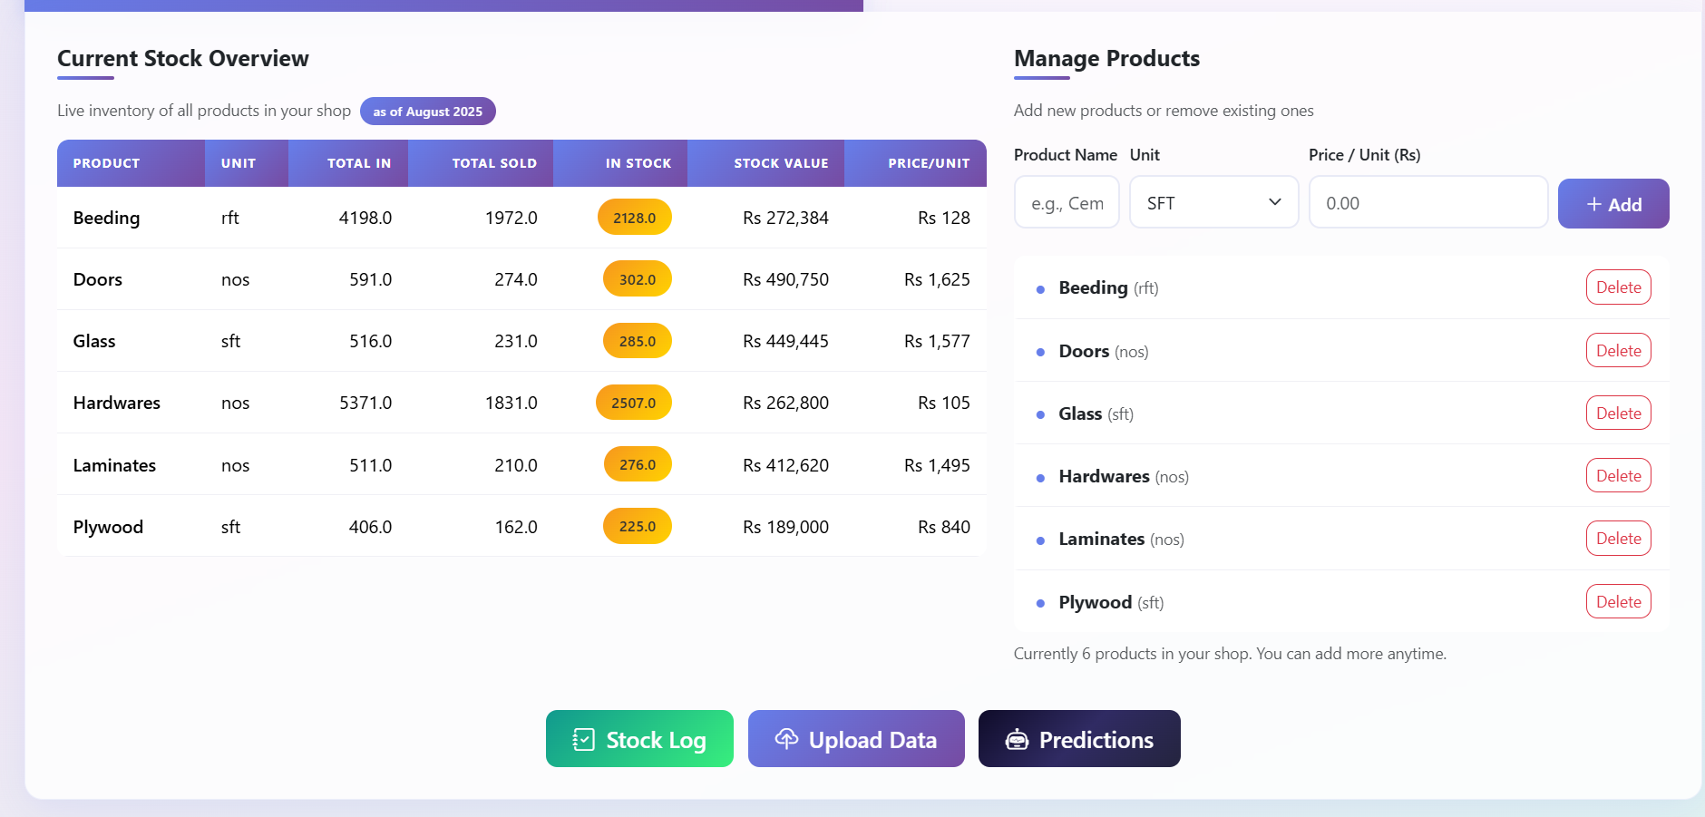

Slide 11
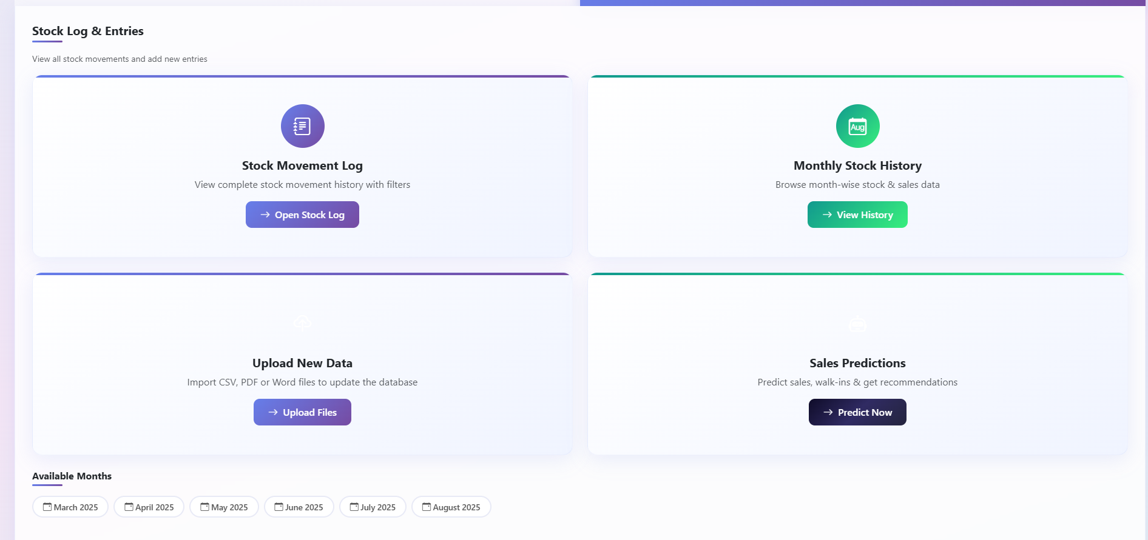

Slide 12
SLIDE 7: Stock Movement Log
Purpose: Track every inventory transaction
Key Features:
Triple filter: Product, Month, Year
Scrollable table with all transactions Bulk delete: Select multiple entries Add entry form: Quick data entry
How It Works:
Results displayed in sortable table
Checkbox selection for bulk operations Real-time updates after changes

Slide 13
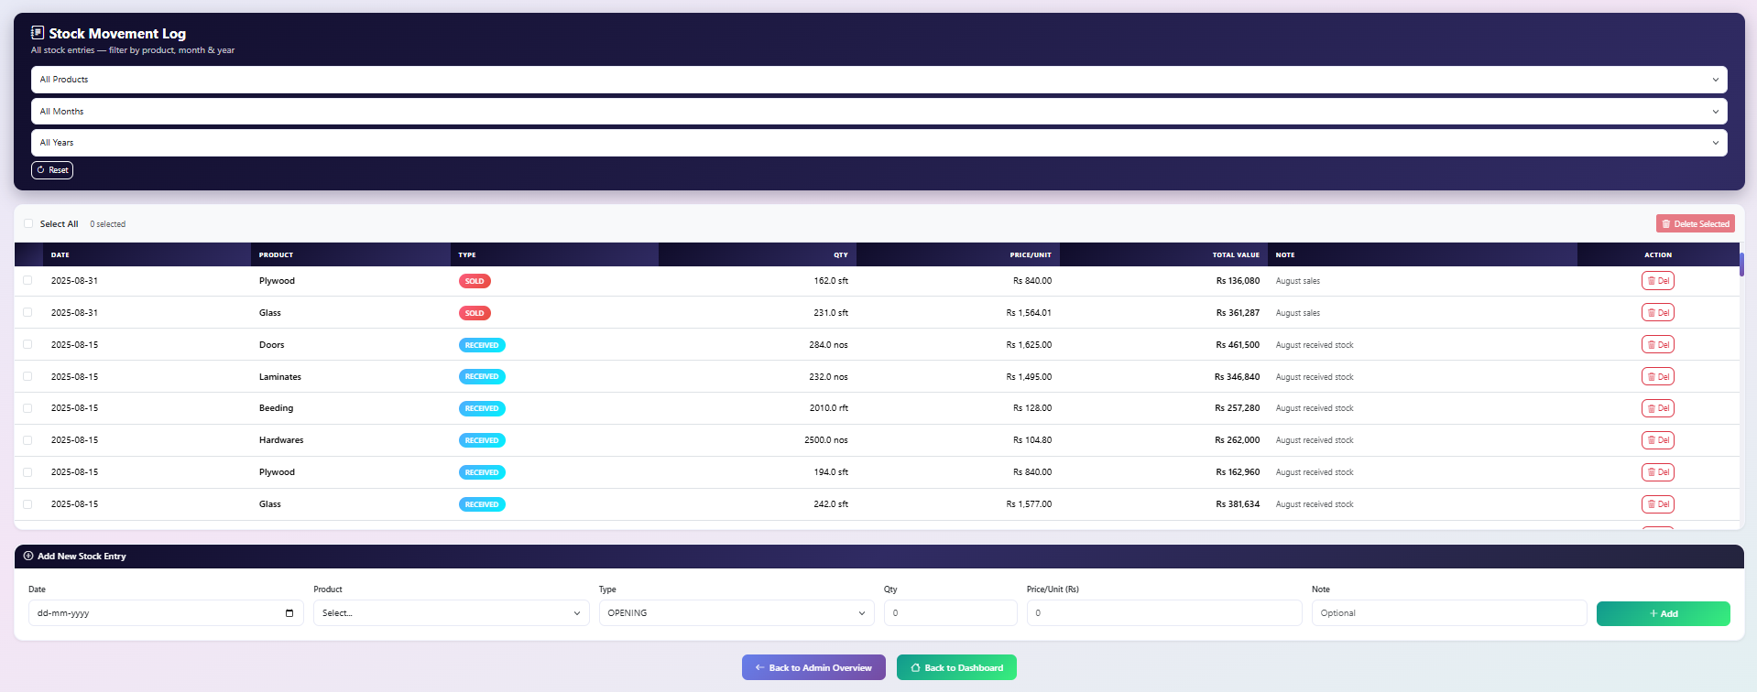

Slide 14
SLIDE 8: Monthly History - Analytics Dashboard
Purpose: Visual insights into sales performance
Features:
Month/Year selector dropdown
3 Key Insights Cards:
Top product by sales value
Lowest product by sales value Most quantity sold

Slide 15
5 Interactive Charts:
Horizontal Bar - Monthly sales by product
Doughnut Chart - Sold quantity distribution
Grouped Bar - Stock flow (Opening/Received/Sold/Closing)
Pie Chart - Marketing channel allocation
Line Chart - Month-on-month sales trend

Slide 16
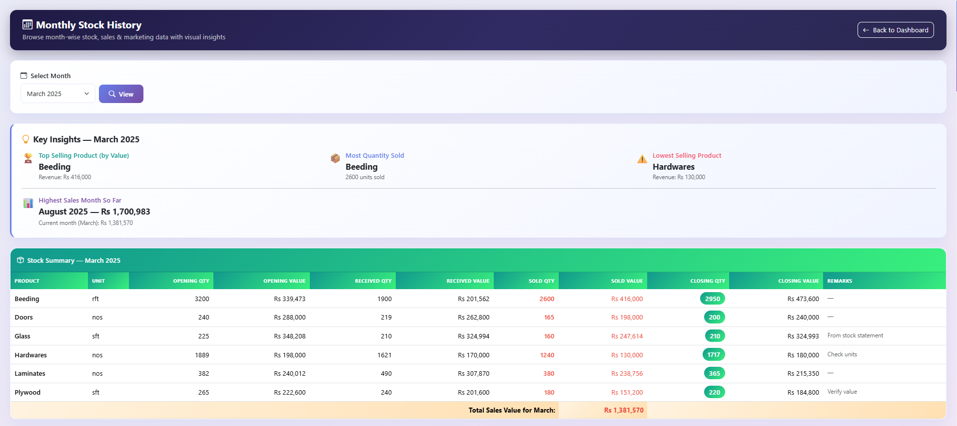

Slide 17
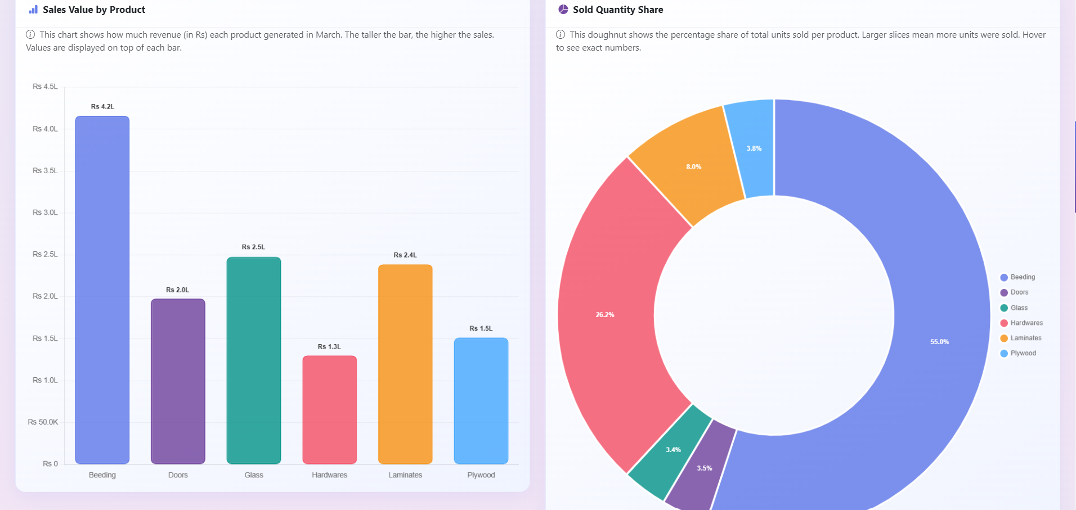

Slide 18
SLIDE 9: How Charts Work
Backend Process (Python/Flask):
Query database for selected month
Aggregate sales, quantities, marketing data
Convert to JSON format
Pass to HTML template
Frontend Rendering (Chart.js):
Parse JSON data in JavaScript
Create Chart.js configuration objects
Apply colors, gradients, animations
Add Data Labels plugin for values
Render interactive charts with tooltips

Slide 19
SLIDE 10: Upload Data Page
Purpose: Import data from multiple file formats
Two Upload Forms:
Stock Data Uploader:
File input + Year input
Formats: CSV, Excel, PDF, Word
Expected columns: Month, Item, Opening/Received/Sold/Closing quantities
Marketing Data Uploader:
File input only
Formats: CSV, Excel, PDF, Word
Expected columns: Date, Marketing spends, Walk-ins, Sales

Slide 20
How It Works:
File uploaded → Parsed (pandas/PyPDF2) →Validated → Inserted to database → Success message

Slide 21
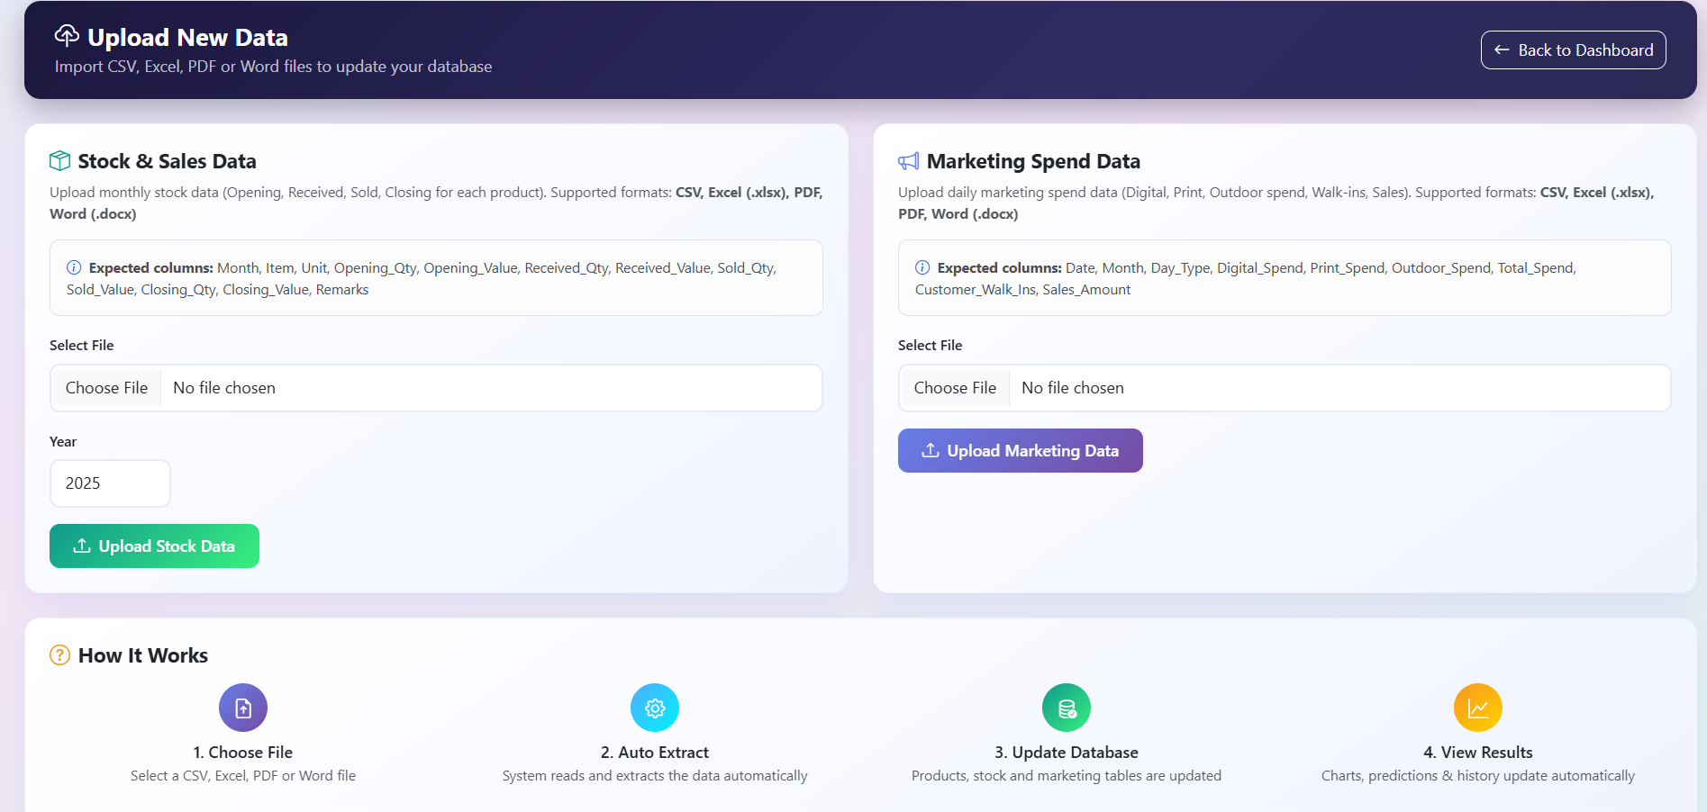

Slide 22
SLIDE 11: Sales Predictions (ML Page)
Purpose: Predict future sales using Machine Learning
Input Form:
Digital Spend (Rs) Print Spend (Rs)
Outdoor Spend (Rs)
Prediction Results (4 cards):
Total Budget - Sum of all channels
Predicted Sales - ML model output
Expected Walk-Ins - Predicted footfall
Expected ROI - Sales / Budget ratio

Slide 23
Additional Insights:
Budget allocation pie chart
Predicted vs historical bar chart Stock recommendations table Smart recommendations panel

Slide 24
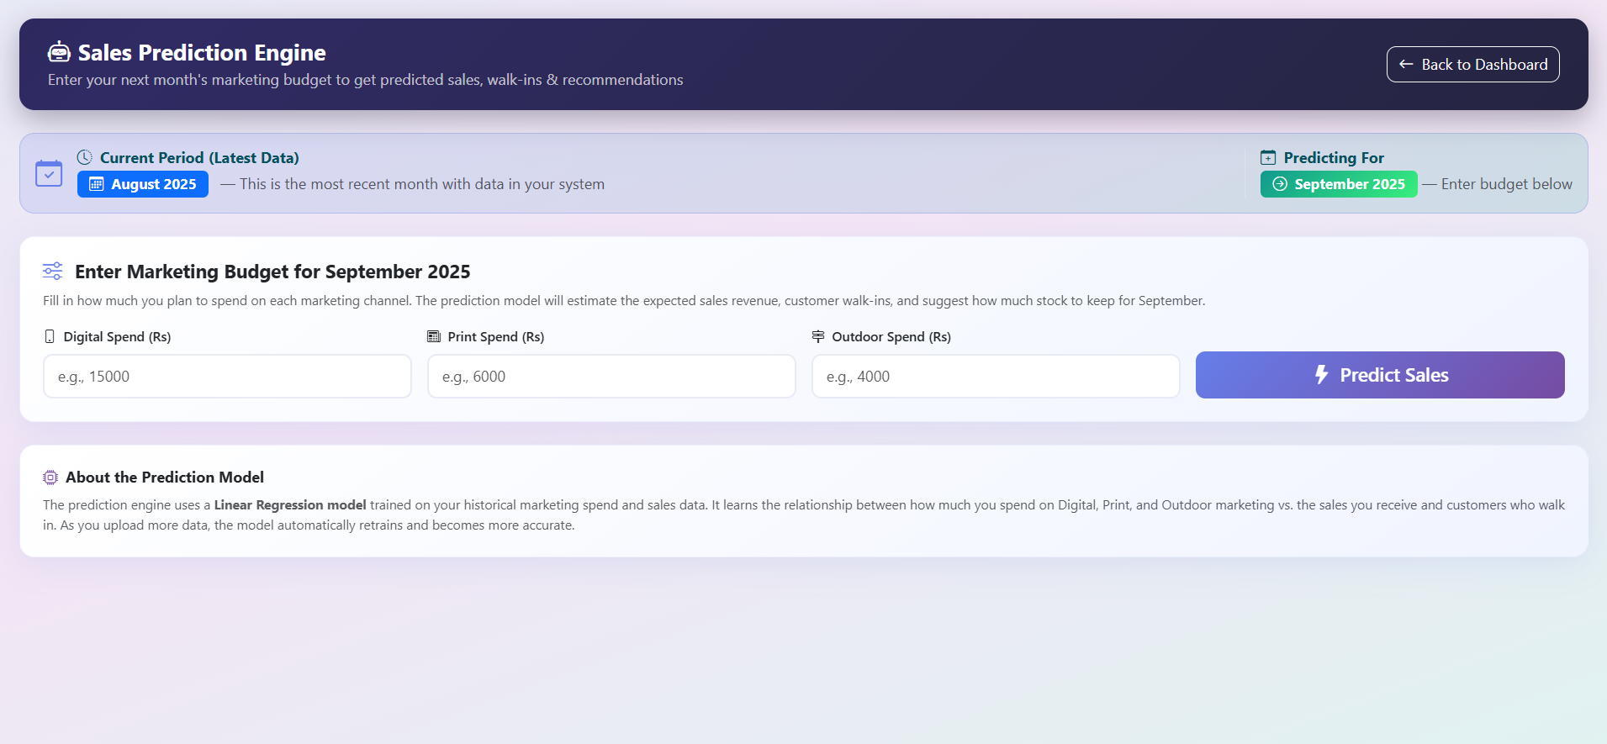

Slide 25
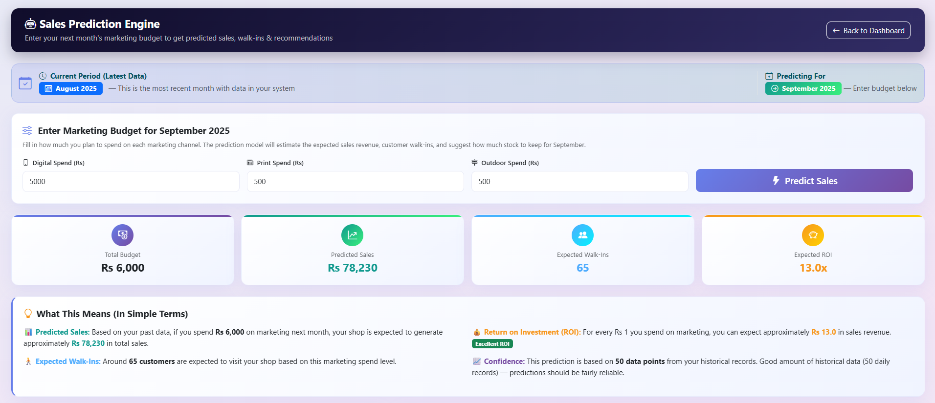

Slide 26
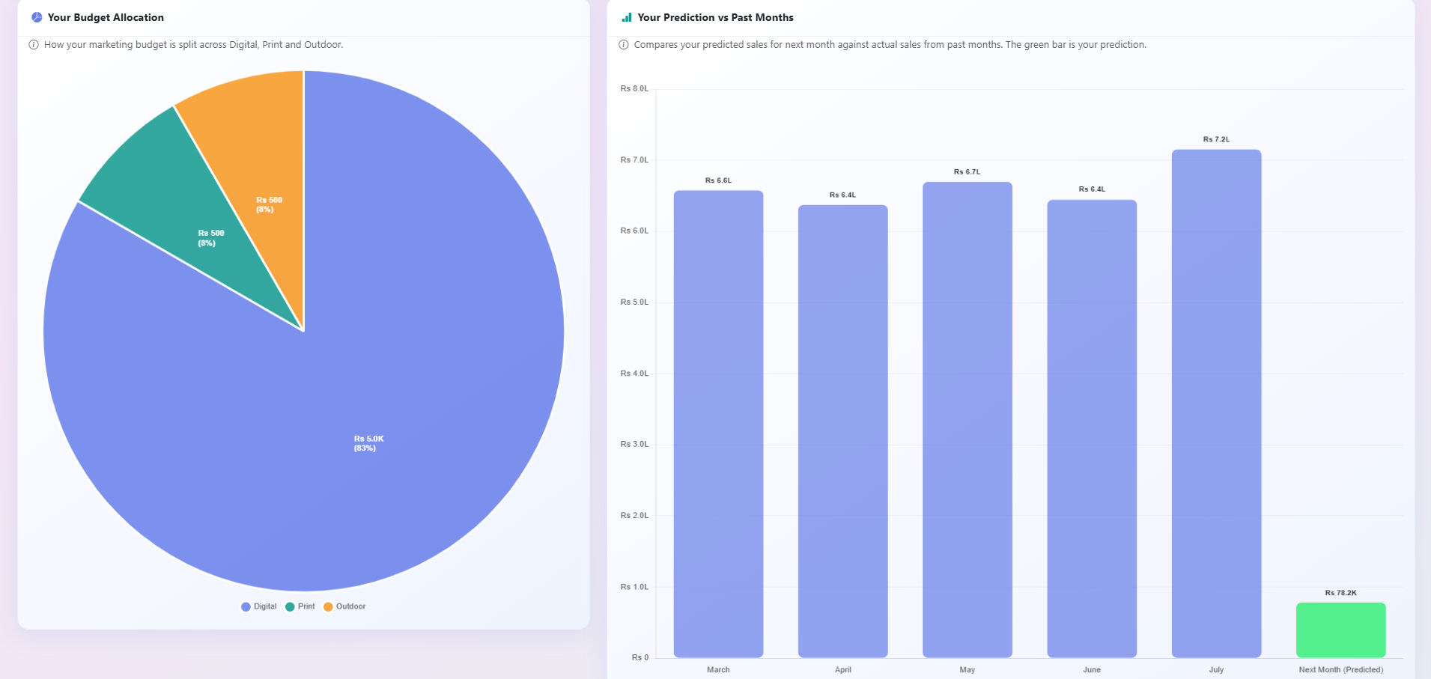

Slide 27
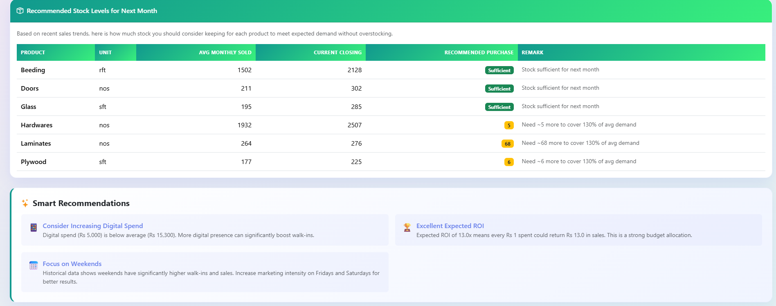

Slide 28
SLIDE 12: Machine Learning Model
Linear Regression:
How It Works:
Collect historical marketing spend & sales data
Create feature matrix X: [digital, print, outdoor]
Create target vector y: [sales]
4. Train model:
model.fit(X, y)
5. Predict:
Equation:
predicted_sales = model.predict(new_budget)
Sales = Base + (β₁ × Digital) + (β₂ × Print) + (β₃ × Outdoor)

Slide 29

Why Linear Regression?
Simple and interpretable Fast training (milliseconds)
Works with small datasets (10-15 months) Reliable predictions (±15% accuracy)

Slide 30
SLIDE 13: Complete Project Workflow
Data Flow:
CSV Files → import_data.py → MySQL Database
↓
User Login → Session Created → Dashboard
↓
User Actions → Flask Routes → SQL Queries
↓
Database Results → Processing → JSON Data
↓
Chart.js → Renders → Visual Analytics
↓
ML Model → Predicts → Recommendations

Slide 31
Key Technologies at Each Step:
pandas for file parsing MySQL for data storage Flask for routing & logic Chart.js for visualization
scikit-learn for predictions

Slide 32
SLIDE 14: Results & Impact
Time Savings:
Stock counting: 30 min → 5 min daily (25 min saved) Monthly reports: 8 hours → 5 minutes
Total: 22.5 hours saved per month
Cost Savings:
Labor cost: Rs 4,500/month
Reduced stockouts: Rs 15,000/month Reduced overstock: Rs 20,000/month Total benefit: Rs 39,500/month

Slide 33
Qualitative Benefits:
Data-driven decisions Inventory optimization
Better marketing ROI (15% improvement) Complete audit trail
Scalable system

Slide 34
SLIDE 15: Conclusion & Next Steps
What We Delivered:
6-page web application 19 Flask routes
-5 database tables
ML prediction model
Complete documentation
Success Criteria Met:
Secure authentication
Fast performance (<2 sec) Accurate predictions
User-friendly interface

