Slide 1


Automotive Data Pipeline
Data Engineer - Assessment
Diogo Gomes
Notes:
“Hi everyone, I’m Diogo Gomes, and this is the solution I built for the Bosch Data Engineer assessment. The idea was to design an end-to-end automotive data pipeline using only public datasets, and take it all the way from raw files to analytics-ready tables. I’ll walk you through the architecture, the main design decisions, and some of the insights we can actually extract from the data.”

Slide 2

Contents
1
Introduction
2
Architecture & Data Acquisition
3
Data Processing & Transformation
4
Loading Strategy & Automation
5
Results, Validation & Data Quality
6
Conclusion & Next Steps
Notes:
“Here’s the structure I’ll follow. First, a quick introduction and objectives. Then architecture, data acquisition, and processing. After that, integration, loading and automation. And finally, the main results, challenges, and a short conclusion.”

Slide 3

Introduction
The automotive industry increasingly relies on data to monitor safety, performance and infrastructure trends
This assessment focuses on building an end-to-end pipeline for publicly available datasets
The goal is to automate acquisition, cleaning, transformation and simulate loading of vehicle-related datasets
The pipeline supports analysis of safety complaints, fuel economy and alternative fuel infrastructure
Notes:
“The automotive industry is increasingly data-driven – whether it’s monitoring safety, fuel efficiency or how prepared infrastructure is for new fuels. For this assessment I focused on building a realistic pipeline for public automotive data, instead of just doing a one-off analysis. The goal was to automate acquisition, cleaning and transformation of several datasets, and simulate how those outputs would land in an analytics environment. With that in place, we can analyse safety complaints, fuel economy and alternative fuel infrastructure in a consistent way.”

Slide 4

Objectives
Build an end-to-end pipeline to ingest, clean, transform
Prepare the data for downstream analysis and insights
Simulate loading the final datasets into a target storage system (Azure Delta Lake)
Document Key Decisions made during processing and transformation
Propose an automation strategy with a suitable schedule
Notes:
“I organised the work around five main objectives.
First, to build an end-to-end pipeline: ingest, clean and transform data from multiple public sources. Second, to shape the data for analysis, so the final outputs are actually useful for answering business questions. Third, to simulate loading these outputs into a target like Azure Delta Lake, so it’s closer to a real production setup. Fourth, to document the key data decisions – filters, joins, assumptions – so that someone else can understand and maintain the pipeline. And finally, to propose an automation strategy, with a schedule that can refresh the data regularly without manual steps.”

Slide 5









Architecture & Data Flow
Data Acquistion: NHTSA, DOE and EPA Datasets
Data Processing: Cleaning, normalize and schema alignment
Data Transformation:
Aggregation, joining and feature creation
Load Simulation & Automation Layer:
Loading simulation into Azure Delta Lake structure & a simple simulated weekly orchestration
Notes:
“This is the high-level architecture. On the left, data acquisition from EPA, NHTSA and DOE into a raw layer. Then a processing layer, where each dataset is cleaned and normalised. On top, transformation and integration, where I aggregate, join and build analytical features. Finally, a loading and automation layer, where I simulate loading into Delta tables and orchestrate everything as a weekly pipeline.”

Slide 6
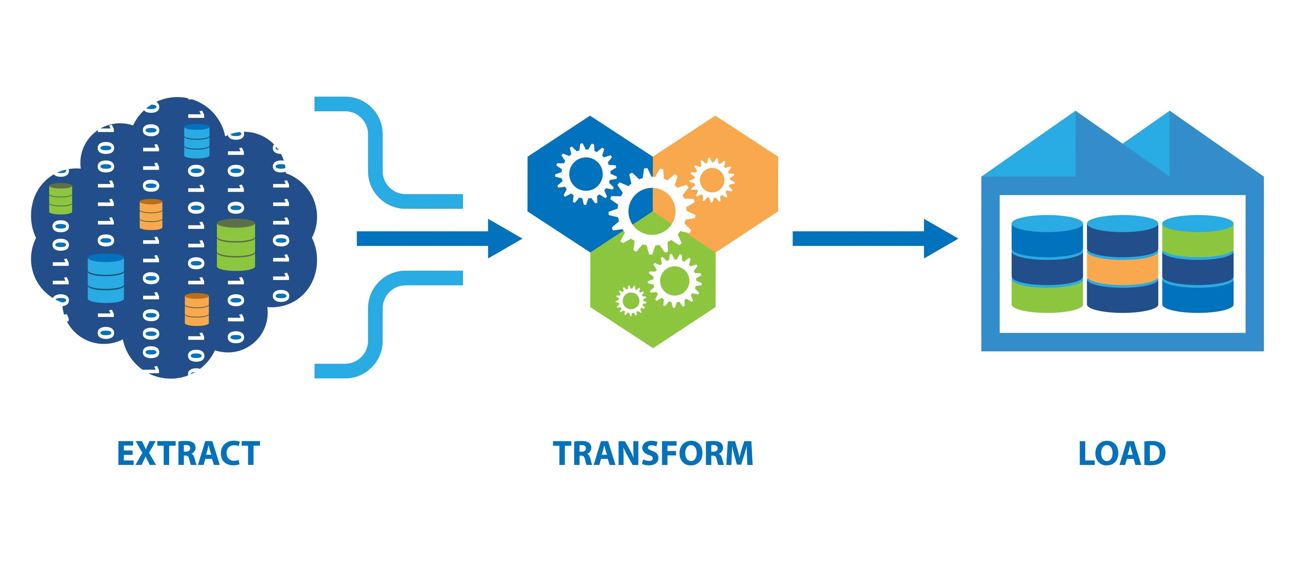
Data Sources
Source | Format | Key Fields
NHTSA Complaints | TSV (bulk) | Make, Model, Year, Component, Crash, Fire, Injured, Deaths, Complaint ID
DOE Alt Fuel Stations | API JSON→CSV | Fuel_Type_Code, Station_Name, State, Latitude, Longitude, Status
EPA Fuel Economy | CSV (bulk) | Make, Model, Year, Fuel Type, MPG, CO2, Cylinders, Transmission
Notes:
“I worked with three main public datasets.
• First, EPA vehicle fuel economy – that gives me fuel efficiency and technical specs for vehicles: MPG, CO₂ emissions, engine size, vehicle class, and so on. • Second, NHTSA vehicle complaints – real-world safety and reliability complaints reported by drivers, including information on crashes, fires, injuries and deaths. • Third, DOE/NREL alternative fuel stations – that describes the fuel infrastructure: which stations exist, where they are, and what fuels they support.
Combining these three lets me analyse fuel efficiency, reliability and infrastructure in one coherent view.”

Slide 7
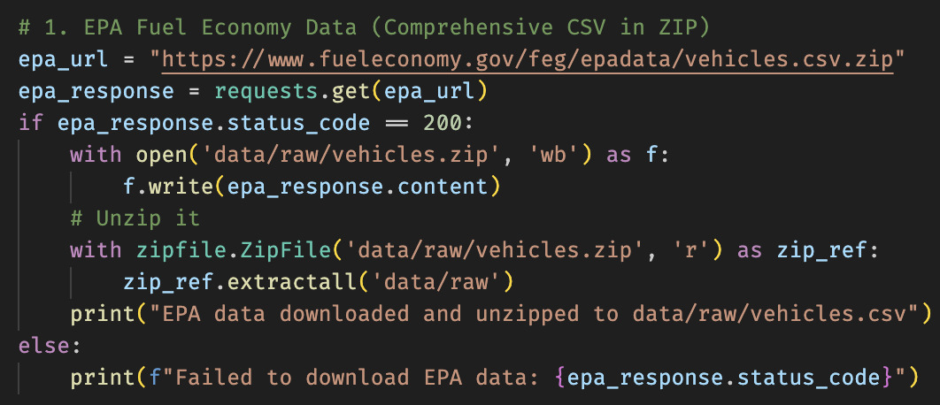
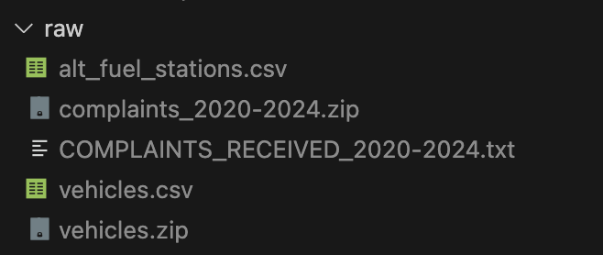
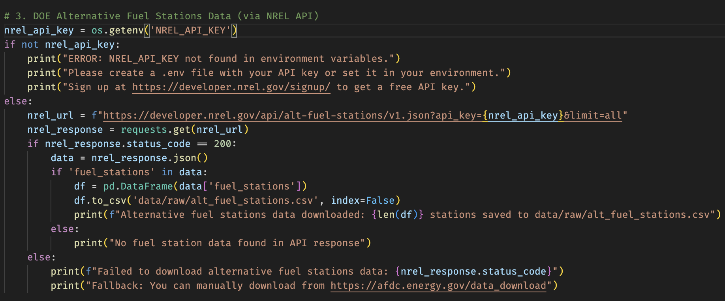
Data Acquisition – Extract Phase
Single Acquisition Script
acquire_data.py downloads all three sources into data/raw
EPA – Fuel Economy (vehicles)
Download ZIP from fueleconomy.gov
Save as data/raw/vehicles.zip and unzip to data/raw
NHTSA – Vehicles Complaints (2020-2024)
Download ZIP from nhtsa.gov
Save as data/raw/complaints_2020-2024.zip and unzip to data/raw
DOE – Alternative Fuel Stations (NREL API)
Read NREL_API_KEY from .env using python-dotenv
Call NREL API (alt-fuel-stations/v1.json?limit=all)
Convert JSON → pandas.DataFrame → data/raw/alt_fuel_stations.csv
Notes:
“All acquisition is done by one script, acquire_data.py, which populates the data/raw folder.
• For EPA, I download the official vehicles ZIP, store it in data/raw and unzip it to vehicles.csv. • For NHTSA, I download the complaints ZIP for 2020–2024 and extract the large tab-separated text file. • For DOE, I call the NREL API using an API key from .env, pull all stations, convert the JSON to a DataFrame, and save alt_fuel_stations.csv.
That gives me a reproducible raw layer I can rebuild from scratch.”

Slide 8
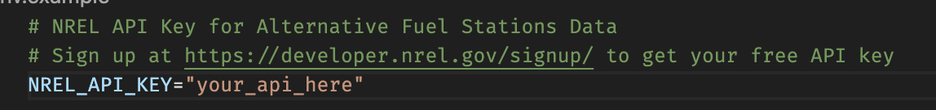
Data Acquisition – Extract Phase
DOE – Alternative Fuel Stations (NREL API)
Read NREL_API_KEY from .env using python-dotenv
Call NREL API (alt-fuel-stations/v1.json?limit=all)
Convert JSON → pandas.DataFrame → data/raw/alt_fuel_stations.csv
Notes:
“For the DOE data specifically, the acquisition is done via the NREL ‘alt-fuel-stations’ API. I inject the API key via .env, call the endpoint with limit=all to avoid pagination complexity, and load the JSON into a DataFrame. That DataFrame is then stored as data/raw/alt_fuel_stations.csv, so from this point on all sources behave like regular CSVs in the pipeline. In a real environment I’d also keep a fallback to a static CSV export for resilience if the API is temporarily down.”

Slide 9
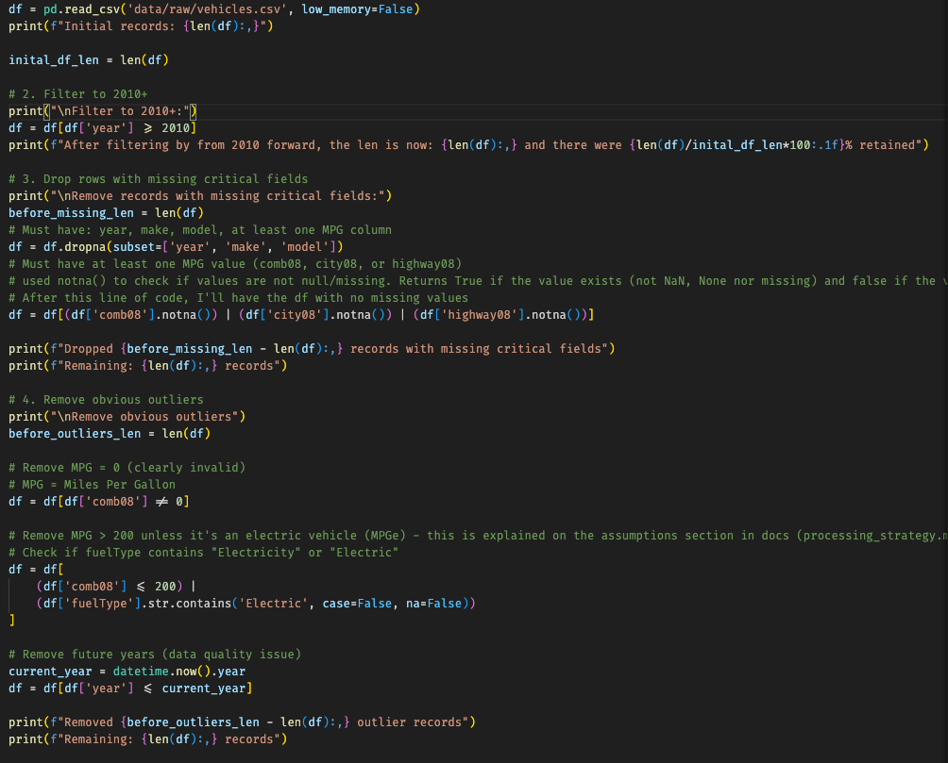
Data Processing – Cleaning & Preparation
EPA Vehicles – Processing & Dual-Fuel Handling
Initial filtering & basic cleaning
Load vehicles.csv, keep model years ≥ 2010
Drop rows missing year, make, or model
Require at least one MPG value (comb08 / city08 / highway08)
Outlier & quality filters
Remove comb08 = 0 (invalid MPG)
Cap comb08 at ≤ 200, except for electric / “Electricity” entries
Remove vehicles from future years (greater than current year)
Column reduction & renaming
Reduce from 84 columns to a focused subset (year, make, model, class, engine, MPG, CO₂, etc.)
Keep fuelType1 and fuelType2 for dual-fuel handling
Rename to primary_fuel and secondary_fuel
Notes:
“On the EPA side, the initial cleaning focuses on keeping the data recent and valid. I load vehicles.csv, filter to model years from 2010 onwards so we’re not mixing very old vehicles with newer ones, and drop rows missing key fields like year, make or model. I require at least one MPG value to be present, and I remove vehicles where combined MPG is zero, which is clearly invalid. Extremely high MPG values are capped at a reasonable upper bound, except for electric vehicles which behave differently. Finally, I slim the dataset down from more than 80 columns to a focused subset: year, make, model, vehicle class, engine, MPG metrics, CO₂ and the fuel type fields. That gives a solid base for the more interesting step: handling dual-fuel vehicles.”

Slide 10
Data Processing – Shared Cleaning Principles
Data quality goals:
Make each dataset consistent, recent and reliable for analysis
Ensure key fields are present (IDs, year/make/model, coordinates, dates)
Core cleaning rules:
Drop rows missing critical identifiers or dates
Normalise text fields (trim, uppercase, consistent naming)
Parse numeric fields and dates into proper types
Outlier and scope filters:
Remove obviously invalid values (e.g. MPG (Miles Per Gallon) = 0, negative mileage, (0,0) coordinates)
Restrict to realistic, recent model years to keep the analysis current (2010+ for example in EPA)
Column reduction for analytics:
Reduce wide raw schemas to focused column sets per source
Standardise column names across datasets (e.g. primary_fuel / secondary_fuel) to simplify joins later
Notes:
“Across all datasets I followed the same basic cleaning principles.
• Ensure key fields are present – IDs, dates, year/make/model or coordinates, depending on the dataset. • Drop rows missing those critical fields. • Normalise text – trimming and uppercasing, especially for make and model. • Parse dates and numeric fields into proper types. • Remove obviously invalid values like MPG = 0, negative mileage or (0,0) coordinates, and restrict to realistic, recent years. • And finally, reduce each raw schema to a focused set of columns needed for integration and analysis.”

Slide 11
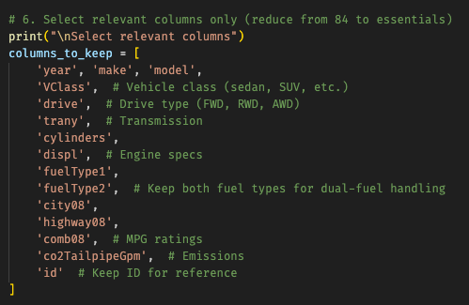
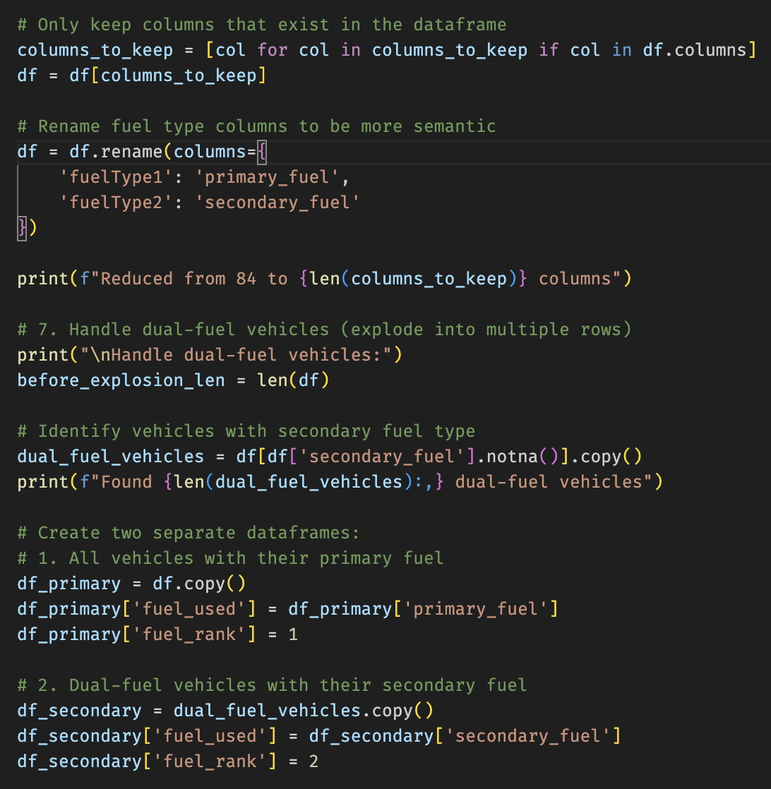
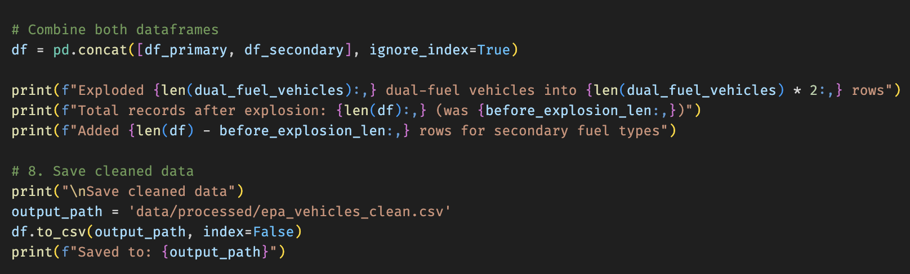
Data Processing – Cleaning & Preparation
EPA Vehicles – Processing & Dual-Fuel Handling (Biggest Decision)
Dual-fuel explosion
Identify vehicles with secondary_fuel not null
Build:
df_primary: fuel_used = primary_fuel, fuel_rank = 1
df_secondary: fuel_used = secondary_fuel, fuel_rank = 2
Concatenate into final dataset: rows represent vehicle–fuel combinations
Save to data/processed/epa_vehicles_clean.csv
Notes:
“The most important processing decision was how to handle dual-fuel vehicles in the EPA data.
Many vehicles, especially plug-in hybrids, have both a primary and a secondary fuel – for example, electricity and gasoline. If we treat them as a single row with two fuels attached, it becomes very hard to correctly relate them to infrastructure later.
So what I do is: – identify vehicles where secondary_fuel is not null; – build one DataFrame where fuel_used is the primary fuel and fuel_rank is 1; – and another where fuel_used is the secondary fuel and fuel_rank is 2.
Then I concatenate both, so the final EPA dataset has one row per vehicle–fuel combination. This lets me later analyse EV demand separately from gasoline, and cleanly join with the DOE stations by fuel type. That processed dataset is saved as epa_vehicles_clean.csv.”

Slide 12
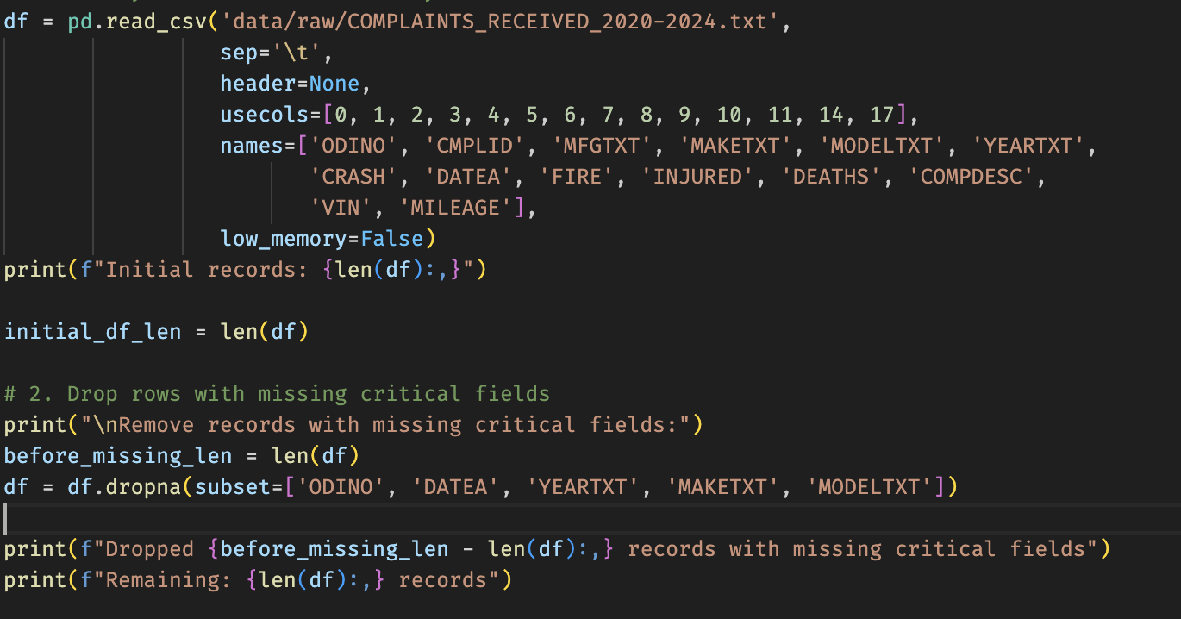
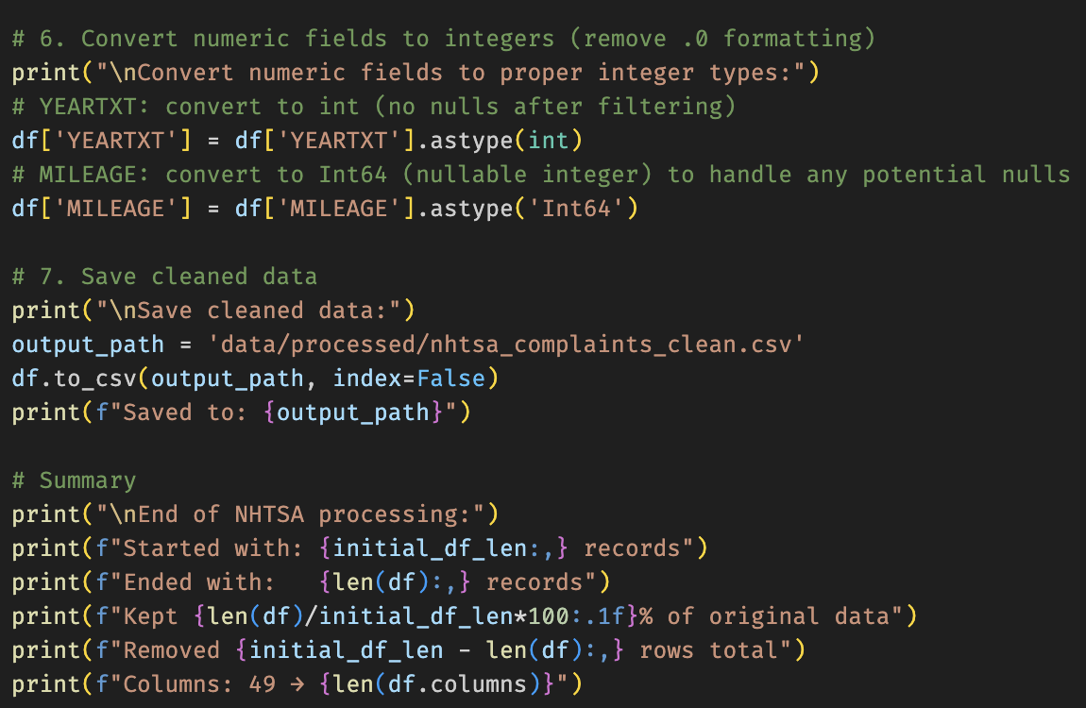
Data Processing – Cleaning & Preparation
NHTSA Complaints – Processing & Cleaning
Raw file characteristics
Flat text file (.txt) with no header row
Tab-separated (\t)
Columns selected by position and renamed:
ODINO, CMPLID, MFGTXT, MAKETXT, MODELTXT, YEARTXT, CRASH, DATEA, FIRE, INJURED, DEATHS, COMPDESC, VIN, MILEAGE
Critical filters & basic cleaning
Drop rows missing: ODINO, DATEA, YEARTXT, MAKETXT, MODELTXT
Parse DATEA (YYYYMMDD → datetime)
Convert YEARTXT to numeric
Outlier & quality rules
Remove future dates and future vehicle years
Cap MILEAGE at ≤ 1,000,000 miles (data entry error filter)
Deduplication & final formatting
Drop exact duplicates on ODINO
Convert DATEA back to YYYY-MM-DD string
Cast YEARTXT to int and MILEAGE to nullable Int64
Save as data/processed/nhtsa_complaints_clean.csv
Notes:
“The raw NHTSA complaints file is a fairly messy flat text file: tab-separated and without a header row. I start by selecting columns by position and renaming them to meaningful names like complaint ID, make, model, year, crash flag, fire flag, injuries, deaths, complaint description, VIN and mileage.
I drop rows missing a complaint ID, a date, a year, or basic make/model information, then parse the DATEA field from YYYYMMDD into a proper datetime. I convert YEARTXT to numeric and cast mileage to a numeric type as well.
For quality, I remove any complaints with dates or vehicle years in the future, and I cap mileage at a very high but reasonable threshold to catch obvious data entry errors. I then deduplicate by complaint ID, normalise the date back to YYYY-MM-DD, cast types properly and save the result as nhtsa_complaints_clean.csv.”

Slide 13
Data Processing – Cleaning & Preparation
NHTSA Complaints – Processing & Cleaning
Raw file
Tab-separated text file without header
Selected key columns: IDs, make/model/year, crash flags, injuries/deaths, complaint text, mileage
Core cleaning
Dropped rows missing IDs, dates, or make/model/year
Parsed dates and converted years/mileage to numeric types
Quality checks
Removed future dates/years and capped unrealistic mileage values
De-duplicated by complaint ID and saved as nhtsa_complaints_clean.csv
Notes:
“In simpler terms, the NHTSA cleaning does three main things.
• It turns a messy tab-separated text file into a structured table with IDs, make/model/year, crash flags, injuries, deaths, complaint text and mileage. • It enforces basic validity: no missing IDs, no missing dates or vehicle information, and no future dates or years. • It normalises dates and numeric types, caps unrealistic mileage, and removes duplicate complaints.
That gives me a reliable view of real-world safety and reliability issues.”

Slide 14
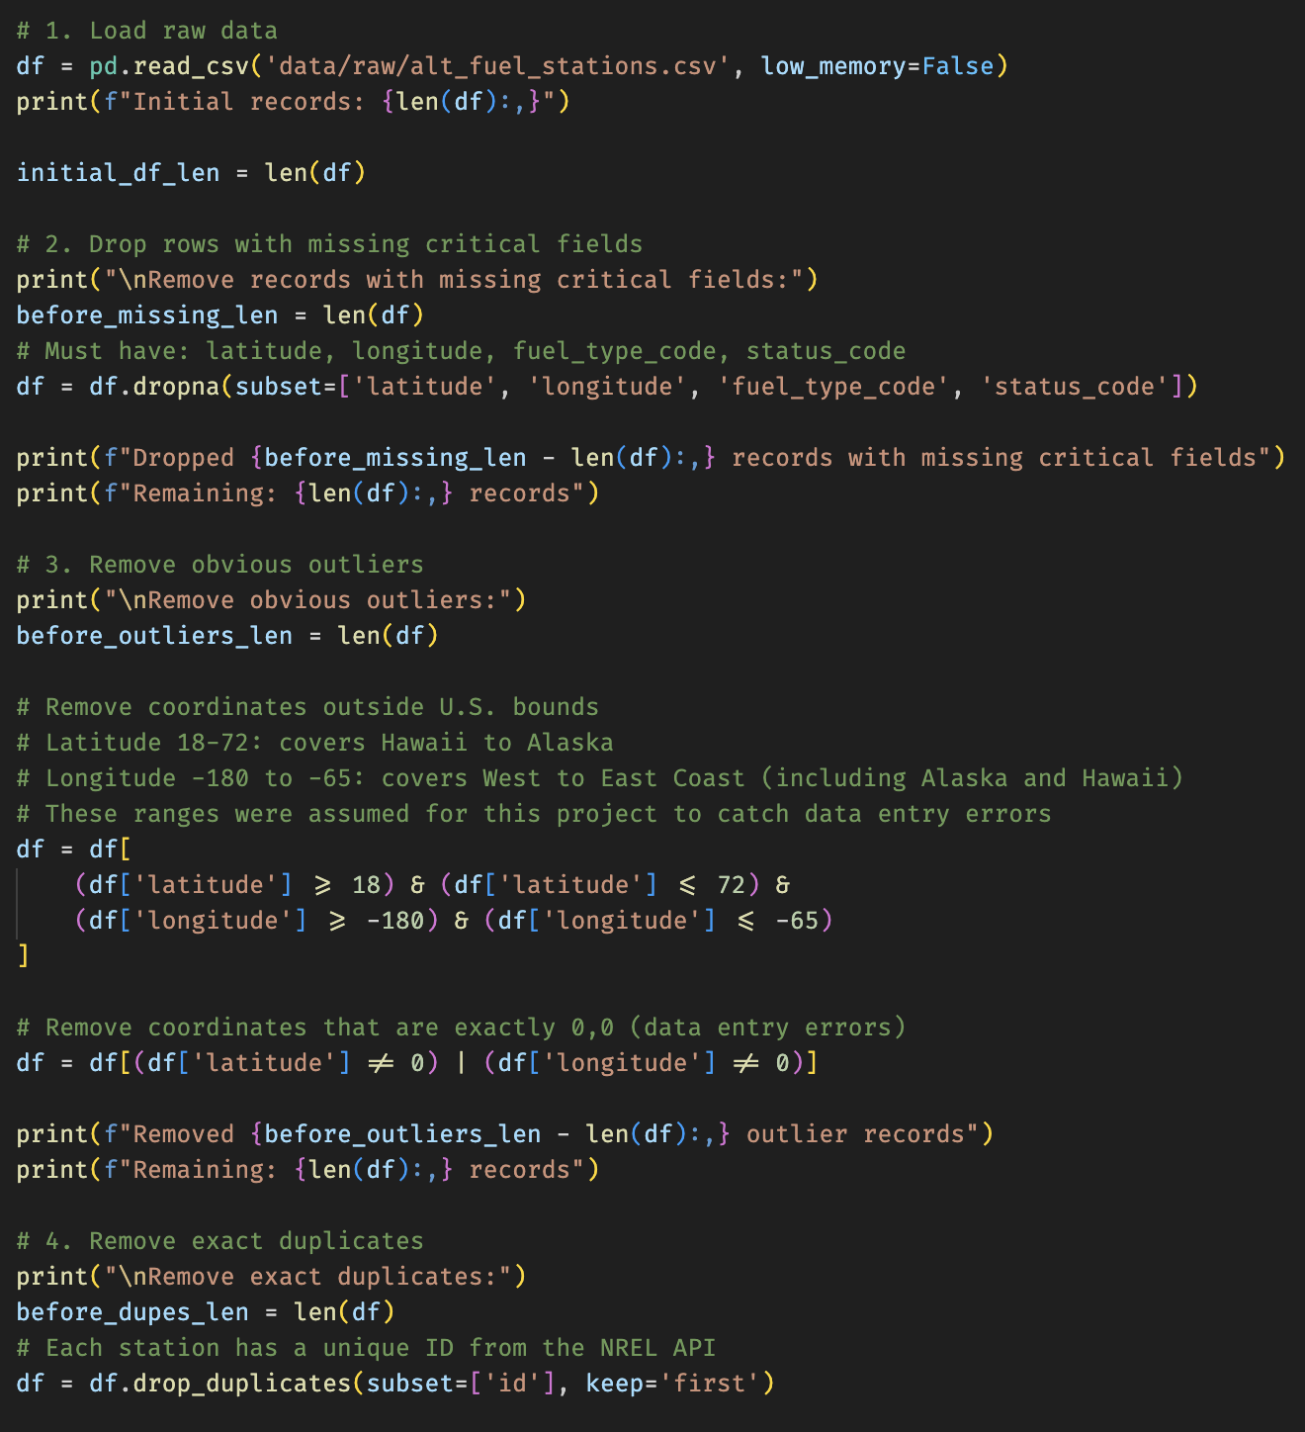
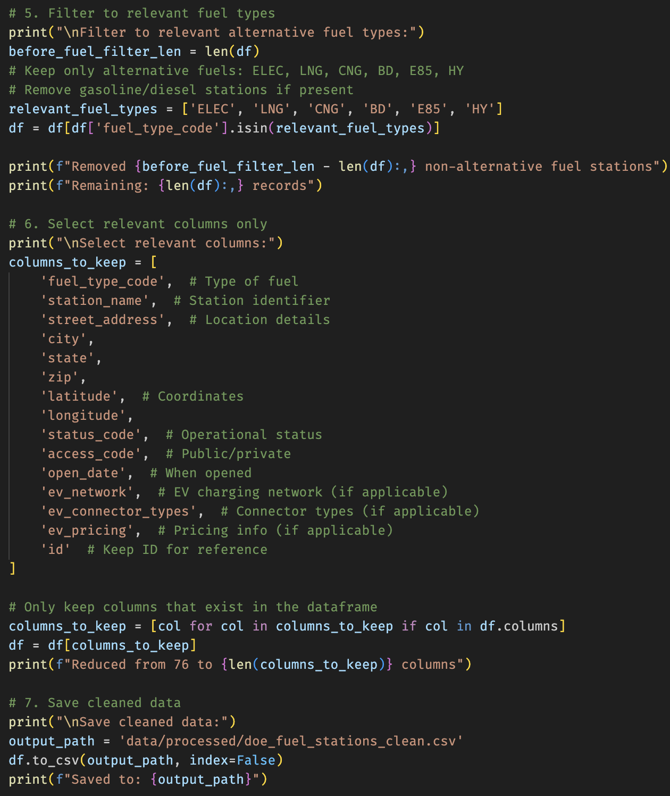
Data Processing – Cleaning & Preparation
DOE Fuel Stations – Processing & Cleaning
Raw data
Source: NREL “Alternative Fuel Stations” API → alt_fuel_stations.csv
~76 columns per station
Critical filters & location sanity checks
Drop rows missing: latitude, longitude, fuel_type_code, status_code
Remove coordinates outside assumed US bounds:
Latitude between 18 and 72
Longitude between –180 and –65
Remove exact (0, 0) coordinates
Duplicates & fuel-type filtering
Drop exact duplicates by NREL id
Keep only alternative fuels:
ELEC, LNG, CNG, BD, E85, HY
Column reduction & output
Reduce from ~76 columns to a focused subset:
fuel type, station name, address, state, coordinates, status, access type, EV network info
Save to data/processed/doe_fuel_stations_clean.csv
Notes:
“For the DOE fuel stations, the detailed cleaning is about getting a realistic map of infrastructure. I start from the alt_fuel_stations.csv generated from the NREL API, with around 76 columns per station.
I keep only rows that have latitude, longitude, a fuel type code and a status code. I drop any coordinates outside plausible US bounds, and any that are exactly (0,0), which are clearly invalid. Then I remove duplicate stations by NREL ID and keep only alternative fuels – electric, CNG, LNG, biodiesel, E85 and hydrogen. Finally, I reduce the schema to the key columns: fuel type, station name, address, state, coordinates, status, access type and EV network information, and save that as doe_fuel_stations_clean.csv.”

Slide 15
Data Processing – Cleaning & Preparation
DOE Fuel Stations – Processing & Cleaning
Raw data
NREL “Alternative Fuel Stations” API exported to CSV (~76 columns)
Location & validity filters
Kept only rows with latitude, longitude, fuel type and status
Removed out-of-bounds coordinates and (0, 0) points
Fuel types & columns
Focused on alternative fuels (ELEC, LNG, CNG, BD, E85, HY)
Dropped duplicates and reduced to core station attributes
(fuel type, address, coordinates, status, access/network info)
Output
Saved as doe_fuel_stations_clean.csv for integration
Notes:
“At a higher level, the DOE fuel station cleaning can be summarised like this:
– The raw data comes from the NREL ‘Alternative Fuel Stations’ API as a wide CSV with many columns. – I enforce basic validity: every station must have coordinates, a fuel type and a status; I remove out-of-bounds coordinates and (0,0). – I focus only on alternative fuel codes – ELEC, LNG, CNG, biodiesel, E85 and hydrogen – and drop duplicates. – Then I reduce it to the core attributes we actually need: fuel type, address, coordinates, status and some basic network or access information.
The result is a clean list of alternative fuel stations that can be reliably aggregated and compared with vehicle data.”

Slide 16

Data Integration & Analytics Datasets
Why Integrate Datasets?
Three cleaned sources
EPA → fuel economy & vehicle specs
NHTSA → reliability & safety (complaints)
DOE → fuel infrastructure (stations)
Why integrate?
Link efficiency ↔ complaints and safety
Link vehicle fuel types ↔ station availability
Move from isolated datasets to end-to-end insights
Final analytical outputs
Vehicle Complaints Analysis
Fuel Infrastructure Analysis
Comprehensive Vehicle Analysis
Notes:
“Once each dataset is clean, they’re already useful… but the real value comes from integrating them.
• EPA gives me fuel economy and vehicle specifications. • NHTSA gives me reliability and safety through complaints. • DOE gives me the fuel infrastructure.
By joining them, I can: – link fuel efficiency with complaint behaviour and safety; – link vehicle fuel types with how dense the station network is; – and move from three isolated views to end-to-end insights.
Concretely, I produce three purpose-built outputs: a Vehicle Complaints Analysis table, a Fuel Infrastructure Analysis table, and a Comprehensive Vehicle Analysis that brings everything together.”

Slide 17
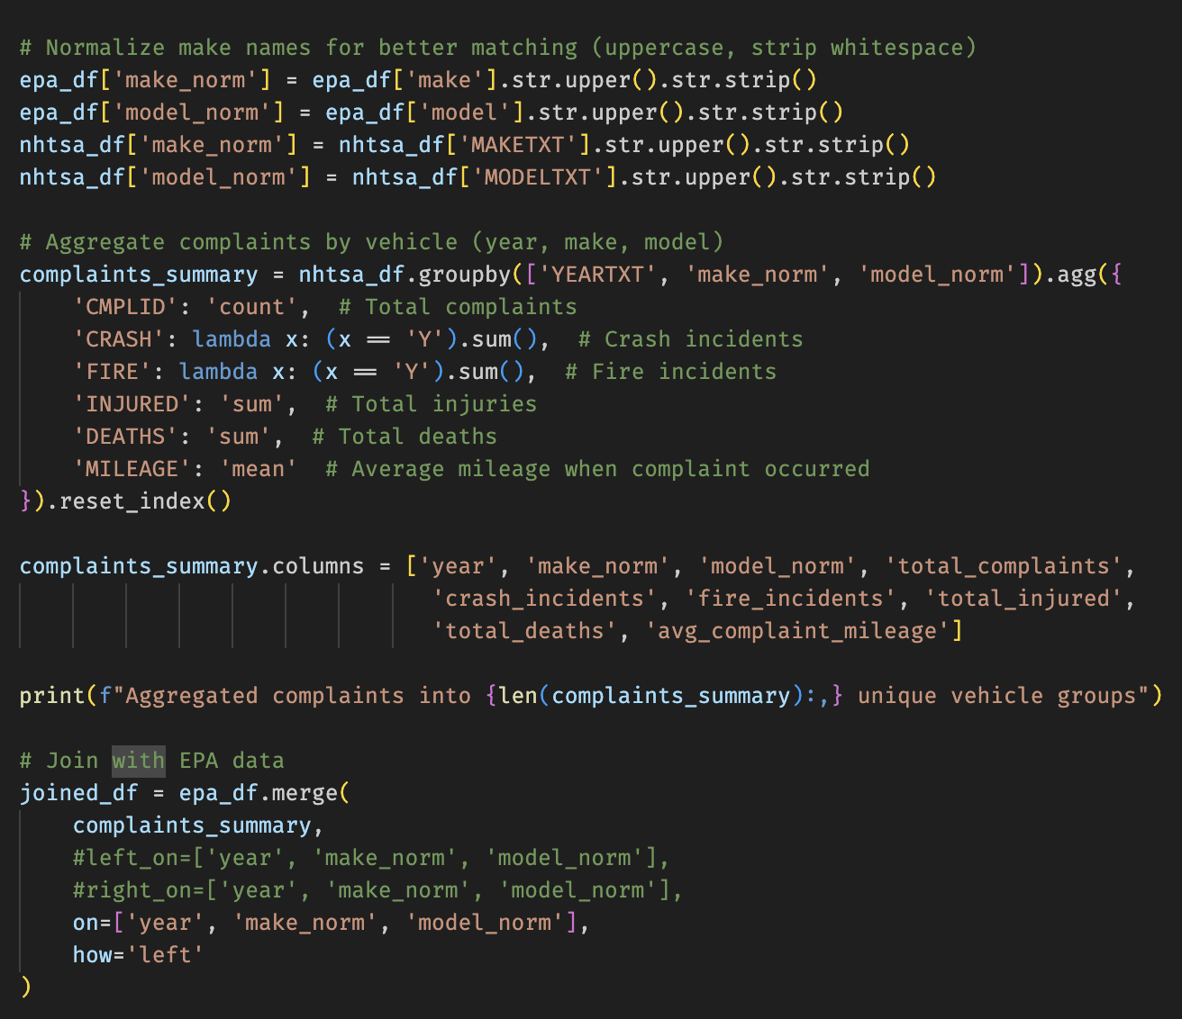
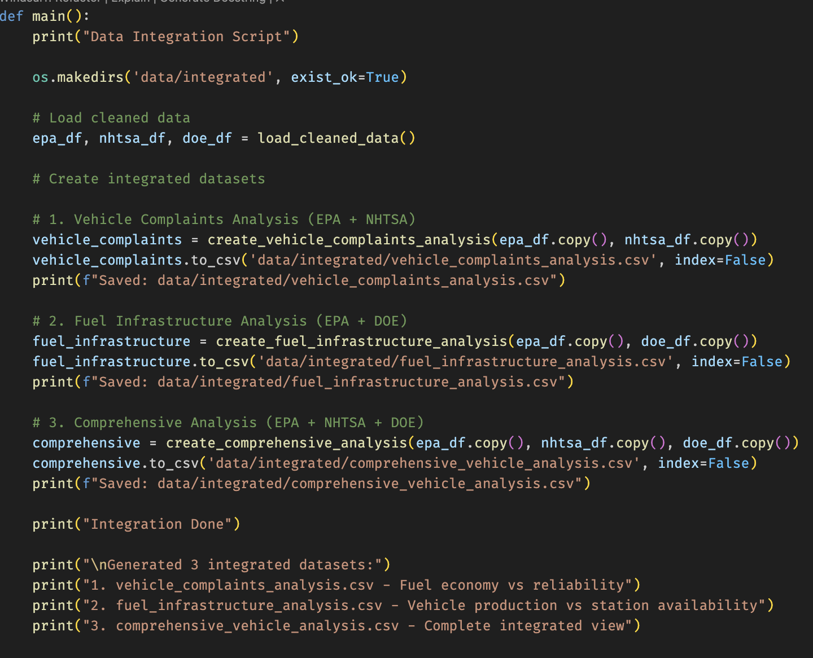
Data Integration & Analytics Datasets
Coding Process
1. vehicle_complaints_analysis.csv (EPA + NHTSA)
Normalize make / model (uppercase + trim)
Aggregate complaints per (year, make, model):
total_complaints, crash_incidents, fire_incidents
total_injured, total_deaths, avg_complaint_mileage
Left join onto EPA vehicles (incl. dual-fuel expansion)
Add vehicle_variants = count of EPA rows per (year, make, model)
2. fuel_infrastructure_analysis.csv (EPA + DOE)
Map EPA fuel_used → DOE fuel_type_code
Group by (year, fuel_type_code):
vehicle_count
average MPG (avg_combined_mpg, avg_city_mpg, avg_highway_mpg)
Aggregate DOE stations per fuel_type_code (nationwide)
Compute vehicles_per_station per fuel type and year
3. comprehensive_vehicle_analysis.csv (EPA + NHTSA + DOE)
Start from vehicle_complaints_analysis
Map fuel_used → fuel_type_code
Join DOE station counts (stations_nationwide) by fuel_type_code
One row per vehicle × fuel combination, with:
fuel economy, complaints, and infrastructure together
Notes:
“In the detailed integration view, each analytical table has a clear recipe.
For vehicle_complaints_analysis, I normalise make and model, aggregate NHTSA complaints by year, make and model, compute counts of complaints, crashes, fires, injured and deaths, plus average mileage at complaint; then I left-join that back to EPA vehicles and add a count of vehicle variants.
For fuel_infrastructure_analysis, I map the EPA fuel_used value to DOE fuel_type_code, group vehicles by year and fuel type for counts and average MPG, and then bring in DOE station counts per fuel type to compute a vehicles-per-station metric.
And for comprehensive_vehicle_analysis, I start from the vehicle complaints view and join in the station metrics by fuel type, so each row represents a vehicle–fuel combination with fuel economy, reliability and infrastructure metrics all side by side.”

Slide 18
Data Integration & Analytics Datasets
Coding Process
1. vehicle_complaints_analysis (EPA + NHTSA)
Aggregate NHTSA complaints by year, make, model
Metrics: complaints, crashes, injuries, deaths, avg mileage
Left join onto EPA vehicles (incl. dual-fuel) and add vehicle_variants
2. fuel_infrastructure_analysis (EPA + DOE)
Map EPA fuel_used → DOE fuel_type_code
Group by year & fuel type: vehicle counts + average MPG
Join DOE station counts and compute vehicles_per_station
3. comprehensive_vehicle_analysis (EPA + NHTSA + DOE)
Start from vehicle_complaints_analysis
Join station metrics by fuel type
Notes:
These are the three analytical datasets that come out of the integration step.
First, vehicle_complaints_analysis: I aggregate NHTSA complaints by year, make and model, compute metrics like total complaints, crashes, injuries and deaths, and then left-join that back onto EPA vehicles — including the dual-fuel rows — and add a count of variants per year/make/model.
Second, fuel_infrastructure_analysis: here I align fuel labels by mapping EPA’s fuel_used to DOE fuel_type_code, group vehicles by year and fuel type to get counts and average MPG, and then join in DOE station counts to compute a vehicles-per-station metric.
Finally, comprehensive_vehicle_analysis: I start from the complaints table and join the infrastructure metrics by fuel type, so each row represents a vehicle–fuel combination with economy, complaints and infrastructure all together. That’s the table I use for the final end-to-end analysis.

Slide 19

Data Loading – Databricks (Simulated)
Simulation process
Goal
Expose the 3 integrated CSVs as Delta tables for analytics
Target structure
Catalog: automotive_data
Schema: analytics
Tables:
vehicle_complaints_analysis
fuel_infrastructure_analysis
comprehensive_vehicle_analysis
Loading strategy (full refresh)
Overwrite tables on each run (CREATE OR REPLACE TABLE)
Load data from staged CSV files (e.g. /mnt/staging/...)
Run OPTIMIZE and ANALYZE TABLE afterwards for compaction and stats
Notes:
“On the loading side, the goal is to expose these three integrated CSVs as Delta tables.
I define a simple target: – Catalog automotive_data,
- schema analytics, – with three tables: vehicle_complaints_analysis, fuel_infrastructure_analysis, and comprehensive_vehicle_analysis.
The strategy is a full refresh: recreate the tables each run, load from staged CSVs, and run OPTIMIZE and ANALYZE TABLE to keep performance good.”

Slide 20
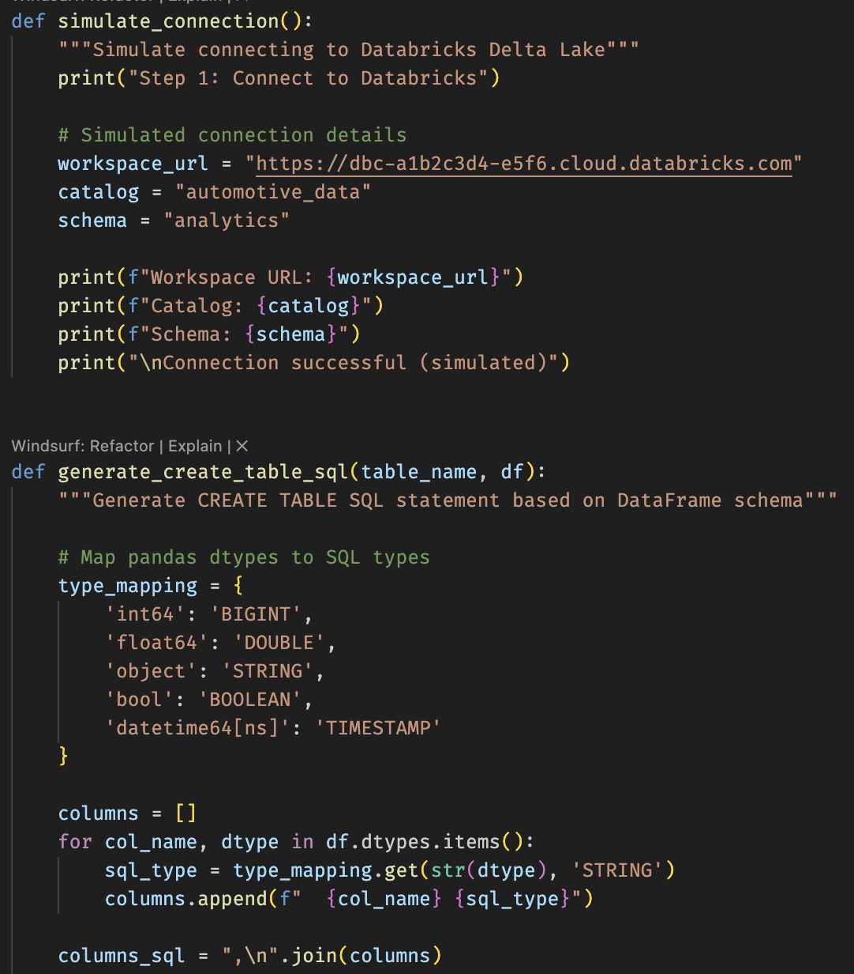
Data Loading – Databricks (Simulated)
Simulation process
What the script actually does
Inspects CSV schema with pandas
Generates CREATE TABLE DDL dynamically from dtypes
Outputs SQL or Pyspark commands that would create and load Delta tables
Simulates optimization and shows record counts per table
Notes:
“The loading simulation is done in Python and is built to be dynamic. It inspects each final CSV with pandas, maps dtypes to SQL types, and generates the CREATE OR REPLACE TABLE statements. Instead of actually connecting to Databricks here, the script prints the SQL or PySpark commands and the row counts, so we can see exactly how the tables would be created and populated. In a real environment, the same logic could live inside a Databricks notebook or a CI/CD pipeline.”

Slide 21
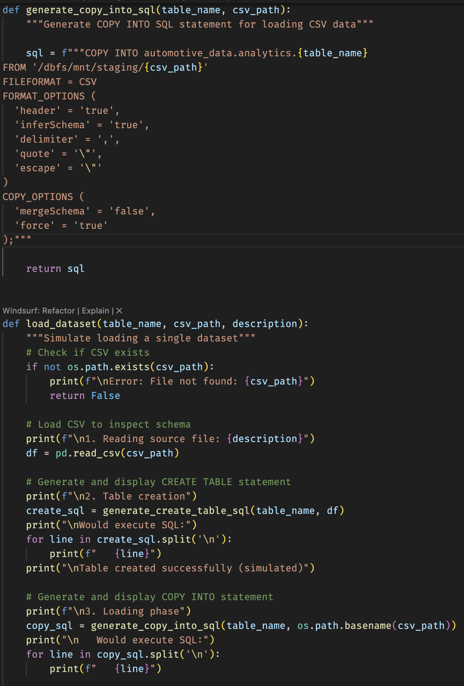
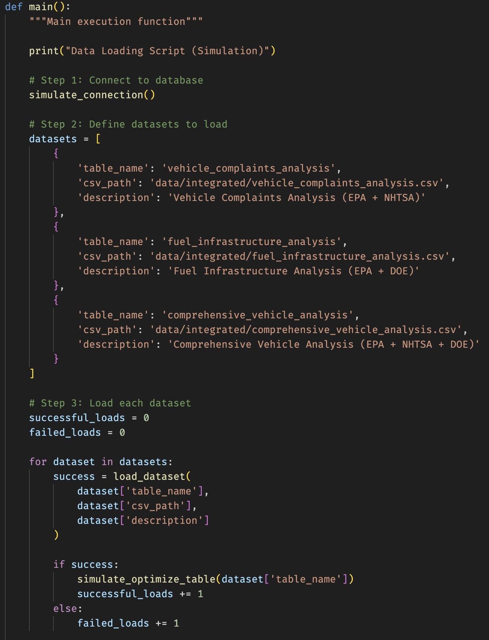
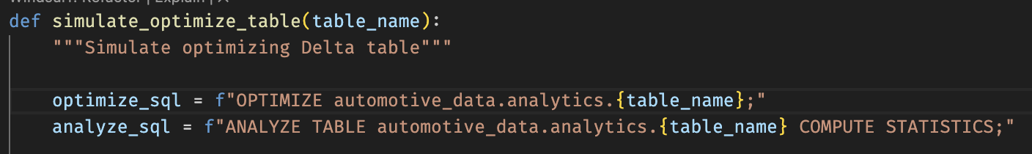
Data Loading – Databricks (Simulated)
Simulation process (code example)
Notes:
“This slide shows a snippet of how that looks in code.
The main point isn’t the specific syntax, it’s the approach: infer the schema from the processed data, generate the DDL dynamically, and treat table creation and data loading as an automated, repeatable step in the pipeline.
That makes it easy to change the schema in the processing layer and keep the tables in sync without manual intervention.”

Slide 22
Final Datasets Overview (Results)
Vehicle Complaints Analysis (EPA + NHTSA)
Purpose
Combine fuel efficiency and reliability into a single view
Questions answered
Are more efficient vehicles actually more reliable?
Which brands/models have the highest complaint rates?
Are EVs reporting fewer issues than gasoline cars?
Results (from this dataset)
No clear correlation between fuel efficiency and complaint rate
EVs show ~71.7% fewer complaints per vehicle than gasoline cars
Highest complaints per vehicle: Chrysler, Honda, Hyundai, Kia, Dodge
Business value
Highlights safety & reliability risks by brand and fuel type
Helps prioritize investigations and quality improvements
Notes:
“Now, the fun part – the results.
The Vehicle Complaints Analysis combines fuel economy with reliability. It lets us ask: are more efficient vehicles really more reliable, which brands have high complaint rates, and how EVs compare to gasoline cars.
In this dataset, I didn’t see a clear correlation between MPG (Miles Per Gallon) and complaints by itself. But EVs stand out: they show about 71.7% fewer complaints per vehicle compared to gasoline cars. The brands with the highest complaints per vehicle are Chrysler, Honda, Hyundai, Kia and Dodge.
This table is useful to highlight safety and reliability risks and to prioritise where to investigate quality issues.”

Slide 23
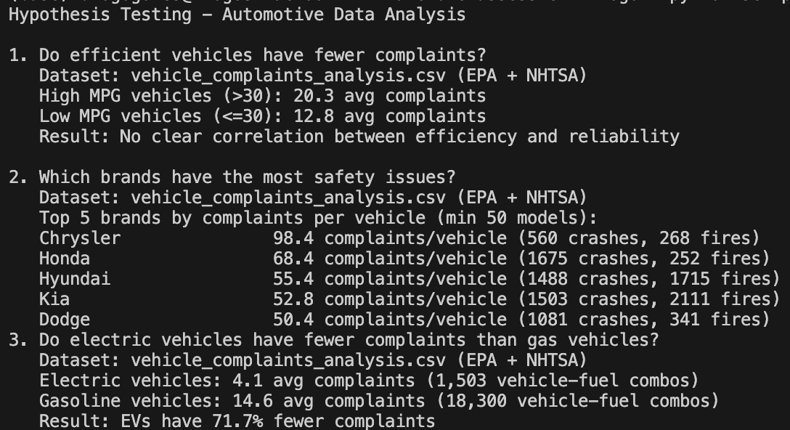
Final Datasets Overview (Results)
Vehicle Complaints Analysis (EPA + NHTSA)
Notes:
“Here’s an example visual built on top of that table. It shows how complaint rates differ by brand and fuel type, which is exactly the kind of view you’d put in a reliability or quality dashboard.”

Slide 24
Final Datasets Overview (Results)
Fuel Infrastructure Analysis (EPA + DOE)
Purpose
Connect vehicle counts (EPA) with national fuel station availability (DOE) to assess infrastructure readiness
Questions answered
Are alternative fuel vehicles supported by enough stations?
Which fuel types are most infrastructure-constrained, if any?
How many vehicles exist per station for each fuel type?
Results (from this dataset)
All analysed alternative fuels (HY, BD, ELEC) sit comfortably above the minimum infrastructure threshold
Electric infrastructure appears extremely dense – very low vehicles-per-station ratio
Biodiesel and Hydrogen also show no signs of shortage in this dataset
Business value
Indicates whether national infrastructure can support growth in alternative fuel vehicles
Helps identify where additional infrastructure investment is – or isn’t – a priority
Notes:
“The Fuel Infrastructure Analysis links vehicles to stations.
The key questions here are: do alternative fuel vehicles have enough stations, and are any fuel types clearly under-served?
In the aggregated view I built, all analysed alternative fuels – hydrogen, biodiesel and electricity – sit comfortably above a minimum infrastructure threshold. Electric infrastructure in particular looks very dense, with a low vehicles-per-station ratio. Biodiesel and hydrogen also don’t show signs of shortage in this dataset.
So, at a national level, infrastructure doesn’t appear to be the bottleneck for these fuels, which helps decide where infrastructure investment is – and isn’t – really needed.”

Slide 25
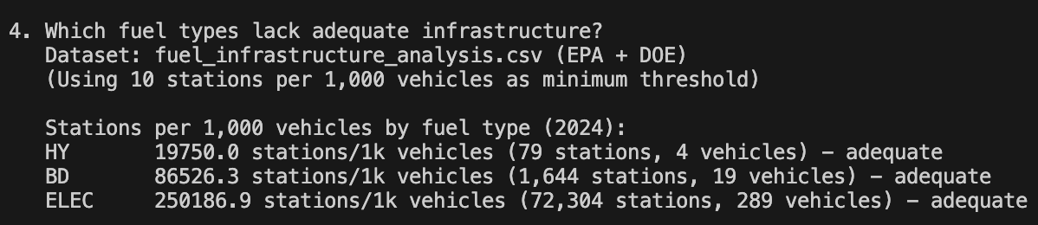
Final Datasets Overview (Results)
Fuel Infrastructure Analysis (EPA + DOE)
Notes:
“This simple visual compares the vehicles-per-station ratio across fuel types. It makes it easy to see that, in this dataset, none of the key alternative fuels are obviously under-served by stations.”

Slide 26
Final Datasets Overview (Results)
Comprehensive Vehicle Analysis (EPA + NHTSA + DOE)
Purpose
Provide an end-to-end view that combines fuel economy, reliability and infrastructure
Questions answered
Do vehicles with poorer infrastructure coverage receive more complaints?
Which vehicle classes best balance efficiency and reliability?
Are infrastructure gaps linked to worse customer experience?
Results (from this dataset)
Vehicles in poorly served infrastructure segments show ~2.5× more complaints
EVs stand out: low complaints combined with strong charging infrastructure
Most efficient classes:
Small Station Wagons
Small SUVs 2WD
Midsize Cars
Most reliable classes:
Small Pickup Trucks
Standard Pickup Trucks
Cargo & Passenger Vans
Business value
Helps identify where customer experience is most at risk and where improving vehicle quality or infrastructure would have the biggest impact
Notes:
“The Comprehensive Vehicle Analysis brings everything together in one table.
Each row is a vehicle–fuel combination with fuel economy, complaint metrics and infrastructure metrics. This lets us check if poor infrastructure is associated with more complaints, and which vehicle classes best balance efficiency and reliability.
In this dataset, vehicles in poorly served infrastructure segments show about 2.5 times more complaints than others. EVs, again, are in a good position: low complaints and strong infrastructure.
The most efficient classes are small station wagons, small SUVs 2WD and midsize cars. The most reliable classes tend to be small and standard pickup trucks, plus cargo and passenger vans.
This table is very useful for both product and infrastructure strategy.”

Slide 27
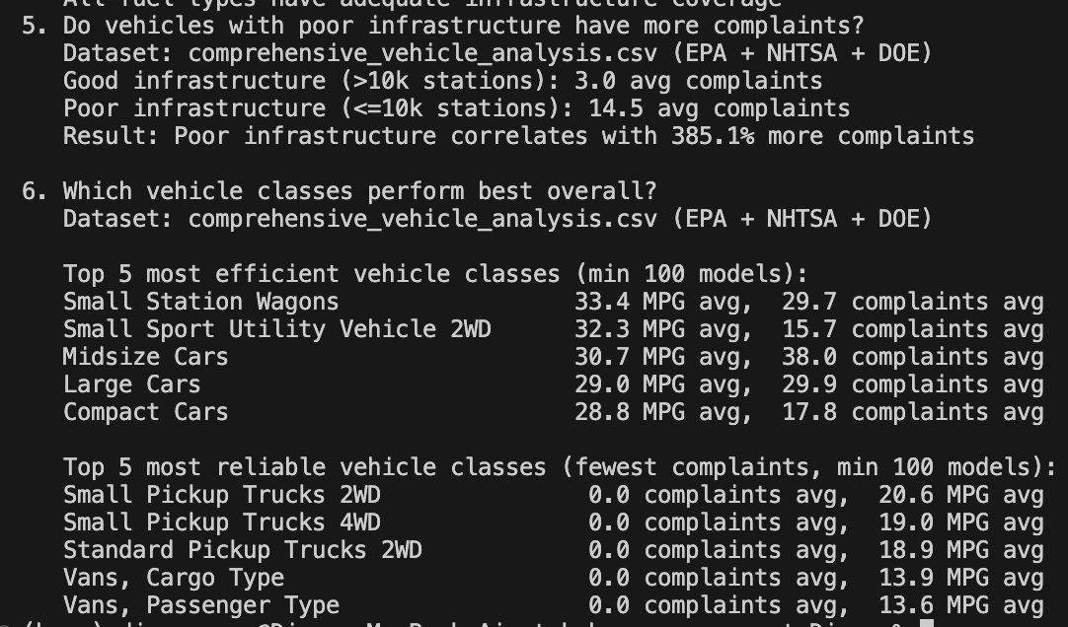
Final Datasets Overview (Results)
Comprehensive Vehicle Analysis (EPA + NHTSA + DOE)
Notes:
“Here’s a visual representation of that comprehensive table. It shows how different classes trade off efficiency, complaints and infrastructure coverage, and points to the segments that might deserve more attention.”

Slide 28

Automation Overview
Pipeline Automation – Azure Data Factory
Weekly automated pipeline (Sunday 02:00)
Orchestrates entire flow:
Acquisition -> Processing -> Integration -> Loading -> Validation
No manual steps
Ensures fresh, validated data weekly
Notes:
“All of this is designed to be automated, not run manually.
I propose a weekly pipeline, for example on Sunday at 2 a.m., that orchestrates the full flow end-to-end: – acquisition of raw data, – processing and cleaning, – integration into the three analytical CSVs, – loading into Delta tables, – and a validation step at the end.
The idea is that, under normal conditions, there are no manual steps – every week we get fresh, validated data ready for analytics.”

Slide 29

Automation Overview
Why Azure Data Factory
Native integration: Databricks + Storage + Key Vault
Visual pipeline design
Built-in scheduling & monitoring
Serverless (pay only when executing)
Durable & scalable
Notes:
“For orchestration on Azure, I chose Azure Data Factory.
It integrates natively with Databricks, Data Lake and Key Vault, which fits this design. It gives you visual pipelines, scheduling, monitoring and retry logic out of the box. And because it’s serverless, you only pay for the activities that actually run.
So ADF is a good, practical choice to coordinate the steps in this pipeline.”

Slide 30
Automation Overview
Process
ADF pipeline – 5 main steps
Ingest - Acquire raw data from EPA, NHTSA, DOE into the raw layer
Clean & enrich - Run processing scripts to create cleaned datasets per source
Integrate - Join sources and build the 3 analytical CSVs in the integrated layer
Load to Delta - Create/replace the 3 Delta tables in automotive_data.analytics
Validate & notify - Run row-count & schema checks and send a run summary
Failure behaviour
Any step fails → downstream steps are skipped
ADF marks the pipeline as failed and sends an email/Teams alert with the error details
Notes:
“The ADF pipeline is structured into five main steps.
Ingest – pull raw data from EPA, NHTSA and DOE into the raw layer.
Clean & Enrich – run the processing scripts to create cleaned datasets.
Integrate – join the sources and build the three analytical CSVs.
Load to Delta – create or replace the three Delta tables.
Validate & Notify – check row counts and schema and send a run summary.
If any step fails, the remaining steps are skipped and the pipeline sends an alert, so the issue can be investigated.”

Slide 31
Automation Overview
Why Azure Data Factory
Key Components:
Linked Services: Databricks, ADLS, Key Vault
Datasets: Raw → Processed → Integrated
Job Clusters: Auto-create & auto-terminate
Validation: Row counts + type checks
Notes:
“In terms of ADF components, the pipeline uses: – Linked Services to connect to Databricks, Azure Data Lake Storage and Key Vault; – Datasets to represent the raw, processed and integrated layers; – Databricks job clusters configured to auto-create and auto-terminate around the notebooks that do the heavy lifting; – and a validation activity that runs a few basic checks – like row counts and data types – before we consider the pipeline run successful.
This keeps the solution modular, cost-efficient and relatively easy to extend.”

Slide 32

Challenges Faced
Top Challenges Faced
Vehicle Matching Across Sources
Different naming conventions (F150 vs F-150)
No universal vehicle ID
Solution: Normalization + year/make/model join
Dual-Fuel Vehicles (Biggest Challenge)
Plug-in hybrids use two infrastructures
Solution: “Exploded rows” → one row per fuel type
Accurate EV + gasoline demand
Notes:
“Two main challenges were worth calling out.
First, vehicle matching across sources. There’s no shared vehicle ID between EPA and NHTSA, and naming can differ – for example ‘F150’ vs ‘F-150’. I normalised make and model names and joined on year + make + model, and I document the limitations of that approach.
The second, and probably biggest challenge, was dual-fuel vehicles. Plug-in hybrids actually rely on two infrastructures – electricity and gasoline – and if we treat them as a single row, we under-represent their impact on infrastructure. The solution was the ‘exploded’ design I described earlier: one row per vehicle–fuel combination with a fuel rank. That means EV demand and gasoline demand are both counted properly when we analyse vehicles per station.
These two decisions – how to join and how to model dual-fuel – are key to making the results realistic and interpretable.”

Slide 33
Conclusion
End-to-end automated pipeline
Integrated data from EPA, NHTSA and DOE
Reliable Delta-ready datasets
Insights on efficiency, reliability & infrastructure
Scalable foundation for future improvements
Notes:
“To wrap up, this project delivers an end-to-end pipeline that integrates EPA, NHTSA and DOE data. It produces clean, integrated, Delta-ready datasets that combine fuel economy, reliability and infrastructure. On top of that, it includes a clear loading strategy and an automation design using Azure Data Factory and Databricks.
The result is a solid foundation for analytics and decision-making around vehicle safety, efficiency and alternative fuel infrastructure. Thanks for listening – I’m happy to go deeper into any part of the pipeline or the code.”

Slide 34
Automotive Data Pipeline
Data Engineer - Assessment
Thank you very much

