Slide 1

2048
Jian Jiao

Slide 2
About My 2048 Game Project
Use API 23, there is a little bug on API 29. I used one day to solve this bug, but it is still there.
The ideal UI Resolution is 1080 * 1920. Density is 420dpi.
You can find this tutorial on my Github

Slide 3
What do I need ?
GridLayout to design Gameboard
FrameLayout to design Card
Animation to achieve Card movement effect
AlertDialog to interact with players
Notifications in case my content is not enough

Slide 4
GridLayout
Set the arrangement of components in the layout
Customize how many rows and columns
Set the component to be in a row and column
Set the component to span several rows or columns

Slide 5
GridLayout
Set the arrangement of components in the layout
Customize how many rows and columns
Set the component to be in a row and column
Set the component to span several rows or columns

Slide 6

GridLayout
Step 1: Customize my GameView class which parent class is GridLayout

Slide 7
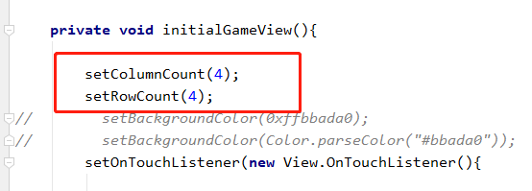
GridLayout
Step 2: Create a initial method.
In this method, setting 4 columns and 4 rows for the game board.

Slide 8
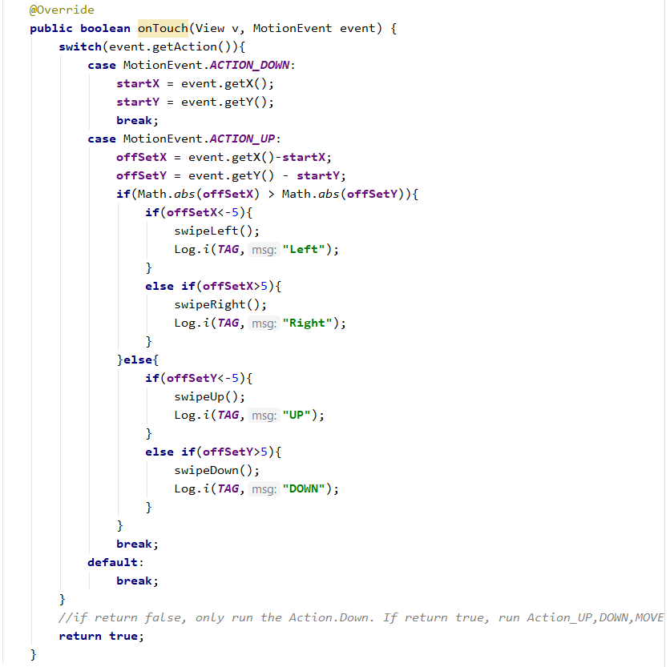
GridLayout
Step 3: override the onTouch() method for swiping actions.

Slide 9
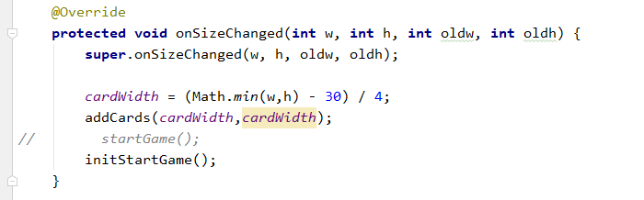
GridLayout
Step 4: override onSizeChanged() method to create 16 Cards (Card class is child of FrameLayout)
Tips: the View Lifecycle
View() --> onMeasure() --> onSizeChanged() --> onLayout() --> onDraw()

Slide 10
GridLayout
Step 5: The logic of the game is implemented in this class. Due to limited time, if you are interested in game logic, you can look at the code.

Slide 11
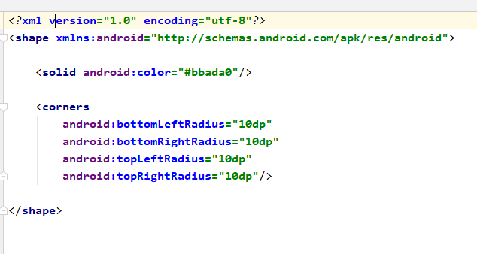
GridLayout
Step 6: create game_board_layout.xml in drawble folder in order to setting the radius and background color

Slide 12
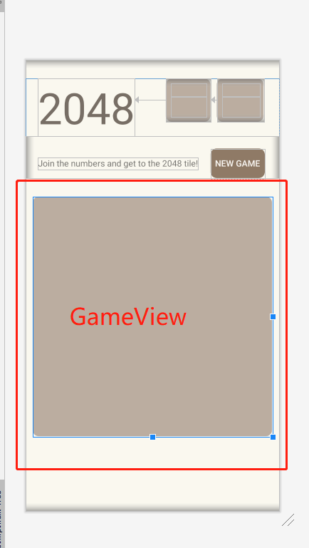
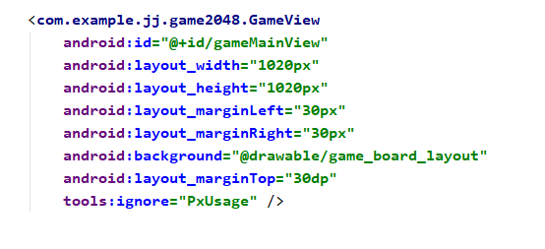
GridLayout
Step 7: use the GameView class in the activity_main.xml

Slide 13
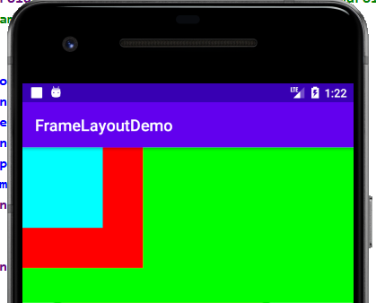
FrameLayout
FrameLayout is designed to display a single widget
Open up a blank area directly on the screen, it will put all views to the upper left corner by default

Slide 14

FrameLayout
Step 1: Customize my Card class which parent class is GridLayout

Slide 15
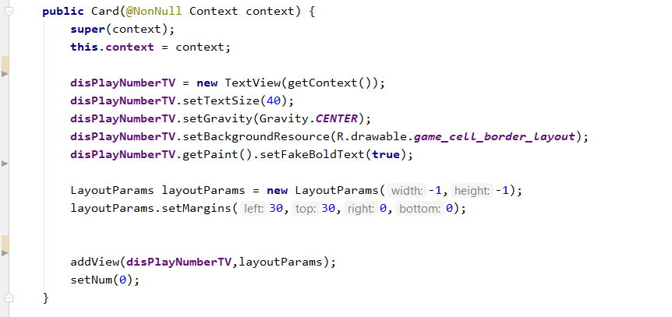
FrameLayout
Step 2: In the constructor, add TextView to display the number
Tips: If you want the create a view in java code, you need to use the class - LayoutParams

Slide 16
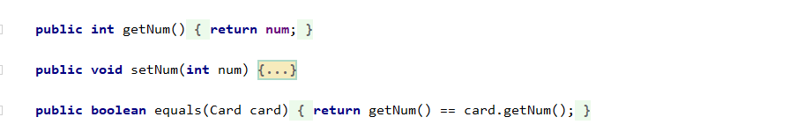
FrameLayout
Step 3: In Card class, add getNum(), setNum(), equals().

Slide 17
Animation
Property Animations
View Animations
Tween Animation
Frame Animation
Drawable Animations

Slide 18
Animation
In the project, in order to avoid disturbing the player, I tried my best to add animation effects.
In my Github, there are some animation demos. If you are interested, you can download it.

Slide 19
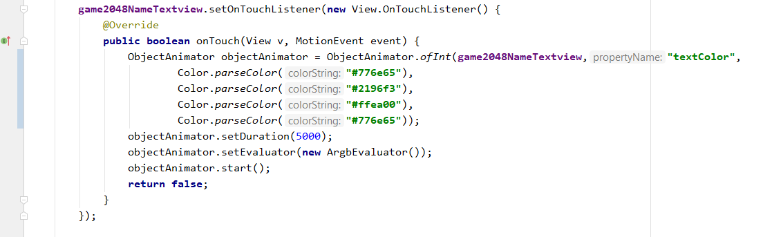
Animation
Game Title Name Animation for changing Colors using Java Code

Slide 20
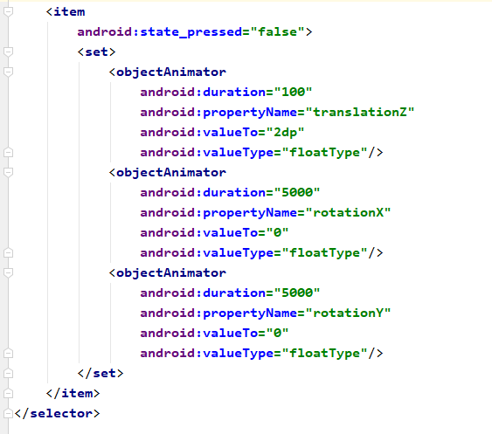
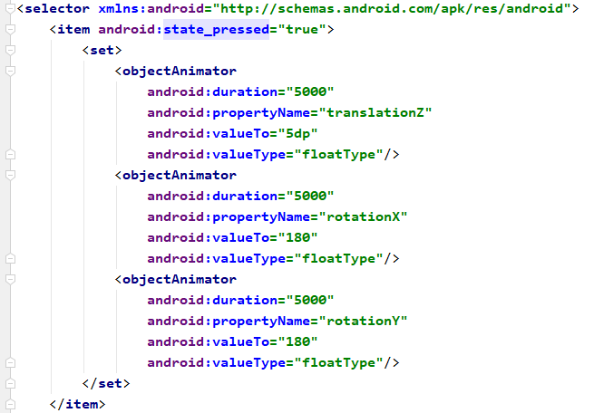
Animation
Game Title Name Animation for rotation using xml
1.Create game2048_game_title_state_change.xml in animator folder

Slide 21
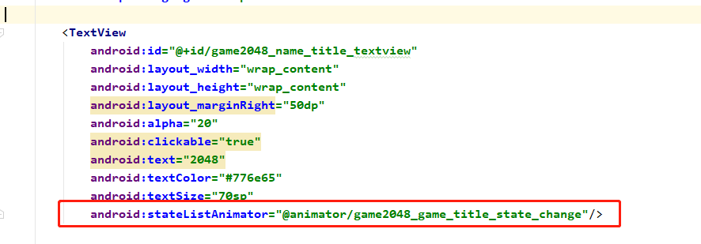
Animation
2. Setting android:stateListAnimator in activity_main.xml

Slide 22
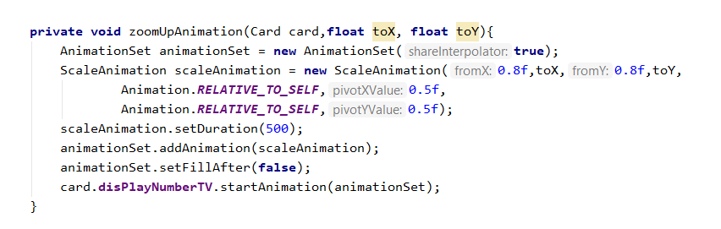
Animation
Add animation to zoom up Card in GameView Class

Slide 23
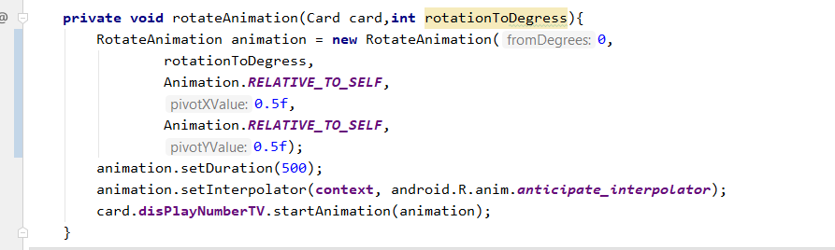
Animation
Add animation to rotate Card in GameView Class

Slide 24
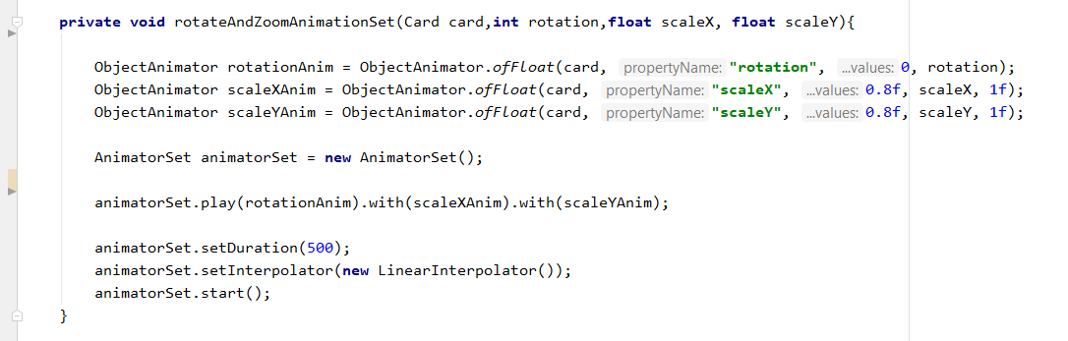
Animation
Add animation Set for Card in GameView Class

Slide 25
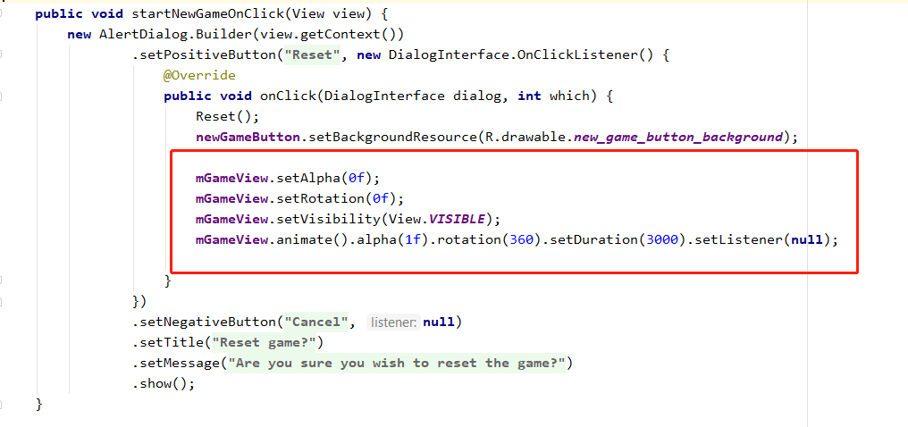
Animation
Add animation to “New Game” Button in OnClick Event

Slide 26
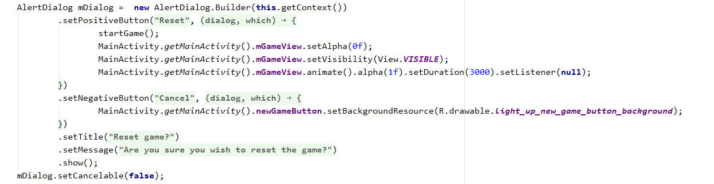
AlterDialog
Create a method and add these code. Call this method when you want to display Dialog
Tips: If you do not want your dialog lose the focus, use setCancelable(fasle)

Slide 27
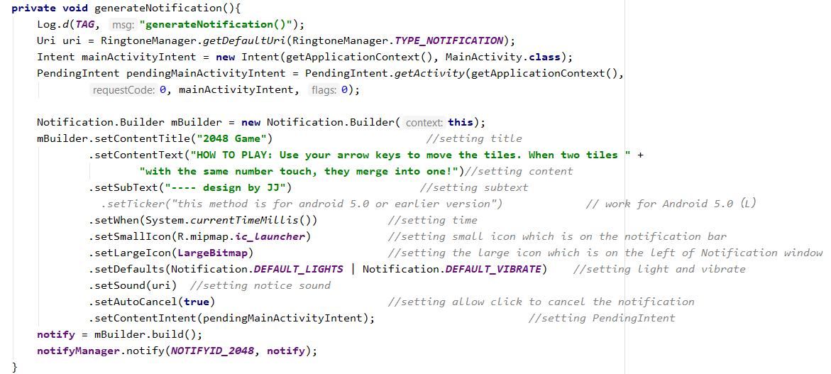
Notification
Create a method and add these code. Call this method when you want to display Notification

Slide 28
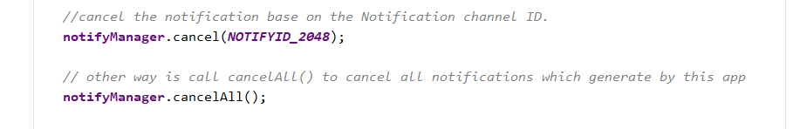
Notification
There are two ways to cancel the notification

Slide 29
Thank You
jj.jianjiao@gmail.com

