Slide 1
Fragments
Shingai Zindi

Slide 2
Moving From Activities to Fragments
Steps
Create Fragments that correspond to the Activities being swapped.
Create an Activity or Activities to control the newly created fragments.
Create a Layout that includes a Fragment Container
Attach the Fragments to the Fragment Container.

Slide 3
0. Add the Following Dependencies to the build.gradle folder and update to Java 8
/* Navigation/FragmentContainer */
implementation 'androidx.navigation:navigation-fragment:2.3.0'
/* UI Colors */
implementation 'com.google.android.material:material:1.1.0'
/* Retrofit */
implementation 'com.squareup.retrofit2:converter-gson:2.9.0'
implementation 'com.squareup.retrofit2:retrofit:2.9.0'
/* Picasso */
implementation 'com.squareup.picasso:picasso:2.71828'

Slide 4
1 A) Create Fragments
Add a new blank Fragment the same way a new you would add a new Activity
This will prompt for the name of the fragment and layout similar to the prompt for a new Activity
The Layout doesn’t matter as the same one for the activity can be used or copied over if you like.
Android Studio will create a template for the Fragment to be used.
Activities that were migrated: BaseActivity, PokemonActivity, StatsActivity, AbilitiesActivity, MovesActivity.

Slide 5
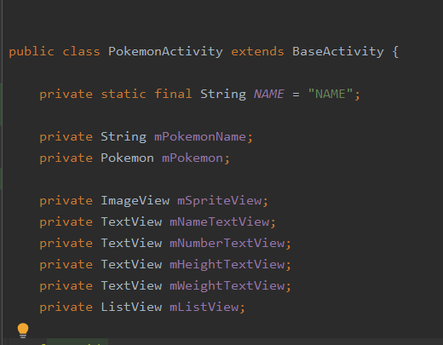
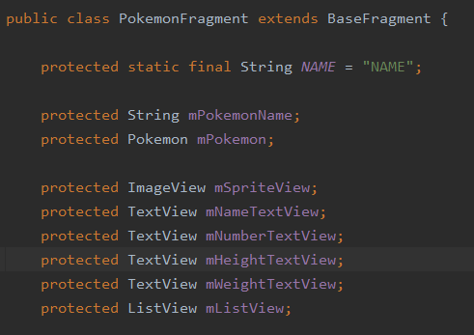
1 B) Implementing the methods.
Copy all the variable declared from the activity to the fragment.

Slide 6

1 B) Implementing the methods.
Leave the empty constructor that was created for you.
Get rid of the newInstance() method as it will not be used.
I left an implemented version for those interested but I did not use it.
The BaseFragment only requires the onCreate() method and variables

Slide 7
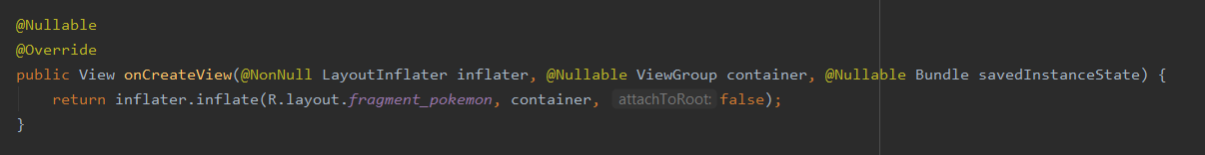
1 B) Implementing the methods.
Leave the onCreateView() method as is as well
The BaseFragment only requires the onCreate() method and variables

Slide 8
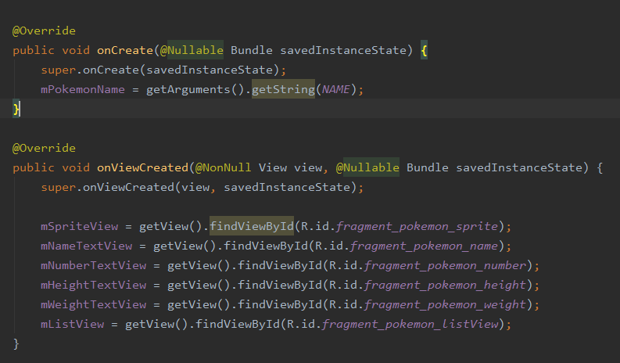
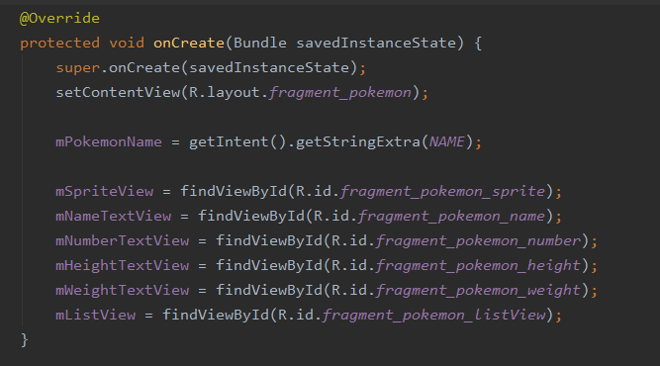
1 B) Implementing the methods.
Copy over code for the activity onCreate like so.
See included Word Document for details.
The BaseFragment only requires the onCreate() method and variables

Slide 9
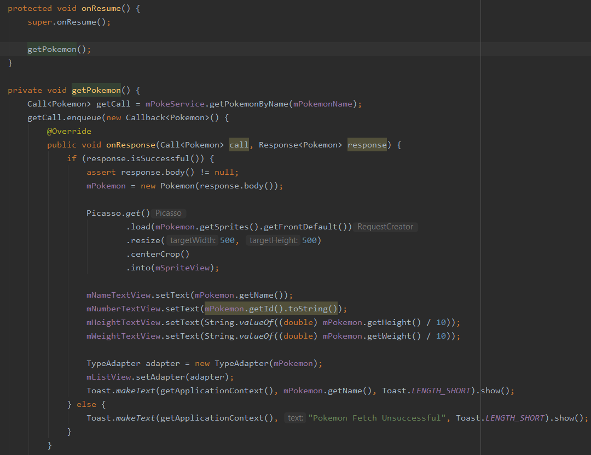
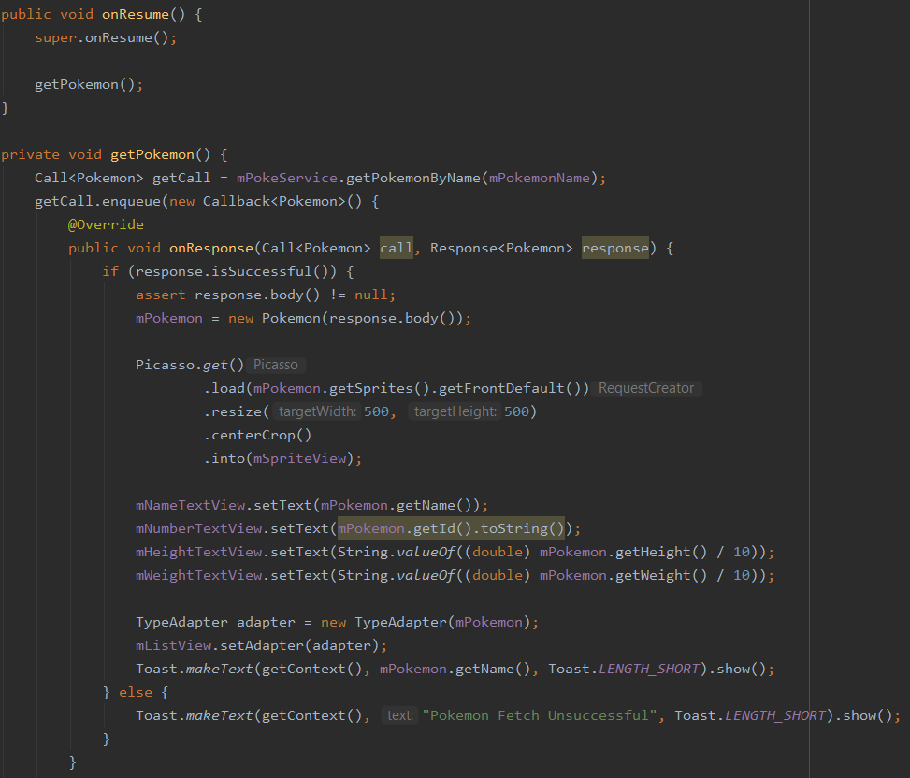
1 B) Implementing the methods.
Copy over the last two methods onStart() and getPokemon().
onStart only requires the change of going from protected to public.

Slide 10
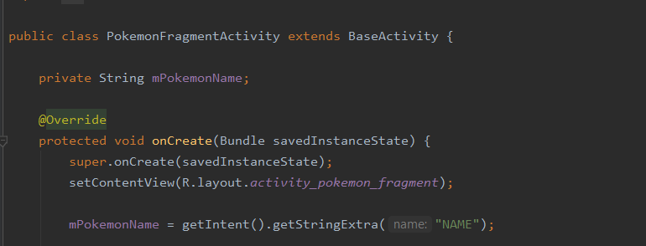
2. Create an activity to control your Fragments
We only require one variable that can be set up like so.

Slide 11
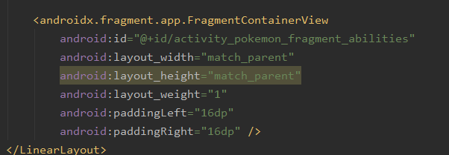
3. Create a layout with Fragment Containers
Set the Layout to a vertical Linear layout.
Add 2 FragmentContainerViews to hold your Fragments
I Added an additional TextView as a label but this is not required.

Slide 12

4. Attach the fragments to the layout
Attach your fragments by:
Create a Fragment.
Create a Bundle and fill it with needed data.
Use the FragmentManager to create a FragmentTransaction to put the Fragment into the FragmentContainer

Slide 13
Remember to switch the activity being started in the onClickListener() of the PokedexActivity PokemonAcivity, StatActivity, AbilitiesActivity and MovesActivity are no longer being used and can be deleted if desired.

Slide 14
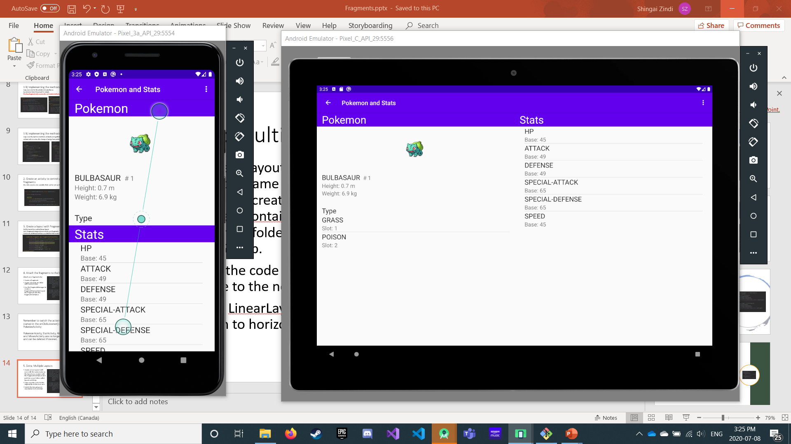
5. Extra: Multiple Layouts
Create a new Layout with your with the same name as the layout you created with the FragmentContainers but put it in a new folder called layout-sw600dp.
Copy over the code for the original file to the new one.
Switch the LinearLayout orientation to horizontal.
Tablets and Phones should now look different. See Word document for details.
Remember that ID changes should be changed in both files in order to avoid issues unless addition programming is done.

