Slide 1
ViewPager2
Shingai Zindi

Slide 2
Steps
Create an Activity to control your ViewPager and Fragments.
Create a Layout with a ViewPager2 Container
Create a FragmentStateAdapter
Put everything together

Slide 3
0. Make sure you have functioning fragments and needed dependencies.
Start from the end of the previous tutorial or Start with the PokedexFragment app included.
Include the following dependencies:
/* Navigation/FragmentContainer */
implementation 'androidx.navigation:navigation-fragment:2.3.0'
/* UI Colors */
implementation 'com.google.android.material:material:1.1.0'
/* Retrofit */
implementation 'com.squareup.retrofit2:converter-gson:2.9.0'
implementation 'com.squareup.retrofit2:retrofit:2.9.0'
/* Picasso */
implementation 'com.squareup.picasso:picasso:2.71828'

Slide 4
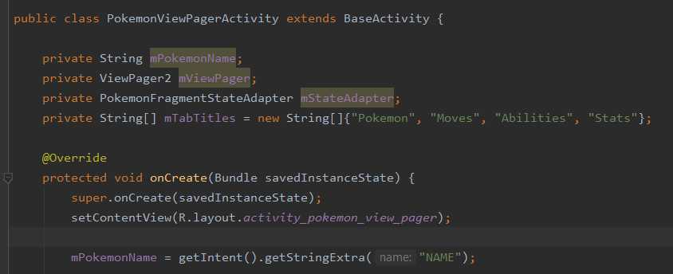
1. Create an Activity to control your ViewPager and Fragments
Create the code as follows.
The mTabTitles Array can be ignored for now.

Slide 5
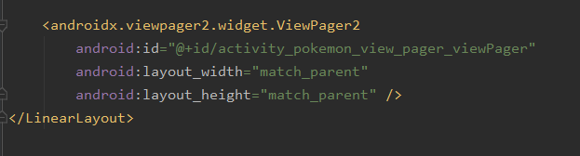
2. Create a Layout with a ViewPager2
Add a ViewPager2 Container to your Layout

Slide 6
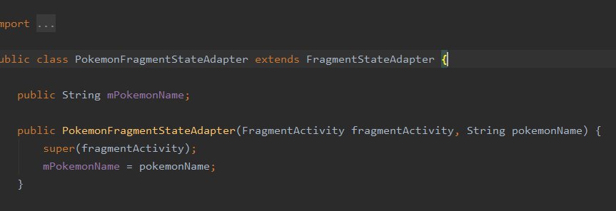
3. A) Create a new Class that extends FragmentStateAdapter
Add a ViewPager2 Container to your Layout
Create the following methods:
Constructor
getItemCount
createFragment
The last two are override methods.

Slide 7
3. B) Implement Constructor
I added the String of pokemonName to the constructor. This is not needed in general but I needed to pass that string to the fragments later.
super(fragmentActivity) is required.
Note AppCompatActivity is a FragmentActivity
Thus BaseActivity is also a FragmentActivity

Slide 8
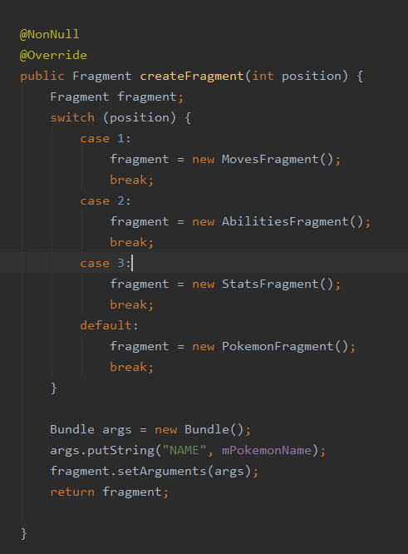
3. C) Implement createFragments()
This method will create the fragments for you. If you only have one repeating fragment you can just create a single fragment with the necessary data in a bundle.
I had 4 different fragments so I used a switch based on the current position being created.
After determining which fragment is needed I add a bundle to it and returned it.
The Fragments are held in a list. New fragments are added to that list. createFragment() is the method that fills that list.

Slide 9
3. D) Implement getItemCount()
This method tells the adapter how many fragments there should be in the list.
I had 4 so I just returned 4. If your needs are more complex I suggest passing the needed info in the Constructor.
The Fragments are held in a list. New fragments are added to that list. getItemCount determins the size of the list.

Slide 10

4. Putting it Together
Find the ViewPager2 view, create an instance of the FragmentStateAdapter you just created.
Set the adapter for the ViewPager2 to be you Adapter.

Slide 11
Remember to switch the Activity Started in the onClickListener of PokedexActivity to your new Activity

Slide 12

5. Extra: TabLayout
Add a TabLayout above the ViewPager2 view in the Layout created earlier.
Remove the automatically created TabItems if they are created.

Slide 13
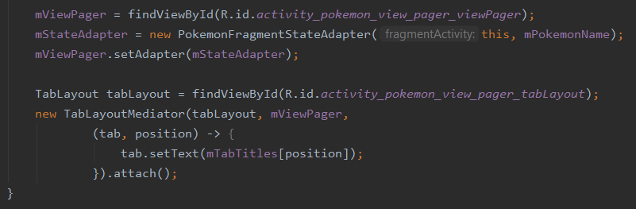
5. Extra: TabLayout
Find the TabLayout view, and attach it to you ViewPager using a TabLayoutMediator as follows.
That array of titles that could be ignored earlier can be used now to set the titles of the tabs.
This step requires Java 8.

