Slide 1
Data Science with Kaggle Decal – Decision Trees and Random Forests
Instructors: Jerry Chen, Joseph Simonian, Phillip Kuznetsov
Website: https://kaggledecal.github.io
Github: https://github.com/kaggledecal/kaggle_fa16
OH: See Piazza
Sign-In: [See board]
Fall ’16

Slide 2
Outline for Today
Decision Trees
Random Forests

Slide 3
Decision Trees - Motivation
Age | Has Job? | Owns Car
12 | 0 | 0
18 | 1 | 0
45 | 0 | 0
35 | 1 | 1
How would you split* each
column to make a prediction?
*If Age were less than ___, I would then guess that…

Slide 4
Decision Trees - Motivation
Age | Has Job? | Owns Car
12 | 0 | 0
18 | 1 | 0
45 | 0 | 0
35 | 1 | 1

Slide 5
Decision Trees - Motivation
Main question: Does this person own a car?
Age
<= 18
Has_Job?
Has_Job?
1
0
0
1

Slide 6
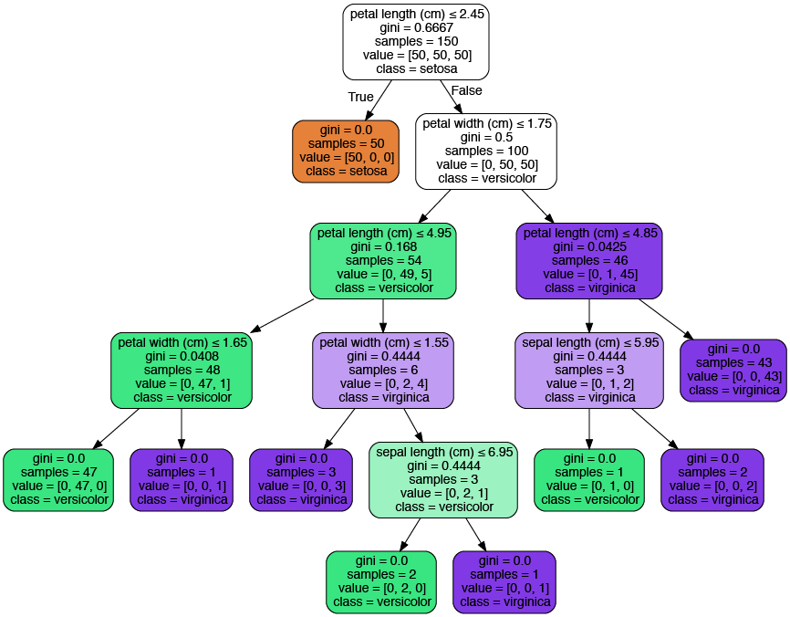
Decision Trees – Iris Data Set
Notice: everything
is a binary split!
Notes:
http://scikit-learn.org/stable/modules/tree.html

Slide 7

How to make decision trees
Choose an error metric to minimize
For regression problems – Residual Sum of Squares (RSS or SSE)
For classification problems – Gini index
Regression

Slide 8

How to find beta? Minimize objective function
College GPA
3.5
3.4
3.7
SAT Score
1800
1900
2000
College GPA
SAT Score
or
minimize

Slide 9
How to make decision trees
Choose an error metric to minimize
For regression problems – Residual Sum of Squares (RSS or SSE)
For classification problems – Gini index
Regression
Classification
where k is your kth class and m is your mth region

Slide 10
Residual Sum of Squares or SSE
Formula for SSE
…
0.1
0.5
m0
regions
…
…
0.3
0.4
0.9
m1
0.1
0.1
0.2
0.3
0.1
…
0.2

Slide 11
Residual Sum of Squares or SSE
Formula for SSE
…
0.1
0.5
m0
regions
…
…
0.3
0.4
m1
(0.1 – 0.44)^2 + (0.5 – 0.44)^2 + …
0.9
0.1
0.1
0.2
(0.1 – 0.167)^2 + (0.1 – 0.167)^2 + …
0.3
0.1
…
0.2

Slide 12
Residual Sum of Squares or SSE
Formula for SSE
(0.1 – 0.44)^2 + (0.5 – 0.44)^2 + …
(0.1 – 0.167)^2 + (0.1 – 0.167)^2 + …

Slide 13
Residual Sum of Squares or SSE
Formula for SSE
(0.1 – 0.44)^2 + (0.5 – 0.44)^2 + …
0.1
0.5
0.3
0.4
Vs.
0.9
(0.1 – 0.29)^2 + (0.5 – 0.29)^2 + …
(0.1 – 0.167)^2 + (0.1 – 0.167)^2 + …
0.1
0.1
0.2
0.3
0.1
0.2

Slide 14
Residual Sum of Squares or SSE
Formula for SSE
(0.1 – 0.44)^2 + (0.5 – 0.44)^2 + …
0.1
0.5
0.3
0.4
Vs.
0.9
(0.1 – 0.29)^2 + (0.5 – 0.29)^2 + …
(0.1 – 0.167)^2 + (0.1 – 0.167)^2 + …
0.1
0.1
0.2
0.3
0.1
***Our split helped! ☺
0.2

Slide 15
How to make decision trees
Choose an error metric to minimize
For regression problems – Residual Sum of Squares (RSS or SSE)
For classification problems – Gini index
Regression
Classification
where k is your kth class and m is your mth region

Slide 16
The Gini Index
Gini Equation
where k is your kth class and m is your mth region
…
m0
regions
…
…
m1
2 classes here:
Red = k0
Blue = k1
…

Slide 17
The Gini Index
Gini Equation
where k is your kth class and m is your mth region
…
Exercises
m0
regions
…
…
m1
2 classes here:
Red = k0
Blue = k1
…

Slide 18
The Gini Index
Gini Equation
where k is your kth class and m is your mth region
…
Exercises
2/5
m0
regions
…
…
3/5
m1
2 classes here:
Red = k0
Blue = k1
1/6
5/6
…

Slide 19
The Gini Index
Gini Equation
where k is your kth class and m is your mth region
Exercises
2/5
3/5
1/6
5/6

Slide 20
The Gini Index
Gini Equation
where k is your kth class and m is your mth region
Exercises
2/5
2/5 * (1 - 2/5) + 3/5*(1 - 3/5)
3/5
1/6
5/6

Slide 21
The Gini Index
Gini Equation
where k is your kth class and m is your mth region
Exercises
2/5
2/5 * (1 - 2/5) + 3/5*(1 - 3/5)
3/5
1/6
1/6 * (1 - 1/6) + 5/6*(1 - 5/6)
5/6

Slide 22
The Gini Index
Gini Equation
where k is your kth class and m is your mth region
Exercises
2/5
2/5 * (1 - 2/5) + 3/5*(1 - 3/5)
3/5
1/6
1/6 * (1 - 1/6) + 5/6*(1 - 5/6)
5/6
How do we get a Gini index of 0?
What’s the highest index we can get for a 2 class problem? For an N class problem?
In general, do we want a low or high Gini index?

Slide 23
The Gini Index
2/5 * (1 - 2/5) + 3/5*(1 - 3/5)
1/6 * (1 - 1/6) + 5/6*(1 - 5/6)
Vs.
3/11 * (1 - 3/11) + 8/11*(1 - 8/11)

Slide 24
The Gini Index
2/5 * (1 - 2/5) + 3/5*(1 - 3/5)
1/6 * (1 - 1/6) + 5/6*(1 - 5/6)
Vs.
3/11 * (1 - 3/11) + 8/11*(1 - 8/11)
** So our split helped! ☺

Slide 25
The Gini Index
Gini Equation
where k is your kth class and m is your mth region
…
…
…
or
for multiple classes
…

Slide 26
How to make decision trees
Choose an error metric to minimize
For regression problems – Residual Sum of Squares (RSS or SSE)
For classification problems – Gini index
Regression
Classification
where k is your kth class and m is your mth region

Slide 27
How to make decision trees
Choose an error metric to minimize
For regression problems – Residual Sum of Squares (RSS or SSE)
For classification problems – Gini index
Regression
Classification
where k is your kth class and m is your mth region
Choose the split that minimizes SSE or G for each variable and perform split for best one
Repeat #2 for each split you made
Repeat until the number of rows in a region is below some threshold

Slide 28
Decision Trees – Iris Data Set
Notice: everything
is a binary split!
Notes:
http://scikit-learn.org/stable/modules/tree.html

Slide 29
Random Forests
It turns out that using a single decision tree to predict is fairly inaccurate.
This is because decision trees fit really well to training data but not necessarily to test data.
A good work around is to make a bunch of decision trees on different subsets of the data, then average the
the predictions from each tree.

Slide 30
Random Forests
It turns out that using a single decision tree to predict is fairly inaccurate.
This is because decision trees fit really well to training data but not necessarily to test data.
A good work around is to make a bunch of decision trees on different subsets of the data, then average the
the predictions from each tree.
This procedure will thus make a forest.
Notes:
https://www.mapr.com/sites/default/files/blogimages/sparkmlrandomforest.png

Slide 31
Random Forests
The random part of RandomForests comes from the fact that we randomly pick which rows and columns of
data to feed into each decision tree.
Consequently, each decision tree we make will be different.
We can then aggregate the predictions from each tree to form
our final prediction.
Notes:
https://www.mapr.com/sites/default/files/blogimages/sparkmlrandomforest.png

Slide 32
Random Forests
The random part of RandomForests comes from the fact that we randomly pick which rows and columns of
data to feed into each decision tree.
Consequently, each decision tree we make will be different.
We can then aggregate the predictions from each tree to form
our final prediction.
Regression
Tree 1: 12.06
Tree 2: 14
Tree 3: 11.59
Tree 4: 10
Tree 5: 12
Final Prediction: 11.93
(Average)
Notes:
https://www.mapr.com/sites/default/files/blogimages/sparkmlrandomforest.png

Slide 33
Random Forests
The random part of RandomForests comes from the fact that we randomly pick which rows and columns of
data to feed into each decision tree.
Consequently, each decision tree we make will be different.
We can then aggregate the predictions from each tree to form
our final prediction.
Regression
Classification
Tree 1: 12.06
Tree 2: 14
Tree 3: 11.59
Tree 4: 10
Tree 5: 12
Final Prediction: 11.93
Tree 1: Freshman
Tree 2: Freshman
Tree 3: Senior
Tree 4: Junior
Tree 5: Freshman
Final Prediction: Freshman
(Average)
(Mode)
Notes:
https://www.mapr.com/sites/default/files/blogimages/sparkmlrandomforest.png

