Slide 1
Data Science with Kaggle Decal – Bias-Variance Tradeoff, Clustering, K-Means
Instructors: Jerry Chen, Joseph Simonian, Phillip Kuznetsov
Website: https://kaggledecal.github.io
Github: https://github.com/kaggledecal/kaggle_fa16
OH: See Piazza
Sign-In: [See board]
Fall ’16

Slide 2
Outline
Unsupervised Learning and Clustering
Intro to K-Means

Slide 3
What is Unsupervised Learning?
Wikipedia Definition : “inferring a function to describe hidden structure from unlabeled data”
In contrast, Linear/Logistic Regression and k-NN are supervised

Slide 4
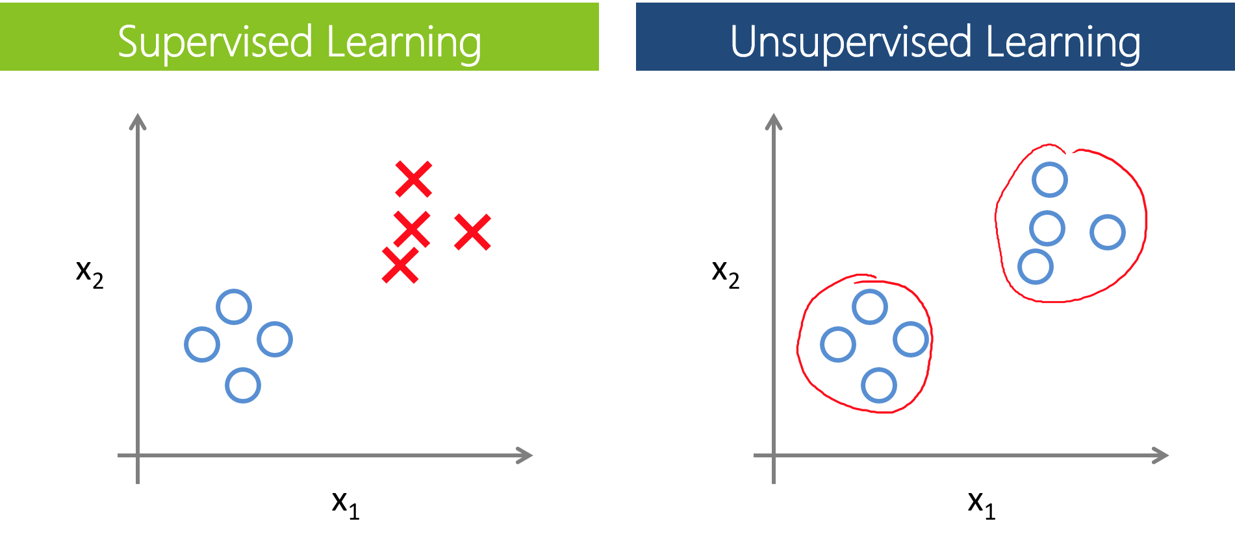
What’s the Difference?
Supervised Learning:
Unsupervised Learning:
Image source: https://leonardoaraujosantos.gitbooks.io/artificial-inteligence/content/machine_learning.html
Notes:
Supervised Learning 1: $$\{(x_{(0)}, y_{(0)}), (x_{(1)}, y_{(1)}), \dots, (x_{(n)}, y_{(n)})\}$$

Slide 5
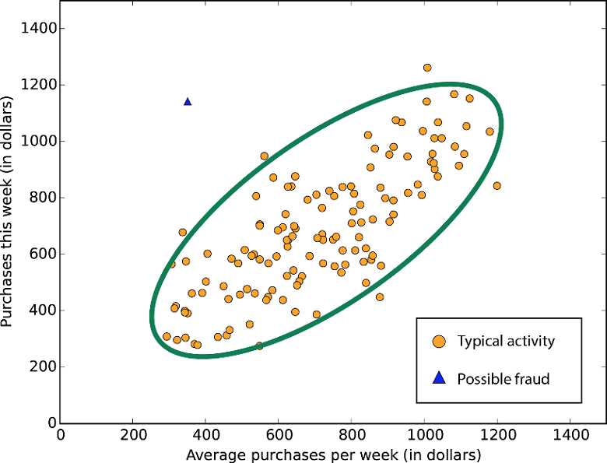
Ways to do it
Clustering
Neural networks
Anomaly Detection
Source
Notes:
The picture on the right shows anamoly detection, the one on the bottom left is clustering.
For sake of time, we’ll be looking at clustering. We’ll have a later section on supervised neural networks later on, but if you’re curious, the unsupervised learning subset of neural networks is called Hebbian Learning

Slide 6
Clustering and K-means
Clustering is grouping together data that have similar characteristics
There’s a bunch of techniques, but the most popular is called K-means
Notes:
The picture on the right shows anamoly detection, the one on the bottom left is clustering.
For sake of time, we’ll be looking at clustering. We’ll have a later section on supervised neural networks later on, but if you’re curious, the unsupervised learning subset of neural networks is called Hebbian Learning

Slide 7
K-means Algorithm
Initialize k centroids randomly
Iterate through data and find the closest centroid to each data point. Label the data point using the centroid
For each centroid, take the mean of all data points labeled by the centroid. This will be the new coords
Repeat steps 2-4 until no data is re-labelled (same thing as when centroids stop changing)

Slide 8
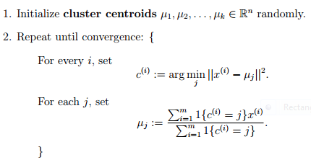
K-means Algorithm + More Math
Pseudocode Source

