Slide 1
Data Science with Kaggle Decal – Validation Methods
Instructors: Jerry Chen, Joseph Simonian, Phillip Kuznetsov
Website: https://kaggledecal.github.io
Github: https://github.com/kaggledecal/kaggle_fa16
OH: See Piazza
Sign-In: [See board]
Fall ’16

Slide 2
Outline
Cross-Validation
Review of Models

Slide 3
Evaluating your Model
Darlene the Data Scientist is making a k-NN model, but doesn’t know what k value to pick.
She tries the values 2,4, 8, and 16 which give an accuracy of 94%, 85%, 90%, and 94% accuracy on the training set.
She chooses to go with k = 2 and runs the trained model on the test set, predicting the labels of the test set. She saves these labels to a csv.
However when she submits to Kaggle, her accuracy on the test set is actually 60%
What went wrong?
Notes:
Reach out to the class for the question
Wait until someone mentions that she’s evaluating her accuracy on the training set
“What should she be evaluating on?”

Slide 4
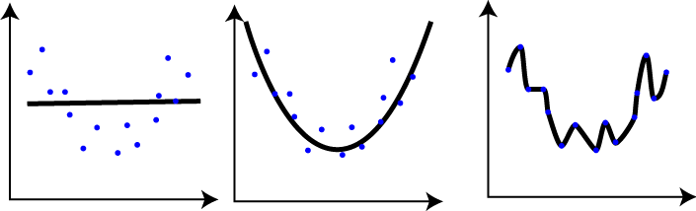
Overfitting
Underfitting Model
Correct Model
Overfitting Model
Source
Notes:
Supervised Learning 1: $$\{(x_{(0)}, y_{(0)}), (x_{(1)}, y_{(1)}), \dots, (x_{(n)}, y_{(n)})\}$$

Slide 5
How can we prevent it?
CROSS VALIDATION
Split data into 3 datasets: Training, Validation, Testing
Fit the model on Training
Change the hyper-parameters on Validation
Assess Generalization on Testing – think of as hold out test set
Notes:
We typically break up our data into three partitions – Training Set, Validation Set, and Testing Set

Slide 6
Limitations of 3 datasets
What if we don’t have that much data? How do we split our data to account for this?
Larger test set provides a better estimate of accuracy
Larger training set will be more representative of all data

Slide 7
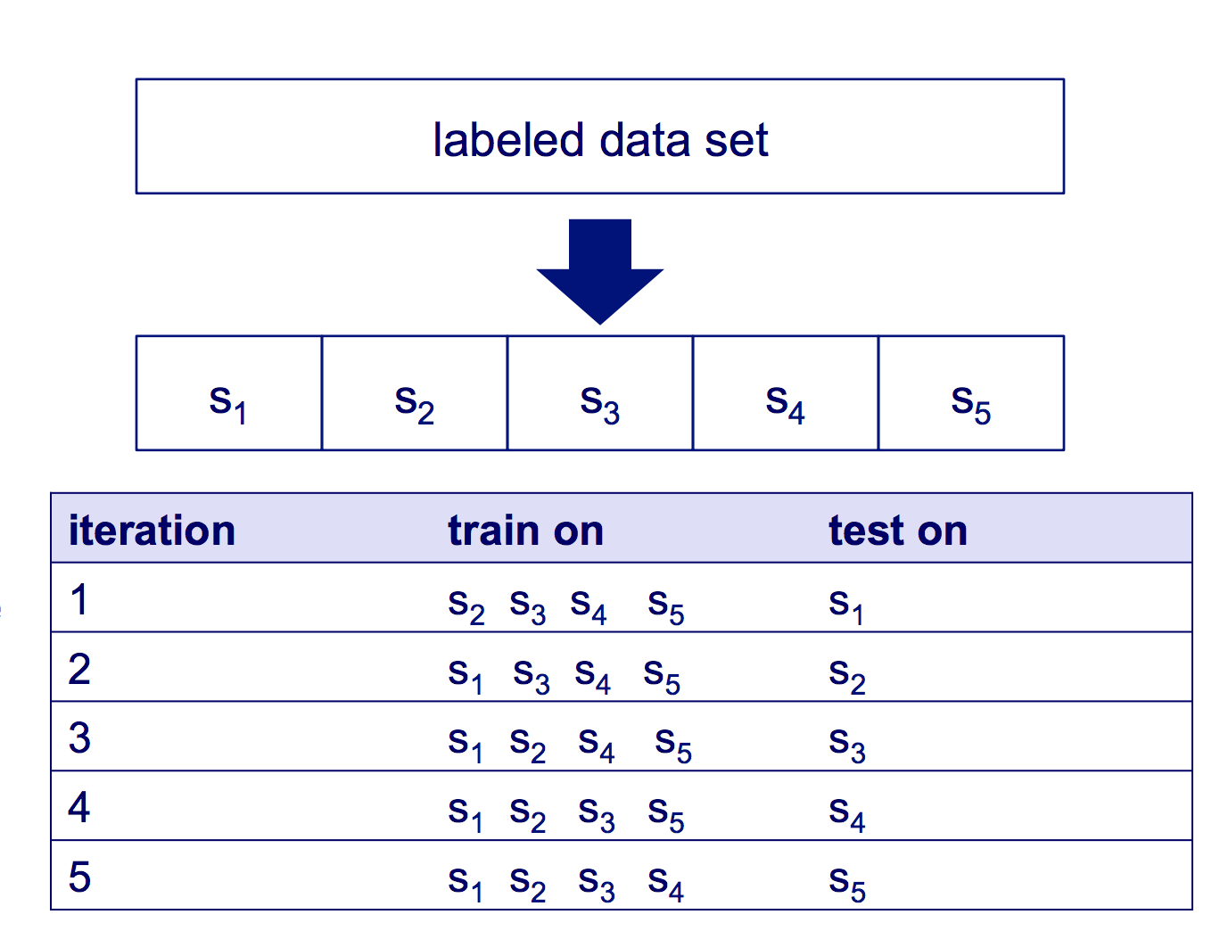
K- Fold
Split data into k partitions
Use k-1 sets as training set
Use remaining set as the validation
Source
Notes:
What this does is basically remove any inherent patterns that may happen by accident when
Ben Recht, this semester’s 189 professor, brought up a situation from his grad school years where a fellow grad student’s model was disproven when Ben shuffled the data. You really need to do this.

Slide 8
Sources of Overfitting
Adjusting parameters based on training or test set (versus the validation set)
Not randomizing your test set (hold out data)
Some inherent pattern in training data that occurs by chance
You

Slide 9
Acknowledgements
University of Wisconsin-Madison Lecture on evaluating machine learning models:
http://pages.cs.wisc.edu/~dpage/cs760/evaluating.pdf

