Slide 1
Data Science with Kaggle Decal – Review
Instructors: Jerry Chen, Joseph Simonian, Phillip Kuznetsov
Website: https://kaggledecal.github.io
Github: https://github.com/kaggledecal/kaggle_fa16
OH: See Piazza
Sign-In: [See board]
Fall ’16

Slide 2
Outline for Today
Linear/Logistic Regression
Clustering
Cross Validation
Decision Trees
Neural Networks
Ensembling
Next Semester Plans
Free OH

Slide 3


Motivation
College GPA
3.5
3.4
3.7
SAT Score
1800
1900
2000
College GPA
SAT Score

Slide 4
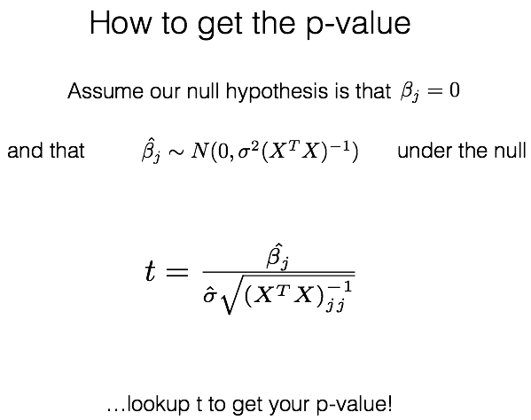
Getting p-values for Beta Coefficients
(or use a python package)

Slide 5
Logistic Regression Interpretation
In contrast to linear regression where a 1 unit increase in x corresponds to a beta change in y,
in logistic regression a 1 unit increase in x corresponds to a different change in y depending on what value x is.
Since the relationship between X and p(X) is not a straight line.
So a positive, significant beta suggests an increase in the x variable increases the probability of something occurring.
A negative, significant beta suggests a increase in the x variable decreases the probability of something occurring.

Slide 6
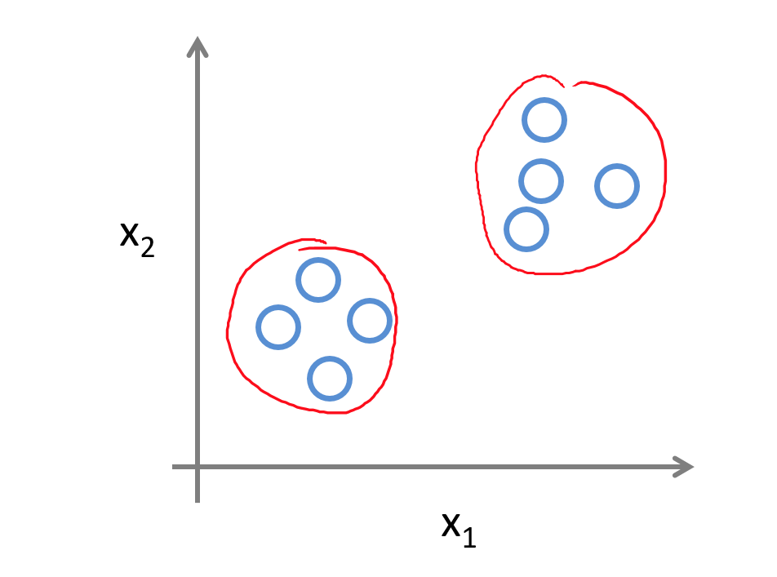
Clustering and K-means
Clustering is grouping together data that have similar characteristics
There’s a bunch of techniques, but the most popular is called K-means
Notes:
The picture on the right shows anamoly detection, the one on the bottom left is clustering.
For sake of time, we’ll be looking at clustering. We’ll have a later section on supervised neural networks later on, but if you’re curious, the unsupervised learning subset of neural networks is called Hebbian Learning

Slide 7
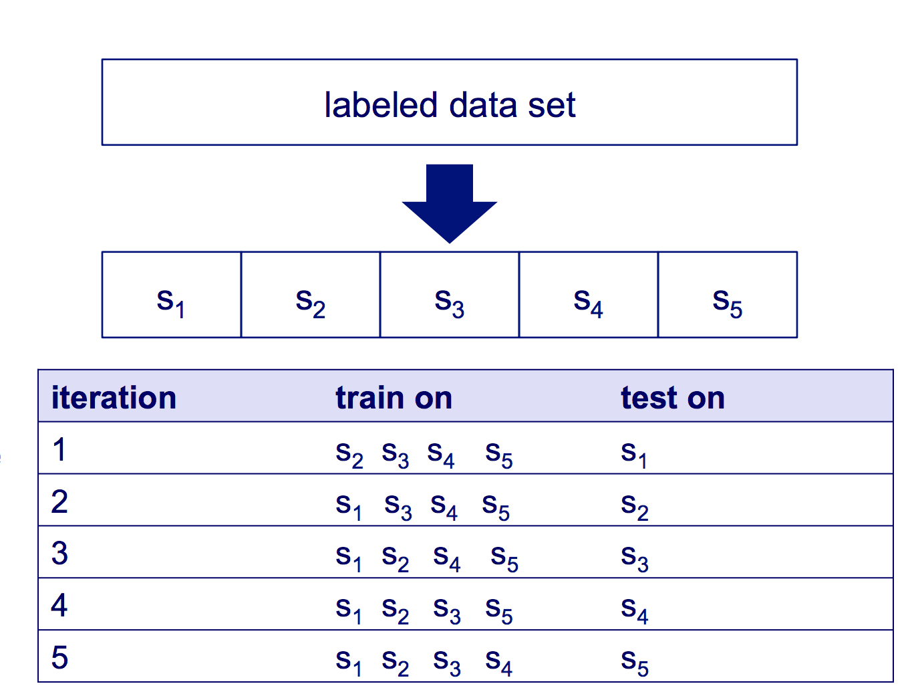
K- Fold
Split data into k partitions
Use k-1 sets as training set
Use remaining set as the validation
Source
Notes:
What this does is basically remove any inherent patterns that may happen by accident when
Ben Recht, this semester’s 189 professor, brought up a situation from his grad school years where a fellow grad student’s model was disproven when Ben shuffled the data. You really need to do this.

Slide 8
Decision Trees - Motivation
Age | Has Job? | Owns Car
12 | 0 | 0
18 | 1 | 0
45 | 0 | 0
35 | 1 | 1

Slide 9
Decision Trees - Motivation
Main question: Does this person own a car?
Age
<= 18
Has_Job?
Has_Job?
1
0
0
1

Slide 10
Random Forests
The random part of RandomForests comes from the fact that we randomly pick which rows and columns of
data to feed into each decision tree.
Consequently, each decision tree we make will be different.
We can then aggregate the predictions from each tree to form
our final prediction.
Regression
Classification
Tree 1: 12.06
Tree 2: 14
Tree 3: 11.59
Tree 4: 10
Tree 5: 12
Final Prediction: 11.93
Tree 1: Freshman
Tree 2: Freshman
Tree 3: Senior
Tree 4: Junior
Tree 5: Freshman
Final Prediction: Freshman
(Average)
(Mode)
Notes:
https://www.mapr.com/sites/default/files/blogimages/sparkmlrandomforest.png

Slide 11
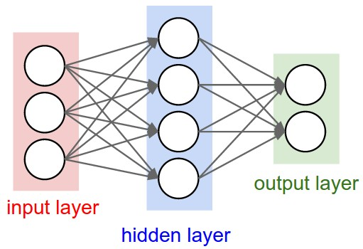
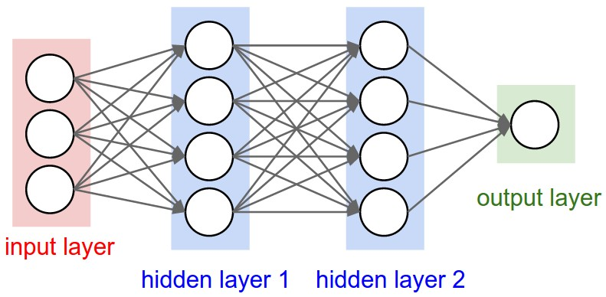
Fully-Connected Neural Network
Notes:
You might remember from last time that we can model a single neuron as a linear combination of the inputs (that’s the x values) and weights (that’s the w values). We can then take this same model, duplicate over and over gain to make a layer, then connect the outputs of this layer to the inputs of another layer, as many times as we’d like (and think we have resources for).
Now the big question you might be asking is, how could we make our model learn?

Slide 12
Blending Example
1
2
3
LR
4
KNN
Local Train
RF
Train Data
NN
Train on local train
set. Then predict
on local test set
and actual test set.
LR
Local Test
Train on local test
set. Then predict
on actual test set.
5
Ensembled
Prediction
Test Data

Slide 13
Stacking Example
1
2
3
LR
4
KNN
Local Train A
LR
RF
Train Data
NN
Train on A+B,
Predict on test
set.
Train on A, predict on B.
Train on B, predict on A.
Train on A+B, predict on
test set. Repeat for each
model.
Local Train B
5
Ensembled
Prediction
Test Data

Slide 14
Next Semester Plans
The decal will continue next semester! Time and location TBD.
Cal Kaggle Team

Slide 15
Next Semester Plans
The decal will continue next semester! Time and location TBD.
Cal Kaggle Team
Free OH!

