Slide 1
Data Science with Kaggle Decal How Neural Networks Learn
Instructors: Jerry Chen, Joseph Simonian, Phillip Kuznetsov
Website: https://kaggledecal.github.io
Github: https://github.com/kaggledecal/kaggle_fa16
OH: See Piazza
Sign-In: [See board]
Fall ’16

Slide 2
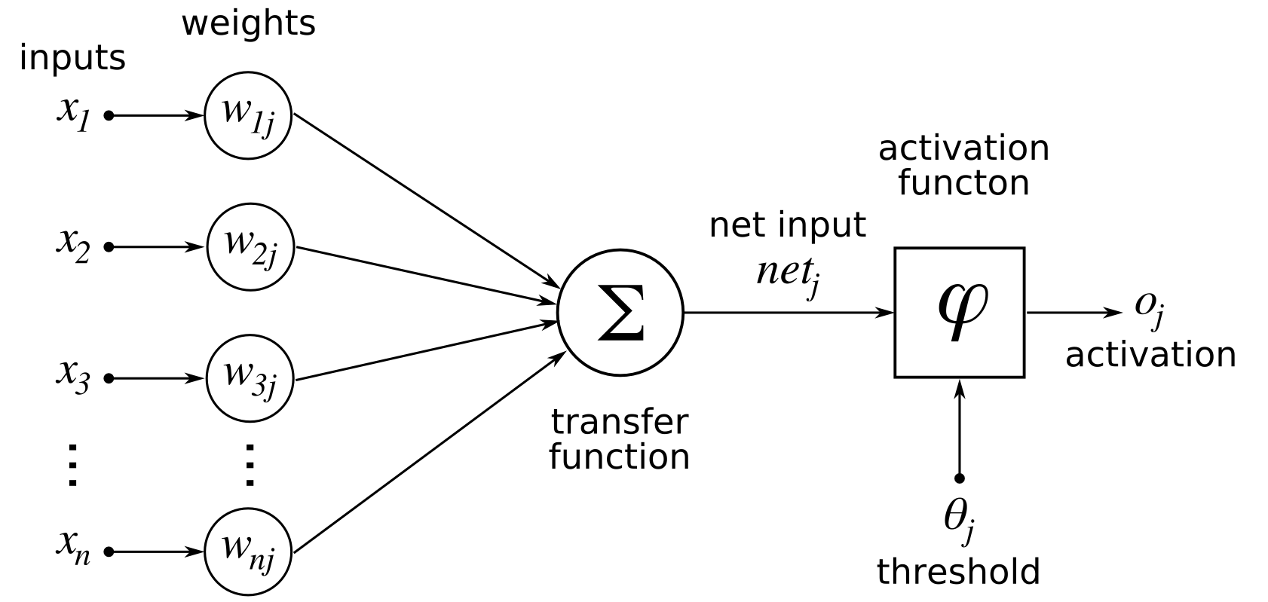
Single Neuron
Notes:
You might remember from last time that we can model a single neuron as a linear combination of the inputs (that’s the x values) and weights (that’s the w values). We can then take this same model, duplicate over and over gain to make a layer, then connect the outputs of this layer to the inputs of another layer, as many times as we’d like (and think we have resources for)

Slide 3
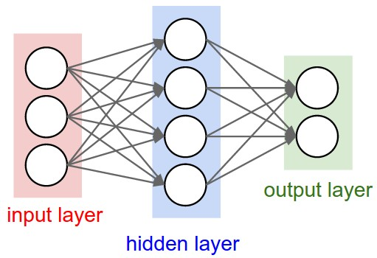
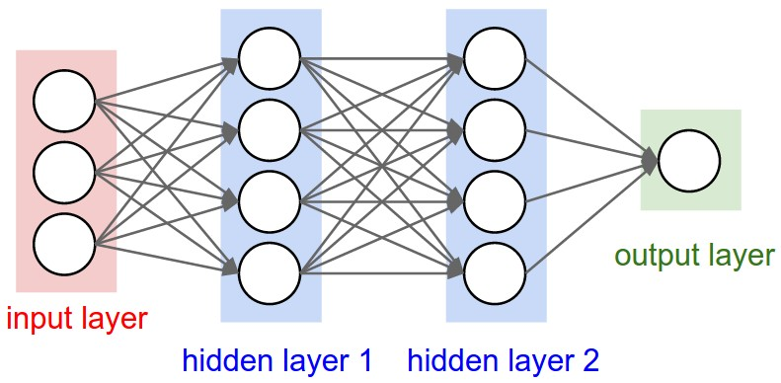
Fully-Connected Neural Network
Notes:
You might remember from last time that we can model a single neuron as a linear combination of the inputs (that’s the x values) and weights (that’s the w values). We can then take this same model, duplicate over and over gain to make a layer, then connect the outputs of this layer to the inputs of another layer, as many times as we’d like (and think we have resources for).
Now the big question you might be asking is, how could we make our model learn?

Slide 4
How do we make it learn?
Do it by hand?
Throw random values at it until it works?
We need an algorithm that does this for us
Notes:
Draw on the board with a 2-1 demo

Slide 5
What our algorithm needs to do
Know the desired output of the network
Determine what weights are most important
Determine what way to change those weights to minimize error
Image Source
Notes:
Under a supervised learning paradigm, we get the first qualification for free. For MNIST, we know that a handwritten 9 should encourage the network to output a 9.
Determining what weights are important, however, is a more difficult challenge. What we need is a way to determine how much a single weight affects the output. We want to be able to change the weight value in such a way that it increases the accuracy of our network the most.
What if we could determine the direction of these weights

Slide 6
The Solution
GRADIENT DESCENT
Notes:
Now this allows us to create a mathematical representation of what our weights and the error of our algorithm will look like. We can then traverse the representation to find the location with least error.

Slide 7
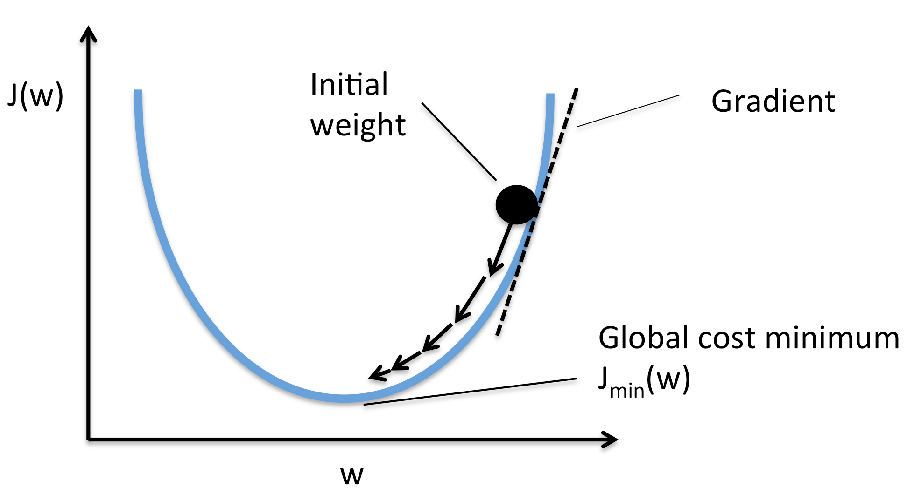
Gradient Descent
Notes:
The basis idea behind gradient descent is that we have an error surface (a curve in this example) that we want to find the bottom of. Our algorithm acts like a ball in this surface – we want to roll down the direction of steepest descent.
Now if we were to expand this to two dimensions, we’d get a plot like <next-slide>

Slide 8
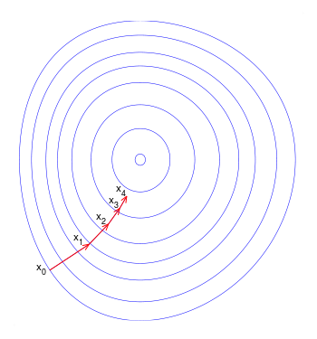
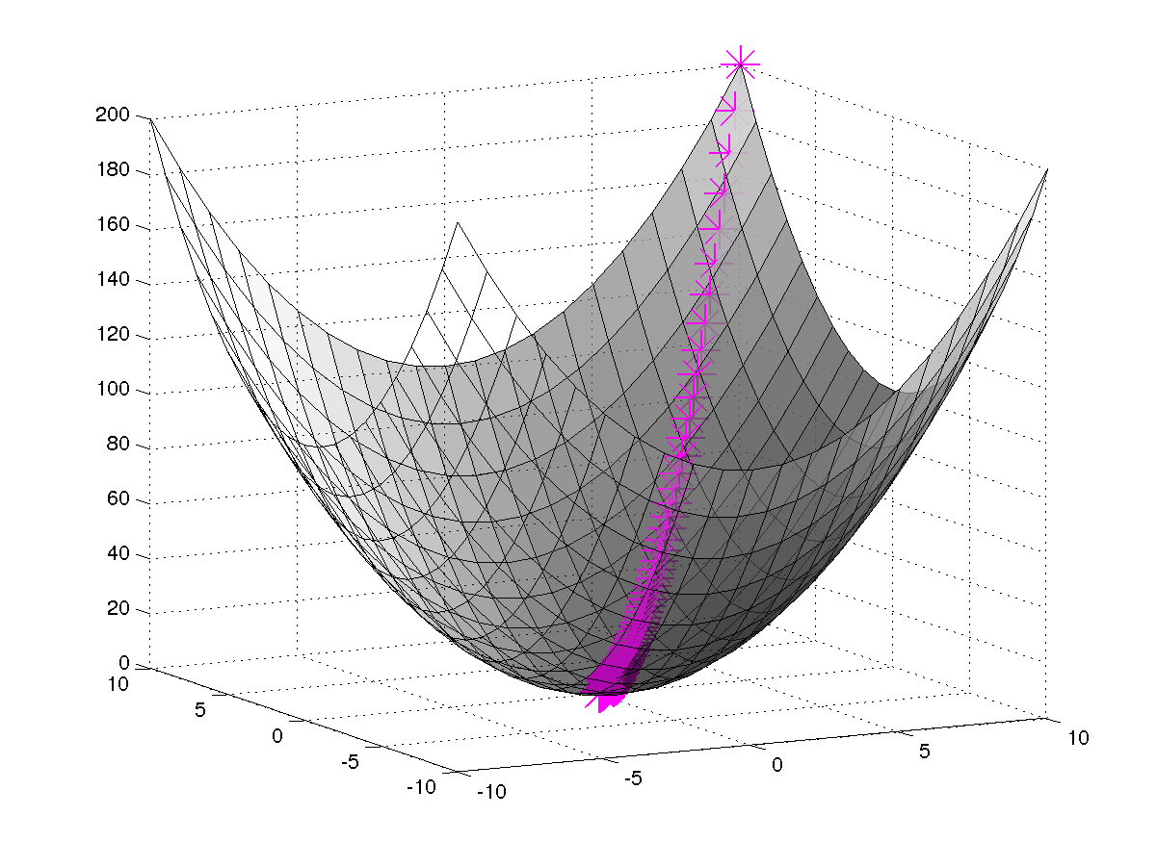
Gradient Descent
Notes:
We see here the case where we now display two weights on the graph

Slide 9
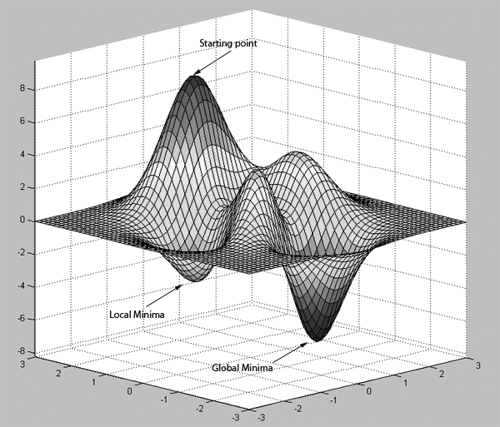
Why do we need gradient descent?
Couldn’t we just solve for the minimum (where the gradient = 0)?
No, for these reasons:
Most neural network problems are non – convex
Has many local minima that could be confused with the global minima
Solving using a quadratic solver is impossible
Notes:
For those of you who remember calculus, you might wonder, why can’t we just solve for the minimum (where the gradient = 0)?
The crux of this problem is summarized through this analogy:
Imagine you’re a hiker on a mountain, and you know the sun is setting soon.
You try to walk down the mountain, however your vision quickly becomes encapsulated by a thick layer of fog, meaning you can only see the topography 20 ft in all directions.
You want to make it to the village which is at the bottom of the valley, so you walk in the direction of steepest descent, because that will guarantee you’ll get to the bottom of the mountain. However your greater goal is to get off the slope in the first place, so you’ll at least be happy to not be in a valley.
Now of course there are discrepencies

Slide 10
Stochastic gradient descent
Randomly sample datapoint
Calculate the gradient w.r.t. those datapoints
Update weights according to the gradient
Compromise w/ batch g.d. through “mini-batches”
Notes:
For those of you who remember calculus, you might wonder, why can’t we just solve for the minimum (where the gradient = 0?

Slide 11
Now how about neural networks
Naïve implementation is O(n^2)
We need something better
The structure of the network can help us
Chain Rule
Notes:
For those of you who remember calculus, you might wonder, why can’t we just solve for the minimum (where the gradient = 0?

Slide 12
Gradient Descent + Chain Rule =
BACKPROPAGATION
More Here
Notes:
Backpropagation is the answer to all of our problems

Slide 13
Backpropagation
More Here and Here
Notes:
Backpropagation is the answer to all of our problems. Because of the scope of our class, I’ll provide a very very surface level understanding of what is happening here, but I recommend you run through the derivation in the video, then go to neuralnetworksanddeeplearning.com to walk through a derivation.
For those of you who really want to know what’s happening underneath the hood, I recommend you actually do this by hand for a network with 2 inputs, 3 hidden units and 1 output. Feel free to send me a picture of your derivation and I can try to spot any discrepancies.
Anyways, all we basically do is take the gradient of the netand the work output w.r.t to the error function.
We can then pass this gradient back through to the second hidden layer in our network, exploiting the chain rule. We calculate the gradient w.r.t to this value and the input into the layer, then pass that gradient back through to the first hidden layer and so on.

Slide 14
Intuition for Neural Networks Learning
Linear Decision Boundary
Circular Decision Boundary
Manifold Demo
More on visualizing training
Notes:
Now with this in mind, let’s try to build your intuition on what is actually happening when we train our neural network.

Slide 15
More Resources
http://neuralnetworksanddeeplearning.com/
Neural Networks Demystified: https://www.youtube.com/watch?v=bxe2T-V8XRs&list=PLiaHhY2iBX9hdHaRr6b7XevZtgZRa1PoU
Hacker’s guide to Neural Networks: http://karpathy.github.io/neuralnets/
Javascript implementation – I haven’t read this piece, but I like his other blogposts

