Slide 1
Data Science with Kaggle Decal The Neural Network Zoo
Instructors: Jerry Chen, Joseph Simonian, Phillip Kuznetsov
Website: https://kaggledecal.github.io
Github: https://github.com/kaggledecal/kaggle_fa16
OH: See Piazza
Sign-In: [See board]
Fall ’16

Slide 2
Acknowledgements
Much of the material from this lecture comes from here:
www.asimovinstitute.org/neural-network-zoo/
Awesome blog post that displays all of the different types of networks out there
Notes:
Keras is a really great tool to get your deep learning projects off the ground.
Building a network in Keras is really easy.
You just need to define the model, then define what optimization technique you want and you’re done
It’s great because you can also choose the backend deep learning framework you want to use.
Tensorflow and Theano will probably continue to try and out perform each other, so why not avoid the compromise – chose both

Slide 3
Other information
All of the notebooks use Keras and are available in this repo:https://github.com/philkuz/Neural-Network-Zoo
And are running on an Amazon instance with GPU
(p2.xlarge to be exact)
Video coming soon
Notes:
I will make a video that details how to setup an amazon instance like I have, running through the step by step process and point you to all the things you need to properly set everything up.

Slide 4
Other information
All of the notebooks use Keras and are available in this repo:https://github.com/philkuz/Neural-Network-Zoo
And are running on an Amazon instance with GPU
(p2.xlarge to be exact)
Video coming soon
Notes:
I will make a video that details how to setup an amazon instance like I have, running through the step by step process and point you to all the things you need to properly set everything up.

Slide 5
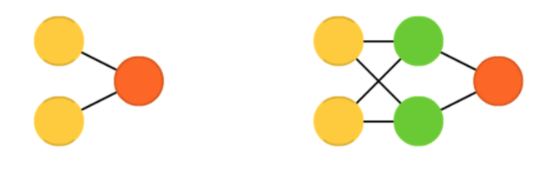
Some Familiar Faces
Perceptron
Fully-Connected Feed Forward

Slide 6
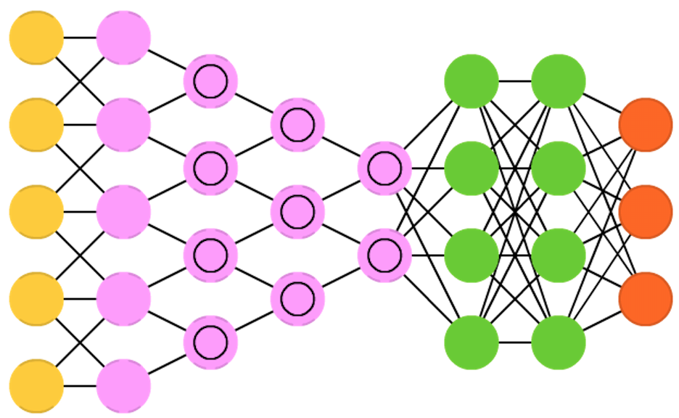
Some Familiar Faces
Convolutional Neural Network

Slide 7
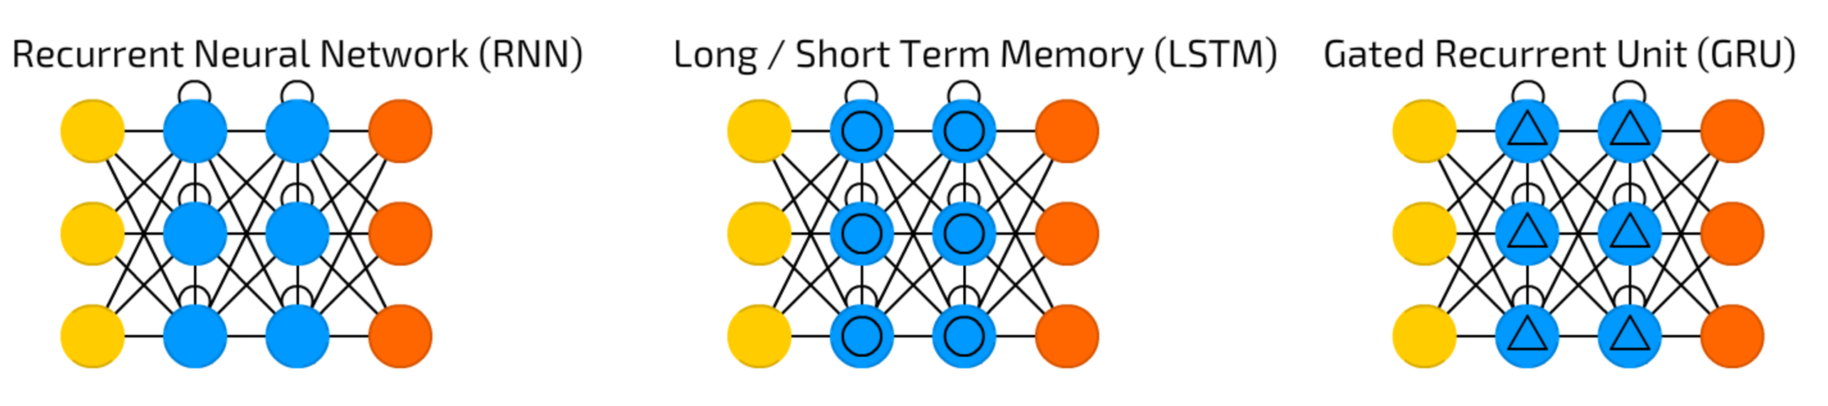
Less familiar
Unreasonable Effectiveness of RNNs
LSTMs Blog post by Colah
Short film w/ script generated by an LSTM
Website for the LSTM screenwriter
Notes:
Loops in the graph
These loops provide a notion of state
Important for dealing with time series data like stocks for example
Also good for data with sequences
Especially good with speech, autocomplete, things like that

Slide 8
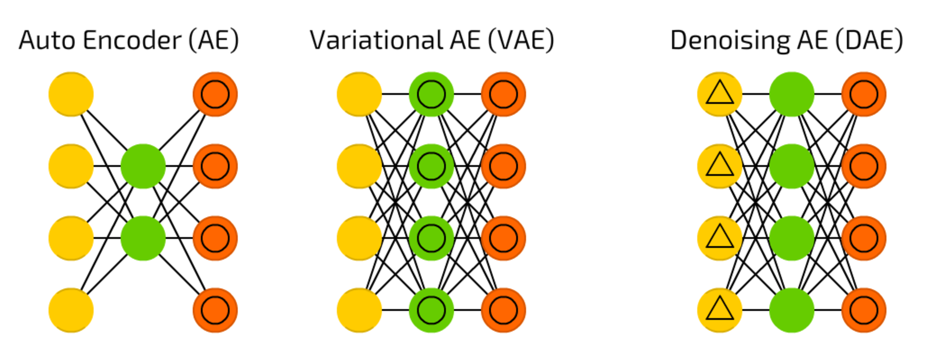
Auto Encoders
Building an Autoencoder in Keras
Notes:
Use the structure of the network to do a bunch of cool operations.
Basically, we pass in an input to the network and ask it to try and reconstruct that input.
Why the identity loss?
You’ll notice in this structure that we have a bottleneck.
What you’ve got to realize is that in the process of learning this identity to itself, we’re actually compressing the information along the path that it travels. Using backpropagation, we basically can learn a mapping that places information into this bottleneck, shown as this center layer, that will effectively learn a proper compression through the preceding layers.
We can then simply remove all layers after the bottoleneckand we get a well-trained compression technique.
Subsequently, we can remove all layers before the bottleneck to get a deencoder.
The vanilla auto-encoder allows you to use neural networks to compress your

