Slide 1

AI-Spotter
Final Presentation
Course: Senior Capstone 1
Team: 58
Developed By: Jacob Collier, Elijah Garman, Denis Kalala & Michael Martina

Slide 2

Semester Progress
Website is functional
Image upload working
Detection models improving
User workflow foundation

Slide 3

Current Limitations
All images in one shared folder
No user accounts
No privacy controls

Slide 4

Why Privacy Matters
Users upload sensitive images
Need private, isolated data
Shared storage is unsafe

Slide 5
Planned Login System
User accounts
Private storage
Authentication
Spring milestone

Slide 6

How This Supports the Project
Builds trust
Allows safe uploading
Scales for real users

Slide 7
Next Steps
Build
Build registration
Add
Add sessions
Map
Map storage to accounts
Finish
Finish privacy features

Slide 8
Functionality of the current application

Slide 10
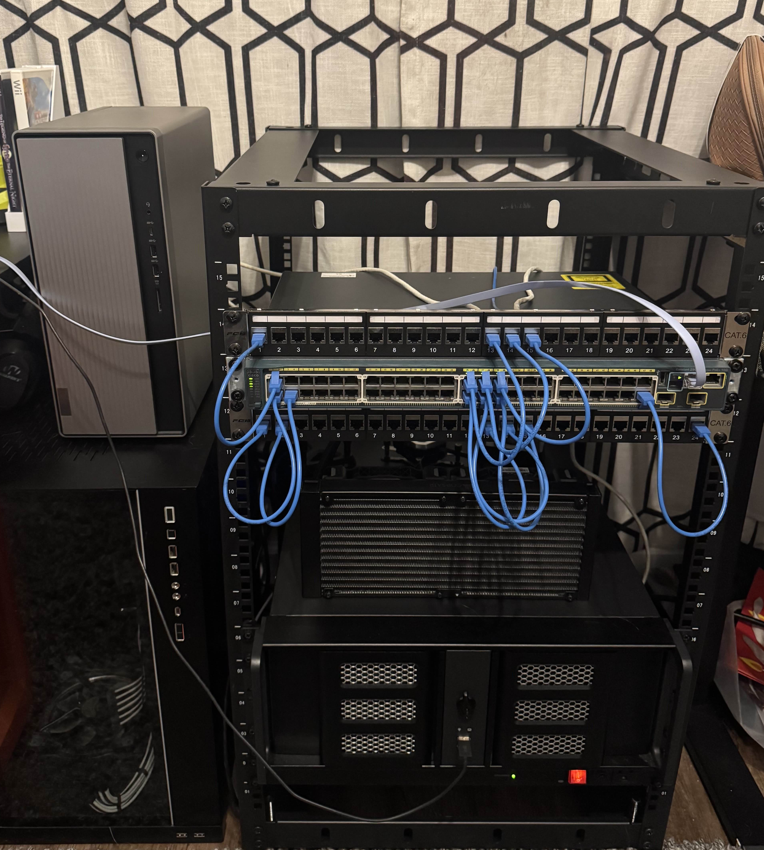
Designing an environment to securely run our application
Jacob primarily tackled researching, purchasing, and implementing any network equipment (Software, hardware, etc.).
Using his Home Lab, we can perform tests on the overall development, security, and efficiency of the application.

Slide 11
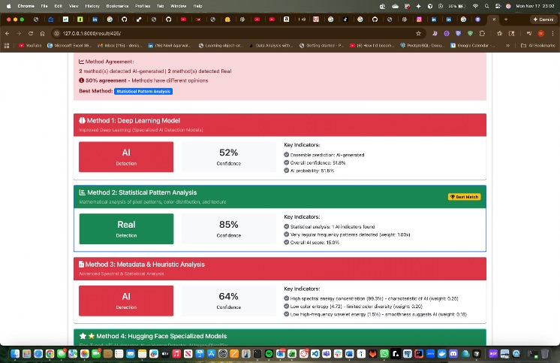
Functionality of the Current Application
Image Upload & Detection: Users can upload images for AI vs. human-created analysis.
Multi-Model Detection System:
- Deep Learning Model: Predicts AI-generated content (~51–52% confidence).
- Statistical Pattern Analysis: Strong indicator for real images (up to 85% confidence).
- Metadata & Heuristic Analysis: Adds context (~64% confidence).
- Hugging Face Specialized Models: Additional verification (~63% confidence).
Detailed Results: Displays confidence levels, key indicators, and technical details.
User Feedback Loop: Allows marking results as correct/incorrect to improve accuracy.

Slide 12
Progress Toward AI Detection Goals
Current Accuracy: Nearly 50% effective in determining if an image is AI-generated or real.
Key Achievements:
- Implemented multi-model comparison for better reliability.
- Integrated confidence scoring and technical breakdowns for transparency.
- Built a feedback mechanism to refine detection continuously.
Next Milestone: Improve model agreement and push accuracy beyond 70% by optimizing algorithms and training data.

