Slide 1
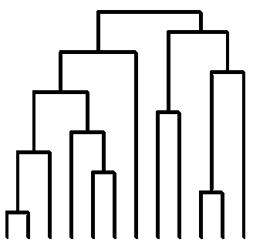
Signatures (+Article Data)
s₁
s_{2,}
.
.
.
s_{n}
Complementing Features:
+ Focus Name
+ LDA Topic
+ Ethnicities
Signatures (+Article Data)
s₁
s_{2,}
.
.
.
s_{n}
Complementing Features:
+ Focus Name
+ LDA Topic
+ Ethnicities
Focus Name
Focus Name
Cross Product Signatures
Similarity Features:
+ Eq. First Name
+ Eq. Middle Name
+ Eq. LDA Topic
+ Diff. Pub. Year
+ Dist. Keywords
+ Dist. References
+ Dist. Subject
+ Dist. Title
+ Dist. Coauthors
+ Dist. Ethnicities
s₁, s2 , … ,s_{n}
Cross Product Signatures
s₁
s₂
.
.
.
s_{n}
Similarity Features:
+ Eq. First Name
+ Eq. Middle Name
+ Eq. LDA Topic
+ Diff. Pub. Year
+ Dist. Keywords
+ Dist. References
+ Dist. Subject
+ Dist. Title
+ Dist. Coauthors
+ Dist. Ethnicities
s₁, s2 , … ,s_{n}
s₁
s₂
.
.
.
s_{n}
Data Mining Techniques:
SVM, LR, GB, RF
s1 s2 =
Signatures belong to the same author or not.
Data Mining Techniques:
SVM, LR, GB, RF
s1 s2 =
Signatures belong to the same author or not.
Hierarchical Clustering
Hierarchical Clustering
Signatures are clustered in disambiguated authors.
Signatures are clustered in disambiguated authors.
Cluster: Disambiguated Author
Cluster: Disambiguated Author

Slide 3
Signatures (+Article Data)
Complementing Features:
+ Focus Name
+ LDA Topic
+ Ethnicities
s₁
s_{2,}
.
.
.
s_{n}
Focus Name
Cross Product Signatures
Similarity Features:
+ Eq. First Name
+ Eq. Middle Name
+ Eq. LDA Topic
+ Diff. Pub. Year
+ Dist. Keywords
+ Dist. References
+ Dist. Subject
+ Dist. Title
+ Dist. Coauthors
+ Dist. Ethnicities
s₁, s2 , … ,s_{n}
s₁
s₂
.
.
.
s_{n}
Data Mining Techniques:
SVM, LR, GB, RF
s1 s2 =
Signatures belong to the same author or not.
Hierarchical Clustering
Signatures are clustered in disambiguated authors.
Cluster: Disambiguated Author

Slide 4
Articles
Articles
id
title
journal
year
Keywords
Subjects
id
title
journal
year
1
0 … *
Keywords
Subjects
# id
keyword
# id
subject
1
0 … *
# id
keyword
# id
subject
0 … *
0 … *
1
0 … *
0 … *
1
References
References
# id
journal
year
1 … *
Signatures
Institutions
# id
journal
year
1 … *
Signatures
Institutions
# id
d
first_name
fn_initial
mn_initial
last_name
# id
# d
institution
0 … *
# id
d
first_name
fn_initial
mn_initial
last_name
# id
# d
institution
0 … *
1
0 … 1
1
0 … 1

Slide 5
