Slide 1
Social Media and Social Computing
Chapter 1

Slide 2



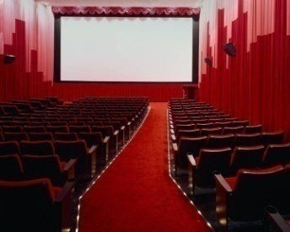


Traditional Media
Broadcast Media: One-to-Many
Communication Media: One-to-One

Slide 3












Social Media: Many-to-Many
Notes:
There are various of social media: like social network , blogs, wiki, forums content sharing. Most of them are an open platform so users can connect with each other, generate content. These web 2.0 applications gained a lot of online traffic recently. They provide rich information about online users, also new tasks and challenges.

Slide 4
Various forms of Social Media
Blog: Wordpress, blogspot, LiveJournal
Forum: Yahoo! Answers, Epinions
Media Sharing: Flickr, YouTube, Scribd
Microblogging: Twitter, FourSquare
Social Networking: Facebook, LinkedIn, Orkut
Social Bookmarking: Del.icio.us, Diigo
Wikis: Wikipedia, scholarpedia, AskDrWiki

Slide 5

Characteristics of Social Media
“Consumers” become “Producers”
Rich User Interaction
User-Generated Contents
Collaborative environment
Collective Wisdom
Long Tail
Broadcast Media
Filter, then Publish
Social Media
Publish, then Filter

Slide 6
Top 20 Websites at USA
1 | Google.com | 11 | Blogger.com
2 | Facebook.com | 12 | msn.com
3 | Yahoo.com | 13 | Myspace.com
4 | YouTube.com | 14 | Go.com
5 | Amazon.com | 15 | Bing.com
6 | Wikipedia.org | 16 | AOL.com
7 | Craigslist.org | 17 | LinkedIn.com
8 | Twitter.com | 18 | CNN.com
9 | Ebay.com | 19 | Espn.go.com
10 | Live.com | 20 | Wordpress.com
40% of websites are social media sites
Notes:
This is based on the Alex Report as of August 3, 2010

Slide 7

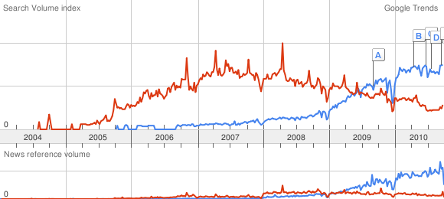

Slide 8
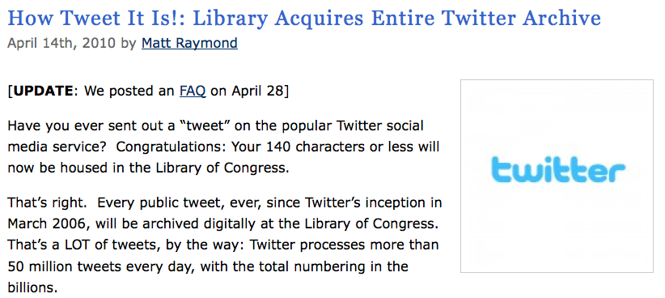

Slide 9
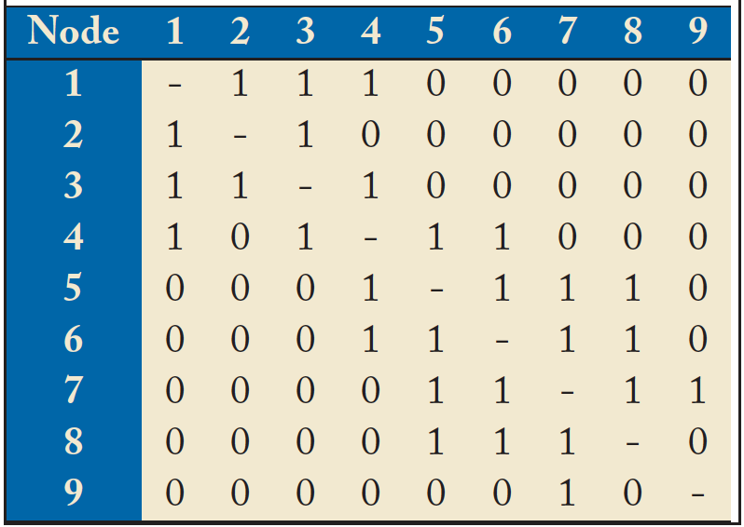
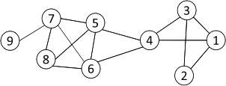
Networks and Representation
Social Network: A social structure made of nodes (individuals or organizations) and edges that connect nodes in various relationships like friendship, kinship etc.
Graph Representation
Matrix Representation

Slide 10
Basic Concepts
A: the adjacency matrix
V: the set of nodes
E: the set of edges
v_{i}: a node v_{i}
e(v_{i}, v_{j}): an edge between node v_{i} and v_{j}
N_{i}: the neighborhood of node v_{i}
d_{i}: the degree of node v_{i}
geodesic: a shortest path between two nodes
geodesic distance

Slide 11
Properties of Large-Scale Networks
Networks in social media are typically huge, involving millions of actors and connections.
Large-scale networks in real world demonstrate similar patterns
Scale-free distributions
Small-world effect
Strong Community Structure

Slide 12
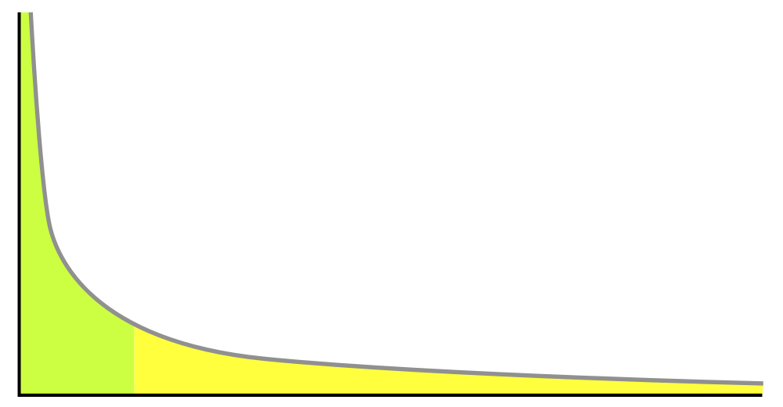

Scale-free Distributions
Degree distribution in large-scale networks often follows a power law.
A.k.a. long tail distribution, scale-free distribution

Slide 13
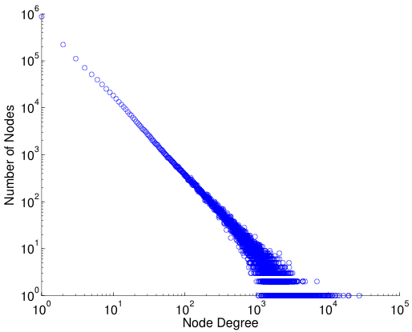
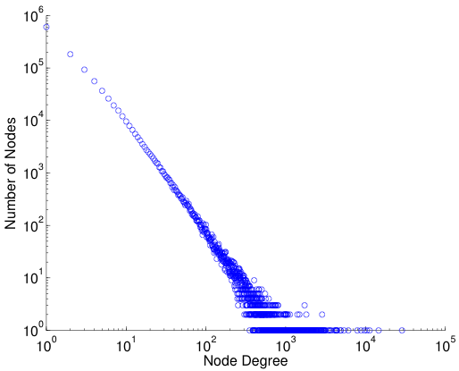
log-log plot
Power law distribution becomes a straight line if plot in a log-log scale
Friendship Network in Flickr
Friendship Network in YouTube

Slide 14
Small-World Effect
“Six Degrees of Separation”
A famous experiment conducted by Travers and Milgram (1969)
Subjects were asked to send a chain letter to his acquaintance in order to reach a target person
The average path length is around 5.5
Verified on a planetary-scale IM network of 180 million users (Leskovec and Horvitz 2008)
The average path length is 6.6

Slide 15
Diameter
Measures used to calibrate the small world effect
Diameter: the longest shortest path in a network
Average shortest path length
The shortest path between two nodes is called geodesic.
The number of hops in the geodesic is the geodesic distance.
The geodesic distance between node 1 and node 9 is 4.
The diameter of the network is 5, corresponding to the geodesic distance between nodes 2 and 9.

Slide 16
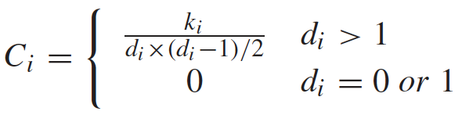
Community Structure
Community: People in a group interact with each other more frequently than those outside the group
Friends of a friend are likely to be friends as well
Measured by clustering coefficient:
density of connections among one’s friends

Slide 17
Clustering Coefficient
d₆=4, N₆= {4, 5, 7,8}
k₆=4 as e(4,5), e(5,7), e(5,8), e(7,8)
C₆ = 4/(4*3/2) = 2/3
Average clustering coefficient
C = (C₁ + C₂ + … + C_{n})/n
C = 0.61 for the left network
In a random graph, the expected coefficient is 14/(9*8/2) = 0.19.

Slide 18
Challenges
Scalability
Social networks are often in a scale of millions of nodes and connections
Traditional Network Analysis often deals with at most hundreds of subjects
Heterogeneity
Various types of entities and interactions are involved
Evolution
Timeliness is emphasized in social media
Collective Intelligence
How to utilize wisdom of crowds in forms of tags, wikis, reviews
Evaluation
Lack of ground truth, and complete information due to privacy

Slide 19
Social Computing Tasks
Social Computing: a young and vibrant field
Many new challenges
Tasks
Network Modeling
Centrality Analysis and Influence Modeling
Community Detection
Classification and Recommendation
Privacy, Spam and Security

Slide 20
Network Modeling
Large Networks demonstrate statistical patterns:
Small-world effect (e.g., 6 degrees of separation)
Power-law distribution (a.k.a. scale-free distribution)
Community structure (high clustering coefficient)
Model the network dynamics
Find a mechanism such that the statistical patterns observed in large-scale networks can be reproduced.
Examples: random graph, preferential attachment process, Watts and Strogatz model
Used for simulation to understand network properties
Thomas Shelling’s famous simulation: What could cause the segregation of white and black people
Network robustness under attack
Notes:
He wondered if racial segregation might, in principle, have absolutely nothing to do with racism.
First experiment – racism can cause segregation
Second experiment – racially tolerant people might prefer to avoid being part of extreme minority (< 30%)

Slide 21
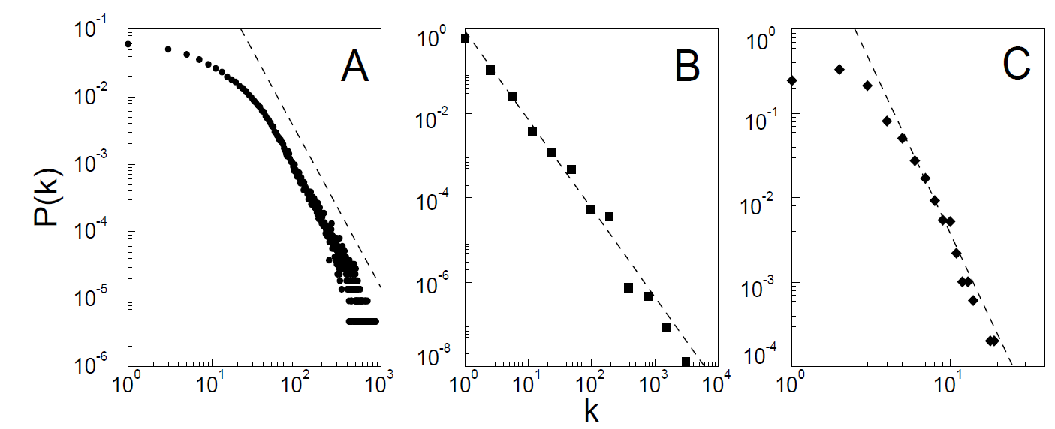
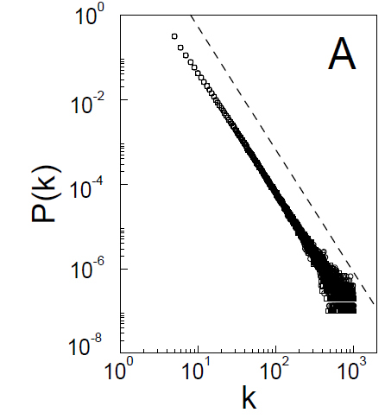
Comparing Network Models
observations over various
real-word large-scale networks
outcome of a
network model
(Figures borrowed from “Emergence of Scaling in Random Networks”)
Notes:
Last figure is a model of similar size to A.

Slide 22
Centrality Analysis and Influence Modeling
Centrality Analysis:
Identify the most important actors or edges
Various criteria
Influence modeling:
How is information diffused?
How does one influence each other?
Related Problems
Viral marketing: word-of-mouth effect
Influence maximization

Slide 23
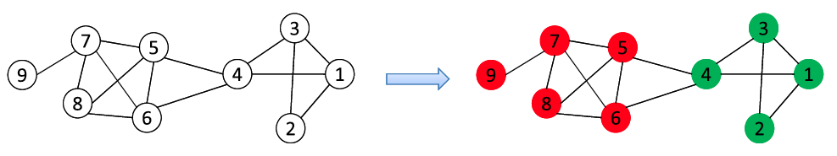
Community Detection
A community is a set of nodes between which the interactions are (relatively) frequent
A.k.a., group, cluster, cohesive subgroups, modules
Applications: Recommendation based communities, Network Compression, Visualization of a huge network
New lines of research in social media
Community Detection in Heterogeneous Networks
Community Evolution in Dynamic Networks
Scalable Community Detection in Large-Scale Networks

Slide 24
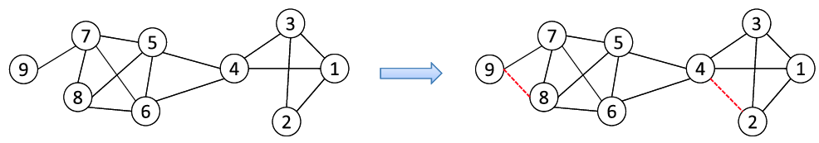
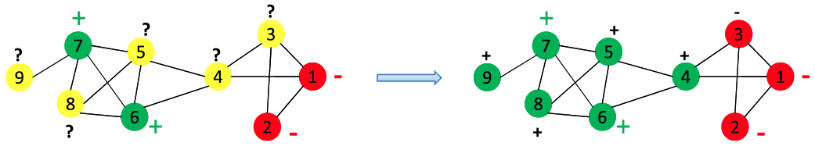
Classification and Recommendation
Common in social media applications
Tag suggestion, Friend/Group Recommendation, Targeting
Link prediction
Network-Based Classification

Slide 25
Privacy, Spam and Security
Privacy is a big concern in social media
Facebook, Google buzz often appear in debates about privacy
NetFlix Prize Sequel cancelled due to privacy concern
Simple annoymization does not necessarily protect privacy
Spam blog (splog), spam comments, Fake identity, etc., all requires new techniques
As private information is involved, a secure and trustable system is critical
Need to achieve a balance between sharing and privacy

Slide 26
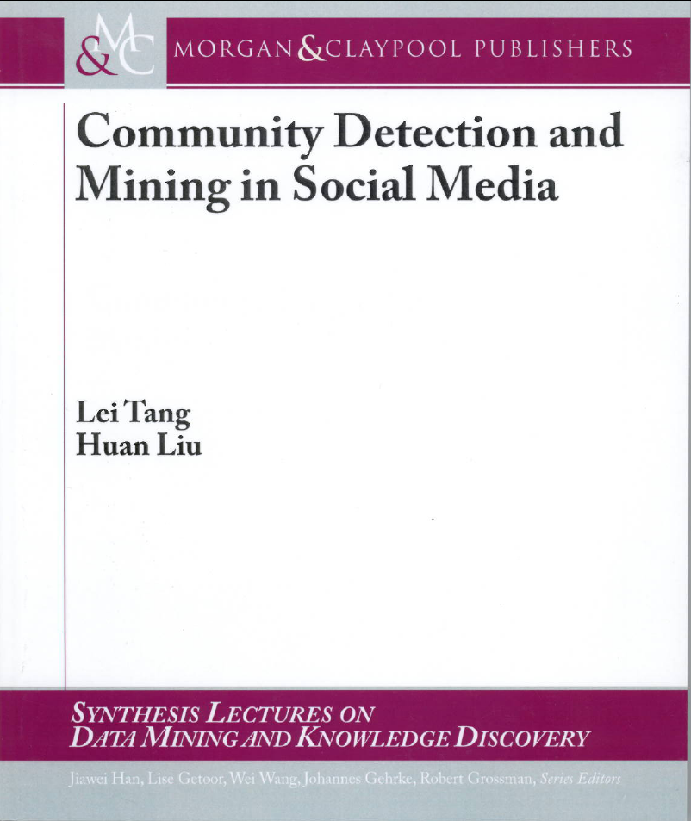
Book Available at
Morgan & claypool Publishers
Amazon
If you have any comments, please feel free to contact:
Lei Tang, Yahoo! Labs, ltang@yahoo-inc.com
Huan Liu, ASU huanliu@asu.edu

