Slide 1
Nodes, Ties and Influence
Chapter 2

Slide 2
Importance of Nodes

Slide 3
Importance of Nodes
Not all nodes are equally important
Centrality Analysis:
Find out the most important nodes in one network
Commonly-used Measures
Degree Centrality
Closeness Centrality
Betweenness Centrality
Eigenvector Centrality

Slide 4


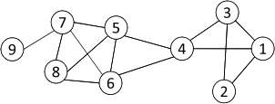
Degree Centrality
The importance of a node is determined by the number of nodes adjacent to it
The larger the degree, the more import the node is
Only a small number of nodes have high degrees in many real-life networks
Degree Centrality
Normalized Degree Centrality:
For node 1, degree centrality is 3;
Normalized degree centrality is
3/(9-1)=3/8.
Notes:
“A small number of nodes have high degrees” thanks to the power law

Slide 5

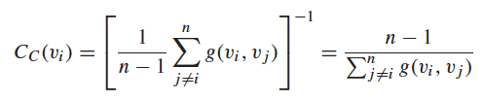
Closeness Centrality
“Central” nodes are important, as they can reach the whole network more quickly than non-central nodes
Importance measured by how close a node is to other nodes
Average Distance:
Closeness Centrality

Slide 6
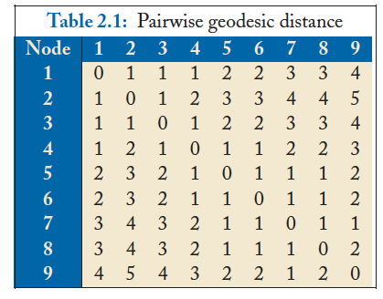
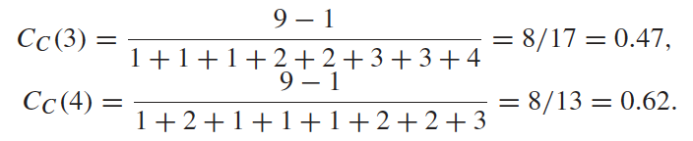
Closeness Centrality Example
Node 4 is more central than node 3

Slide 7


Betweenness Centrality
Node betweenness counts the number of shortest paths that pass one node
Nodes with high betweenness are important in communication and information diffusion
Betweenness Centrality
The number of shortest paths between s and t
The number of shortest paths between s and t that pass v_{i}

Slide 8
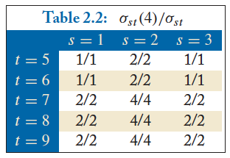

Betweenness Centrality Example
What’s the betweenness centrality for node 5?
The number of shortest paths between s and t
The number of shortest paths between s and t that pass v_{i}

Slide 9


Eigenvector Centrality
One’s importance is determined by his friends’
If one has many important friends, he should be important as well.
The centrality corresponds to the top eigenvector of the adjacency matrix A.
A variant of this eigenvector centrality is the PageRank score.

Slide 10
Strengths of Ties

Slide 11
Weak and Strong Ties
In practice, connections are not of the same strength
Interpersonal social networks are composed of strong ties (close friends) and weak ties (acquaintances).
Strong ties and weak ties play different roles for community formation and information diffusion
Strength of Weak Ties (Granovetter, 1973)
Occasional encounters with distant acquaintances can provide important information about new opportunities for job search

Slide 12
Connections in Social Media
Social Media allows users to connect to each other more easily than ever
One user might have thousands of friends online
Who are the most important ones among your 300 Facebook friends?
Imperative to estimate the strengths of ties for advanced analysis
Analyze network topology
Learn from User Profiles and Attributes
Learn from User Activities

Slide 13

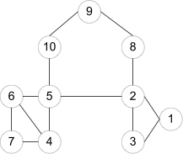
Learning from Network Topology
Bridges connecting two different communities are weak ties
An edge is a bridge if its removal results in disconnection of its terminal nodes
e(2,5) is a bridge
e(2,5) is NOT a bridge

Slide 14
“shortcut” Bridge
Bridges are rare in real-life networks
Alternatively, one can relax the definition by checking if the distance between two terminal nodes increases if the edge is removed
The larger the distance, the weaker the tie is
d(2,5) = 4 if e(2,5) is removed
d(5,6) = 2 if e(5,6) is removed
e(5,6) is a stronger tie than e(2,5)

Slide 15
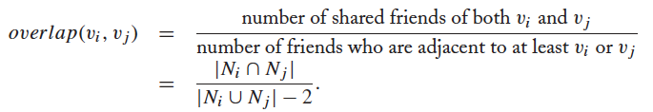

Neighborhood Overlap
Tie Strength can be measured based on neighborhood overlap; the larger the overlap, the stronger the tie is.
-2 in the denominator is to exclude v_{i} and v_{j}

Slide 16
Learning from Profiles and Interactions
Twitter: one can follow others without followee’s confirmation
The real friendship network is determined by the frequency two users talk to each other, rather than the follower-followee network
The real friendship network is more influential in driving Twitter usage
Strengths of ties can be predicted accurately based on various information from Facebook
Friend-initiated posts, message exchanged in wall post, number of mutual friends, etc.
Learning numeric link strength by maximum likelihood estimation
User profile similarity determines the strength
Link strength in turn determines user interaction
Maximize the likelihood based on observed profiles and interactions

Slide 17
Learning from User Activities
One might learn how one influences his friends if the user activity log is accessible
Depending on the adopted influence model
Independent cascading model
Linear threshold model
Maximizing the likelihood of user activity given an influence model

Slide 18
Influence Modeling

Slide 19
Influence modeling
Influence modeling is one of the fundamental questions in order to understand the information diffusion, spread of new ideas, and word-of-mouth (viral) marketing
Well known Influence modeling methods
Linear threshold model (LTM)
Independent cascade model (ICM)

Slide 20
Common properties of Influence modeling methods
A social network is represented a directed graph, with each actor being one node;
Each node is started as active or inactive;
A node, once activated, will activate his neighboring nodes;
Once a node is activated, this node cannot be deactivated.

Slide 21
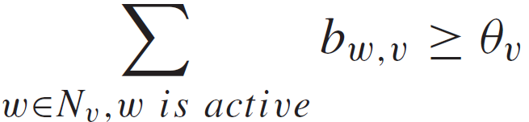
Linear Threshold Model
An actor would take an action if the number of his friends who have taken the action exceeds (reaches) a certain threshold
Each node v chooses a threshold ϴ_{v} randomly from a uniform distribution in an interval between 0 and 1.
In each discrete step, all nodes that were active in the previous step remain active
The nodes satisfying the following condition will be activated

Slide 22
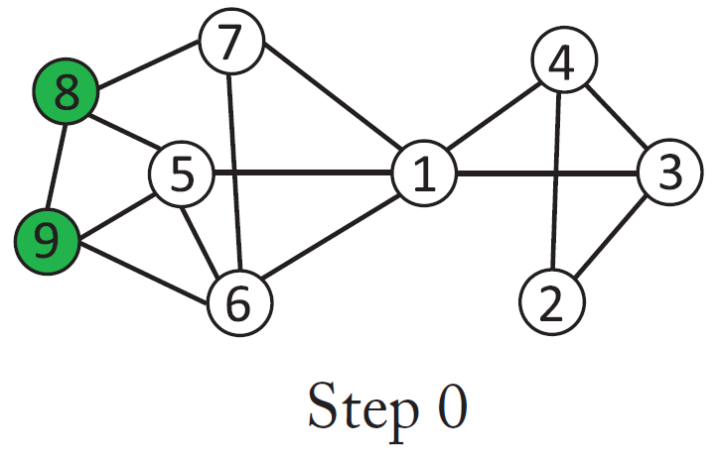
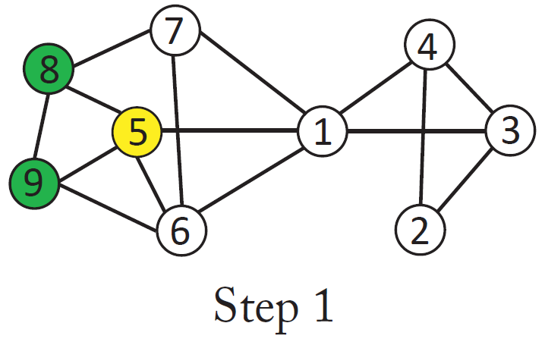
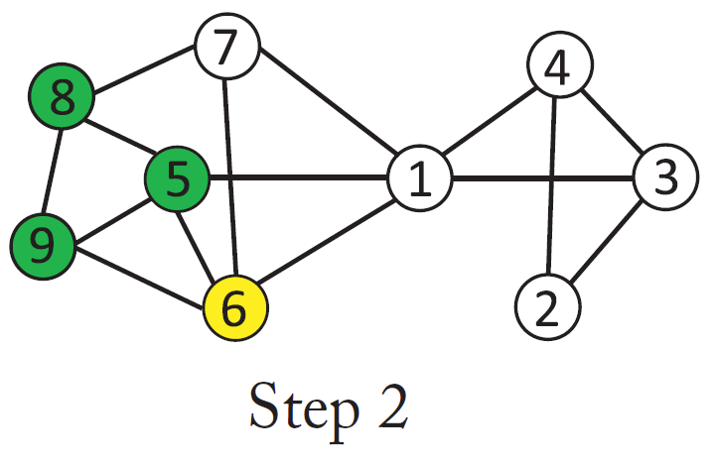
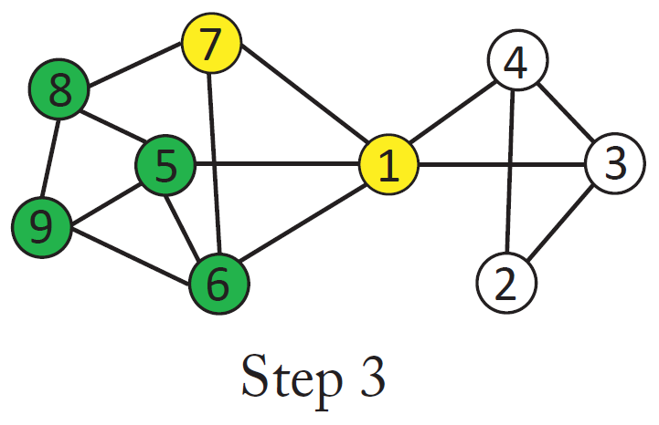
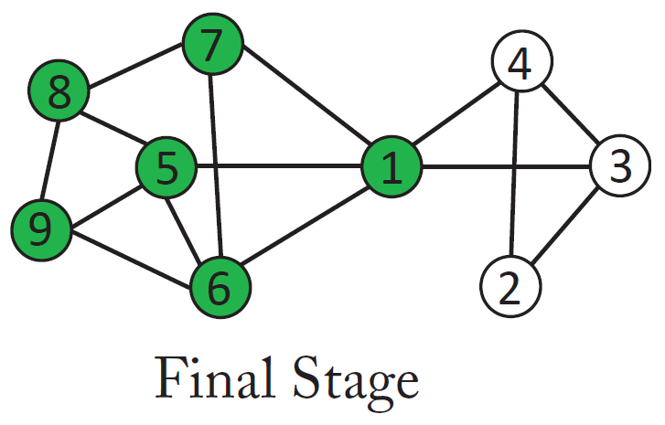
Linear Threshold Model- Diffusion Process (Threshold = 50%)

Slide 23
Independent Cascade Model (ICM)
The independent cascade model focuses on the sender’s rather than the receiver’s view
A node w, once activated at step t , has one chance to activate each of its neighbors randomly
For a neighboring node (say, v), the activation succeeds with probability p_{w,v} (e.g. p = 0.5)
If the activation succeeds, then v will become active at step t + 1
In the subsequent rounds, w will not attempt to activate v anymore.
The diffusion process, starts with an initial activated set of nodes, then continues until no further activation is possible

Slide 24
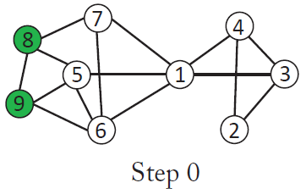
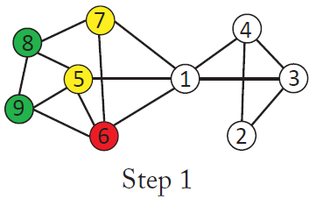
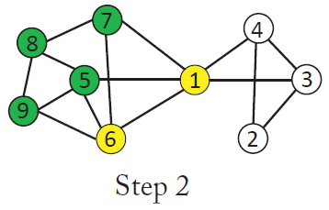
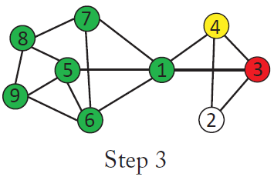
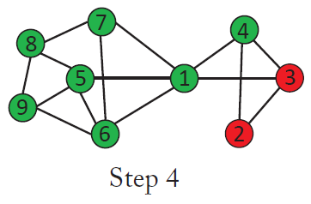
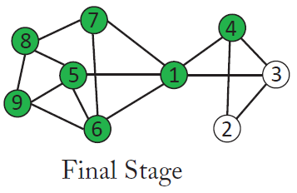
Independent Cascade Model- Diffusion Process

Slide 25
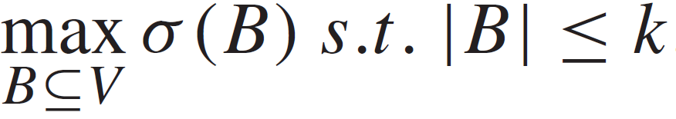
Influence Maximization
Given a network and a parameter k, which k nodes should be selected to be in the activation set B in order to maximize the influence in terms of active nodes at the end?
Let σ(B) denote the expected number of nodes that can be influenced by B, the optimization problem can be formulated as follows:

Slide 26
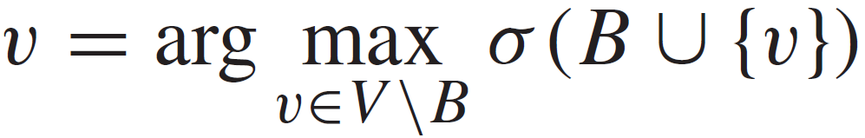
Influence Maximization- A greedy approach
Maximizing the influence, is a NP-hard problem but it is proved that the greedy approaches gives a solution that is 63 % of the optimal.
A greedy approach:
Start with B = Ø
Evaluate σ(v) for each node, and pick the node with maximum σ as the first node v1 to form B = {v1}
Select a node which will increase σ(B) most if the node is included in B.
Essentially, we greedily find a node v ∈ V \B such that

Slide 27
Distinguish Between Influence and Correlation

Slide 28
Correlation
It has been widely observed that user attributes and behaviors tend to correlate with their social networks
Suppose we have a binary attribute with each node (say, whether or not being smoker)
If the attribute is correlated with the network, we expect actors sharing the same attribute value to be positively correlated with social connections
That is, smokers are more likely to interact with other smokers, and non-smokers with non-smokers

Slide 29
Test For Correlation
If the fraction of edges linking nodes with different attribute values are significantly less than the expected probability, then there is evidence of correlation
Example; if connections are independent of the smoking behavior:
p fraction are smokers (1-p non-smoker)
one edge is expected to connect two smokers with probability p × p,
two non-smokers with probability: (1 − p) × (1 − p)
A smoker and a non-smoker: 2 p (1-p)

Slide 30
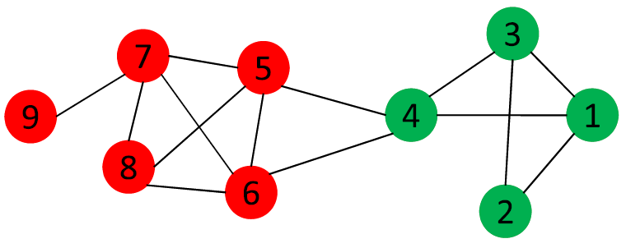
Test For Correlation- An example
Red nodes denote non-smokers, and green ones are smokers. If there is no correlation, then the probability of one edge connecting a smoker and a non-smoker is 2 × 4/9 × 5/9 = 49%.
In this example the fraction is 2/14 = 14% < 49% , so this network demonstrates some degree of correlation with respect to the smoking behavior.
A more formal way is to conduct a χ2 test for independence of social connections and attributes (La Fond and Neville, 2010)

Slide 31
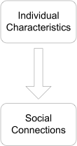
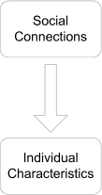
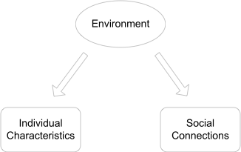
Correlation in social networks
It is well known that there exist correlations between behaviors or attributes of adjacent actors in a social network.
Three major social processes to explain correlation are:
Homophily, confounding, and influence
homophily
influence
Confounding

Slide 32
Correlation in social networks
Homophily; is a term to explain our tendency to link to others that share certain similarity with us
Confounding; correlation between actors can also be forged due to external influences from environment. “two individuals living in the same city are more likely to become friends than two random individuals”
Influence; a process that causes behavioral correlations between adjacent actors. “if most of one’s friends switch to a mobile company, he might be influenced by his friends and switch to the company as well.”

Slide 33
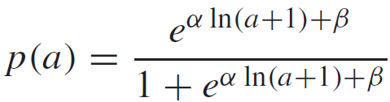
Influence or Correlation
In many studies about influence modeling, influence is determined by timestamps
Shuffle test is an approach to identify whether influence is a factor associated with a social system
The probability of one node being active is a logistic function of the number of his active friends as follows
a is the number of active friends,
α the social correlation coefficient and β a constant to explain the innate bias for activation

Slide 34

Activation likelihood
Suppose at one time point t , Y_{a,t} users with a active friends become active, and N_{a,t} users who also have a active friends yet stay inactive at time t .
The likelihood at time t is
Given the user activity log, we can compute a correlation coefficient α to maximize the above likelihood.

Slide 35
Shuffle test
The key idea of the shuffle test is that if influence does not play a role, the timing of activation should be independent of the timing of other actors. Thus, even if we randomly shuffle the timestamps of user activities, we should obtain a similar α value.
Test for Influence:
After we shuffle the timestamps of user activities, if the new estimate of social correlation is significantly different from the estimate based on the user activity log, then there is evidence of influence.

Slide 36

Book Available at
Morgan & claypool Publishers
Amazon
If you have any comments, please feel free to contact:
Lei Tang, Yahoo! Labs, ltang@yahoo-inc.com
Huan Liu, ASU huanliu@asu.edu

