Slide 1
Communities in Heterogeneous Networks
Chapter 4

Slide 2
Heterogeneous Networks

Slide 3

Multi-Dimensional Networks
Communications in social media are multi-dimensional
Networks often involve heterogeneous connections
E.g. at YouTube, two users can be connected through friendship connection, email communications, subscription/Fans, chatter in comments, etc.
a.k.a. multi-relational networks, multiplex networks, labeled graphs

Slide 4
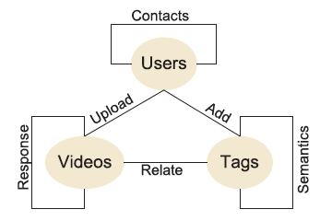
Multi-Mode Networks
Interactions in social media may involve heterogeneous types of entities
Networks involve multiple modes of nodes
Within-mode interaction, between-mode interaction
Different types of interactions between different modes

Slide 5
Why Does Heterogeneity Matter
Social media introduces heterogeneity
It calls for solutions to community detection in heterogeneous networks
Interactions in social media are noisy
Interactions in one mode or one dimension might be too noisy to detect meaningful communities
Not all users are active in all dimensions or with different modes
Need integration of interactions at multiple dimensions or modes

Slide 6
Communities in Multi-Dimensional Networks

Slide 7
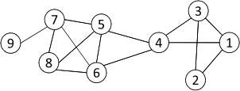
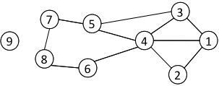
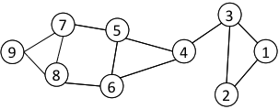
Communities in Multi-Dimensional Networks
A p-dimension network
An example of a 3-dimensional network
Goal: integrate interactions at multiple dimensions to find reliable community structures

Slide 8
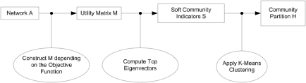

A Unified View for Community Partition (from Chapter 3)
Latent space models, block models, spectral clustering, and modularity maximization can be unified as

Slide 9
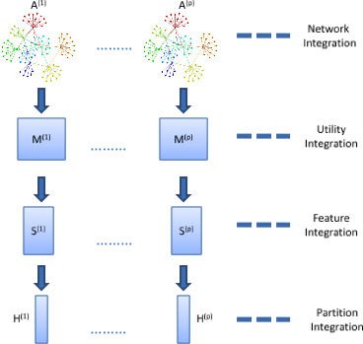
Integration Strategies
Notes:
We will use spectral clustering as an vehicle to illustrate these concepts

Slide 10

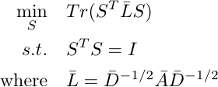
Network Integration
Convert a multi-dimensional network into a single-dimensional network
Different types of interaction strengthen one actor’s connection
The average strength is
Spectral clustering with a p-dimensional network becomes

Slide 11
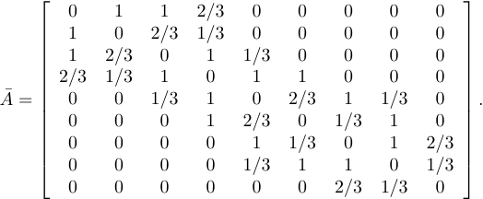
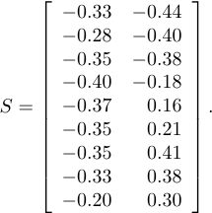
Network Integration Example

Slide 12



Utility Integration
Integration by averaging the utility matrix
Equivalent to optimizing average utility function
For spectral clustering,
Hence, the objective of spectral clustering becomes

Slide 13
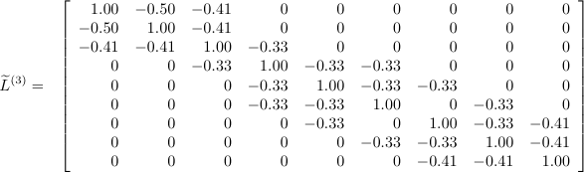
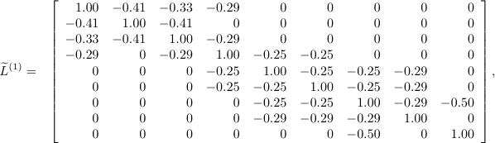
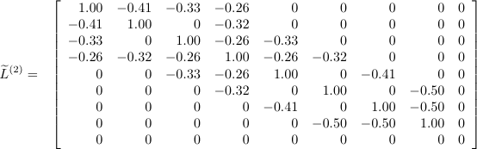
Utility Integration Example
Notes:
Each type of interaction output a graph laplacian

Slide 14

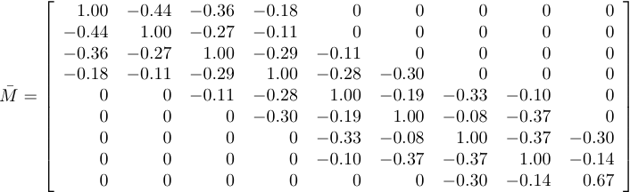
Utility Integration Example
Spectral clustering based on utility integration leads to a partition of
two communities: {1, 2, 3, 4} and {5, 6, 7, 8, 9}

Slide 15

Feature Integration
Soft community indicators extracted from each type of interactions are structural features associated with nodes
Integration can be done at the feature level
A straightforward approach: take the average of structural features
Direct feature average is not sensible
Need comparable coordinates among different dimensions

Slide 16
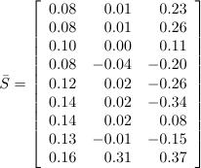
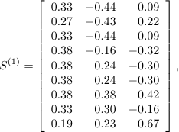
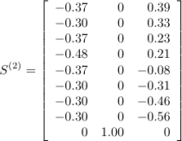
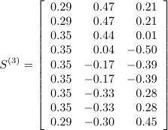
Problem with Direct Feature Average
Two communities:
{1, 2, 3, 7, 9}
{4, 5, 6, 8}

Slide 17


Proper way of Feature Integration
Structural features of different dimensions are highly correlated after a certain transformation
Multi-dimensional integration can be conducted after we map the structural features into the same coordinates
Find the transformation by maximizing pairwise correlation
Suppose the transformation associated with dimension (i) is
The average of structural features is
The average is shown to be proportional to the top left singular vector of data X by concatenating structural features of each dimension

Slide 18
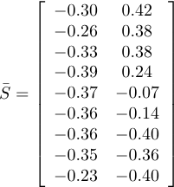
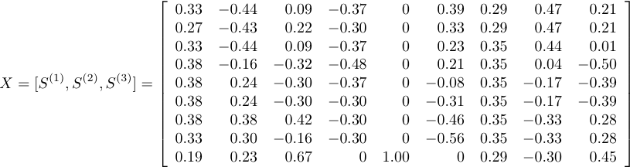
Feature Integration Example
Two Communities:
{1, 2, 3, 4}
{5, 6, 7, 8, 9}
The top 2 left singular
vectors of X are

Slide 19
Partition Integration
Combine the community partitions obtained from each type of interaction
a.k.a. cluster ensemble
Cluster-based Similarity Partitioning Algorithm (CPSA)
Similarity is 1 is two objects belong to the same group, 0 otherwise
The similarity between nodes is computed as
The entry is essentially the probability that two nodes are assigned into the same community
Then apply similarity-based community detection methods to find clusters

Slide 20
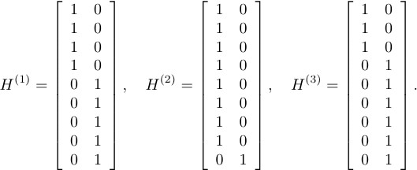
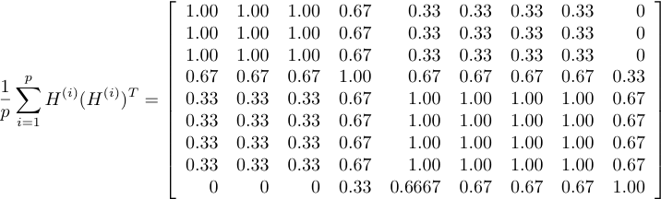
CPSA Example
Applying spectral clustering to the above matrix results in
two communities: {1, 2, 3, 4} and { 5, 6, 7, 8, 9}

Slide 21

More Efficient Partition Integration
CPSA requires the computation of a dense similarity matrix
Not scalable
An alternative approach: Partition Feature Integration
Consider partition information as features
Apply a similar procedure as in feature integration
A detailed procedure:
Given partitions of each dimension
Construct a sparse partition feature matrix
Take the top left singular vectors of Y as soft community indicator
Apply k-means to the singular vectors to find community partition

Slide 22
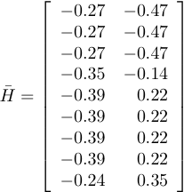
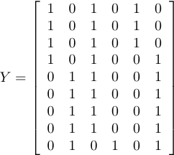
Partition Integration Example
SVD
k-means
{1, 2, 3, 4}
{5, 6, 7, 8, 9}
Y is sparse

Slide 23
Comparison of Multi-Dimensional Integration Strategies
 | Network Integration | Utility Integration | Feature Integration | Partition Integration
Tuning weights for different types of interactions | X | X | X | X
Sensitivity to noise | Yes | OK | Robust | Yes
Clustering quality | bad | Good | Good | OK
Computational cost | Low | Low | High | Expensive

Slide 24
Communities in Multi-Mode Networks

Slide 25

Co-clustering on 2-mode Networks
Multi-mode networks involve multiple types of entities
A 2-mode network is a simple form of multi-mode network
E.g., user-tag network in social media
A.k.a., affiliation network
The graph of a 2-mode network is a bipartite
All edges are between users and tags
No edges between users or between tags

Slide 26
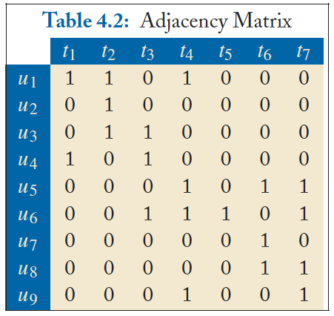
Adjacency Matrix of 2-Mode Network
Each mode represents one type of entity;
not necessarily a square matrix

Slide 27

Co-Clustering
Co-clustering: find communities in two modes simultaneously
a.k.a. biclustering
Output both communities of users and communities of tags for a user-tag network
A straightforward Approach: Minimize the cut in the graph
The minimum cut is 1; a trivial solution is not desirable
Need to consider the size of communities

Slide 28

Spectral Co-Clustering
Minimize the normalized cut in a bipartite graph
Similar as spectral clustering for undirected graph
Compute normalized adjacency matrix
Compute the top singular vectors of the normalized adjacency matrix
Apply k-means to the joint community indicator Z to obtain communities in user mode and tag mode, respectively

Slide 29
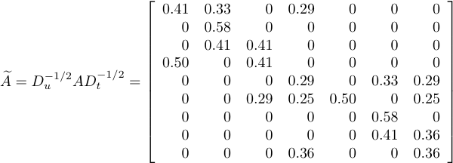
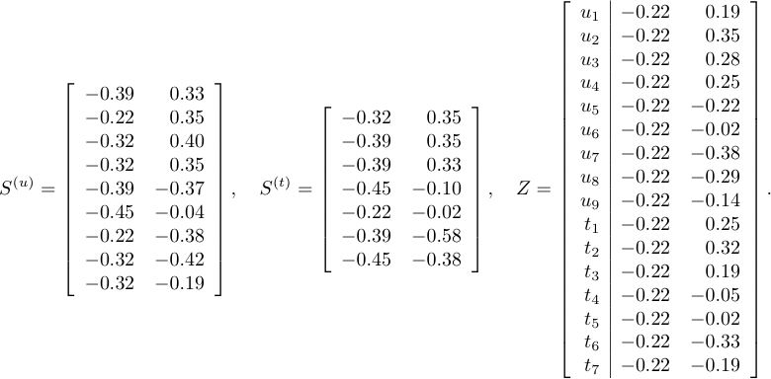
Spectral Co-Clustering Example
Two communities:
{ u₁,u₂, u₃, u₄, t₁, t₂, t₃ }
{ u₅, u₆, u₇, u₈, u₉, t₄, t₅, t₆, t₇}
k-means

Slide 30
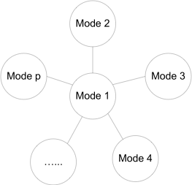
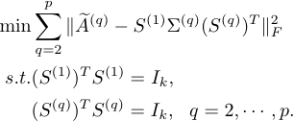

Generalization to A Star Structure
Spectral co-clustering can be interpreted as a block model approximation to normalized adjacency matrix
generalize to
a star structure
S⁽¹⁾ corresponds to the top left singular vectors of the following matrix

Slide 31
Generalization to Multi-Mode Networks
For a multi-mode network, compute the soft community indicator of each mode one by one
It becomes a star structure when looking at one mode vs. other modes
Community Detection in Multi-Mode Networks
Normalize interaction matrix
Iteratively update community indicator as the top left singular vectors
Apply k-means to the community indicators to find partitions in each mode

Slide 32

Book Available at
Morgan & claypool Publishers
Amazon
If you have any comments, please feel free to contact:
Lei Tang, Yahoo! Labs, ltang@yahoo-inc.com
Huan Liu, ASU huanliu@asu.edu

