Slide 1
Social Media Mining
Chapter 5

Slide 2
Evolution Patterns in social media

Slide 3
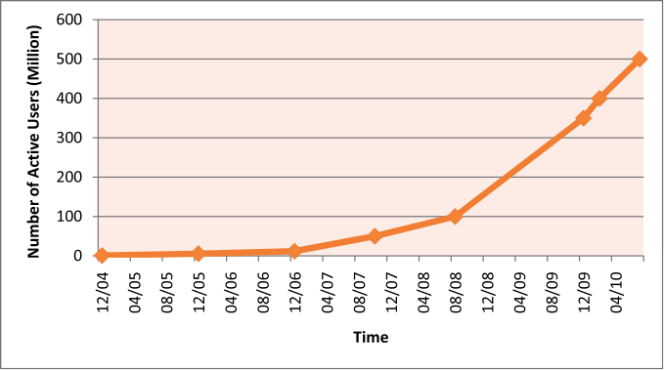
Growth of Facebook Population

Slide 4
Evolutions in Social Media
Social media networks are highly dynamic
Interesting patterns in dynamic networks
Decreasing probability of new connections between two nodes with increasing distance
Many new connections occur as triadic closures
Segmentation of dynamic networks into 3 regions
Singletons
Isolated communities with a star structure
A giant component anchored by a well-connected core region
Density increases with the network growth
Average distance between nodes shrinks

Slide 5
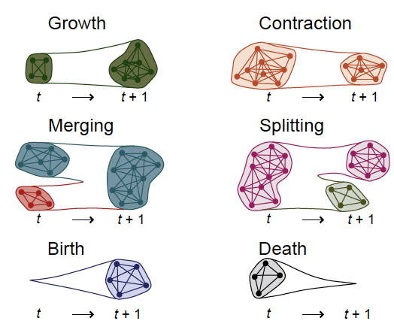
Community Evolution
Communities also expand, shrink , or dissolve in dynamic networks
How to uncover latent community change behind dynamic network interactions?

Slide 6
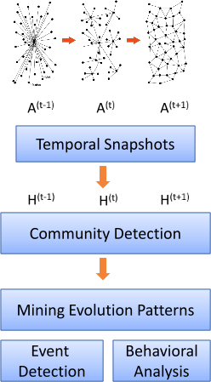
Naïve Approach to Studying Community Evolution
Take snapshots of a network
find communities at each snapshot
Clustering independently at each snapshot
Cons:
Most community detection methods produce local optimal solutions
Hard to determine if the evolution is due to the evolution or algorithm randomness

Slide 7
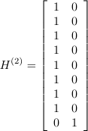
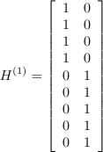
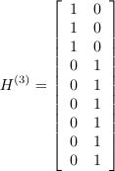
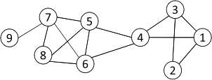
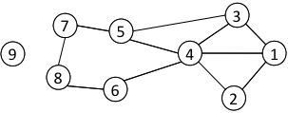
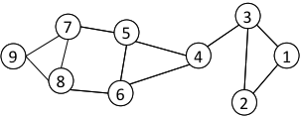
Naïve Approach Example
at T₁
at T₂
at T₃
There is a sharp change at T₂
This approach may report spurious structural changes

Slide 8


Evolutionary Clustering in Smoothly Evolving Networks
Evolutionary Clustering: find a smooth sequence of communities given a series of network snapshots
Objective function: snapshot cost (CS) + temporal cost (CT)
Take spectral clustering as an example
Snapshot cost :
Temporal cost:
Community Evolution:
where
S_{t} is still a valid solution after an orthogonal transformation

Slide 9
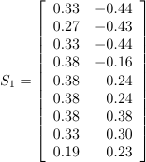
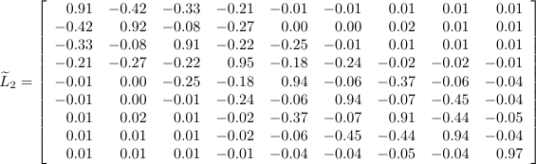
Evolutionary Clustering Example
at T₁
at T₂
at T₃
For T₂
For T₁
We obtain two communities based on spectral clustering with this modified graph Laplacian:
{1, 2, 3, 4} and {5, 6, 7, 8, 9}

Slide 10
Segment-based Clustering with Evolving Networks
Independent clustering at each snapshot
do not consider temporal information
Likely to output specious evaluation patterns
Evolutionary clustering enforces smoothness
may fail to capture drastic change
How to strike balance between gradual changes under normal circumstances and drastic changes caused by major events?
Segment-based clustering:
Community structure remains unchanged in a segment of time
A change between consecutive segments
Fundamental question: how to detect the change points?

Slide 11
Segment-based Clustering
Segment-based Clustering assumes community structure remains unchanged in a segment of time
GraphScope is one segment-based clustering method
If network connections do not change much over time, consecutive network snapshots should be grouped into one segment
If a new network snapshot does not fit into an existing segment (when current community structure induces a high cost on a new network snapshot), then introduce a change point and start a new segment

Slide 12
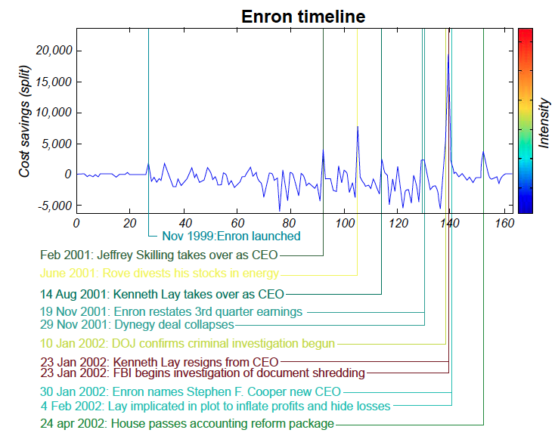
GraphScope on Enron Data

Slide 13
Classification with Network Data

Slide 14
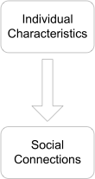
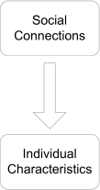
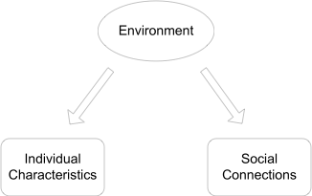
Correlations in Network
Individual behaviors are correlated in a network environment
homophily
influence
Confounding

Slide 15
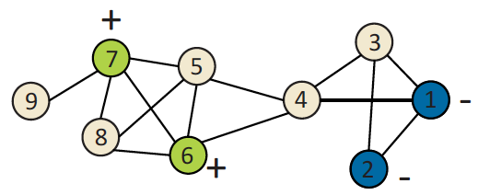
Classification with Network Data
How to leverage this correlation observed in networks to help predict user attributes or interests?
Predict the labels for nodes in yellow

Slide 16

Collective Classification
Labels of nodes are interdependent with each other
The label of one node cannot be determined independently; Need Collective Classification
Markov Assumption: the label of one node depends on the label of his neighbors
Collective classification involves 3 components:

Slide 17
Collective Classification
Local Classifier: used for initial label assignment
Predicts label based on node attributes
Classical classification learning
Does not employ network information
Relational Classifier: capture correlations based on label info
Learn a classifier from the labels or/and attributes of its neighbors to the label of one node
Network information is used
Collective Classification: propagate the correlation
Apply relational classifier to each node iteratively
Iterate until the inconsistency between neighboring labels is minimized
Network structure substantially affects the final prediction

Slide 18
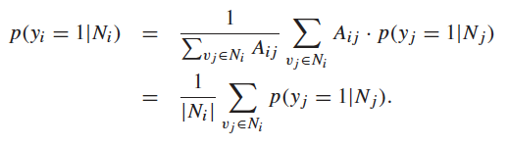
Weighted-vote Relational Neighborhood Classifier
No local classifier
Relational classifier
prediction of one node is the average of its neighbors
Collective Inference

Slide 19
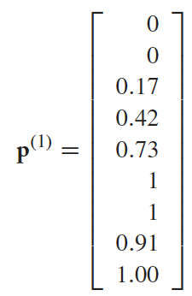
Example of wvRN
Initialization for unlabeled nodes
p(y_{i}=1|N_{i})=0.5
1st Iteration:
For node 3, N₃={1,2,4}
P(y₁=1|N₁) = 0
P(y₂=1|N₂) = 0
P(y₄=1 |N₄) = 0.5
P(y₃=1|N₃) = 1/3 (0 + 0 + 0.5) = 0.17
For node 4, N₄={1,3, 5, 6}
P(y₄=1|N₄)= ¼(0+ 0.17+0.5+1) = 0.42
For node 5, N₅={4,6,7,8}
P(y₅=1|N₅) = ¼ (0.42+1+1+0.5) = 0.73

Slide 20
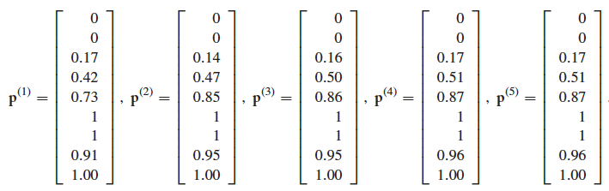
Iterative Result
Stabilizes after 5 iterations
Nodes 5, 8, 9 are + (P_{i} > 0.5)
Node 3 is – (P_{i} < 0.5)
Node 4 is in between (P_{i} =0.5)

Slide 21
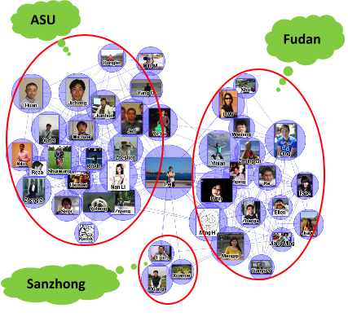
Community-Based Learning
People in social media engage in various relationships
Colleagues
Relatives
Friends
Co-travelers
Different relationships have different correlations with user interests/behavior/profiles

Slide 22
Challenges
Social media often comes with a network, but no relationship information
Or relationship information is not complete or refined enough
Challenges:
How to differentiate these heterogeneous relationship in a network?
How to determine whether the relationship is useful for prediction?

Slide 23
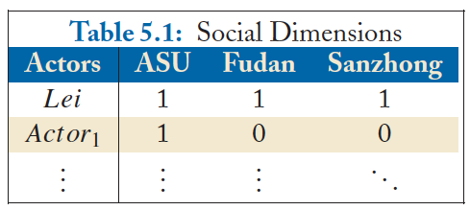
Social Dimension
Social Dimension:
Latent dimensions defined by social connections
Each dimension represents one type of relationship

Slide 24
A Learning Framework based on Social Dimensions
People involved in the same social dimension are likely to connect to each other, thus forming a community
Training:
Extract meaningful social dimensions based on network connectivity via community detection
Determine relevant social dimensions (plus node attributes) through supervised learning
Prediction
Apply the constructed model in Step 2 to social dimensions of unlabeled nodes
No iterative inference

Slide 25
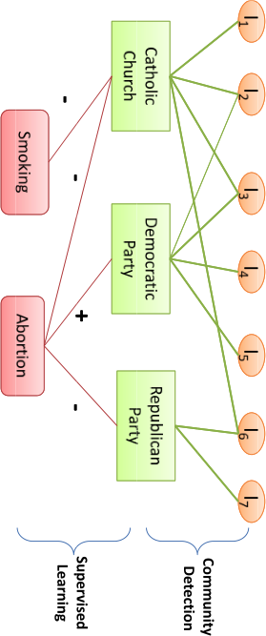
Underlying Assumption
Assumption:
the label of one node is determined by its social dimension
P(y_{i}|A) = P(y_{i}|S_{i})
Community membership serves as latent features

Slide 26
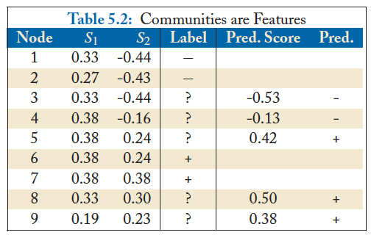
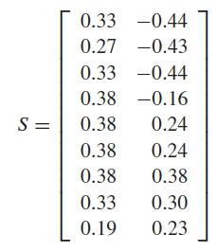

Example of SocioDim Framework
One is likely to involve in multiple relationships, thus soft clustering is used to extract social dimensions
Spectral Clustering
Support Vector Machine

Slide 27
Collective Classification vs. Community-Based Learning
 | Collective Classification | Community-Based Learning
Computational Cost for Training | low | high
Computational Cost for Prediction | high | low
Handling Heterogeneous Relations |  | ✔
Handling Evolving Networks | ✔
Integrating network information and actor attributes | ✔ | ✔

Slide 28

Book Available at
Morgan & claypool Publishers
Amazon
If you have any comments, please feel free to contact:
Lei Tang, Yahoo! Labs, ltang@yahoo-inc.com
Huan Liu, ASU huanliu@asu.edu

