Slide 1

STUDENT START-UP AND INOVATION POLICY - 2019
(SSIP GUJRAT)
Problem statement :
EMPLOYEE ATTENDANCE RECORD KEEPING SYSTEM
Problem id :
GIH093
Team id :
TG000622

Slide 2

GOVERNMENT ENGINEERING COLLEGE
BHAVANAGAR
Team members :
1)Akruvala Utsav
2)Ansari Nikhat shahin
3)Rathod Dharmraj
4)Bhikadiya Dhruvi
5)Modi Foran
Guided by :
Prof.Ashish Nimavat

Slide 3
Introduction
Employee attendance record keeping system is a data logger for calculating work hours of employees works in company.
It manages attendance of all the employees and it will use biomatric authentication (Fingerprint sensors)for daily attendance of employees.

Slide 4
Purpose
The purpose of developing Employee Attendance record keeping system is to computerized the tradition way of taking attendance.
Another purpose for developing this software is to generate the report to determine growth of the company.
It is cost saving to industrial production process.

Slide 5
Technologies used :
Xampp server
PHP
Html and css
SQL and MySQL
Bootstrap
System requirements :
Device that can access browsing (PC)
Fingerprint sensor for biometric authentication
Internet connection to store information online and accessing it.

Slide 6
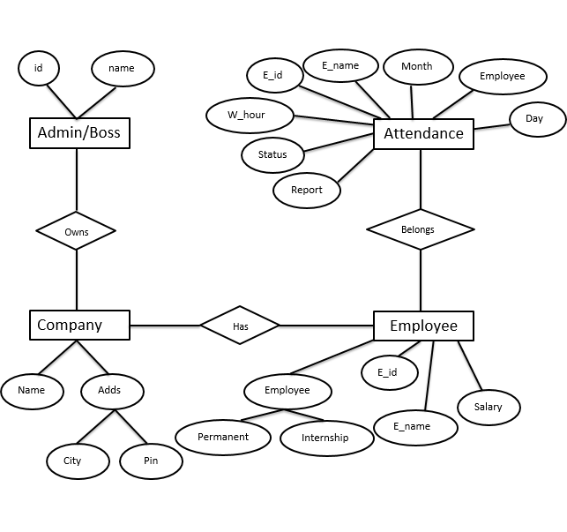
ER-Diagram
1)

Slide 7
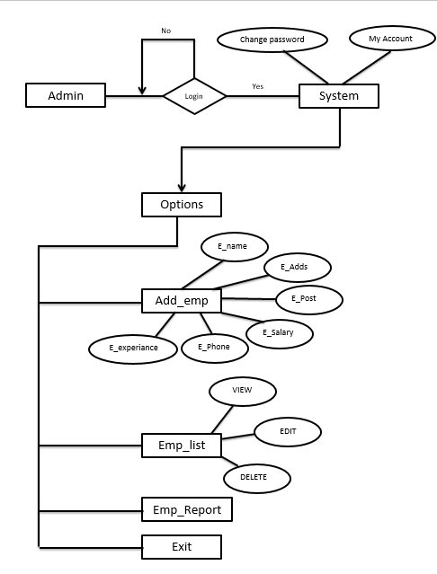
2)

Slide 8
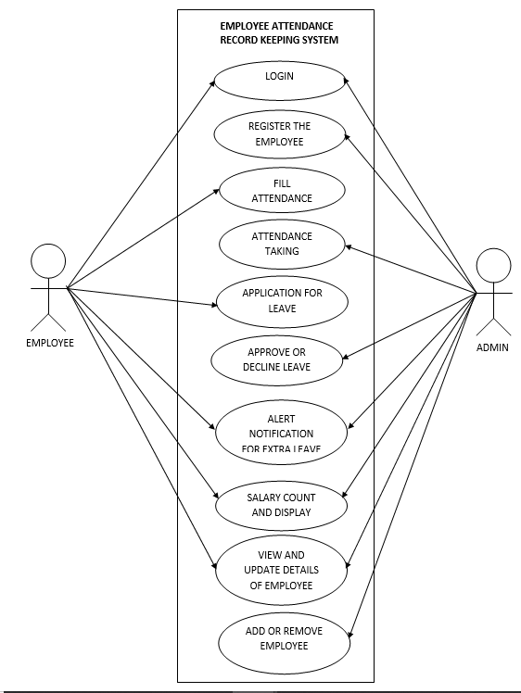
Use-case diagram:

Slide 9
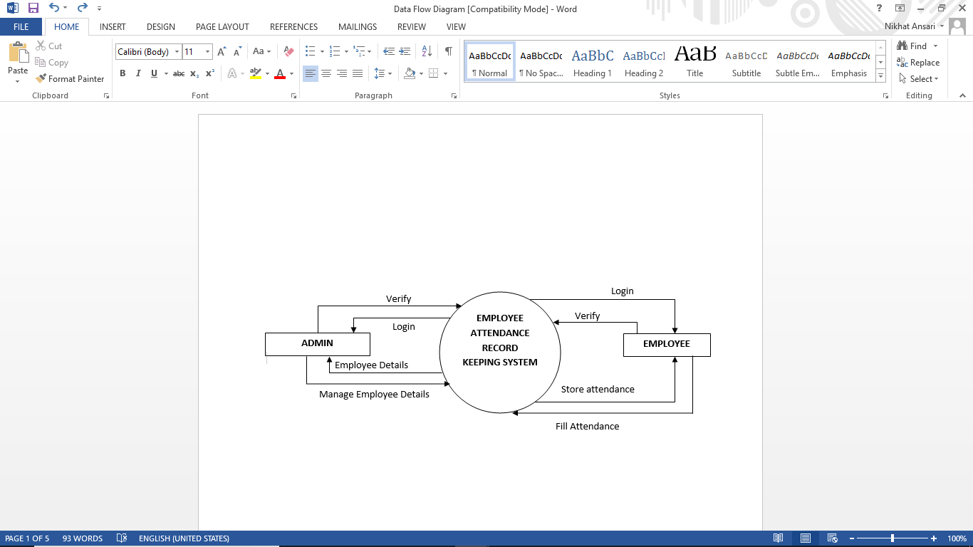
Data flow diagram:
DFD level-0:

Slide 10
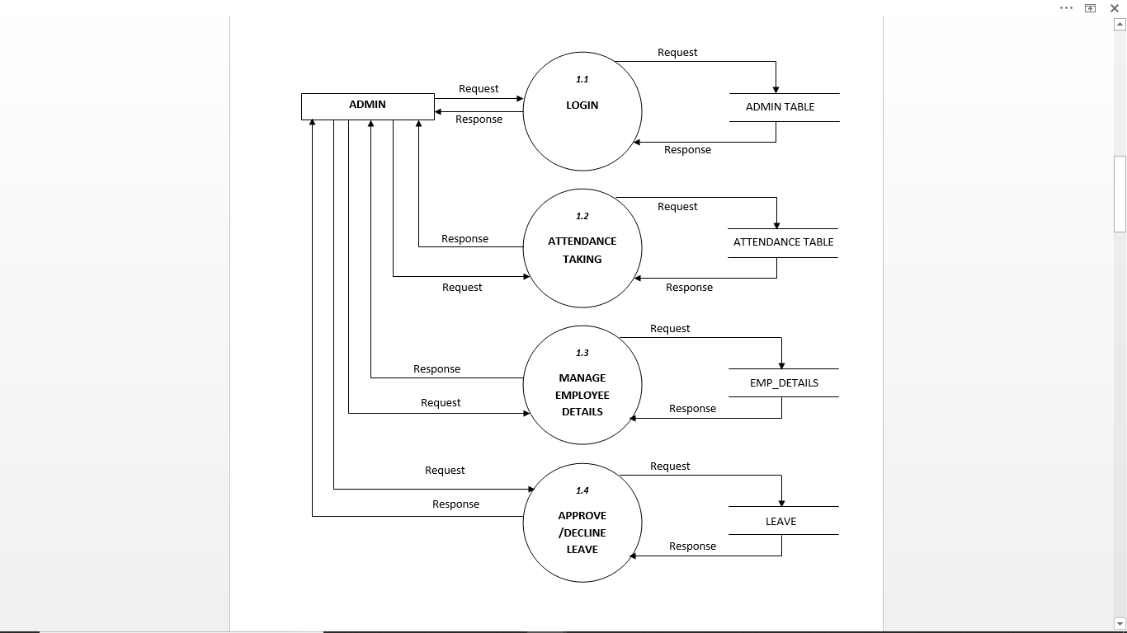
DFD level-1:

Slide 11
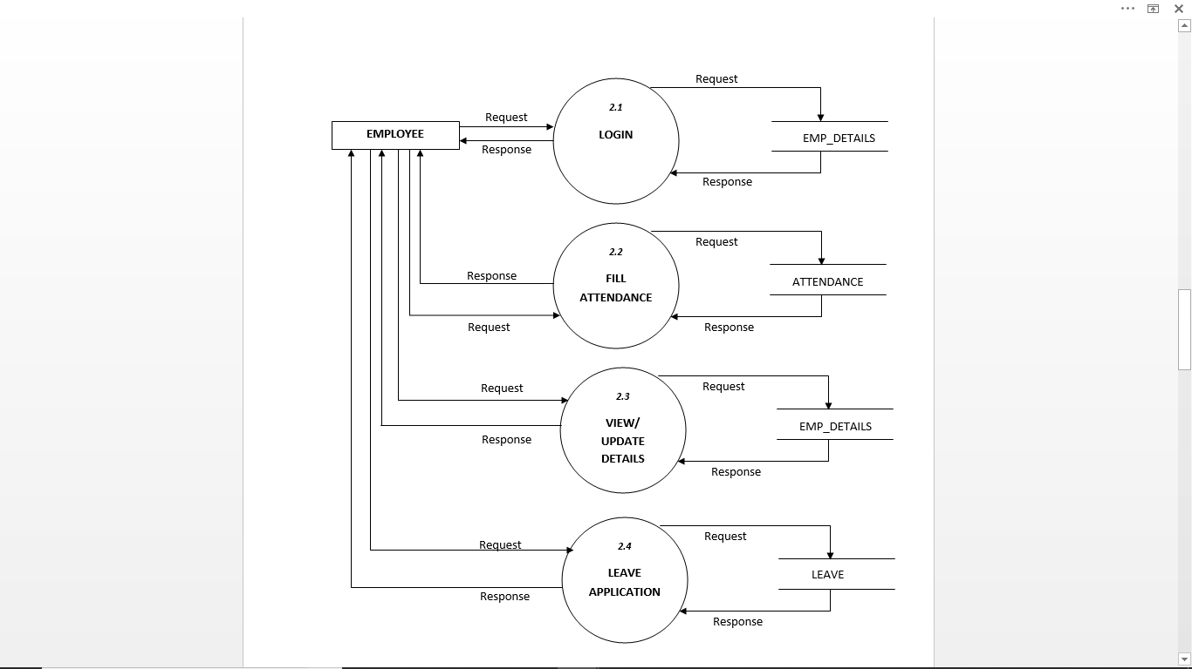
DFD level-2:

Slide 12
Overview
It has two main module for proper functioning.
First module is administrator or authenticated person of company creates a batch of employees. Admin can add, edit or remove the information of any employee.
Second Module will be handled by employees. Employees have right of making daily attendance by applying their fingerprints.
Attendance can be taken in two ways:
On the basis of the fingerprint
On the basis of Employee_id

Slide 13
SCREENSHOTS OF
WORKDONE
Functionality :
Easily Adding Employee
Bio-matric data stored to company
Removing Employee
Daily attendance taking made easy with bio-matric authentication system
Generating report

Slide 14
Admin Login Page:
Only authorized person can login.
Admin will have facility to login only at once to add,edit or remove any employee.
Admin will login into the system by username and password.
Validation will be there in the system for security purpose.

Slide 15
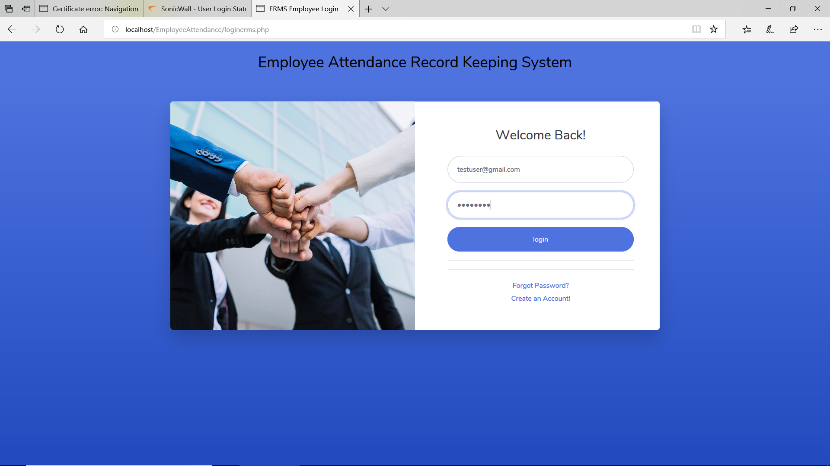
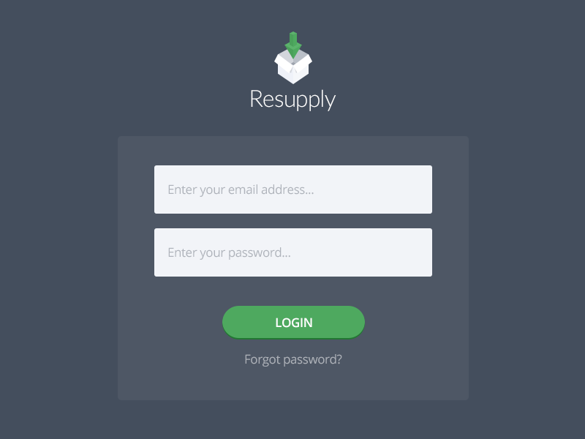
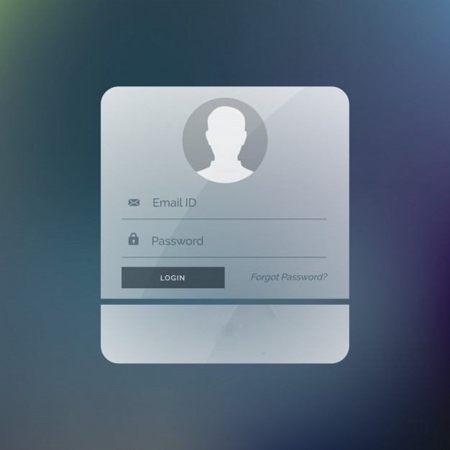
Admin Login page:

Slide 16
Add Employee :
After login admin can add employee whoever is joining the company.
Employees can be added by adding basic details of them.
Furthermore these information will be stored in the database to relate it to employee's attendance.

Slide 17

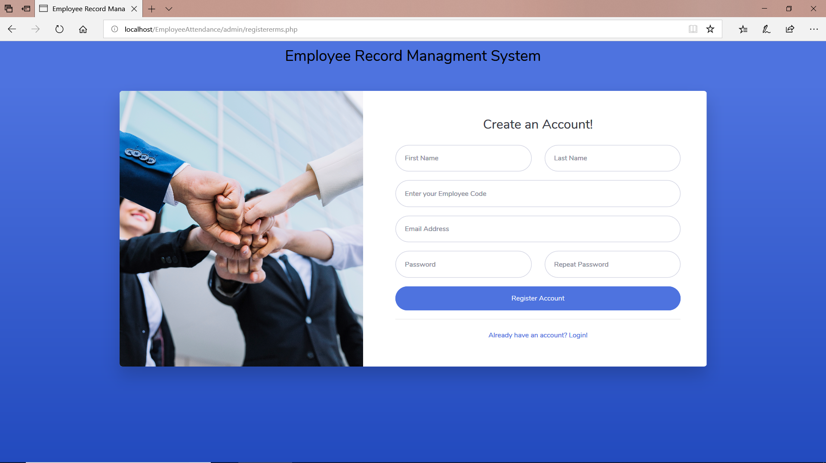

Slide 18
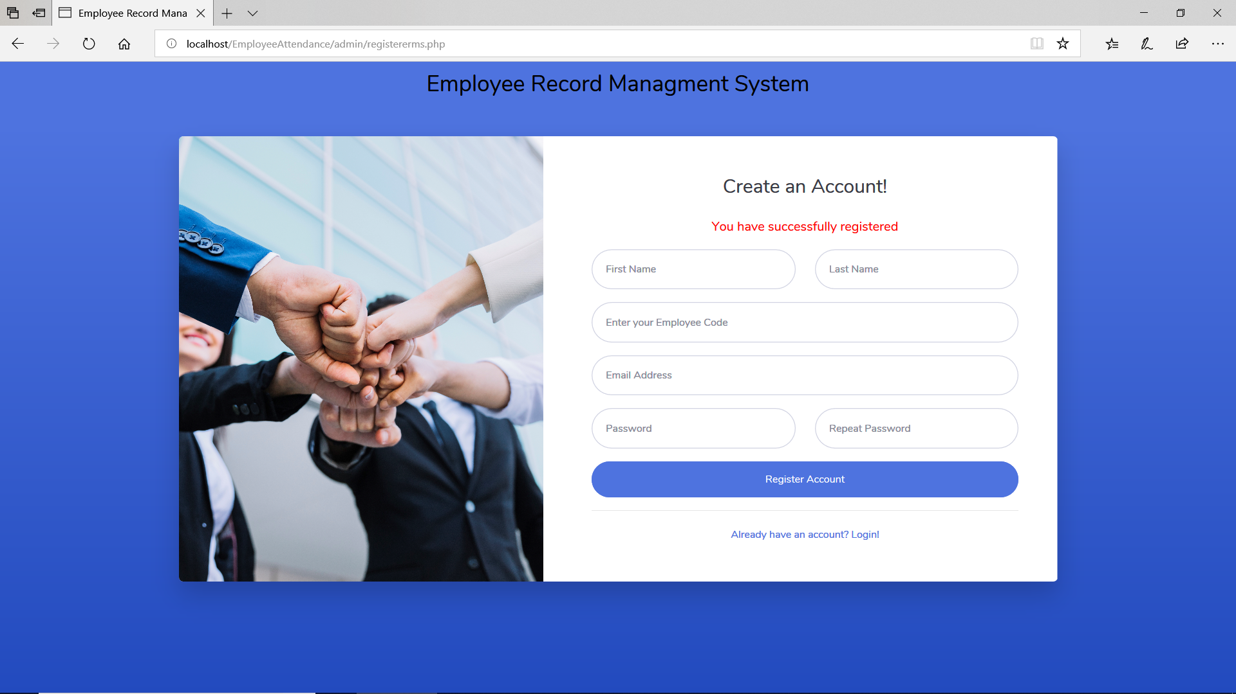
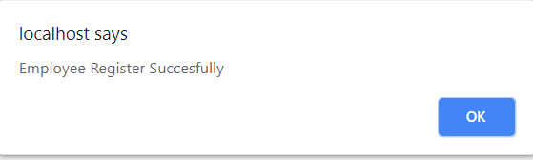
An employee is added or registered with the company successfully

Slide 19
View employee details:
After login ,If admin wants to only view the data or information of all the employees then it is also possible.
Various filters can be applied to find the particular information of any employee.

Slide 20
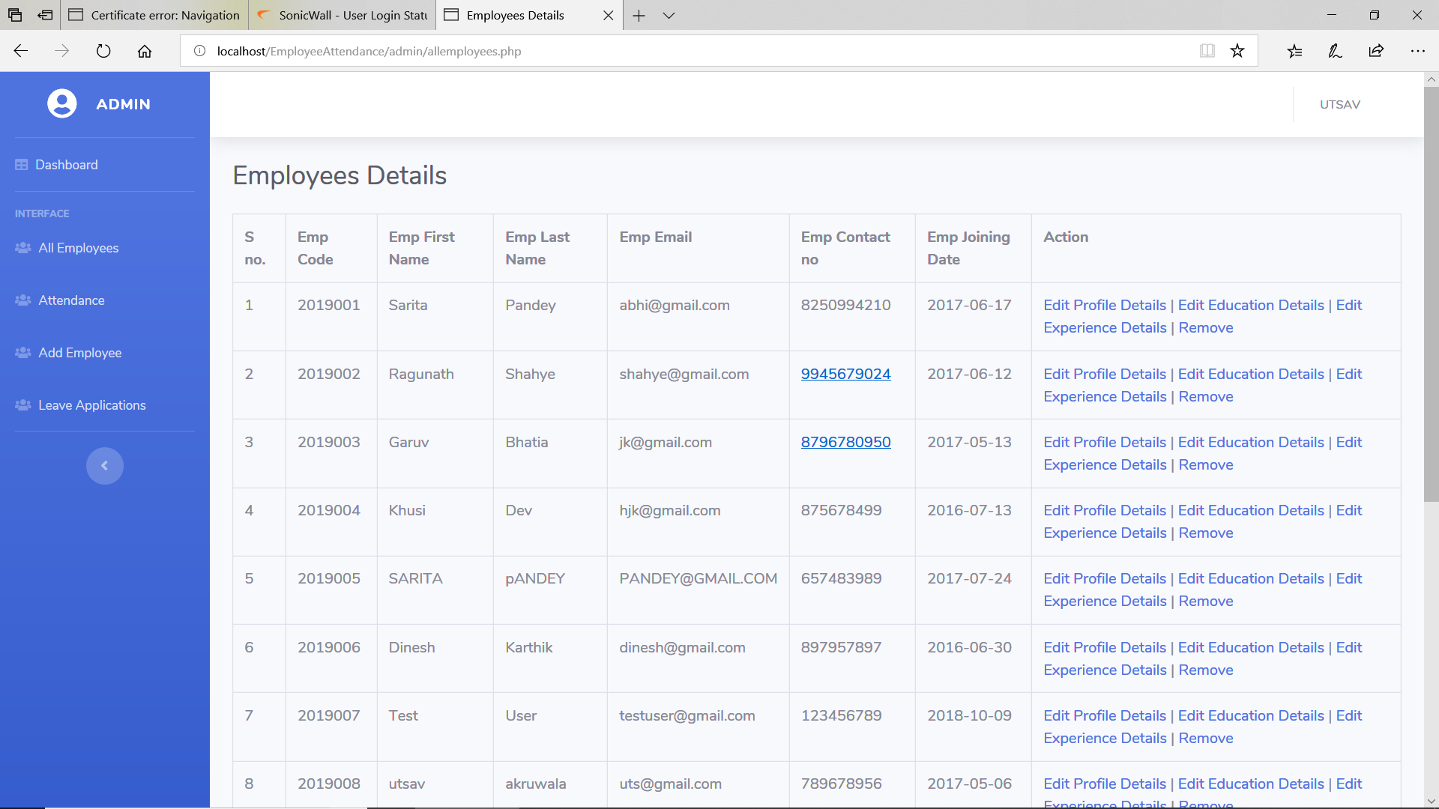

Slide 21
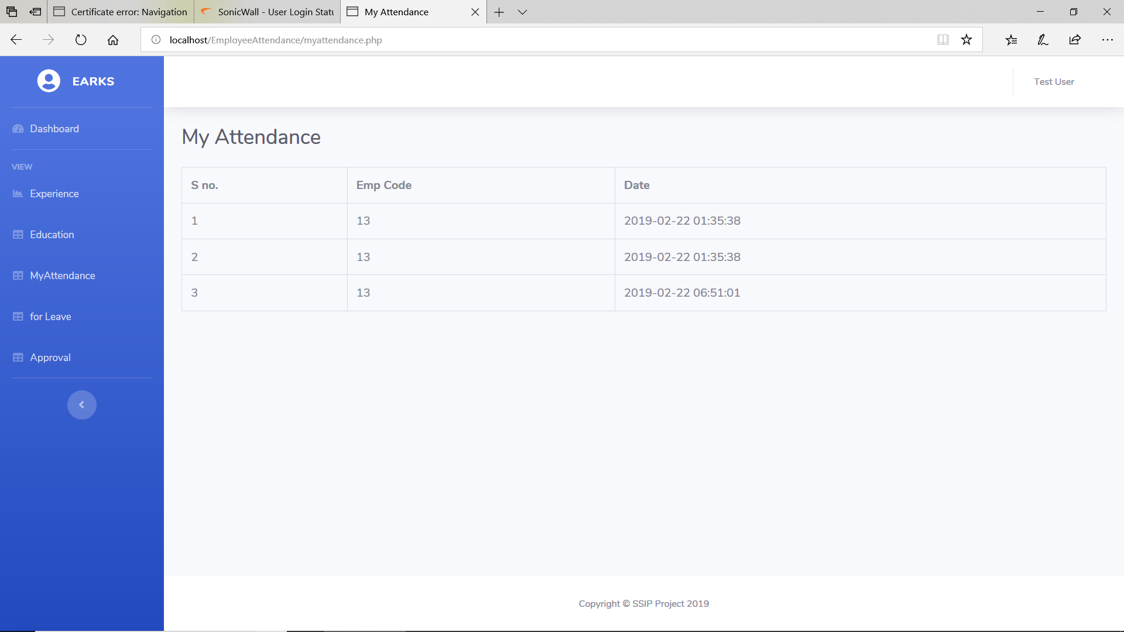
Attendance status of all the employees

Slide 22
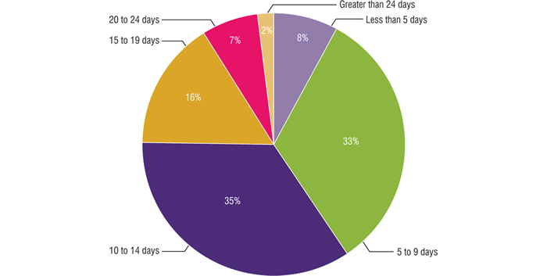
Generation of report
Growth of company is based on the performance and dedication of the employee of particular company.
Admin can generate the report after the evaluation of the employees, which increases productivity.

Slide 23
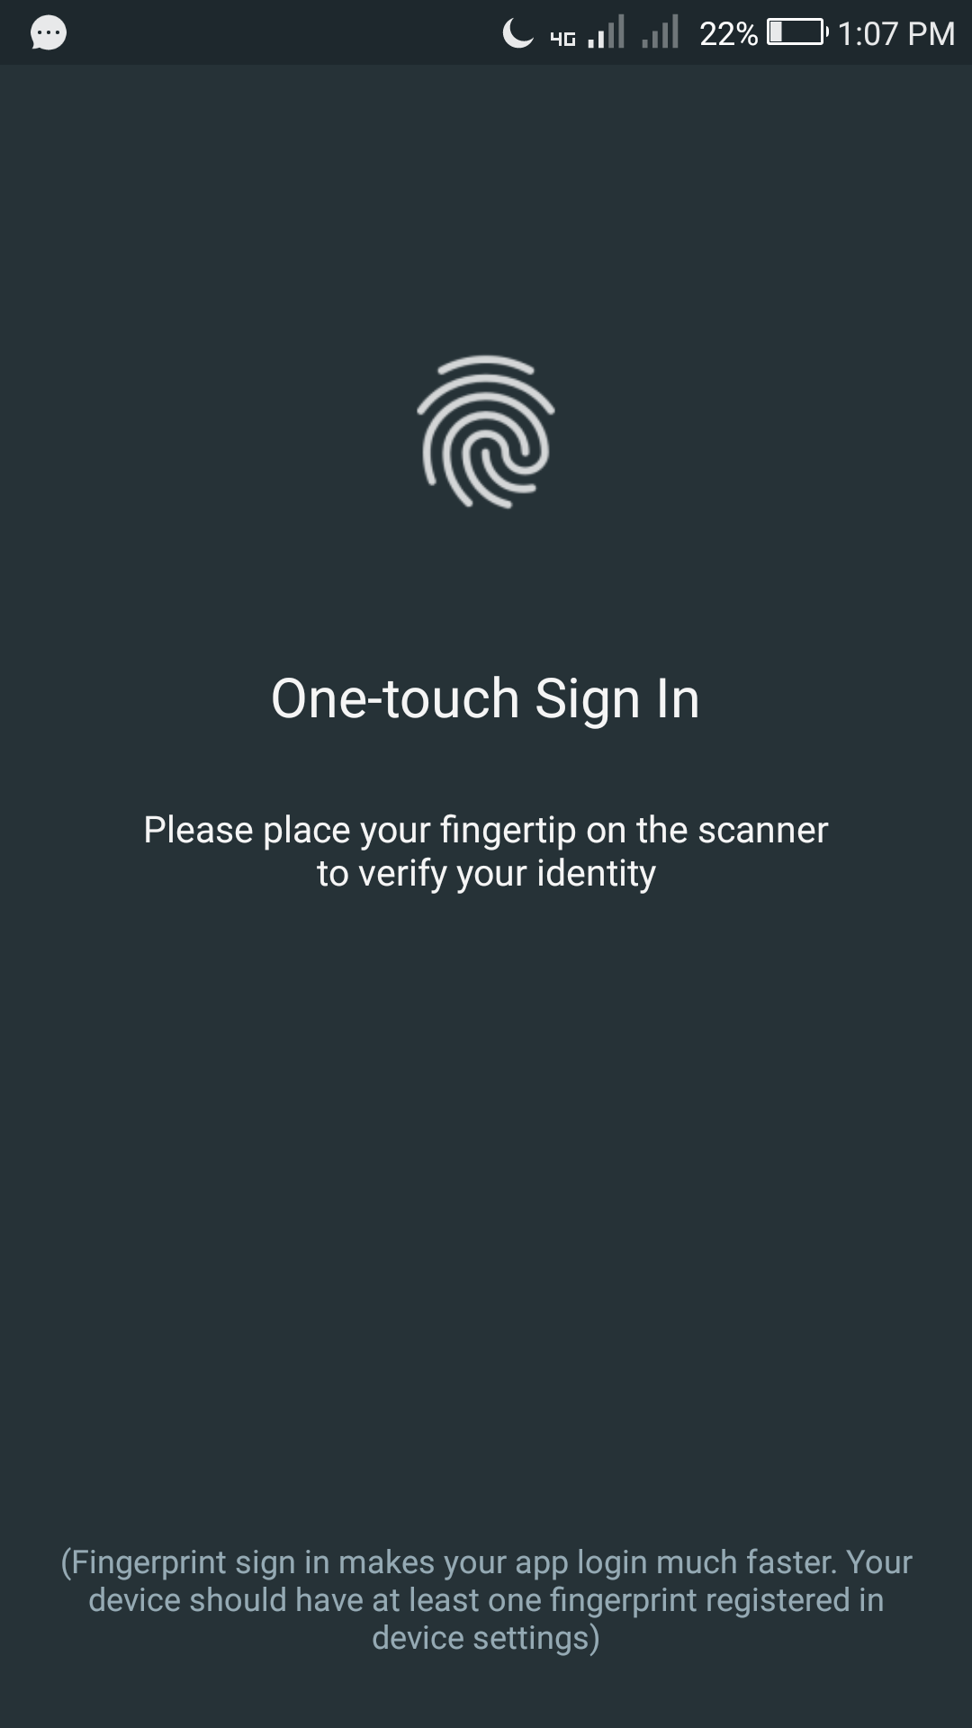
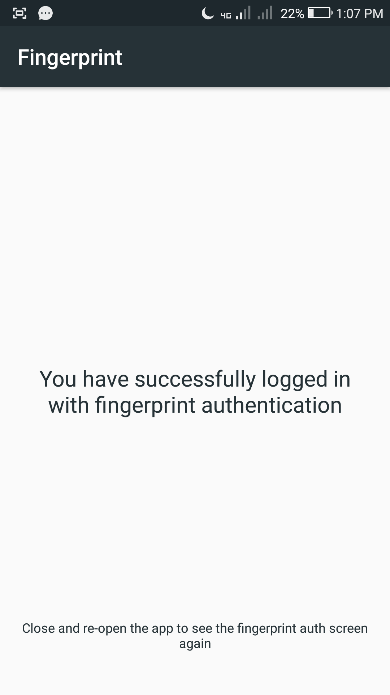
Biometric authentication:

Slide 24
END

