Slide 1


Distributed multidimensional data in Mantid
Anton Piccardo-Selg
In Collaboration

Slide 2
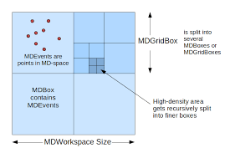
Problem definition
Data reduction/analysis for some technique areas has to be performed in multi-dimensional (MD) space (sparse events)
Current solution: Adaptive Mesh Refinement (AMR) →MDEvent
Note that there is also MDHisto, but since the instrument resolution is not vastly different to SNS or ISIS

Slide 3
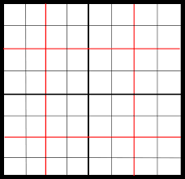
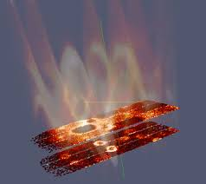
Problem definition
ESS: data sets of several 100 GB to TB require distributed compute and memory resources
In detector space: We have distributed data (split by spectra). Good/Natural solution for many algorithms too.
In momentum transfer space:
How do we create a distributed, MD data set?
How do algorithms operate on this?
?

Slide 4
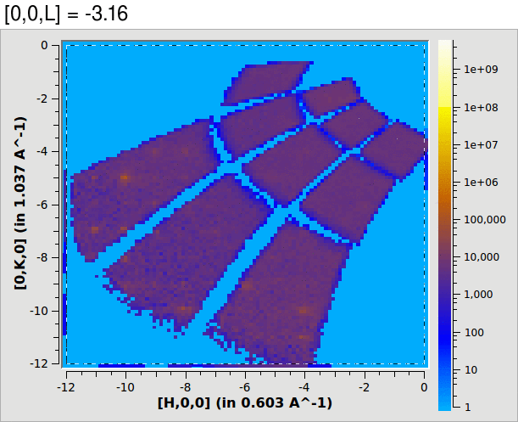
Initial assumptions
Everything will be done via auto-reduction. User will pick up results.
No visualization support for distributed MD data, since there are no dedicated cluster resources for visualization available.

Slide 5
What users actually need
Relevant technique areas: Single Crystal Diffraction (SCD) and Direct Inelastic(DI)
Series of discussions and interviews with instrument scientists/ experts at ESS, ISIS and SNS
The same technique areas across the different facilities expect to operate in a very similar manner. Almost identical for SCD and slight differences between ISIS and SNS for DI
One thing that always came up: Users require interactivity, i.e. must be able to visualize the data and change reduction parameters based on that!

Slide 6
SCD workflow
Operation | Algorithm | Ws Type
Load, crop and normalize data | - | TOF MatrixWs
Convert | ConvertToMD | MDEvent
Peak search | FindMDPeaks | MDEvent
Determine UB | FindUBUsingFFT | PeaksWs
Peak indexing | IndexPeaks | PeaksWs
Integrate Peaks | IntegratePeaksMD or IntegrateEllipsoids | MDEvent &TOF MatrixWs
Correct centre position | CentroidPeaksMD | MDEvent
Visualization in SliceViewer | - | MDEvent
Change some settings, e.g. peak radius and repeat | - | -

Slide 7
DI (ISIS variant)
Horace is used for the MD parts. Equivalent in Mantid would be:
Operation | Algorithm | Ws Type
Reduce several data sets | - | Matrix
Convert | ConvertToMD | MDEvent
Merge data set | MergeMD | MDEvent
Slice data | SliceMD | MDEvent
Fit data | FitResolutionConvolvedModel | MDEvent
Visualization with SliceViewer | - | -

Slide 8
Direct Inelastic (SNS Variant)
Operation | Algorithm | Ws Type
Load and crop data | - | Matrix
Convert | ConvertMD | MDEvent
Calculate norm (includes binning) | MDNormDirectSC | MDEvent/MDHisto
Apply norm | DivideMD | MDHisto
Extract information for further processing and visual inspection with SliceViewer | - | -

Slide 9
Where are MDEvents really needed?
SCD:
Operation | Algorithm | Alternative
Peak search | FindPeaksMD | FindSXPeaks
Peak integration | IntegratePeaksMD | TOF version can be created (see IntegrateEllipsoids)
Centre position correction | CentroidPeaksMD | CentroidPeaks
Visualization in SliceViewer (dynamic binning and zoom features require full event information) | - | None

Slide 10
Where are MDEvents really needed?
DI(ISIS variant)
Mantid is not used any longer for this at ISIS → Horace
FitResolutionConvolvedModel has never been used
Efforts to make Horace compatible with distributed computing (PACE)
DI(SNS variant)
Only required for input to MDNormSCDirect, where it is immediately converted to MDHisto. Avoid MDEvent by providing a ConvertToMDHisto algorithm
Downside of direct conversion means that we need one conversion per set of bin parameters

Slide 11
Minimal viable solution for MD support
Avoid MDEvent data for normalization → develop ConvertToMDHisto and modify MDNormSCDirect
Avoid MDEvent in SCD reduction → create a TOF version of IntegratePeaksMD (see IntegreateEllipsoids) and make IntegreateEllipsoids, FindSXPeaks and IntegratePeaksMD MPI-compatible.
We must be able to visualize MDEvent data (on a single machine)

Slide 12
Minimal viable solution for MD support
How can we support visualization on a single machine? → file-backed operation
File creation:
Convert MatrixWorkspace with event data into a temporary MDEventWorkspace
Parallel saving of the workspace into distributed Nexus file
Slice Viewer with restricted mode: only load data from file if the view will hold only a number of events below a defined threshold

Slide 13
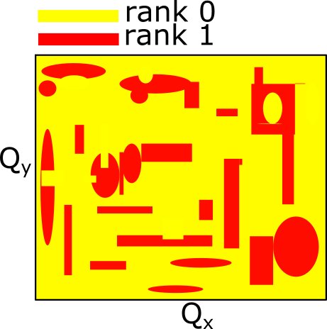
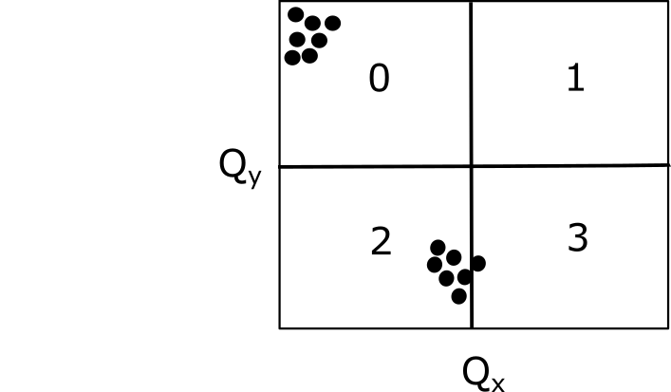
How can we create a distributed MDEventWs?
Each rank contains standard event data which maps into varying regions of MD space.
Ranks should be responsible for certain sections of the MD space which are close to each other.
How can we split MD space between the ranks?
Naïve: wasteful and is likely not going to work
Load balancing approaches from grid computing

Slide 14

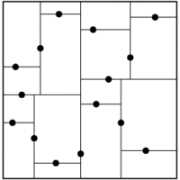
Load balancing
Zoltan Project:
Sandia library for parallel partitioning, load balancing and data-management services
Many interchangeable strategies, but only for 2D and 3D
Recursive Coordinate Bisection
Strategy of ParaView

Slide 15
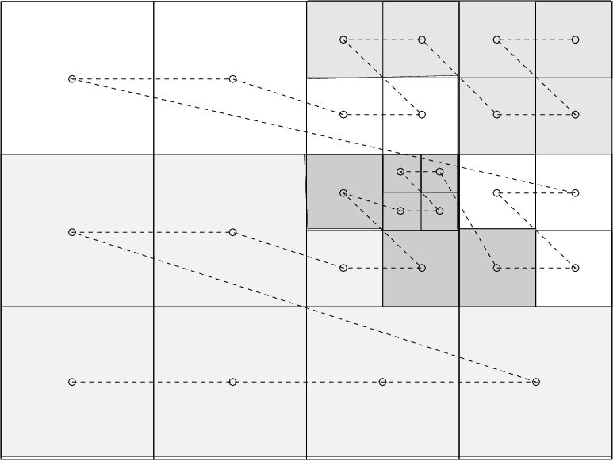
Load balancing
Space Filling Curve
Good when rasterized data is present
Depth-first traversal of trees is a form of space filling curve.

Slide 16
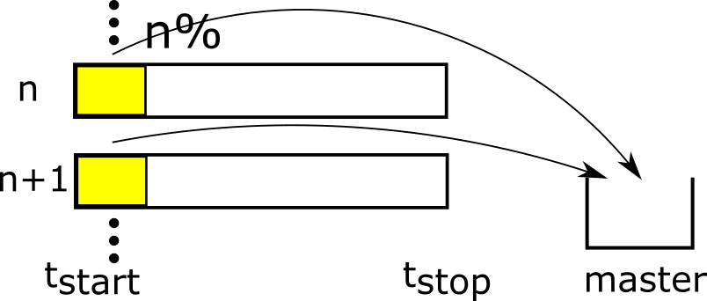
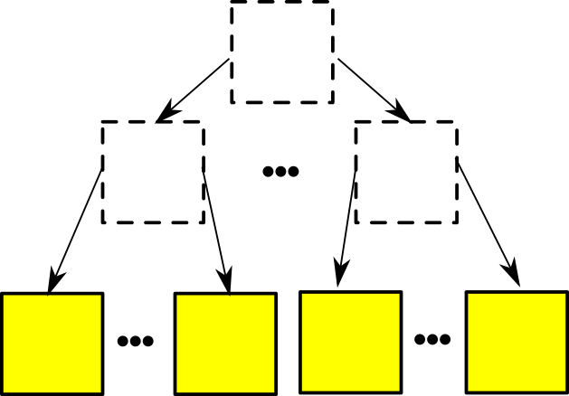
Our steps
n%-sampling: Sample the first n% of the measurement time. Assumption that event distribution does not change largely over time (trialled on TOPAZ data). Can have multiple sample intervals throughout the measurement period
Preliminary box structure: Build box structure based on n% sample on a single machine.

Slide 17
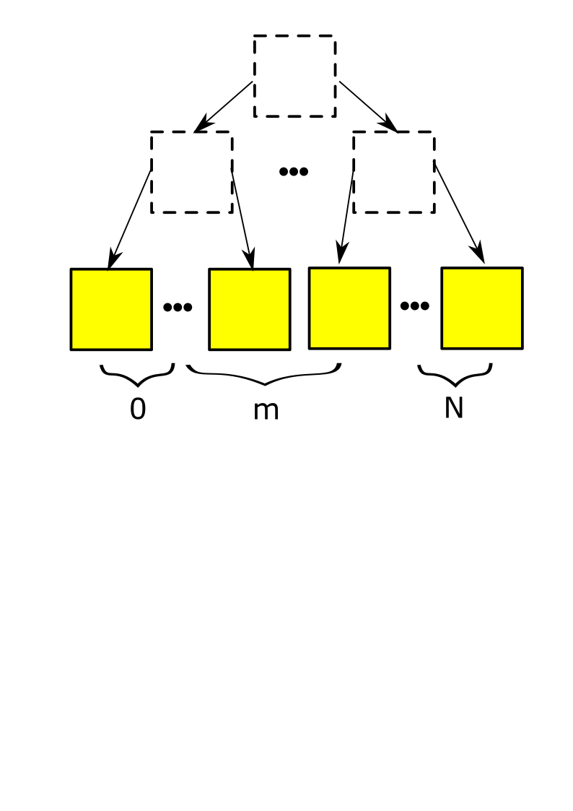
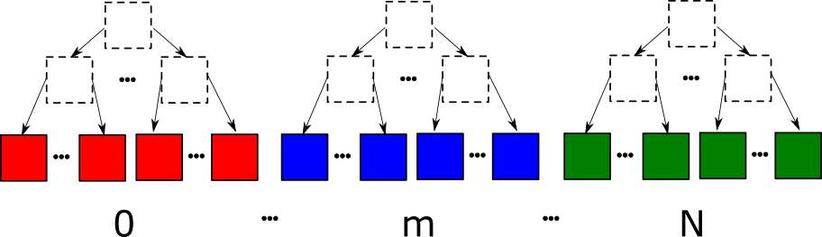
Our steps
Assign boxes to ranks: Use space filling curve for assignment of the boxes to particular ranks
Share hollow structure and add data on all ranks

Slide 18
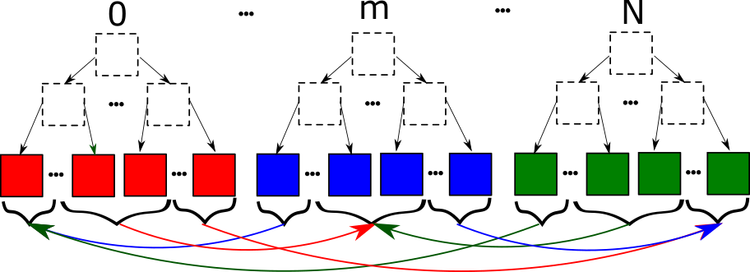
Our steps
Exchange data:

Slide 19
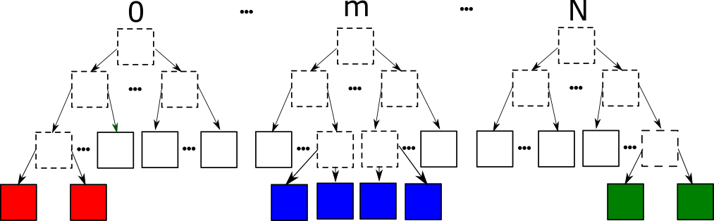
Our steps
Split locally:

Slide 20
Our steps
Consolidate meta data: Meta data stored in the boxes which indicates where in a Nexus file a box needs to be stored. At this point it will not be consistent between ranks at this point. This inconsistency needs to be updated.
Parallel save to HDF5 file Needs to be investigated and prototyped

Slide 21
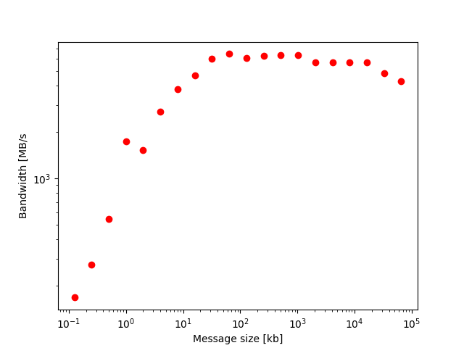
Initial assessment
Scarf17 Rhel7 cluster
201 nodes @ 24 cores each
128GB RAM for each node
Infiniband
TOPAZ_3132_event data set with multiplied events

Slide 22
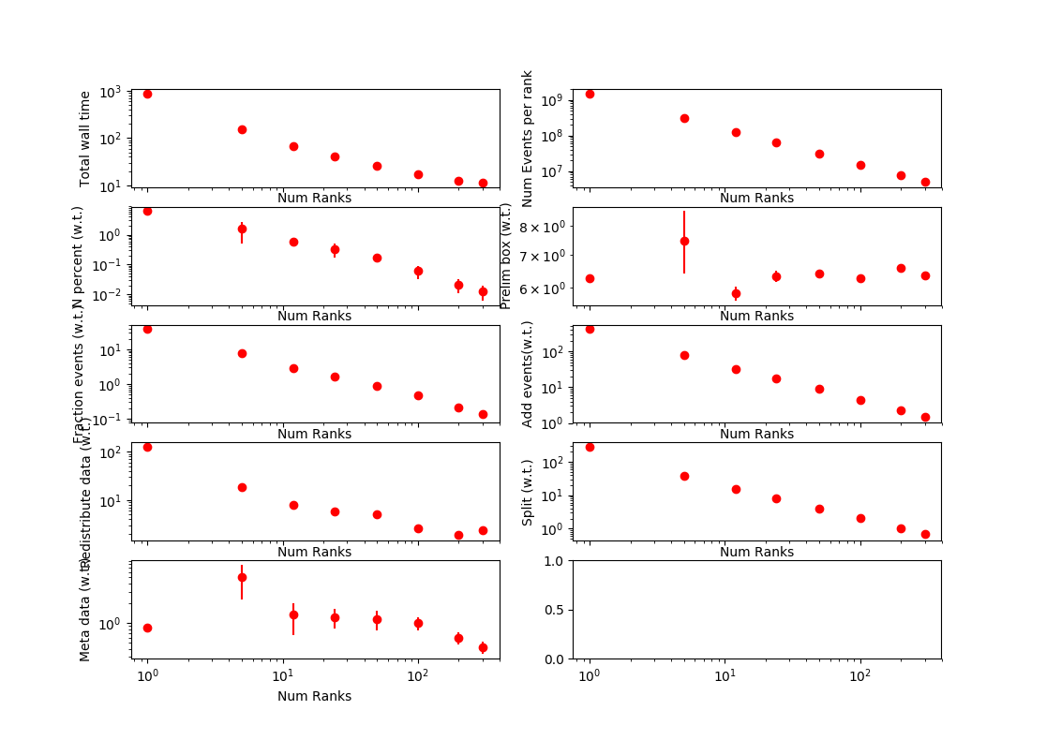
Initial assessment
~ 10GB

Slide 23
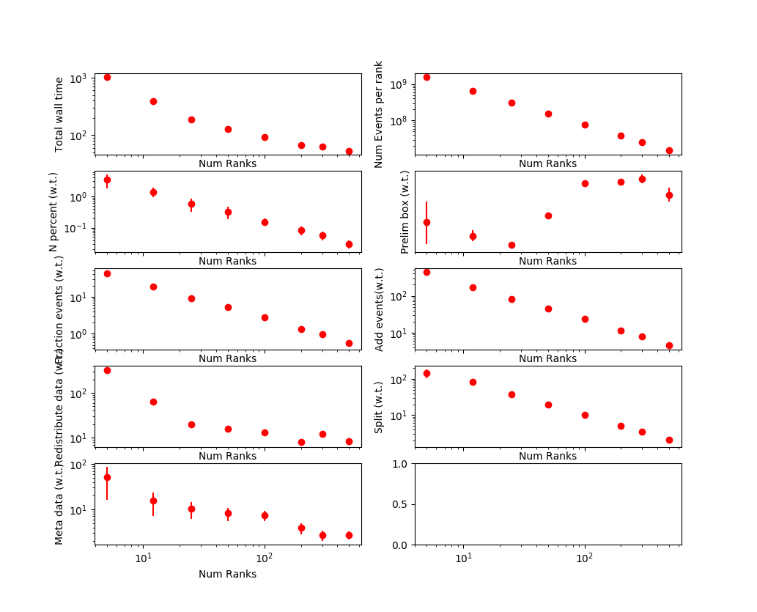
Initial assessment
~ 40GB

Slide 24
Initial assessment
Custom approach to load-balancing works very well. As a result the event-addition and splitting steps scale well.
Redistribute step, where the data-intensive communication is happening is flattening out quickly in our tests, not the bottle-neck up to now
Need to investigate and improve performance of preliminary box structure step (maybe tweak n depending on data size)
Need to investigate and improve performance for consolidation of meta data

Slide 25
Viewing distributed file on single machine
File-backed workspace several orders of magnitudes slower than in-memory workspace, but still good user experience with 40GB+ files in SliceViewer .
Very large files (100s GB – TB) will not be able to run well in standard file-backed mode, still too much data to fetch → determine, based number of events in the view area, if rebinning should be en- or disabled, i.e. only when the user has zoomed far enough into the data, will automatic binning work.
Parallel BinMD for file-backed mode is possible for read-only files might be possible using multiple processes.

Slide 26
Next steps
Investigate parallel HDF5 file saving and develop prototype
Run stress tests on very large data sets → only way to discover bottlenecks
Multiplied data sets
Simulated data sets ?
Are there very large data sets?
Generalize solution
Currently focussed on a 3D SCD scenario
Investigate troubles when running on Scarf

Slide 27
Further steps
Validate model on a wider variety of data sets in order to further grow confidence in the n% approach
Make changes to SliceViewer to allow for inspection of large distributed workspaces
Develop mechanism to start automatic binning only when the data content on the field of view is small enough.
Develop parallel BinMD in file-backed mode (for read-only data)
ConvertToMDHistogram algorithm for DI

Slide 28
More information
Project document repository: https://github.com/DMSC-Instrument-Data/documents/tree/master/investigations/MultiDimensionalInvestigation
Prototype repository:
https://github.com/DMSC-Instrument-Data/mantid/tree/DistributedMDEventPrototype

Slide 29
Thanks
Experts contributing:
ESS
Esko Oksanen (7/11/17)
Xavier Fabreges (23/11/17)
Pascale Deen (16/11/17)
Thomas Rod (27/11/17)
ISIS
Pascal Manuel & Fabio Orlandi (26/10/17)
Alex Buts (31/10/17)
SNS
Vickie Lynch (24/10/17)
Andrei Savici (24/10/2017)

