Slide 1



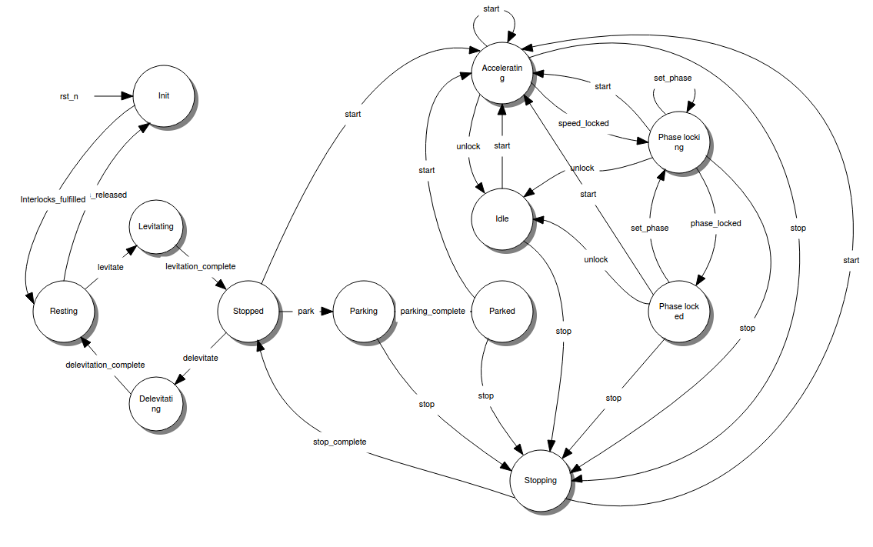
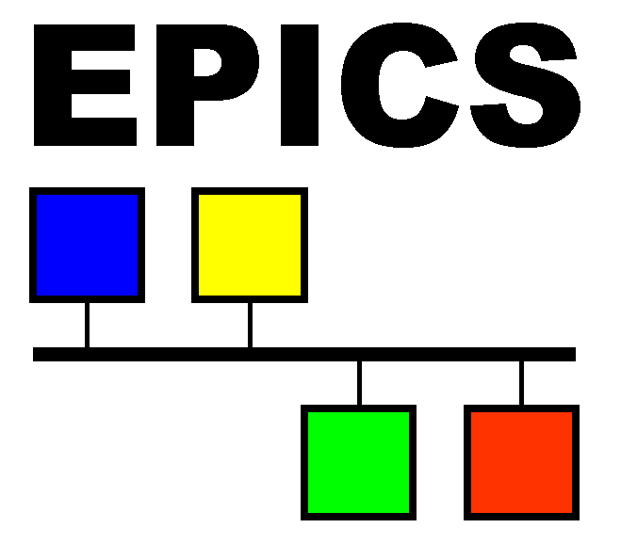


LeWIS – Let’s Write Intricate Simulators!
Michael Hart, Michael Wedel, Owen Arnold
Introduction
Cycle-driven
Lewis is a Python framework for rapidly developing detailed device simulators. It is distributed via PyPI, GitHub and DockerHub.
It is important for a simulation to behave in a predictable and reproducible manner. To ensure this, Lewis operates based on cycles.
Device simulators are valuable for a variety of purposes in the context of developing software that interacts with hardware. Some example use cases are:
Substituting for physical devices when they are unavailable
Testing failure conditions without risk to real devices
Automated system and unit tests of device communication
Perform “dry runs” of user scripts to check validity
Simple simulators which only echo back static values are not enough for many of these use cases. Especially in the context of the ESS, where we have to develop control software while hardware devices are still unavailable, we needed to have a convenient and uniform way of creating and running device simulators that capture rich device behaviour in as much detail as possible.
The Simulation Engine issues cycles periodically, processing network traffic and device simulation. For every cycle, a Δt value – the time since the last cycle – is passed through the simulation. Any device behaviour that is time-dependent (temperature changes, acceleration, movement, …) should be modified by this Δt value.
By modifying the Δt and the cycle rate, we can also speed up and slow down the simulation, as well as modifying simulation fidelity, without any changes to the device implementation.
State Machine
Many devices have complex behaviour that is best modelled using a state machine. For example, this is the state diagram of a chopper that will be used at the ESS:
Very Simple Example:
StateMachineDevice Example:
class VerySimpleDevice(Device):
value = 10
class SimpleTCPInterface(StreamAdapter):
commands = [
Var('value', read_pattern='^V$', write_pattern='^V=(.+)$')
]
in_terminator = '\r\n'
out_terminator = '\r\n'
from lewis.devices import StateMachineDevice
from lewis.core.statemachine import State
from lewis.core import approaches
class DefaultMovingState(State):
def in_state(self, dt):
old_position = self._context.position
self._context.position = approaches.linear(old_position, self._context.target,
self._context.speed, dt)
self.log.info('Moved position (%s -> %s), target=%s, speed=%s', old_position,
self._context.position,
self._context.target,
self._context.speed)
class SimulatedExampleMotor(StateMachineDevice):
def _initialize_data(self):
self.position = 0.0
self._target = 0.0
self.speed = 2.0
def _get_state_handlers(self):
return {
'idle': State(),
'moving': DefaultMovingState()
}
def _get_initial_state(self):
return 'idle'
def _get_transition_handlers(self):
return {
(('idle', 'moving'), lambda: self.position != self.target),
(('moving', 'idle'), lambda: self.position == self.target)
}
@property
def target(self):
return self._target
@target.setter
def target(self, new_target):
if self.state == 'moving':
raise RuntimeError('Cannot change target, moving.')
if not (0 <= new_target <= 250):
raise ValueError('Target is out of range [0, 250]')
self._target = new_target
def stop(self):
self._target = self.position
self.log.info('Stopping movement after user request.')
return self.target, self.position
Running and Interacting with Simulation:
$ lewis VerySimpleDevice –p "stream: {port: 2020}"
$ telnet localhost 2020
V
10
V=20
V
20
EPICS Interface for Same Device:
class SimpleEPICSInterface(EPICSAdapter):
pvs = {
'Value': PV('value', type='int')
}
$ lewis VerySimpleDevice –p "epics: {prefix: 'SIM:'}"
$ caget SIM:Value
SIM:Value 10
$ caput SIM:Value 20
Old : SIM:Value 10
New : SIM:Value 20
Lewis provides a base class that enables modelling a state machine by specifying the available states and the conditions for transitioning between them. Transitions are handled automatically by Lewis, and events are raised when they occur, so that the simulator developer only needs to implement how the device should react.
Control Client on Command-line:
$ lewis-control device value
10
$ lewis-control device value 20
$ lewis-control device value
20
Control Client in Python:
from time import sleep
from lewis.core.control_client import ControlClient
client = ControlClient(host='127.0.0.1', port='10000')
chopper = client.get_object('device')
chopper.target_speed = 100
chopper.initialize()
while chopper.state != 'stopped':
sleep(0.1)
chopper.start()
Lewis supports several common device protocols out-of-the box.
A device simulator can be written once, in a protocol-agnostic way, and then exposed via any protocol using a thin Interface layer that connects properties, attributes and functions of the Device to PVs, registers or commands, depending on the protocol.
Where to find Lewis
GitHub: https://github.com/DMSC-Instrument-Data/lewis
DockerHub: https://hub.docker.com/r/dmscid/lewis/
ReadTheDocs: http://lewis.readthedocs.io/
$ pip install lewis
$ docker pull dmscid/lewis

