Slide 1
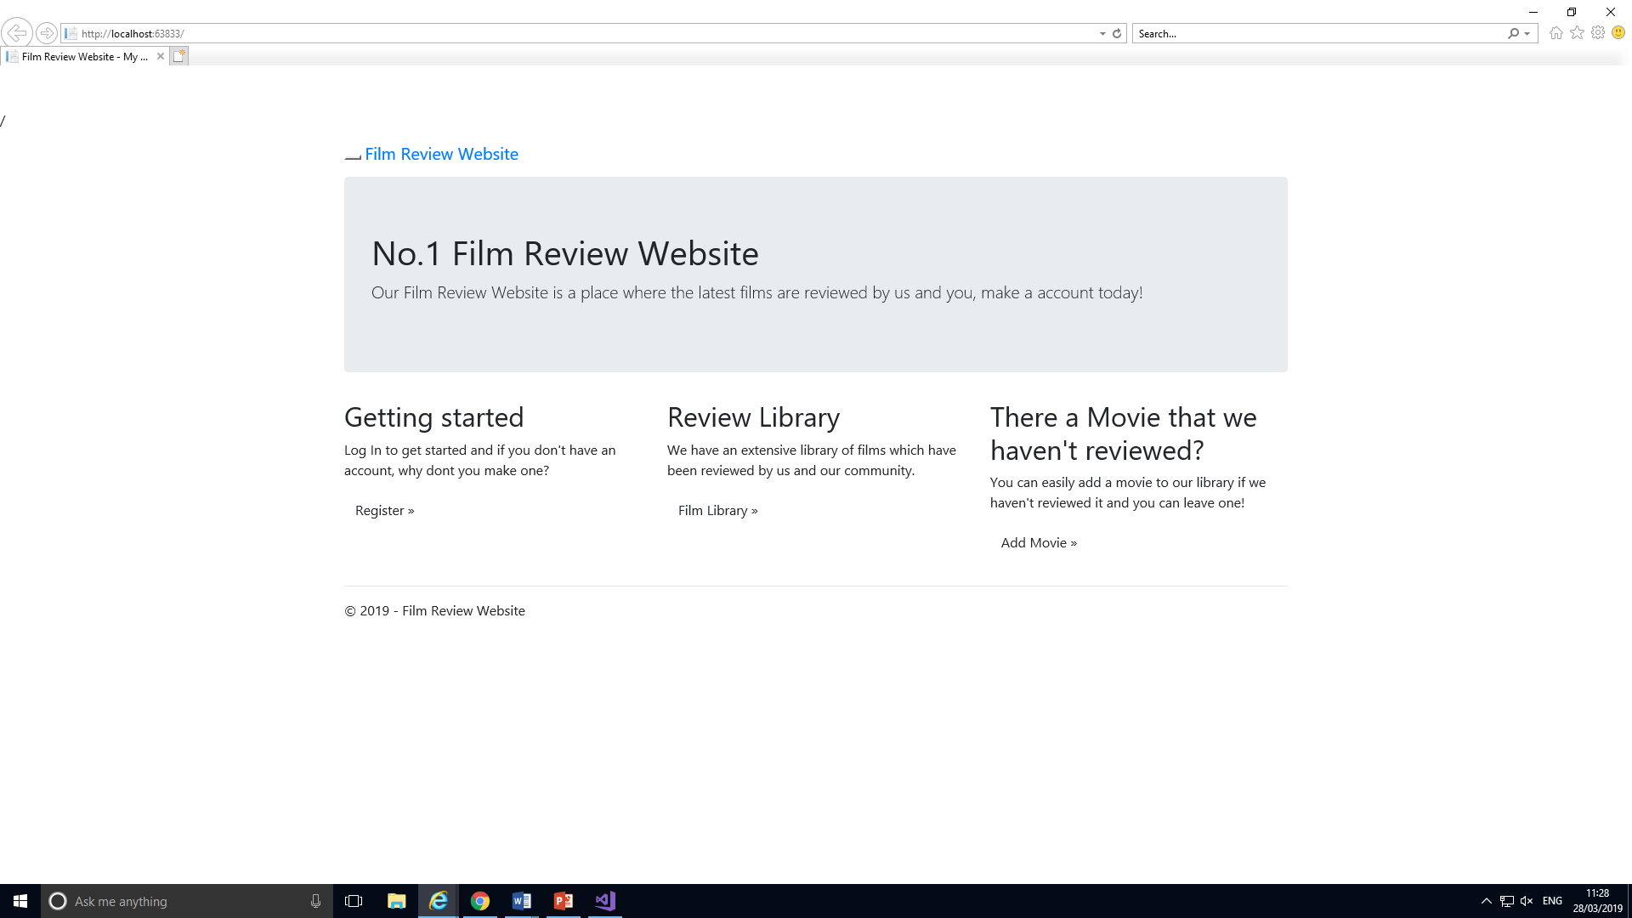
This is the Homepage

Slide 2
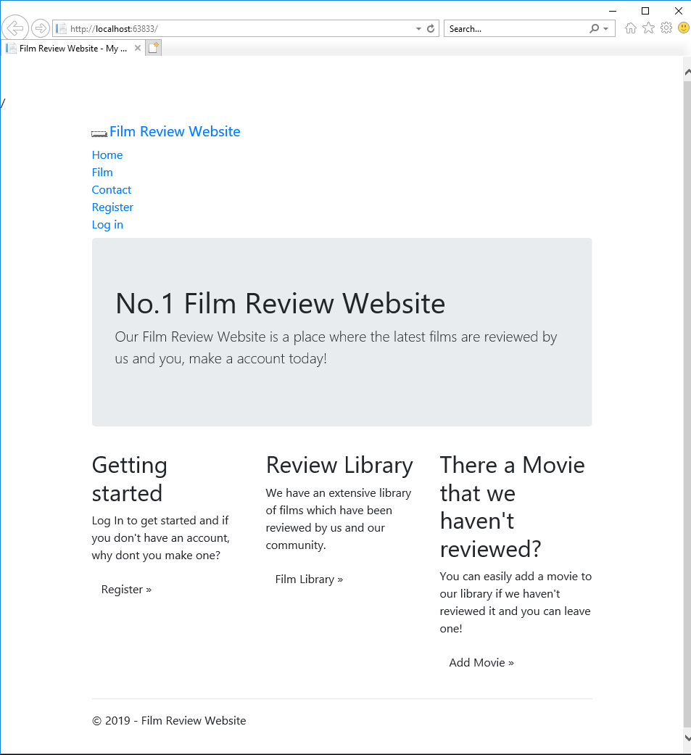
Toolbar access for Home, Films, Actors, Directors, Contact, Register and Log in.

Slide 3
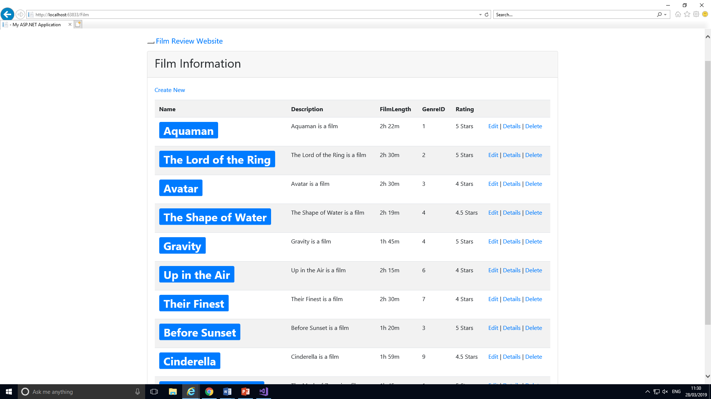
Film Page
List Of Films

Slide 4
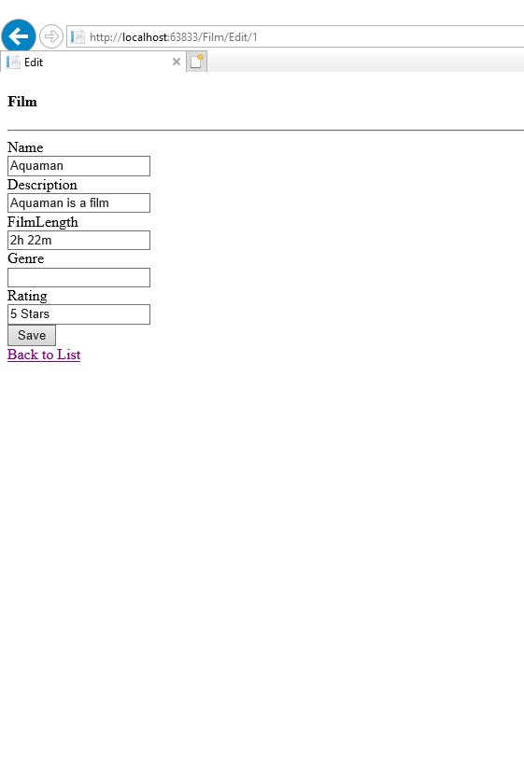
Edit Page
This is where you edit the film.
If this button is clicked, it takes you back to the film list.

Slide 5
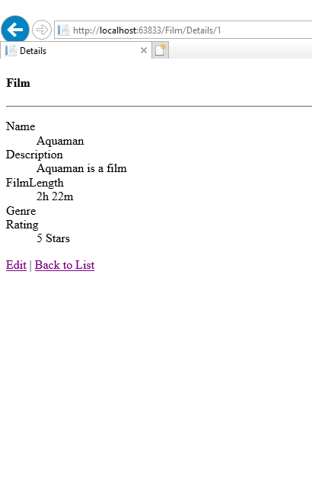
Details Page
This is where you can edit the film details, however only if logged in.
If this button clicked, it takes you to the film list.

Slide 6
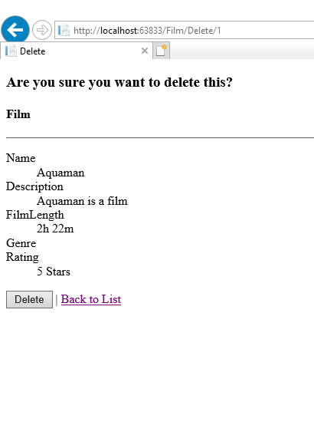
Delete Page
This is where you can delete the film details, however only if logged in.
The button takes you to the film list.

Slide 7
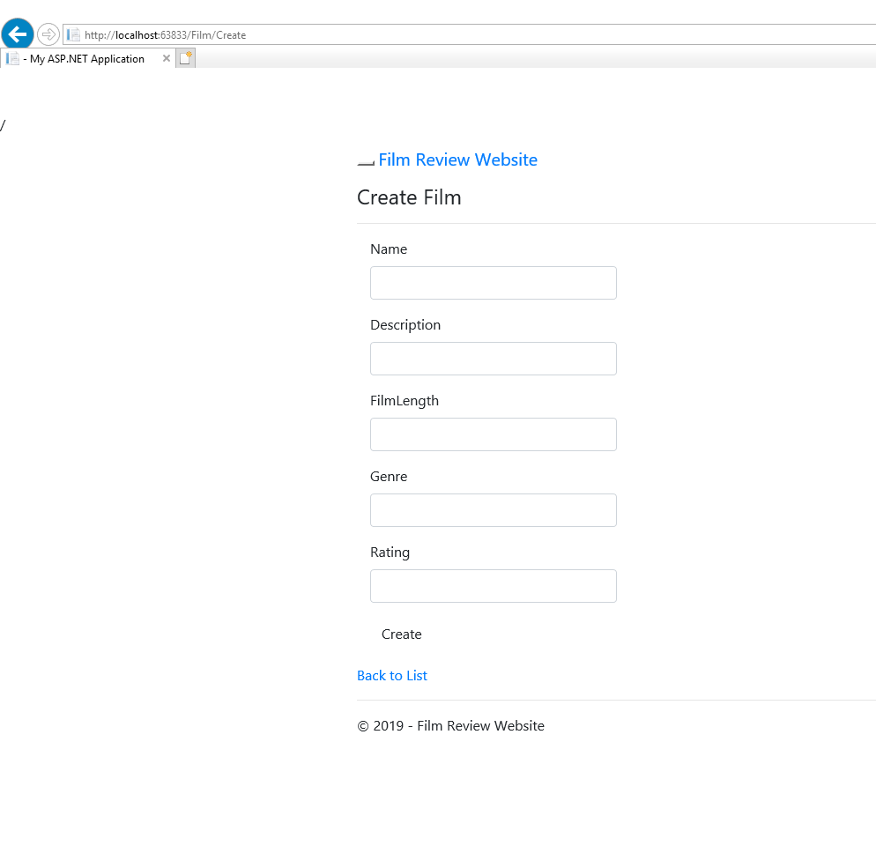
Create New Film Page
This is where you can add a new film, however only if logged in.

Slide 8
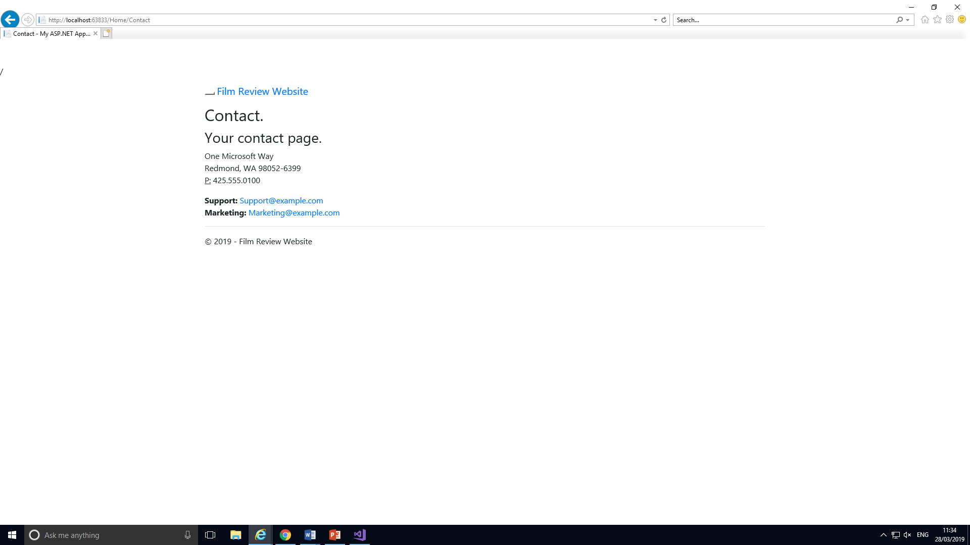
This is a contact page.

Slide 9
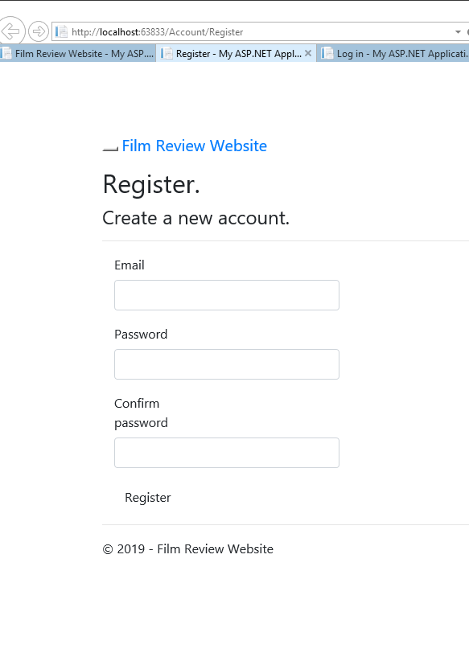
This is a Register page.

Slide 10
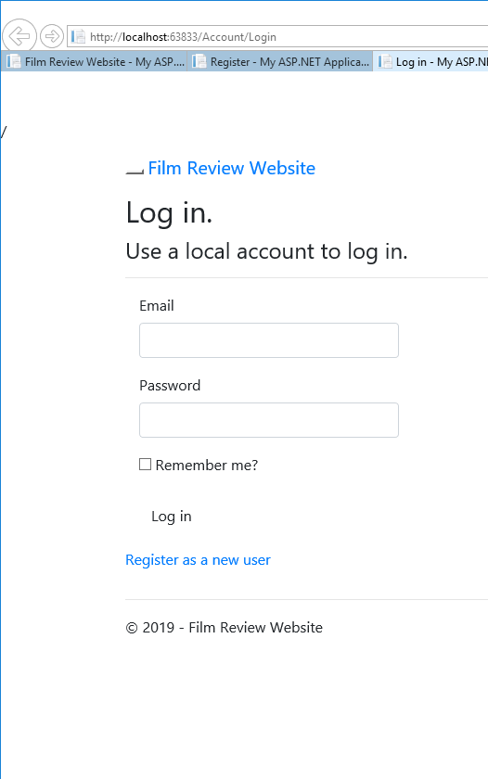
Log In Page
This is where you Log In. When logged in, it gives you the access to view films, add and edit them.

Slide 11
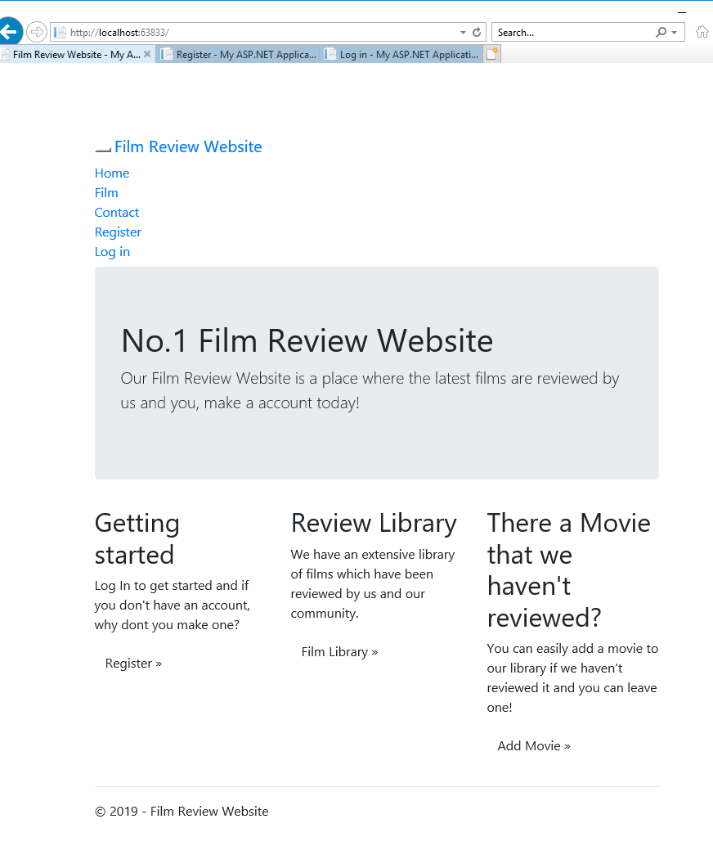
This is where you can add a movie that hasn’t been reviewed.

Slide 12
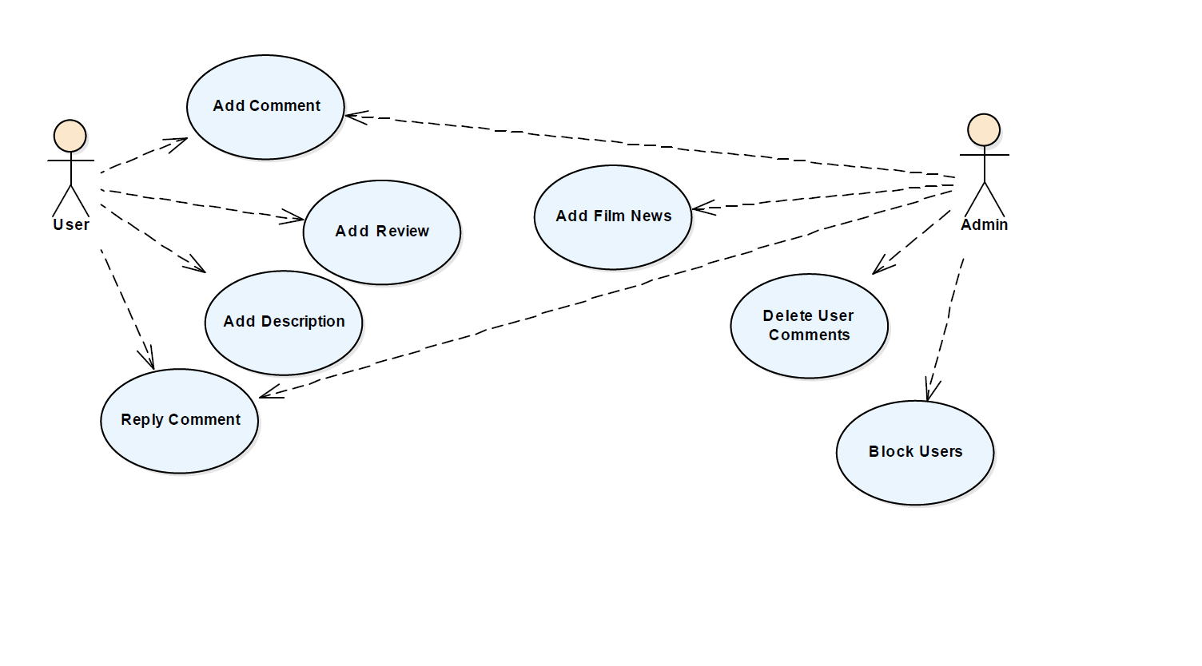

Slide 13
