Slide 1
ADVANCED PROGRAMMING – ASSIGNMENT 2 - PRESENTATION
Niko
Simon
Darnell
Emran

Slide 2
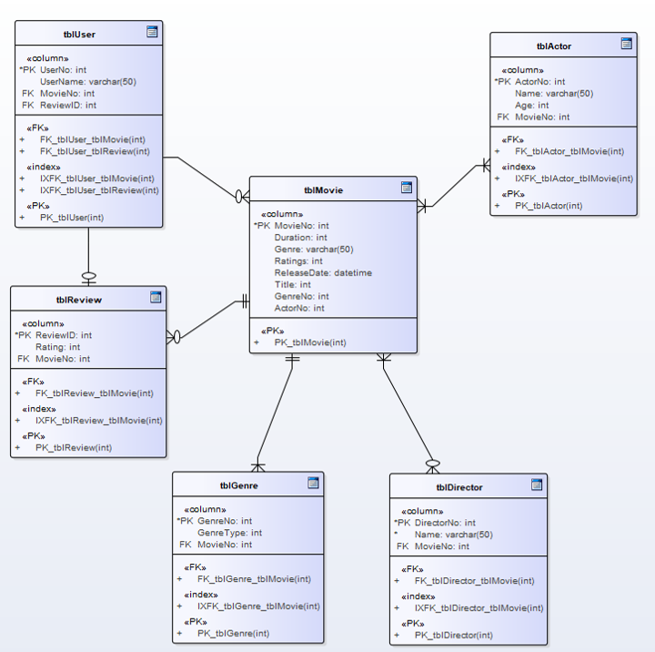
Final Entity Relationship Diagram
Final Entity Relationship Diagram
(Niko)
tblUser
tblActor
tblReview
tblMovie
tblGenre
tblDirector

Slide 3
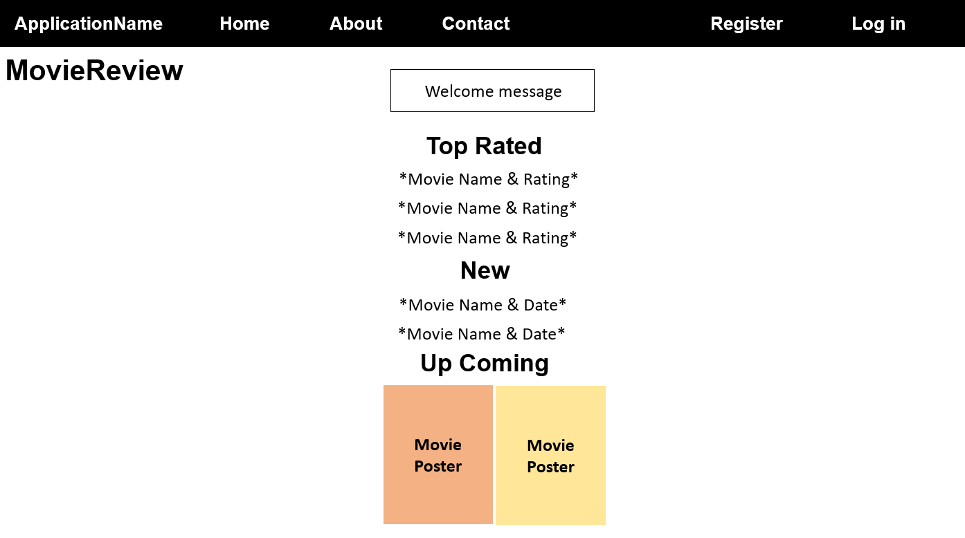
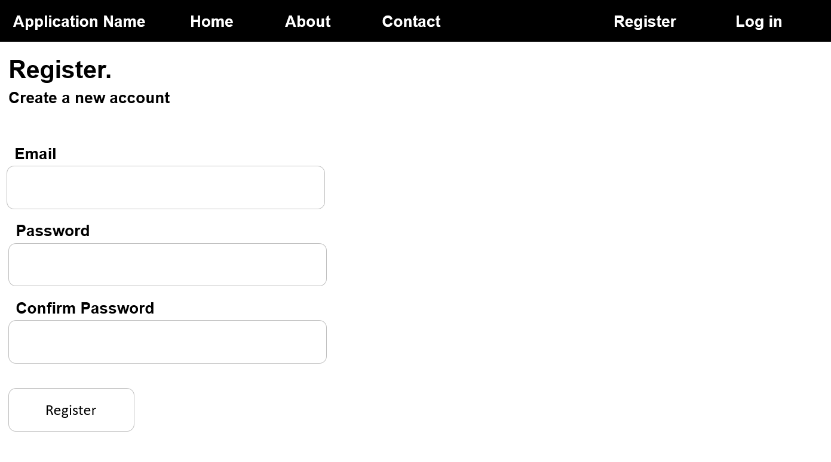
Storyboards
(Niko)
“Index” Page AKA “Home” Page
“Register” Page

Slide 4
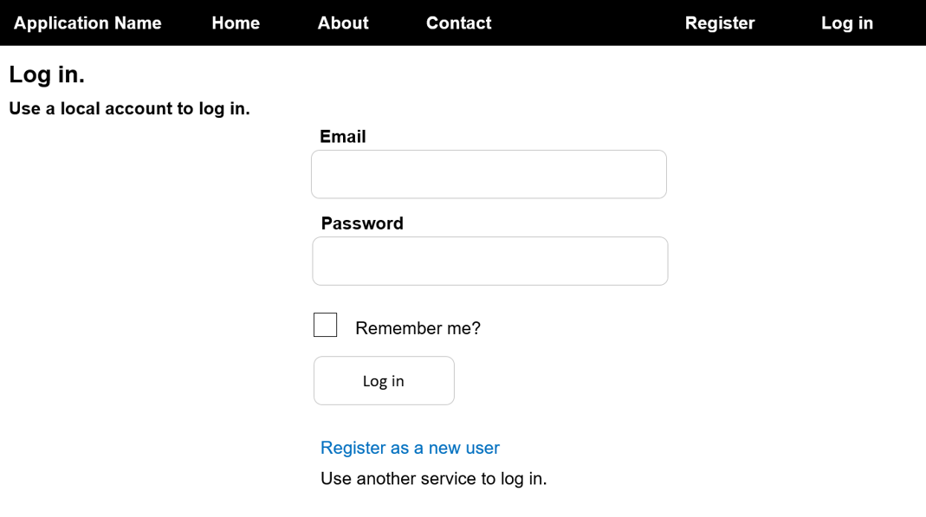
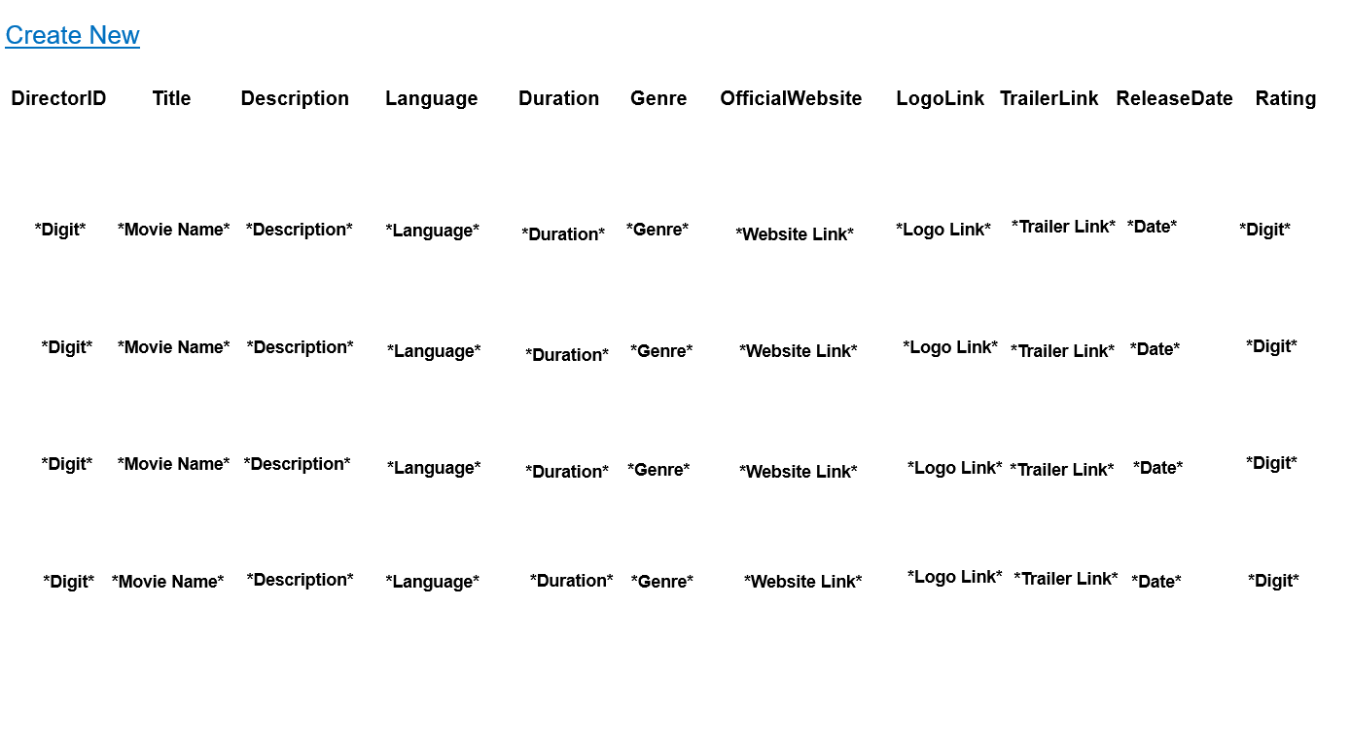
Storyboards
(Niko)
“Log In” Page
List of Movies

Slide 5
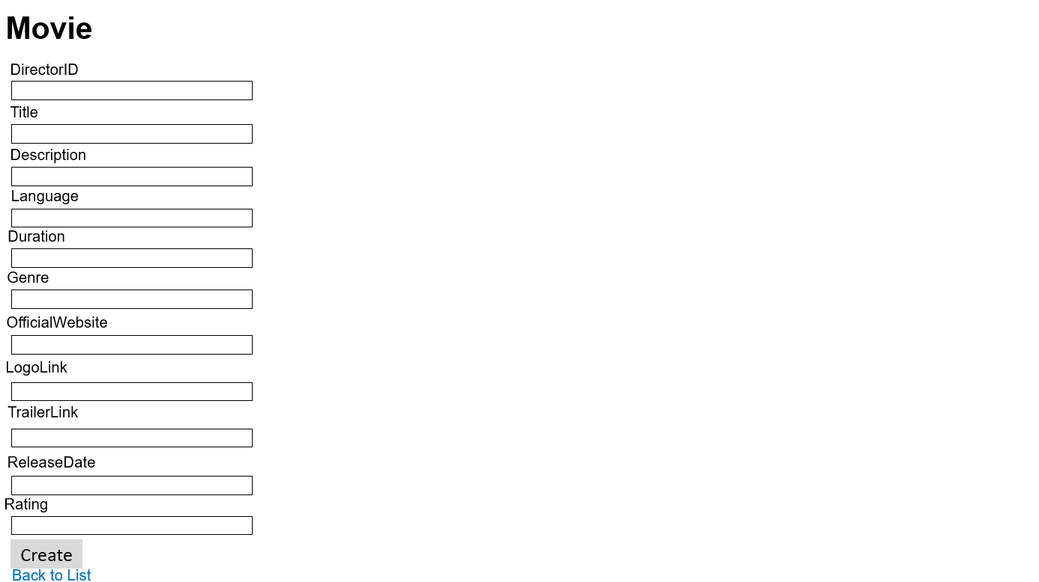
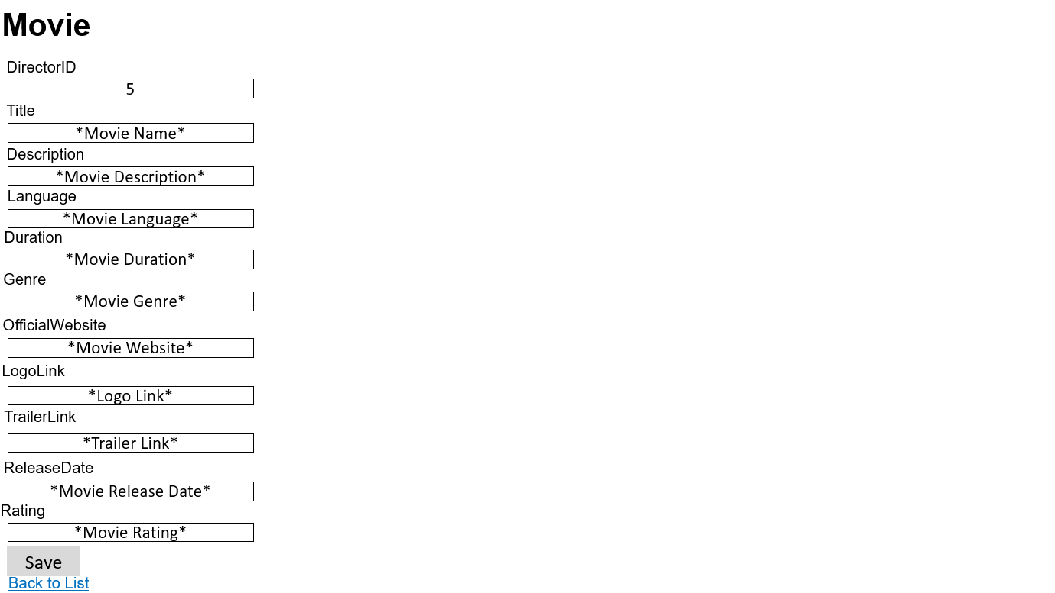
Storyboards
(Niko)
“Create New” Page
“Edit” Page

Slide 6
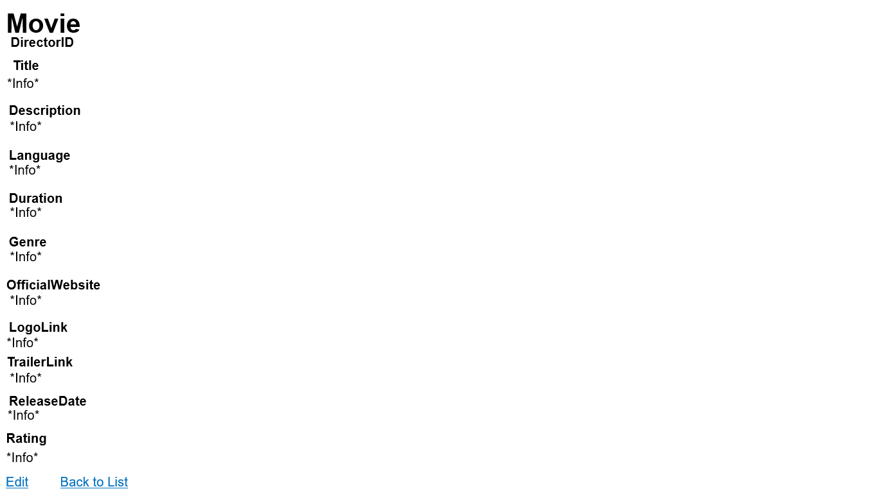
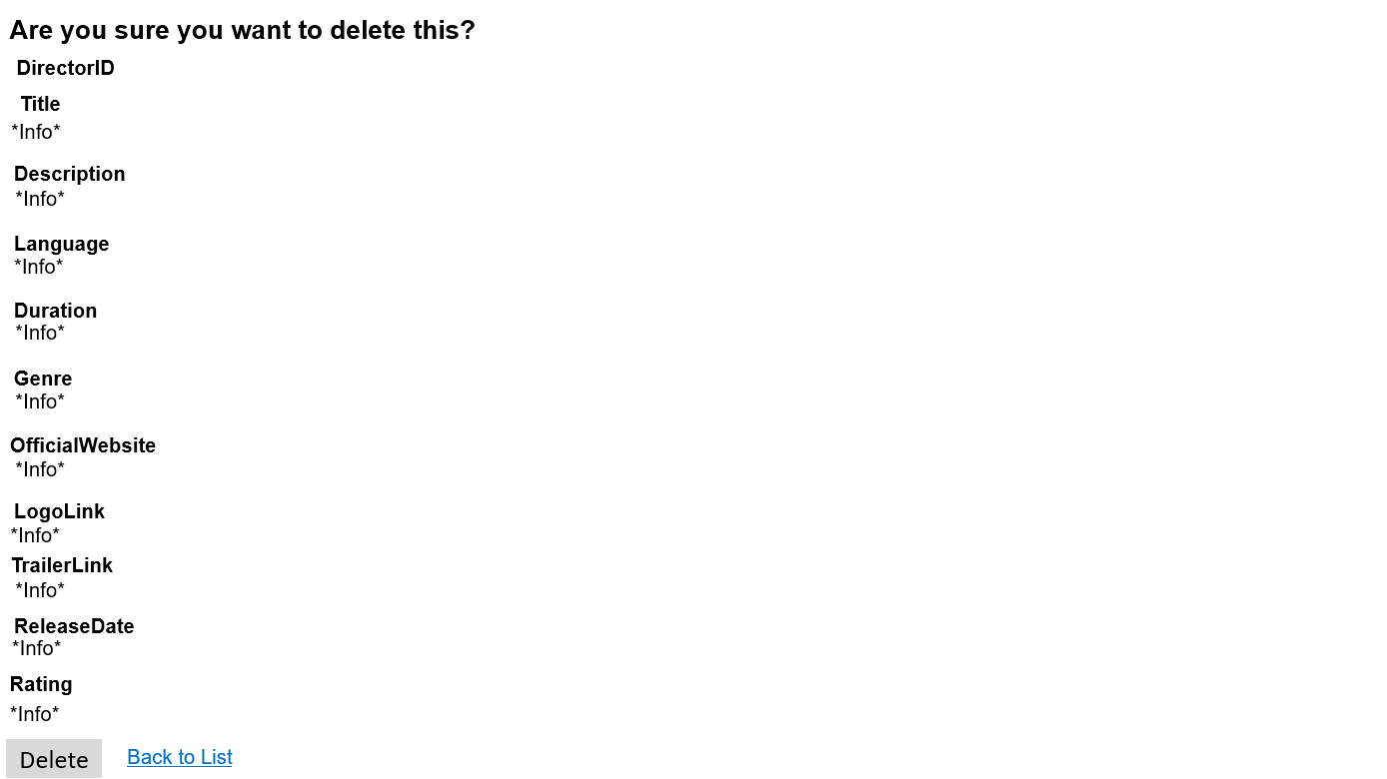
Storyboards
(Niko)
“Details” Page
“Delete” Page

Slide 7

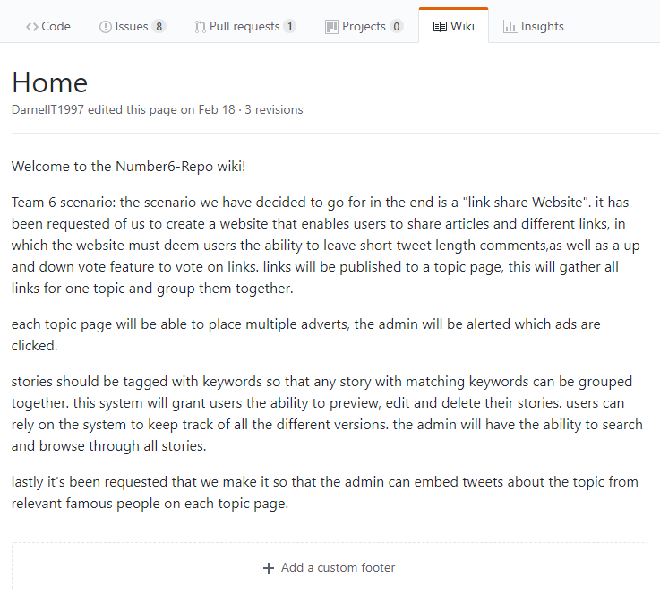
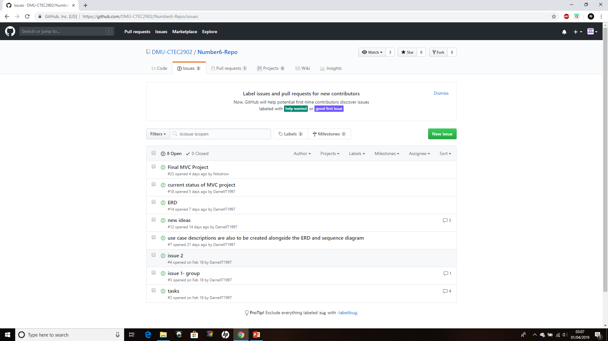
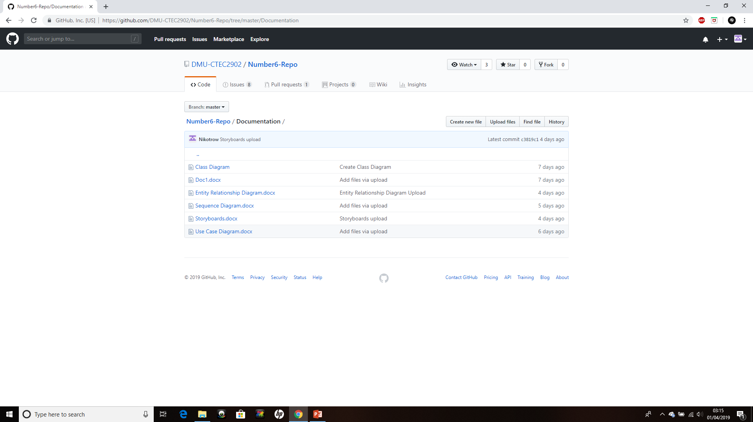
GitHub
(Niko & Darnell)
Updated Wiki
Updated Issues
Kept Everything Documented

Slide 8
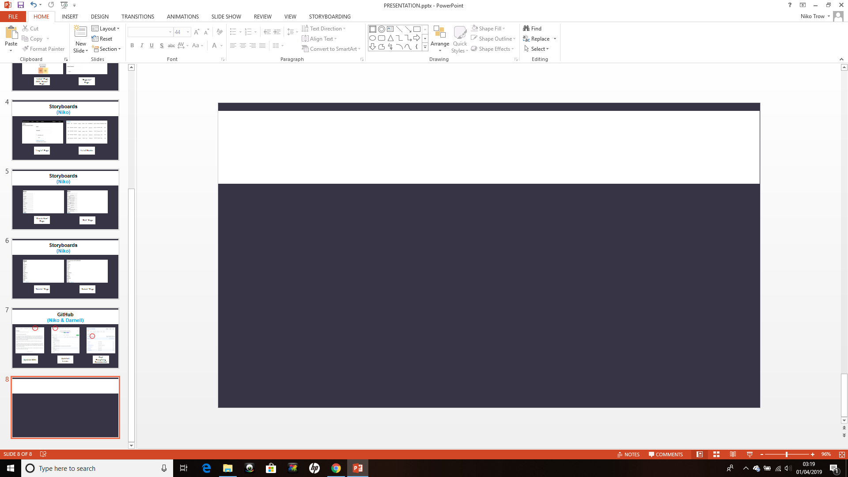

ANY QUESTIONS

