Slide 1
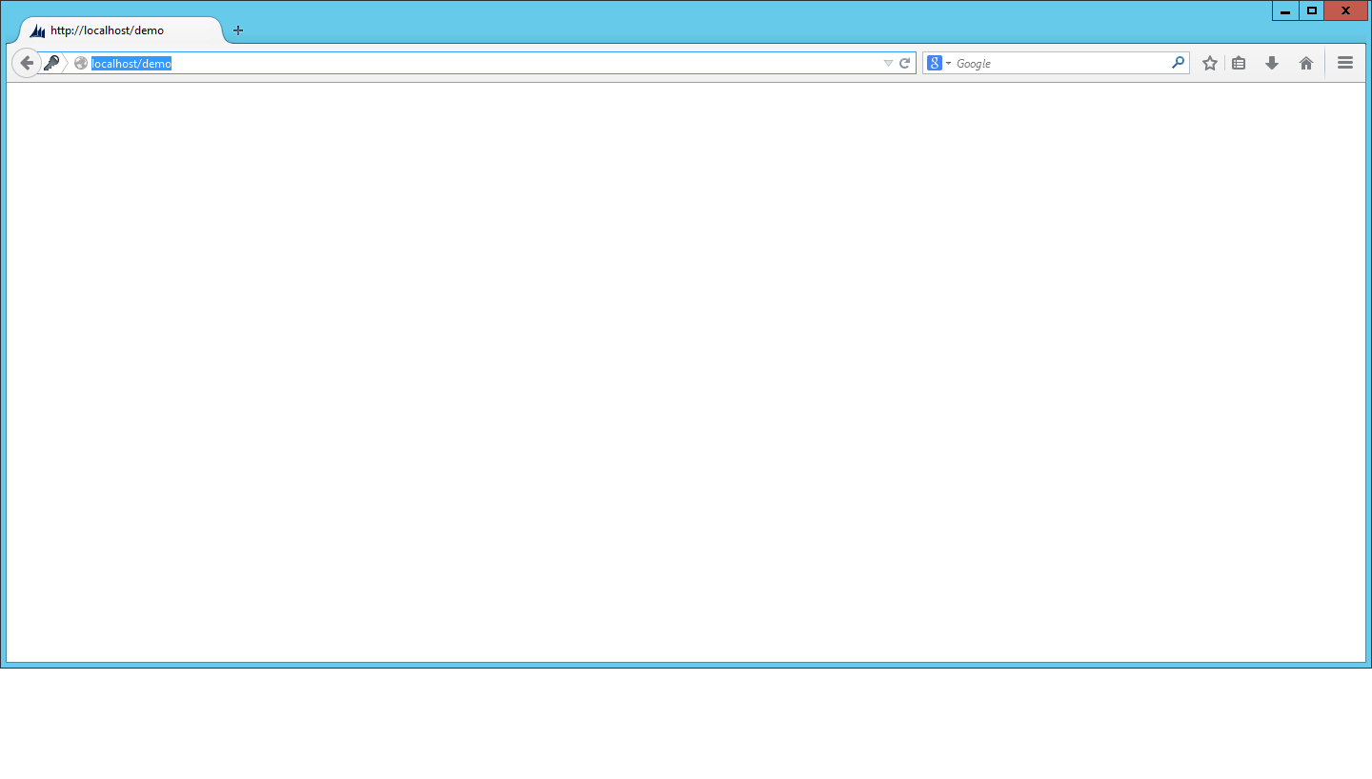
FilmReview Movies | Actors | Directors |
List of movies displayed here when click Movies Link
Title year director
Iron man 2017 Mahdi
Iron man 2017 Mahdi
Iron man 2017 Mahdi
Edit
Delete
Detail
Edit
Delete
Detail
Edit
Delete
Detail
These to buttons will only be visible when logged on as admin – users should only see details

Slide 2
FilmReview Movies | Actors | Directors |
When details of the movie clicked this should come up
Title year director
Iron man 2017 Mahdi
Decribtion :
fdfdjfhdkfndkfnfd
Dfdfdfdfdfdsf
Customer Reviews:
Cool film
Film cover
Edit
Delete
Detail
Again only visible to admin
Delete

Slide 3
FilmReview Movies | Actors | Directors |
Under directors link will look like this
Director Name
Khalid yare
Ali ise
Somboy lester
Edit
Delete
Detail
Edit
Delete
Detail
Edit
Delete
Detail

Slide 4
FilmReview Movies | Actors | Directors |
When details click display changes to this
Name DOB Films
Khalid 01/08/1875 iron man
kill for cash
hero of 70s
Edit
Delete
Detail

Slide 5
FilmReview Movies | Actors | Directors |
List of actors
Actors
Khalid yare
Ali ise
Somboy lester
Edit
Delete
Detail
Edit
Delete
Detail
Edit
Delete
Detail

Slide 6
FilmReview Movies | Actors | Directors |
When details click display changes to this
Actor Name DOB Films
Pete R 01/08/1875 iron man
kill for cash
hero of 70s
Edit
Delete
Detail

