Slide 1
XCode: Film Review MVC
Robert Johnson, Nick Randall, Tomas Tarapavicius and Mike.

Slide 2
Tomas Tarapavicius
Role: Developer

Slide 3
Contributions
News page
Films page
Star Rating/Review Functionality
Charts page
Design with Bootstrap
Little improvements that might not be noticed

Slide 4
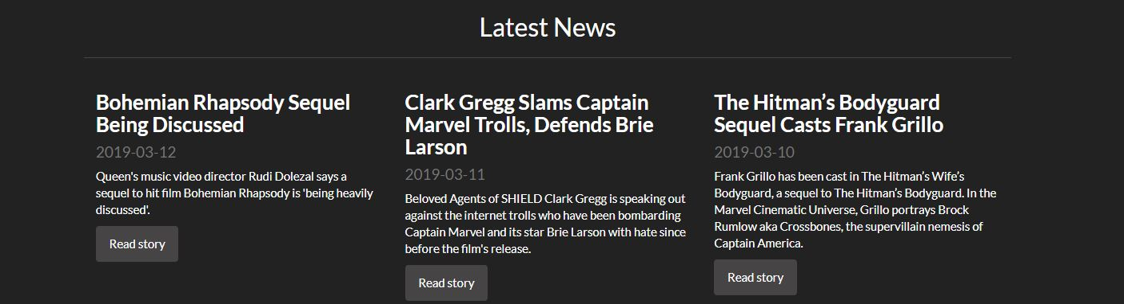
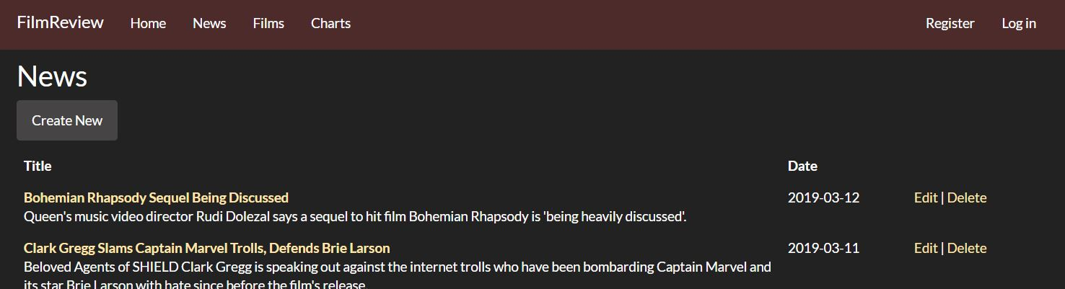
News

Slide 5
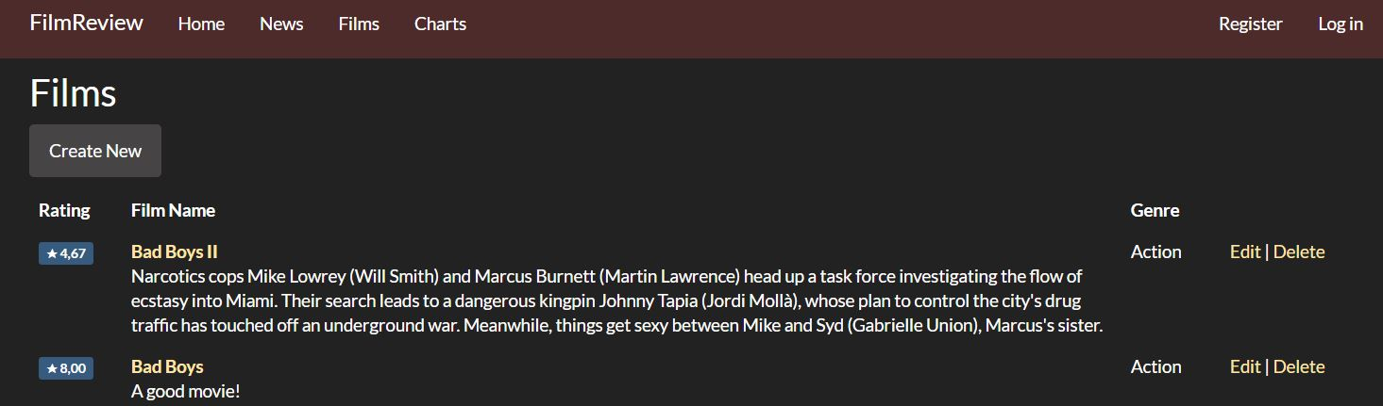
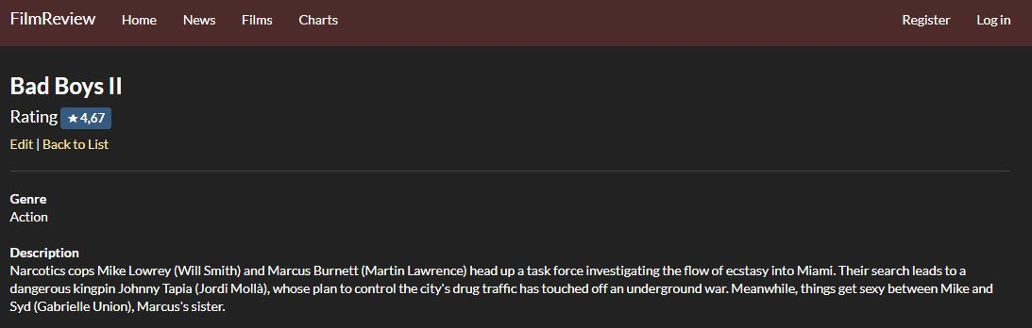
Films

Slide 6
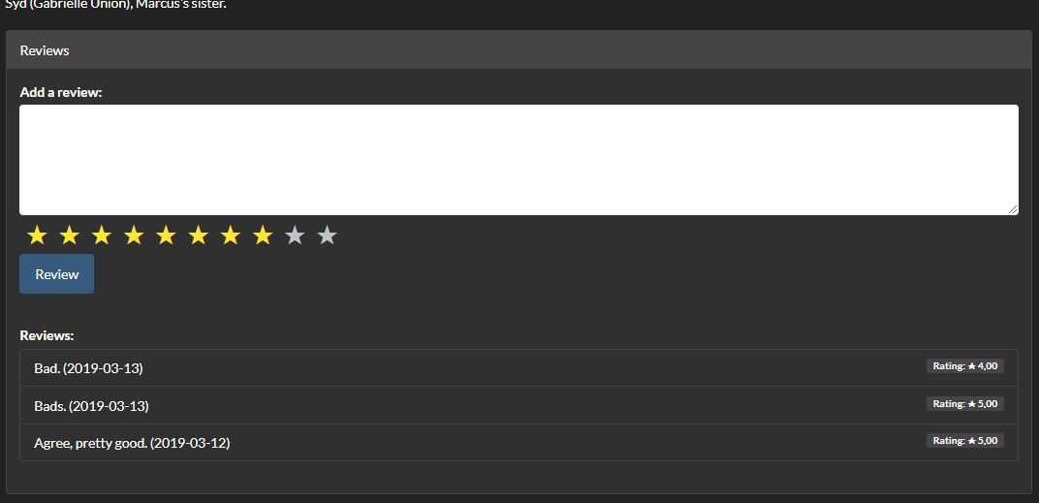
Star Rating/Review Functionality (With weighted average calculation)

Slide 7
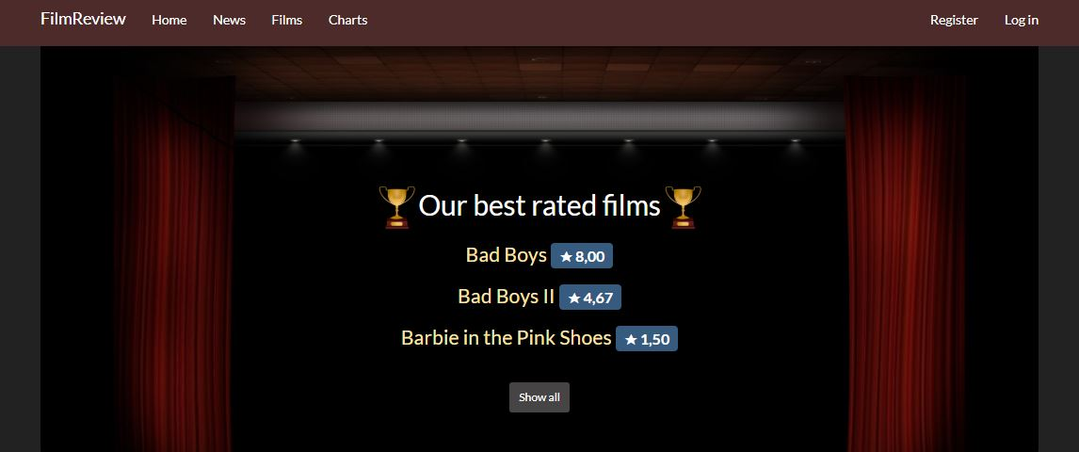
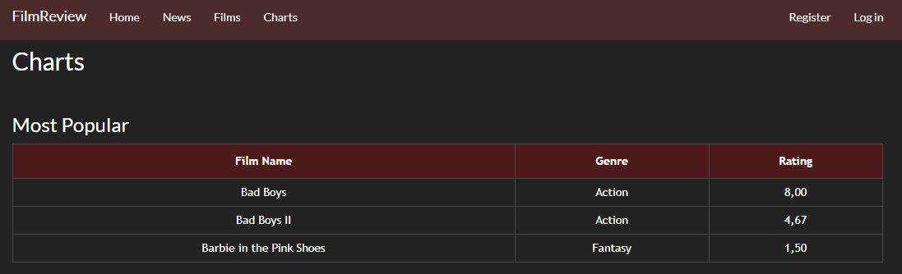
Charts

Slide 8
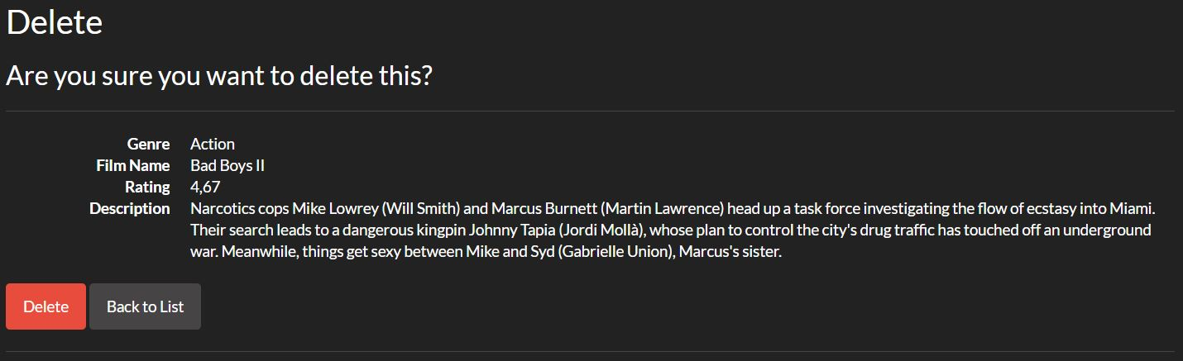
Design with Bootstrap

Slide 9
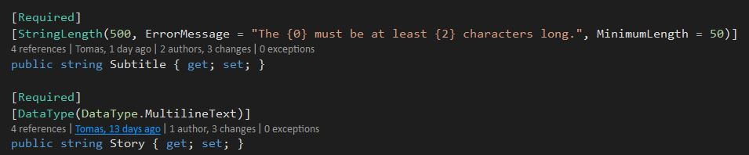
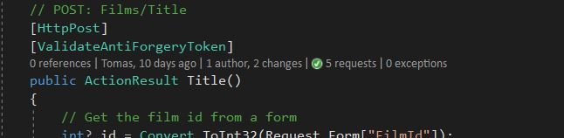
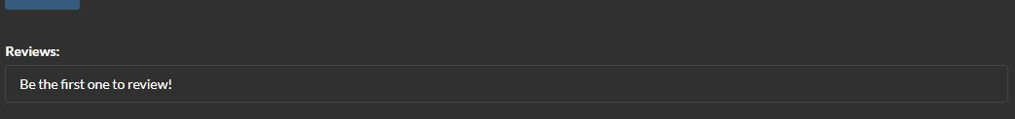
Little improvements that might not be noticed

Slide 10
Robert Johnson
Role: Analyst

Slide 11
Contributions
Updates to GitHub including closing issues and updating ReadMe pages.
Sequence Diagram
Preliminary sketches and final sketches which the final design was based from.
Vision Wiki Pages
Create Class Diagram in Enterprise Architect
Maintain the GitHub repository to make sure it was ‘neat and tidy’, adhering to the assignment specification.

Slide 12
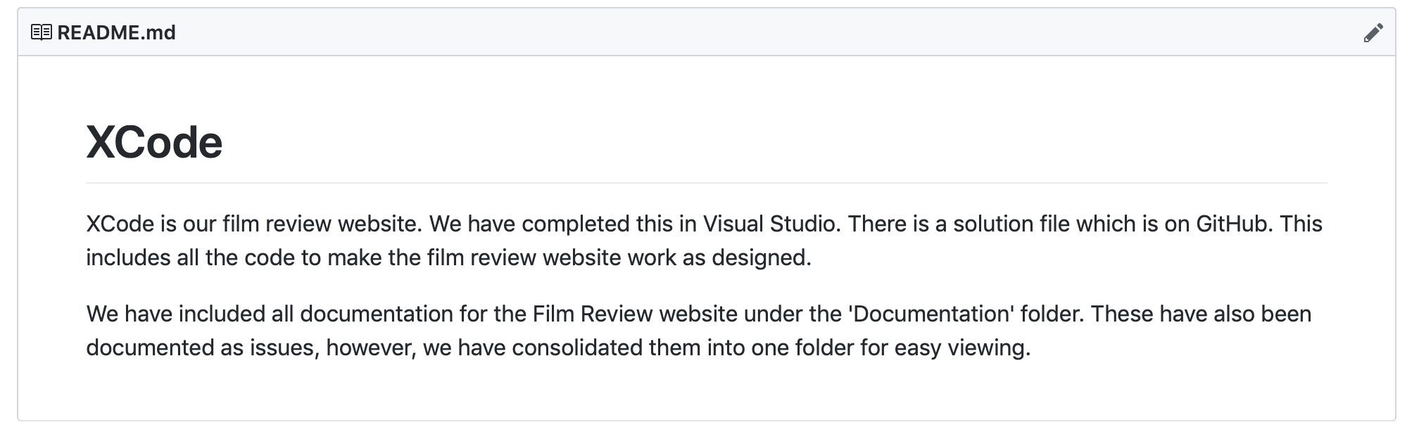
ReadMe on GitHub

Slide 13
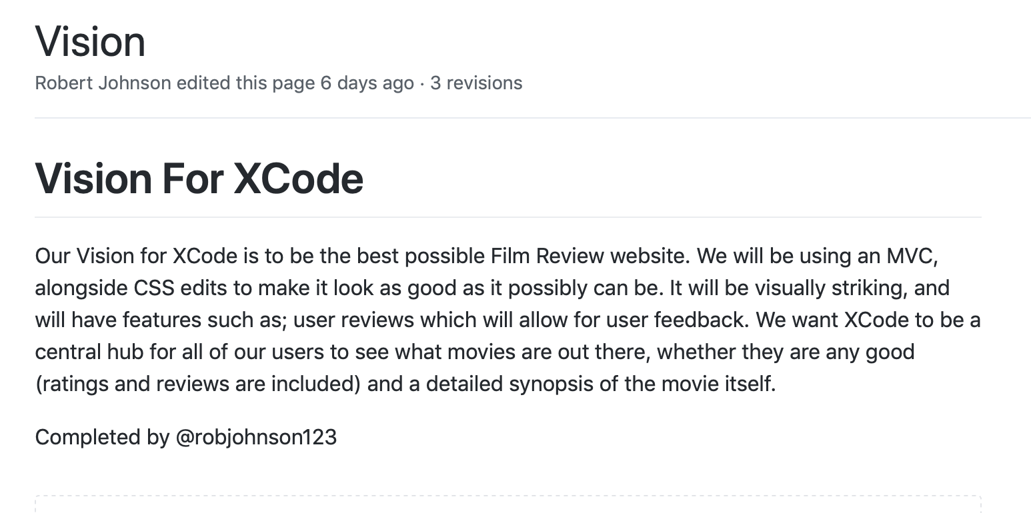
Vision Wiki On GitHub

Slide 14
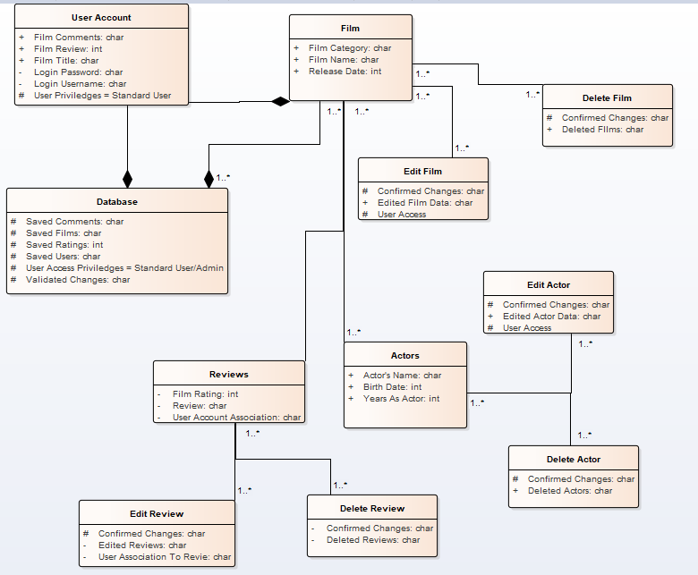
Class Diagram

Slide 15
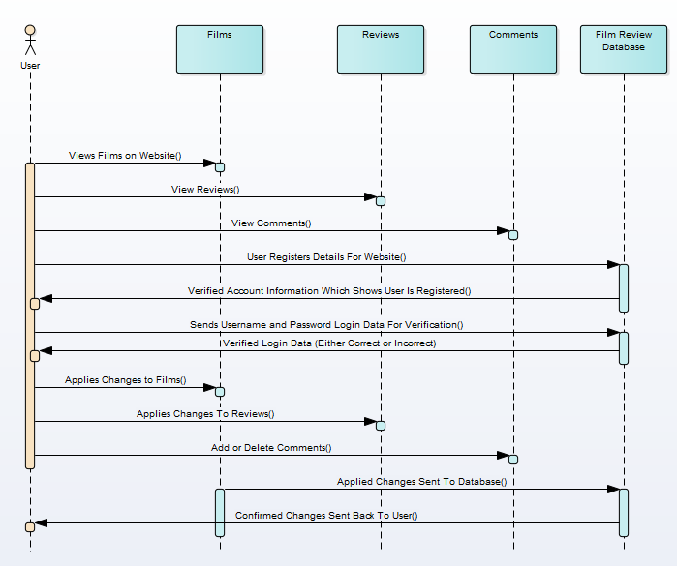
Sequence Diagram

Slide 16
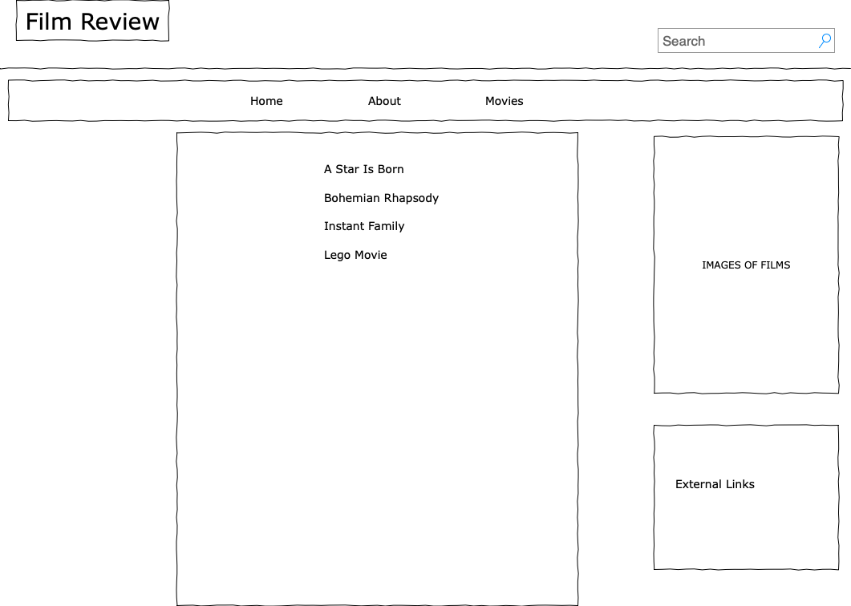
Preliminary Sketches: Home Page

Slide 17
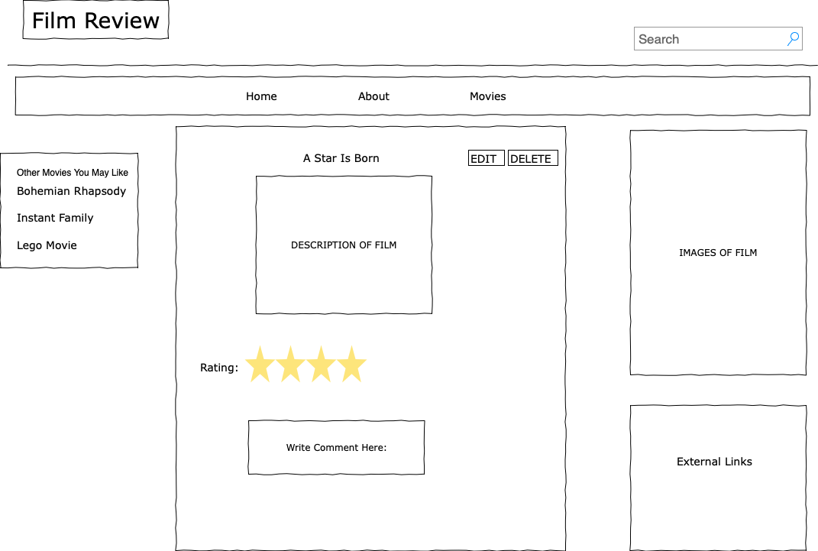
Preliminary Sketches: Movies Page

Slide 18
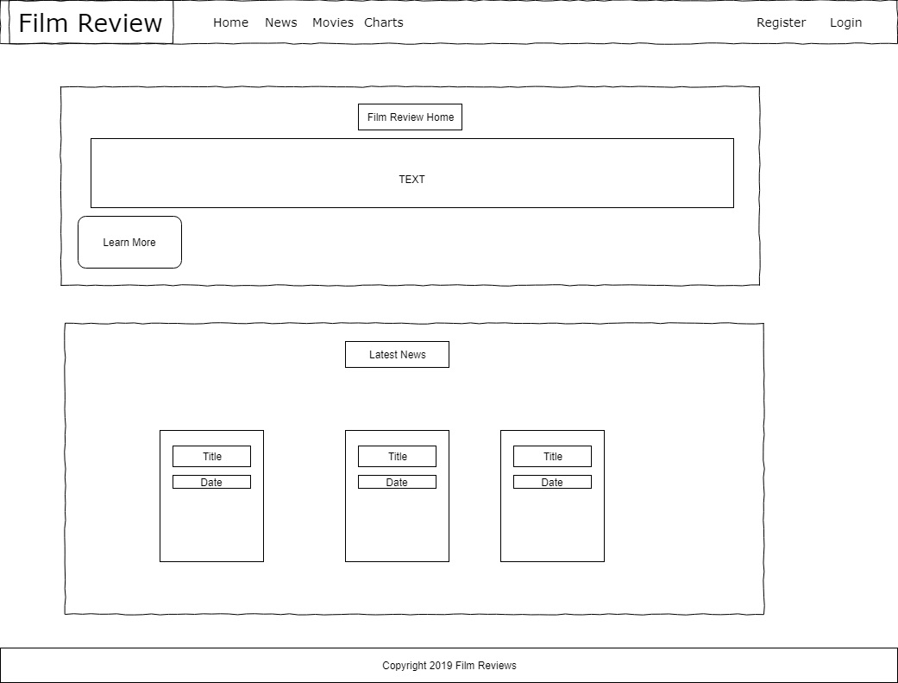
Final Sketches: Home Page

Slide 19
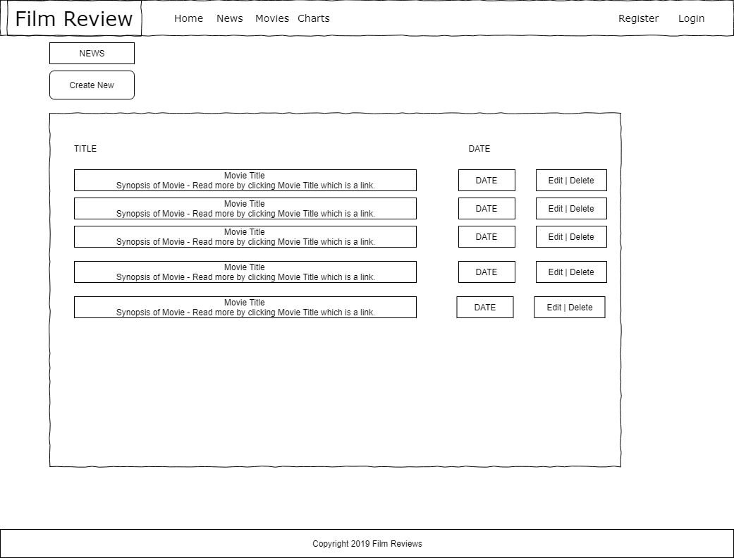
Final Sketches: News Page

Slide 20
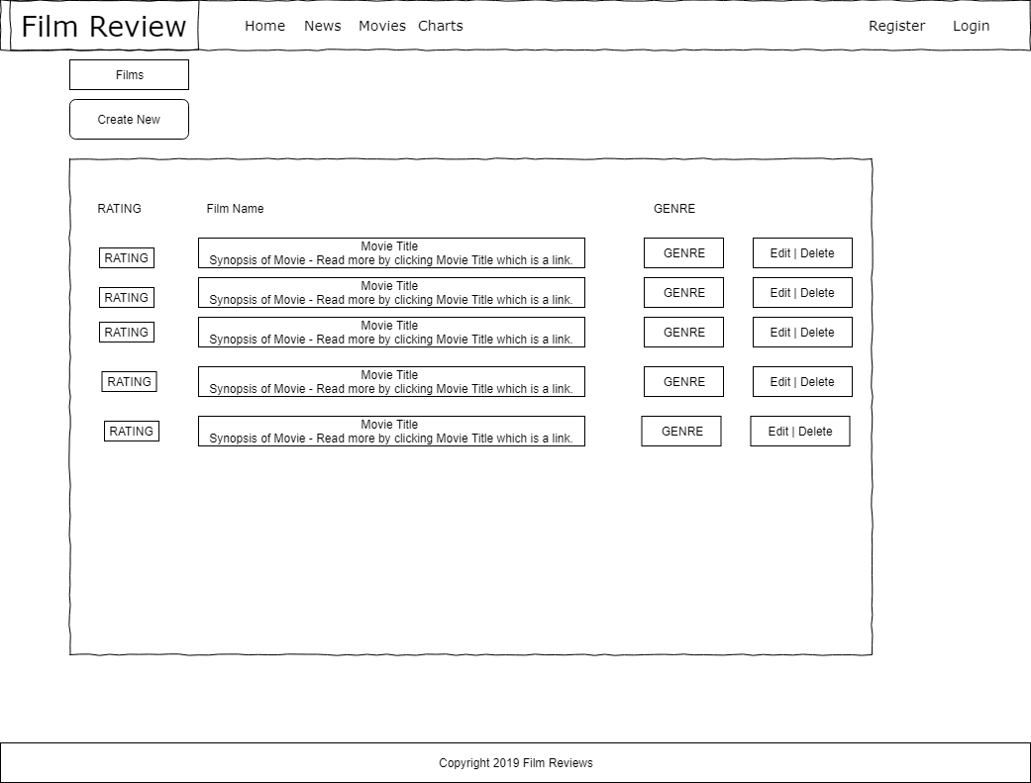
Final Sketches: Movies Page

Slide 21
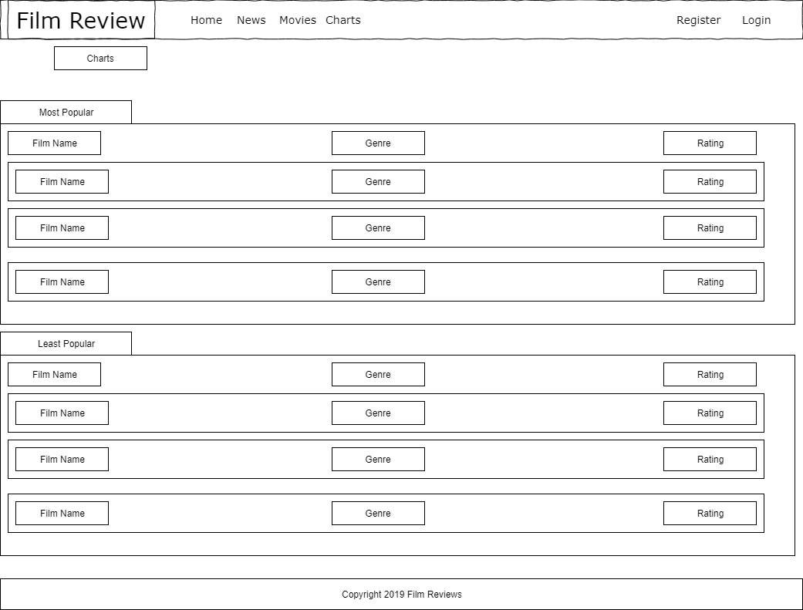
Final Sketches: Charts Page

Slide 22
Nicholas Randall
Role: Developer

Slide 23
Contributions
Actors Controllers, views and pages.
Directors controller, views and pages.
Initial database work for genre and film.
Helping with diagrams and documentation.
General Error troubleshooting and assisting.

Slide 24
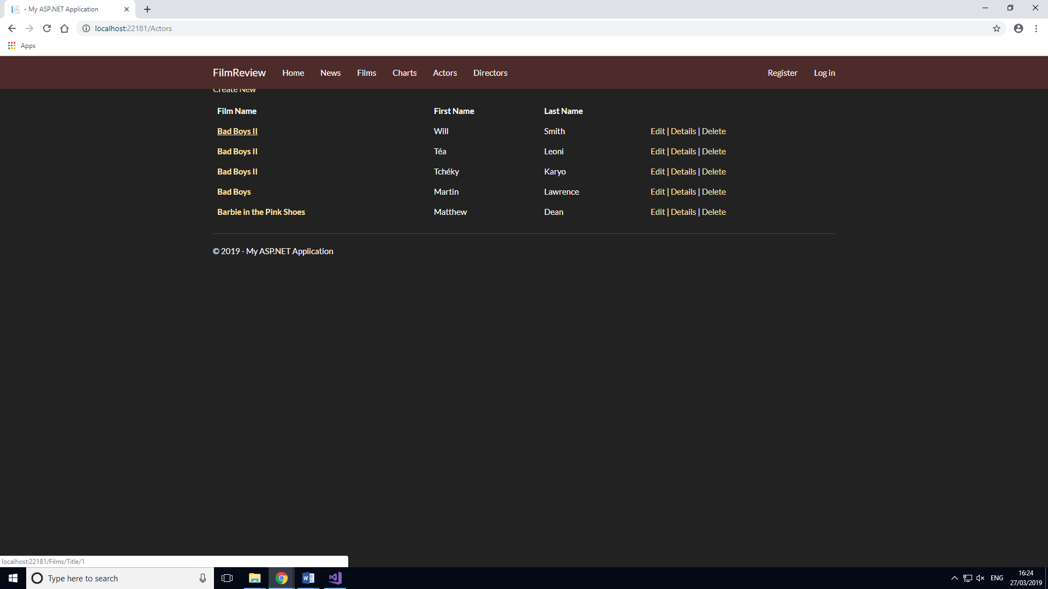
Actors page

Slide 25
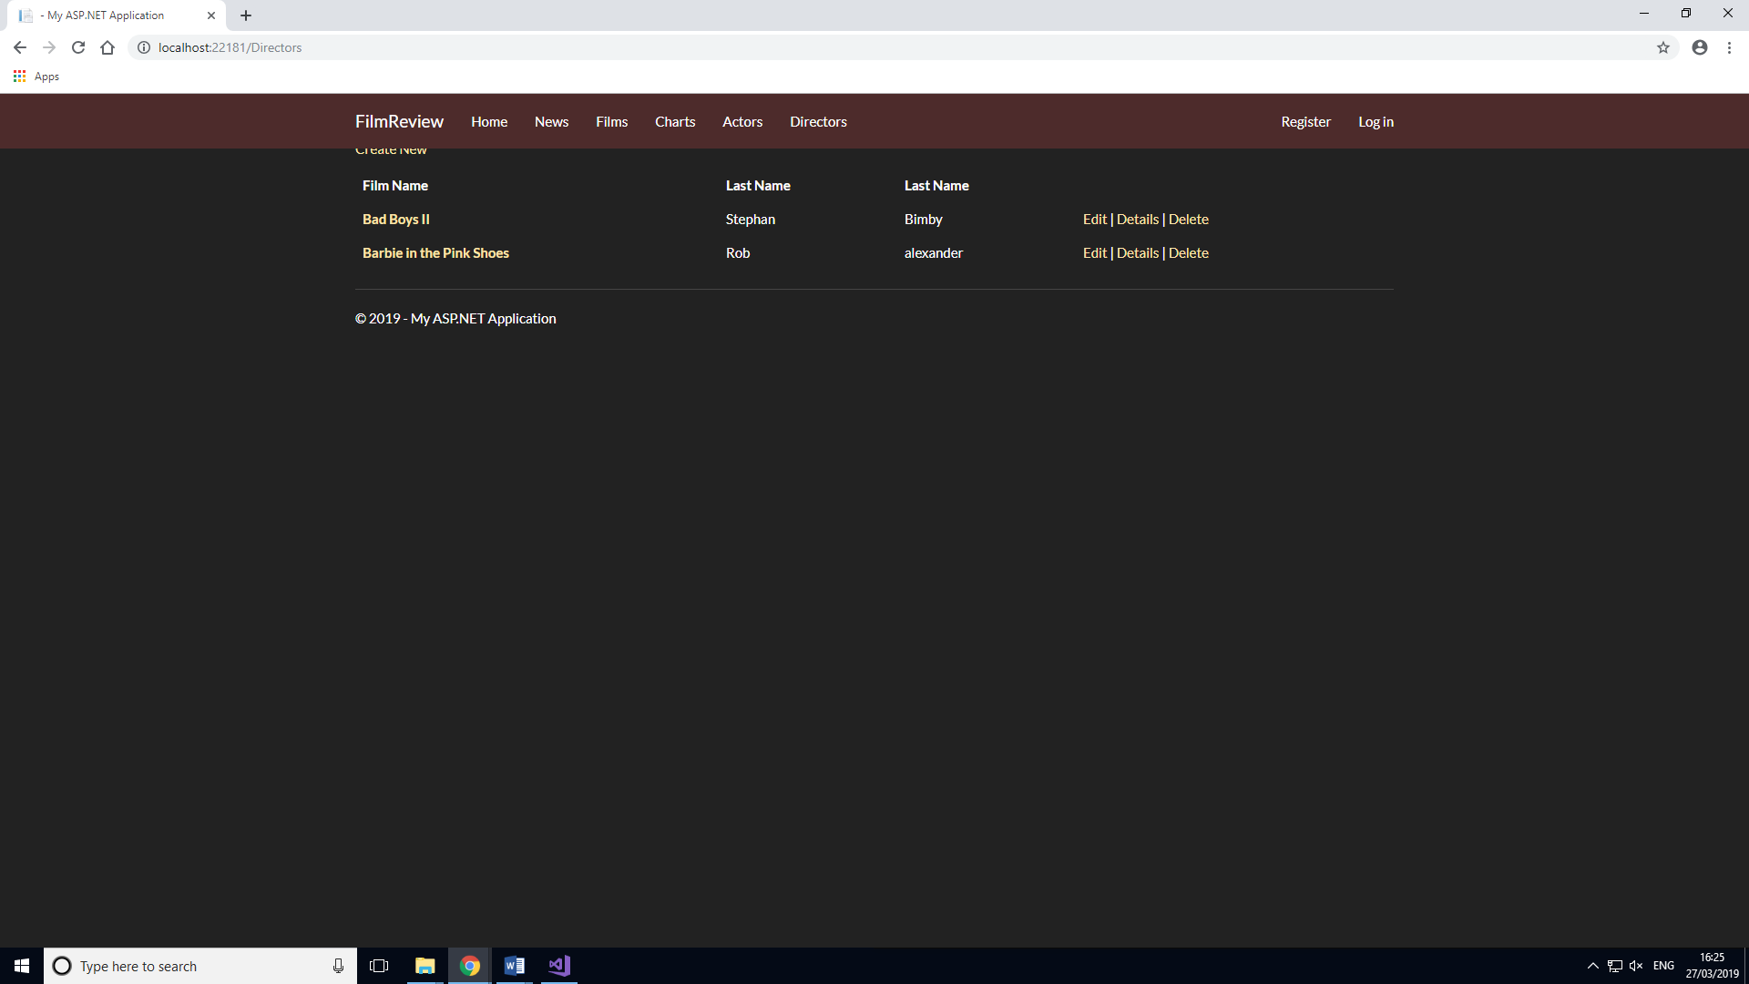
Directors page

Slide 26
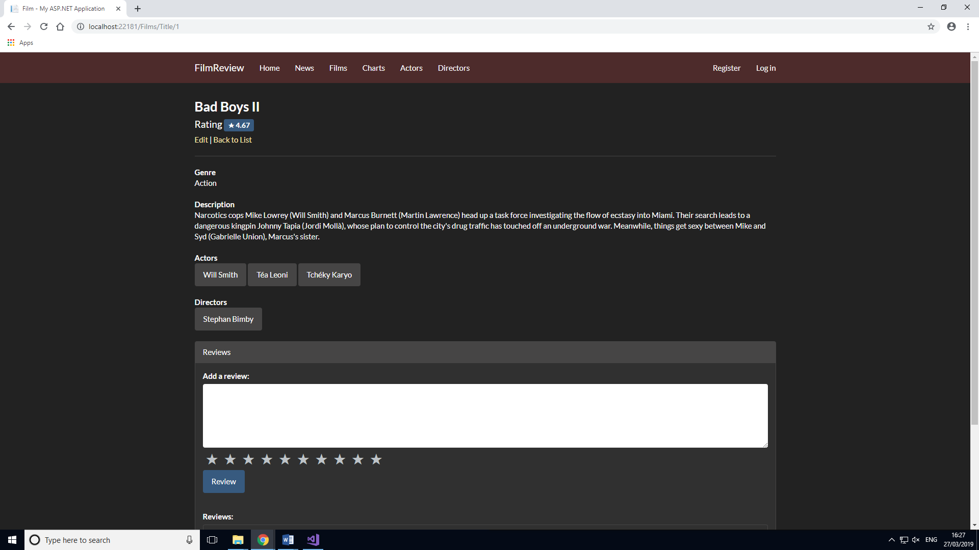
Actors and directors' tags

Slide 27
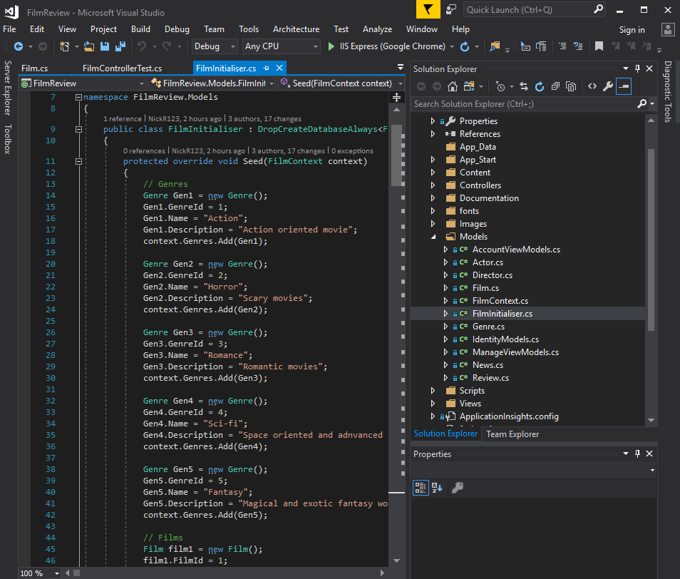
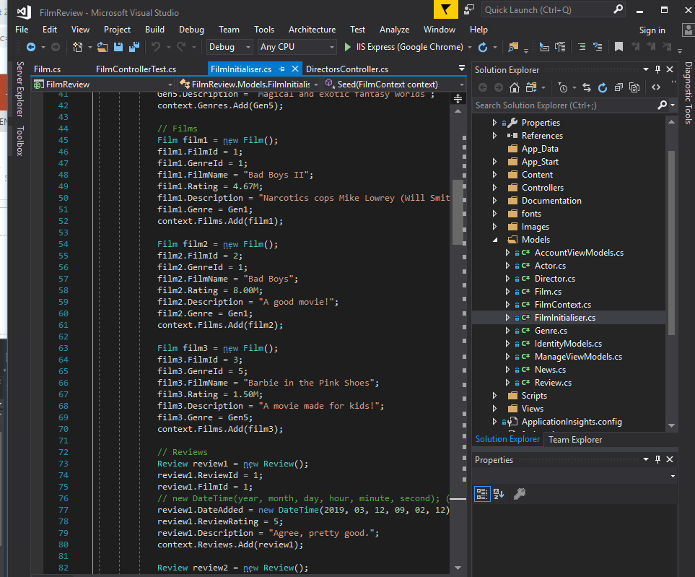
Initial datbase help

Slide 28
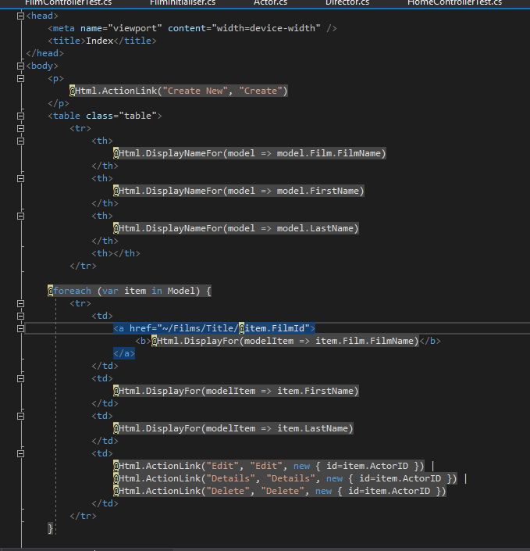
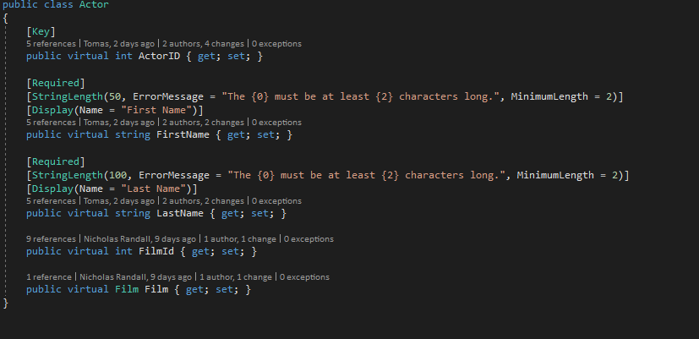
Additional changes

Slide 29
Mike
Role: Analyst

Slide 30
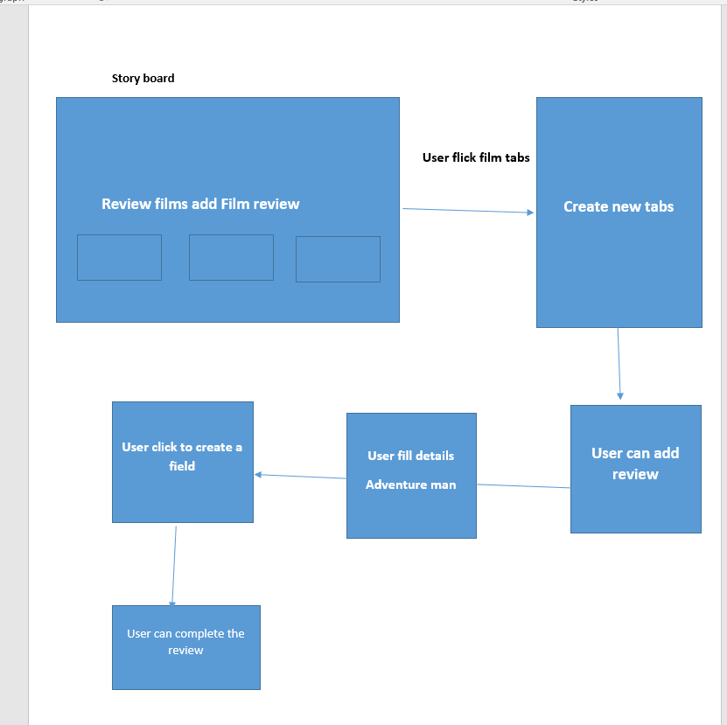
Storyboard

Slide 31
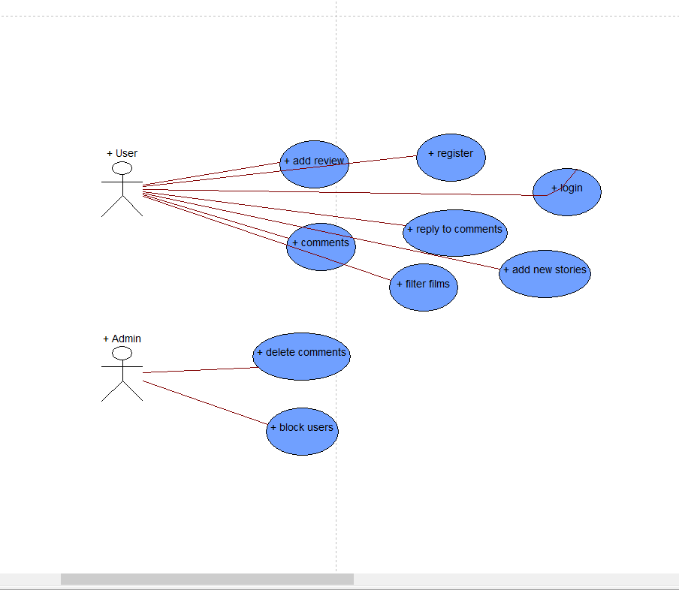
Use case diagram

Slide 32
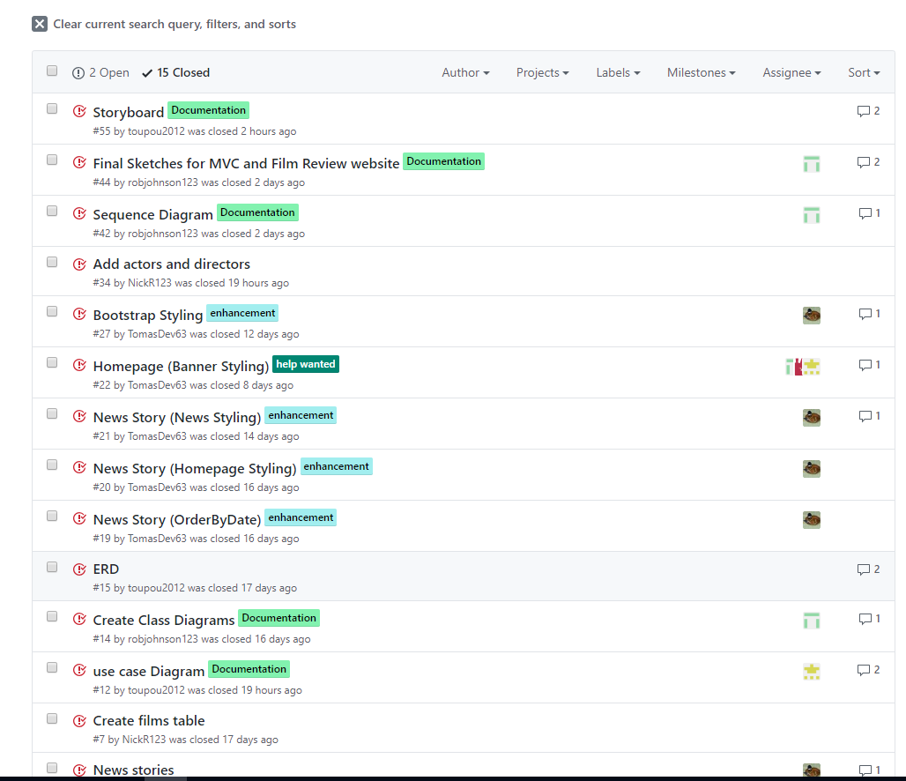
Github managing

