Slide 1
Polymorphism
Dr. Jethro Shell

Slide 2
Overview
Polymorphism
Definition of polymorphism (example).
Review some of the work last year.
Difference between polymorphism and inheritance.
Diamond of Death
Multiple inheritance
Virtual Members
Virtual Functions
Definition of a virtual function (example).
Pure virtual functions (interfaces).
Abstract Base Class

Slide 3
Inheritance: IMAT1908 work
We hinted towards polymorphism in the last year.
Definition:
Essentially it means many forms (Greek – Many shaped).
It is classes that relate to each other through inheritance.
In the OO paradigm which is typically concerned with two class relationships:
IS A:
Inherits from
A circle is a shape
A shape is a drawable object
HAS A:
Association
A shape has a set of points (a matrix?)
A point has an x position (a double?)

Slide 4
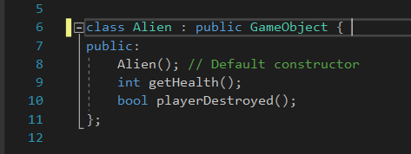
Inheritance:
Inheritance is mapped out when the class is constructed.
Class that is constructed.
Class that is inherited from.
Declaring alien, inherits from GameObject.
Alien contains all public and protect attributes and method from GameObject.
It also contains any private ones but can’t access them.

Slide 5
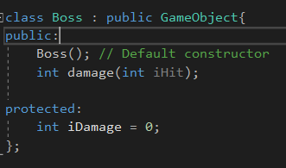
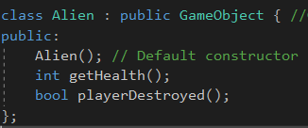
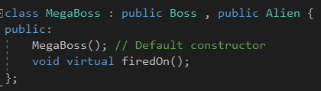
Multiple inheritance
Any class can inherit from multiple classes.
Why might this be a problem?

Slide 6
Diamond of death
Diamond of death can be caused by using multiple inheritance.
C++ allows us to inherit from multiple base classes.
This is really good for code reusability and streamlining.
There are PROBLEMS, though.
Multiple heritance uses a parent / child class. The issues can be caused by the use of the multiple inheritance and calling functions at both parent and child.
EXAMPLE

Slide 7
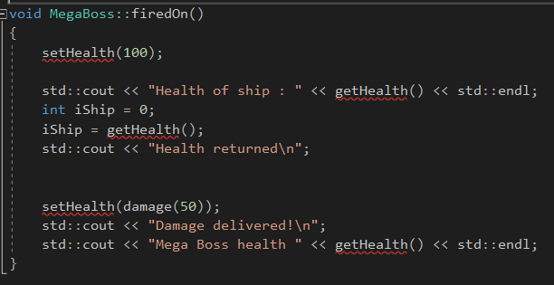
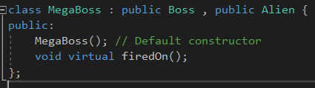
Ambiguity
Both Boss and Alien both inherit the setHealth and getHealth functions from GameObject.
When setHealth and getHealth are called, which of the inherited class functions should be called?

Slide 8
Diamond of death
Boss and Alien both inherit from GameObject
Megaboss inherits from both Boss and Alien
This results in there being 2 instances of GameObject in MegaBoss!
GameObject
Boss
Alien
MegaBoss
This issue can be overcome using virtual inheritance.

Slide 9
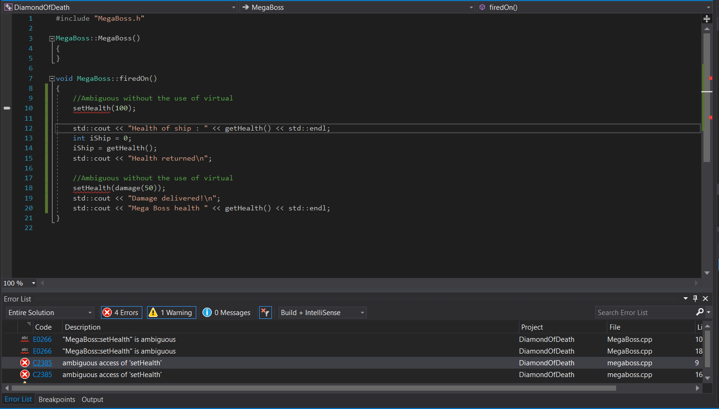
Ambiguity
Ambiguity as both Alien and Boss can call setHealth in GameObject
Compiler doesn’t know which variable to use.

Slide 10
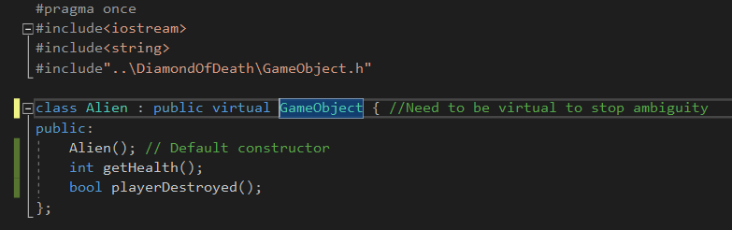
Stop ambiguity
To stop ambiguity, we make the inherited base classes virtual.
Addition to base inherited class the keyword virtual.
Virtual keyword allows a member of a derived class with the same name as one in the base class to be appropriately called from a pointer [1].

Slide 11
Late binding: Virtual functions
We have spoken a little about virtual functions before (IMAT1908).
What do they allow you to do?
You can override functions from a base class when using a subclass.
It is used to inform the compiler to perform dynamic linkage.
Comment about memory: What is dynamic linkage?
Problems with inheritance.
Dynamic link creates memory at runtime rather than static memory that is created for functions at compile time.
Specific data types have memory allocation (we know this).
Memory can be allocated in two ways , static and dynamic.
THING TO REMEMBER:
STATIC MEMORY ALLOCATION IS FIXED vs DYNAMIC MEMORY ALLOCATION CAN BE CHANGED

Slide 12
Late binding: Virtual functions
A virtual function requires the compiler to compile it with late binding.
Late binding means the function which is called is not decided until run-time
Consider this:
You should be able to draw a drawable object.
A character is a drawable object, you should therefore be able to draw it. Text is a drawable object you should therefore also be able to draw it. Drawing a character is not the same as drawing text.

Slide 13
Late binding: Virtual functions
A virtual function requires the compiler to compile it with late binding.
Late binding means the function which is called is not decided until run-time
Consider this:
You should be able to draw a drawable object.
A character is a drawable object, you should therefore be able to draw it. Text is a drawable object you should therefore also be able to draw it. Drawing a character is not the same as drawing text.
Drawable
Character
Text

Slide 14
pOlymorphism
Essentially it means many forms (Greek – Many shaped).
It is classes that relate to each other through inheritance.
Polymorphism
Compile Time Polymorphism
Run Time Polymorphism
Function Overloading
Operator Overloading
Virtual Function
Week 3

Slide 15
Differences between inheritance and polymorphism
Comparison | Inheritance | Polymorphism
Basic | Inheritance is one in which a new class is created (derived class) that inherits the features from the already existing class (Base class). | Whereas polymorphism is that which can be defined in multiple forms.
Implementation | Applied to classes in the main. | Applied to functions and operators.
Use | Inheritance supports the concept of reusability and reduces code length in object-oriented programming. | Allows object to decide which form of the function to implement at compile-time (overloading) as well as run-time (overriding).
Forms | Single, hybrid, multiple, hierarchical and multilevel inheritance. | Compile-time polymorphism (overload) + run-time polymorphism (overriding).

Slide 16
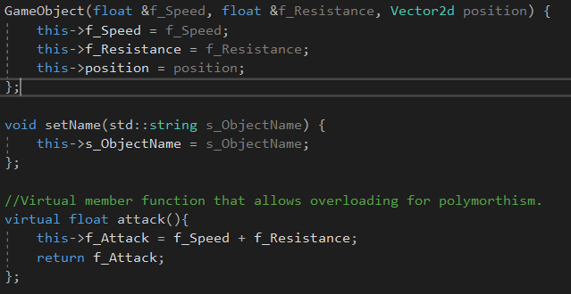
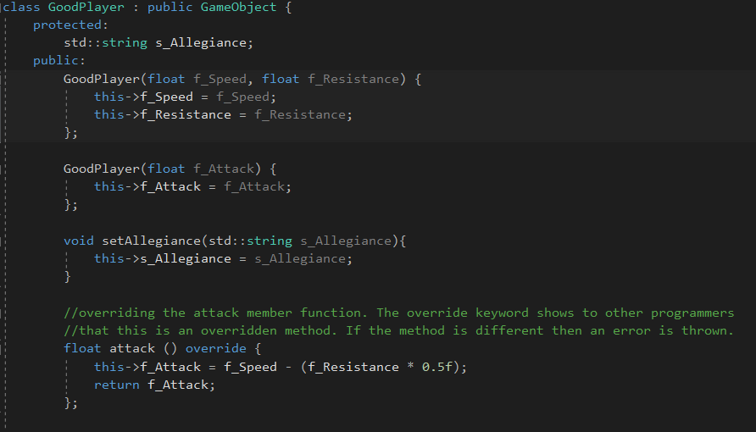
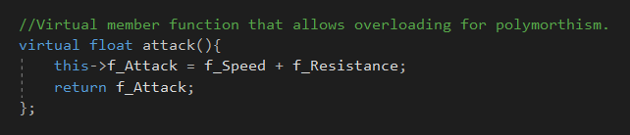
polymorphism
Any virtual functions can be overridden.
Don’t have to, though.
No need to tell the compiler it’s virtual. Suggested to use override. Help stop bugs.

Slide 17
Polymorphism : pure virtual functions
Touched on this before in IMAT1908.
A pure virtual function has a null implementation.
Any class containing a pure virtual class is called an abstract class.
It can never be instantiated.
Non-abstract child classes must provide an implementation.
Consider that:
We want to calculate the attack values from a good player and an enemy player.
Late binding will allow the complier to late bind the type of Game Object on run time.

Slide 18
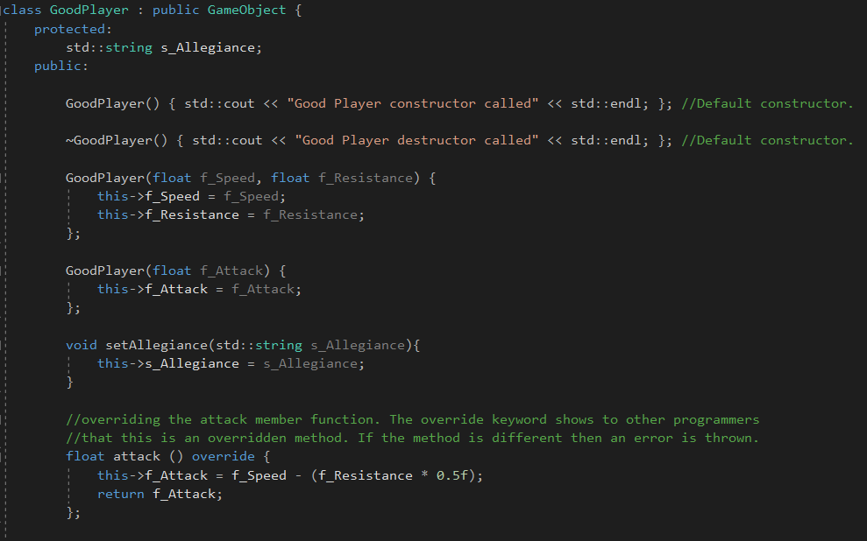
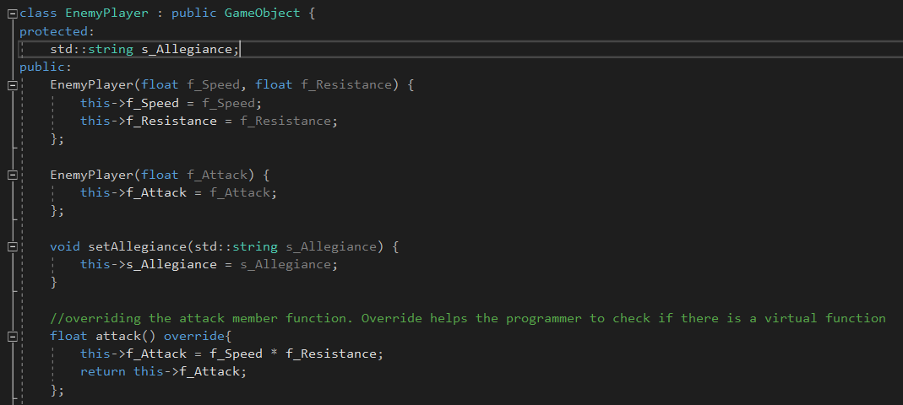
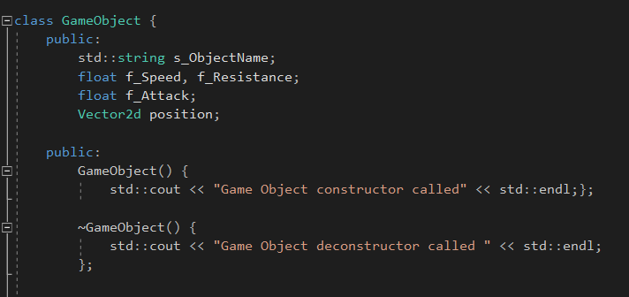

Polymorphism : pure virtual functions
Touched on this before in IMAT1908.

Slide 19
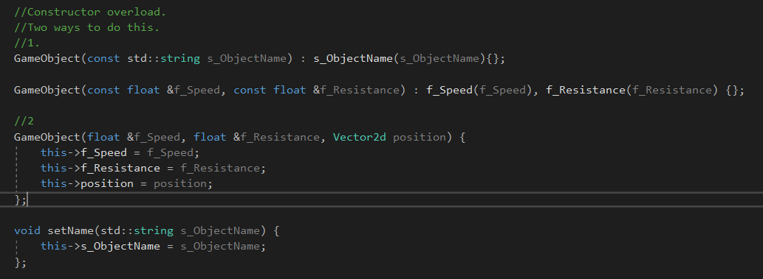
Polymorphism
What’s the difference?
Can initialise without body of constructor.
Can initialise const which can be changed (ONLY WAY)
More standard way that we have seen. Here using the this keyword so the names of the initialising values can be the same.

Slide 20



Polymorphism - Upcasting
C++ has great power to allow you to use the polymorphic structure to control functions.
Suppose we want to create a generic function that any derived class can utilise.
By Upcasting the derived class, we can do this.
Upcast Goodplayer to GameObject.
Different objects but will still work.
Function that derived upcast object is passed to.

Slide 21
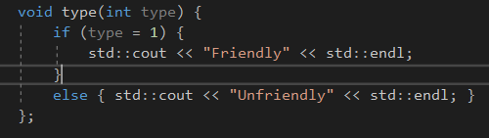
Polymorphism – dynamic (down) casting
Mostly you don’t need to know which is the real type of the object, as virtual functions allow you to manipulate your object independently of its type.
Typical reason is when you want to invoke a non virtual function that exist only for the child class.
For example, the member function type only exists for the GoodPlayer.

Slide 22
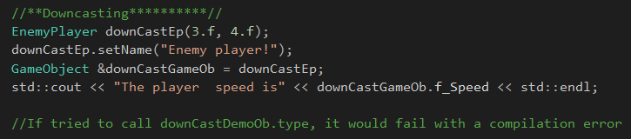
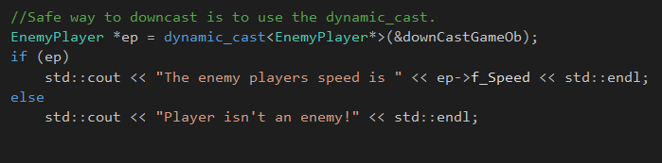
Polymorphism – dynamic (down) casting
If you call that member function, there would be a compiler error!
Safer to use dynamic_cast. This can be checked.
Can also use static casting but you need to know the object (i.e enemy player here).
Need to know what the object is. This can be dangerous if a member function is called that doesn’t belong to it (i.e type)

Slide 23
Polymorphic Destructors
If a class is intended to be used polymorphically, with derived instances being stored as base pointers/references, its base class' destructor should be either virtual or protected.
In the former case, this will cause object destruction to check the vtable, automatically calling the correct destructor based on the dynamic type.
In the latter case, destroying the object through a base class pointer/reference is disabled, and the object can only be deleted when explicitly treated as its actual type [1]

Slide 24
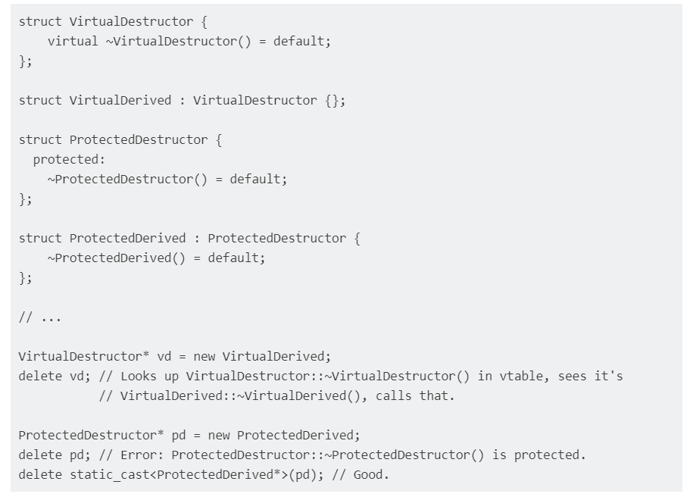
Polymorphism - destructors
[2]

Slide 25
Polymorphic destructors
A destructor, like any other regular function, should be declared virtual in the topmost class from where it is supposed to be invoked in polymorphic manner. The delete calls a destructor before it frees up memory of the instance.

Slide 26
Covered today:
Go over inheritance.
Polymorphism.
Structure.
Compare to inheritance.
Diamond of death.
Upcasting.
Downcasting.
Polymorphic destructors.
Questions?

Slide 27
biblography
[1]"C++ - Polymorphism & Destructors | c++ Tutorial", Riptutorial.com, 2021. [Online]. Available: https://riptutorial.com/cplusplus/example/20178/polymorphism---destructors. [Accessed: 11- Jan- 2021].
[2]"Free C++ Programming Book", Books.goalkicker.com, 2021. [Online]. Available: https://books.goalkicker.com/CPlusPlusBook. [Accessed: 11- Jan- 2021].

