Slide 1
Operator overloading and error handling
Dr. Jethro Shell

Slide 2
Overview
What are operators?
How do we use them and why do we want to overload them?
Overloading process.
Types of operator.
Array subscript operator.
Unary operators.
Binary operators.
Comparison operators.
Function call operators.
Error handling.
Types and when to use them.

Slide 3
Operators
A number of different ones that exist.
Some more known than others.
Mathematical: + - / *
Pointers:
& and * (references and pointers).
-> for pointer functions.
Ones you may not expect such as parentheses (), the comma, new and delete.

Slide 4
Operator overloading
What is it?
Overloading is giving a new meaning to or adding elements to.
Changing the form of a function.
Can help with code reusability, cleaning up code etc.
BE AWARE: C++ gives us lots of power here and can cause problems!
Why do this?
It allows the programmer to add functionality to predefined operators, both inside and outside of a class/struct.
Object could have additional functionality for the use of a arithmetic operator so that multiple elements can be combined.
Object could use the conversion operator overload for change of purpose.

Slide 5
Operator overloading: Arithmetic
Arithmetic operators are:
+ and +=
- and -=
* and *=
/ and /=
& and &=
| and |=
^ and ^=
>> and >>=
<< and <<=

Slide 6
Operator overloading: Arithmetic
To carry out operator overloading, we use the operator keyword.
The function form is:
Outside of a class –
T operator+(T lhs, T rhs)
Inside of a class –
T operator+(T lhs)
There are other ways to implement this, but this is the general form.

Slide 7
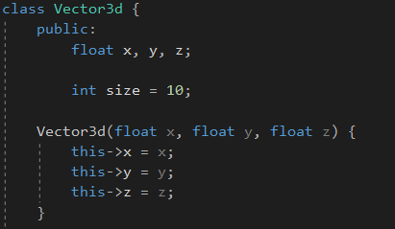
Operator overloading: Arithmetic
General Vector3d class.
Can be used for anything.
Not good OO, but just for demonstration.
x, y, z public. Not good practice as should use getters and setters!

Slide 8


Operator overloading: inside class
If we have an object and want to add the class members together, we may write a function to do so.
We can make this more user friendly and extensible by using operator overloading.
When a user-defined class overloads the function call operator, it becomes a FunctionObject. We call this in the same way as a function-call-like expression.
Notes:
A simple function that takes the defined class members of player and carries out addition. Of the player passed in (a const) and the current player.
As an aside, why might we want this to be a referenced const?

Slide 9
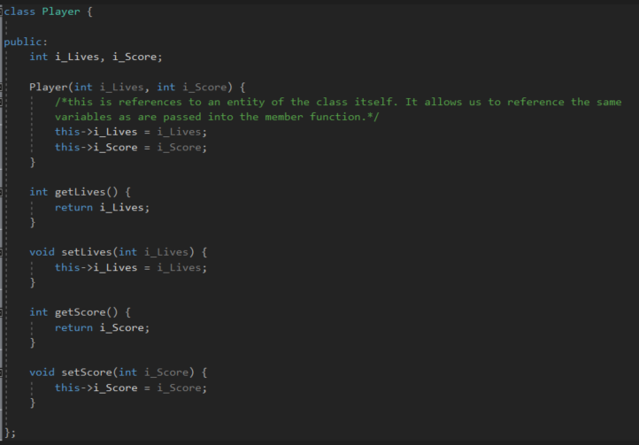
Operator overloading: outside class
Note: gettters and setters are better form, although have public access to int’s.
Notes:
We have a simple player class. It includes some getters and setters for the score and lives. We didn’t use the getters and setters for the GameObject class. This is a better form.

Slide 10
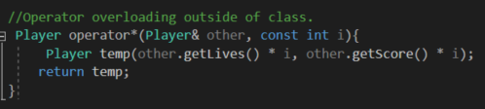
Operator overloading: outside class
Form for an operator overload outside here is:
- LHS (Object to be manipulated) / RHS (Object to manipulate)
This implementation not so efficient as need to create a new object.
Quick question: Why use & to player and const int?
Pass by reference so no need to create new object, const as integer is not changing.

Slide 11

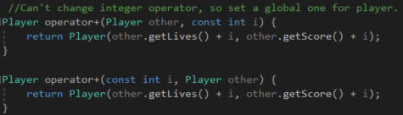
Operator overloading: Inside / outside
Player class has addition overloaded outside of the class:
<Player object> = <Player object> + <integer>
Player p2 = p1 + 10f; Valid
What about <Player object> = <integer> + <Player object>
Player p2 = p1 + 10f; Invalid
Need for global operator.
Notes:
Already created an addition override so player + int is valid (p2+int).
Can’t do other way round.

Slide 12
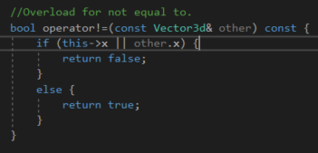
Operator overloading: comparison
Comparison operators are:
== and !=
> and <
>= and <=
These are generally quite easy to implement:
If it’s inside of a class or struct, the form has a LHS (input) that then uses some form of comparison and returns the correct value.

Slide 13
Operator overloading: comparison
We can use the implementation of two comparison overloads to be able to create all the others.
//Only implement those 2
bool operator==(const T& rhs) const { /* Compare */ }
bool operator<(const T& rhs) const { /* Compare */ }
//Now you can define the rest
bool operator!=(const T& rhs) const { return !(*this == rhs); }
bool operator>(const T& rhs) const { return rhs < *this; }
bool operator<=(const T& rhs) const { return !(*this > rhs); }
bool operator>=(const T& rhs) const { return !(*this < rhs); }
Function is const so that the compiler knows that it won’t alter anything.
const as not changing, just returning values and passing by reference as it is quicker than value.
Outside a class function
bool operator==(const T& lhs, const T& rhs) { /* Compare */ }
bool operator<(const T& lhs, const T& rhs) { /* Compare */ }
overloading outside of a class uses a LHS and RHS.
Notes:
We are using the operators that we have already overloaded.

Slide 14
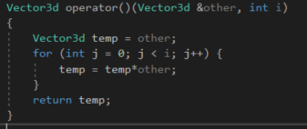

Operator overloading: parenthesis
We can overload the function call operator.
Here is LHS
Here is RHS.
Use left hand side and right had side to produce output (vector3d) based on the function call. Here multiplication. NOT VERY USEFUL.
Not going to cover all of the operators.

Slide 15
Exception handling
Dealing with errors
Using exceptions
When to use exceptions

Slide 16
Errors
What is an error?
Wrong input (from user of software)
Software asks for a number, user enters a character
Data corruption
Memory fails or another program overwrites your memory
Bad code
You mess up
Data structure you don’t understand
Some condition you didn’t think of
Testing failed to find a bug
Hardware failure
Disk drive breaks
Network goes down

Slide 17
Dealing with errors
Four options:
Ignore them
Use error codes
Halt the program
Throw an exception

Slide 18
Ignoring errors!
Really?
Some errors don’t cause problems
Most of the time this is actually what happens
Many functions return things which we don’t check:
std::cout <<“Hello World“ << std::endl;
OK for simple things like this
We need ways of dealing with more critical code

Slide 19
Error codes
C Programmers use these loads
All functions return an int
This int corresponds to some error code
Works fine
Looks very ugly – difficult to read
Difficult to maintain
Requires great discipline from the programmer

Slide 20
Error codes
Might look like this:
#define NO_ERROR 0
#define FILE_NOT_FOUND_ERROR 1
#define TEXTURE_BINDING_ERROR 2
int Level::loadSprite(string fileName)
{
if(!spriteTexture.loadFromFile(fileName))
{return FILE_NOT_FOUND_ERROR;} if(!sprite.setTexture(spriteTexture))
{return TEXTURE_BINDING_ERROR;}
return NO_ERROR;
}

Slide 21
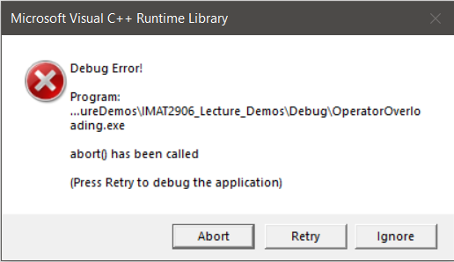
Halt the program
Asserts can be used to make the program exit:
Include <assert.h>
Call the assert function
assert((“Assertion failed msg”, boolean condition));
Along the lines of:
#include <assert.h>
int Level::loadSprite(string fileName)
{
spriteTexture.loadFromFile(fileName); assert(("File not found", spriteTexture != NULL)); sprite.setTexture(spriteTexture);
assert(("Texture binding failed", sprite != NULL));
}

Slide 22
exceptions
How exceptions work:
Program detects something unexpected and throws an exception
Execution jumps to the nearest exception-handling block of code
This code can report the error, try to fix the problem or do nothing
If problem is fixed, carry on
If no exception-handling block is found
Go back up the call stack, cleaning up any objects
Look for an exception-handling block there
If no exception-handling code exist at all
Default exception handling is used
Stop execution

Slide 23
exceptions
int main()
{
{
printf("Start main\n");
printf("Start function call myFunction\n");
try
throw 1;
{
printf("End function call myFunction\n");
printf("About to call myFunction\n");
}
myFunction();
printf("Now called myFunction\n");
}
catch(...)
{
printf("Handling exception\n");
}
printf("Ending main\n");
}
Simplest form, the exception is thrown inside the “try, catch” block.

Slide 24
exceptions
The basics:
void myFunction()
int main()
{
{
Std::cout <<"Start main<< Std::endl
Std::cout <<"Start function call myFunction" << std::endl;;
try
throw 1;
{
Std::cout << End function call myFunction<< std::endl;
Std::cout <<"About to call myFunction<< Std::endl
}
Watch out for the exception
myFunction();
Std::cout <<"Now called myFunction<< Std::endl
}
catch(...)
Handle the exception
{
Std::cout <<"Handling exception<< Std::endl
}
printf("Ending main<< Std::endl
}

Slide 25
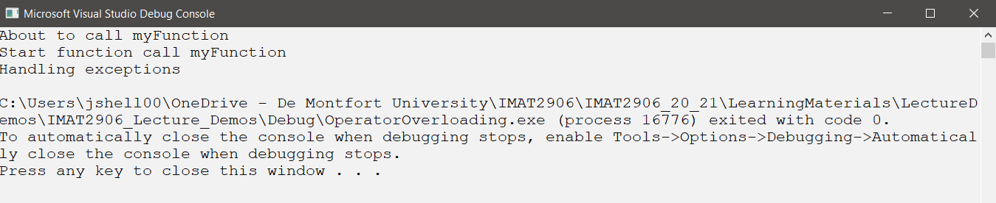
exceptions
Never gets called
The basics:
void myFunction()
int main()
{
{
printf("Start main<< Std::endl
printf("Start function call myFunction<< Std::endl
try
throw 1;
{
printf("End function call myFunction<< Std::endl
printf("About to call myFunction<< Std::endl
}
myFunction();
printf("Now called myFunction<< Std::endl
}
catch(...)
{
printf("Handling exception<< Std::endl
}
printf("Ending main<< Std::endl
}

Slide 26
exceptions
Previous example had throw 1
We can throw anything, so how about a customException class:
class CustomException
{
public:
CustomException(const char * msg); const char * exceptionMsg;
};
CustomException::CustomException(const char * msg)
{
exceptionMsg = msg;
}

Slide 27
Throwing exceptions
Using the customException class:
try // From Level::load
{
while((!in.eof()) && j < height) // go through j lines of text
{
in.getline(line,width+1); // read a line into line
for(i=0;i<width;i++) // Copy the line of the map to the map
{
map[j][i] = line[i];
}
if(i != width) throw CustomException("Map width too short"); j++; // next line
}
if(j != height) throw CustomException("Map height too short");
}
catch (CustomException & e)
{
// Do something…
}

Slide 28
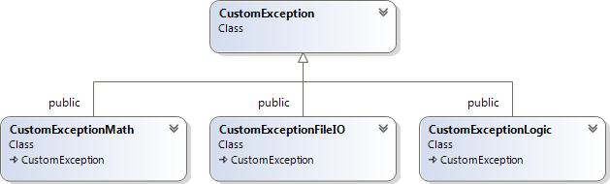
Throwing exceptions
We can create a customException hierarchy
Each class is thrown for a particular type of exception
Each class is handles by a different catch statement

Slide 29
Throwing exceptions
try
{
// Load map in from a text file
ifstream in(filename.c_str()); // Open file for reading if(!in.is_open()) throw CustomExceptionFileIO ("Can't open Map file"); while((!in.eof()) && j < height) // go through j lines of text
{
in.getline(line,width+1); // read a line into line for(i=0;i<width;i++) // Copy the line of the map to the map
{
map[j][i] = line[i];
}
if(i != width) throw CustomExceptionLogic("Map width too short"); j++; // next line
}
if(j != height) throw CustomExceptionLogic("Map height too short");
}

Slide 30
Catching exception
Using the customException class:
catch (CustomExceptionFileIO & e)
{
// Map not loaded
}
catch (CustomExceptionLogic & e)
{
// Map on file is not the right size
}
catch (...)
{
// Some other error
}

Slide 31
Catching exception
Doing something useful:
catch (CustomExceptionFileIO & e)
{
// Map not loaded - Load map from a known file ifstream in("level1.txt"); // Open file for reading j = 0; // reset counter
while((!in.eof()) && j < height) // go through j lines of text
{
in.getline(line,width+1); // read a line into line for(i=0;i<width;i++) // Copy the line of the map to the map
{
map[j][i] = line[i];
}
j++; // next line
}
}

Slide 32
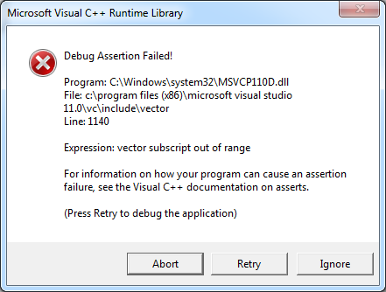
Catching exception
Very few pieces of library code will throw exceptions:
try{
vector<int> v(3); v[-1] = 0;
}
catch (exception & e)
{
printf("Caught exception: %s\n",e.what());
}
Does not catch an exception

Slide 33
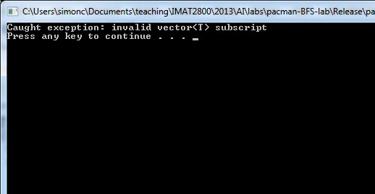
Catching exception
Very few pieces of library code will throw exceptions:
try{
vector<int> v(3); v.at(-1) = 0;
}
catch (exception & e)
{
printf("Caught exception: %s\n",e.what());
}
Does catch an exception

Slide 34
WHEN TO USE EXCEPTIONS
It is tempting to fill our code with exceptions to cover all manner of possible errors
Do you see other peoples codes snippets full of exceptions?
NO!
Exceptions should be used sparingly (exceptionally perhaps?)
Use them where errors could happen but are not expected:
Data file corruption
Hardware failure
Network failure
These things generally need the users attention
Exceptions can give us a way of communicating errors to the user in a meaningful way

