Slide 1
3
PART THREE
Research Method：Quantitative Research
Reporter：吴磊

Slide 2
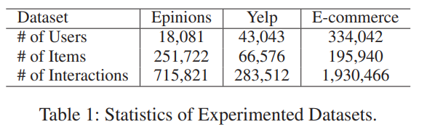
Objective Data
Epinions Dataset
Yelp Dataset
Each data set contains more than ten thousand user information, one hundred thousand product information, and one million interactive information
JD Finance Dataset

Slide 3
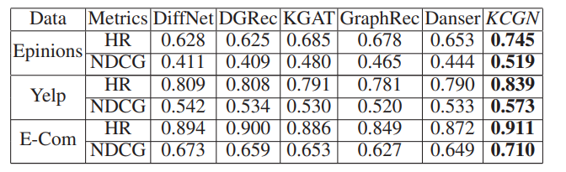
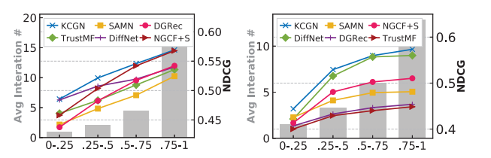
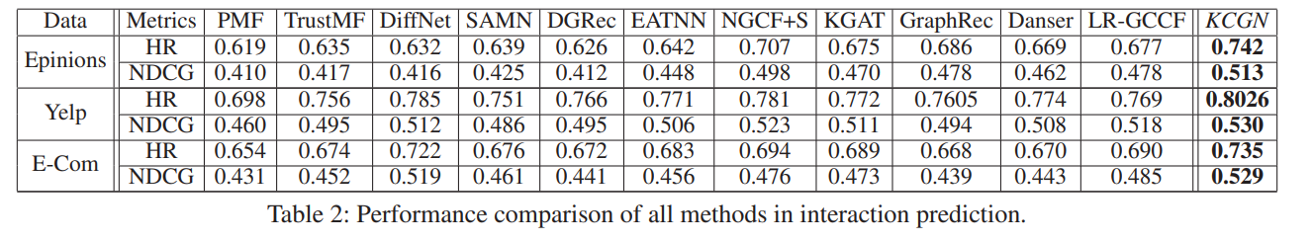
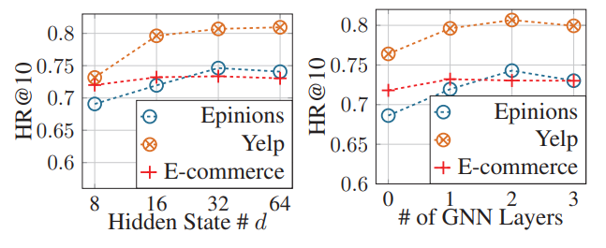
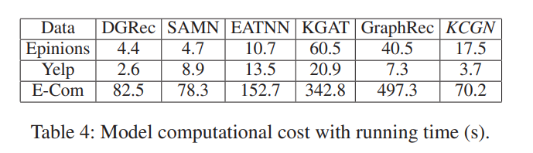
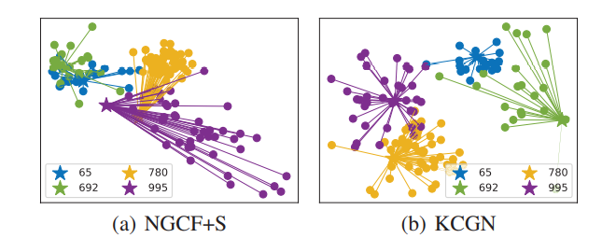
Statistical Calculation
Statistical Calculations Based On Datasets
Questions
Results
1.Does KCGN consistently outperform other baseline in terms of recommendation accuracy?
2. How is the performance of KCGN’s variants with the combination of different relation encoders?
Hit Ratio
3. How is forecasting performance of compared methods w.r.t different interaction density degrees?
Normalized Discounted Cumulative Gain
4. How do the representations benefit from the collectively encoding of global knowledge-aware cross interactive patterns in social recommendation?
etc.
5. How do different hyper-parameter settings impact the performance of our KCGN framework?
6. How is the model efficiency of the KCGN?

