Slide 1
Knowledge-aware Coupled
Graph Neural Network
for Social Recommendation
The Thirty-Fifth AAAI Conference on Artificial Intelligence (AAAI-21)
Chao Huang1*, Huance Xu2∗, Yong Xu2,3,4†, Peng Dai1, Lianghao Xia2,
Mengyin Lu 1, Liefeng Bo1, Hao Xing5, Xiaoping Lai5, Yanfang Ye6.
杨显鹏 贾康 吴磊 孟繁琛 岳峰宇 张志康

Slide 2


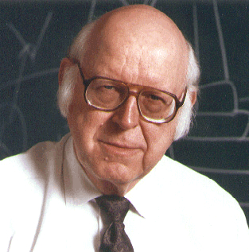

Knowledge-aware Coupled Graph Neural Network for Social Recommendation
The Thirty-Fifth AAAI Conference on Artificial Intelligence (AAAI-21)
academic organization
Allen Newell
Marvin Minsky
John McCarthy
1979

Slide 3
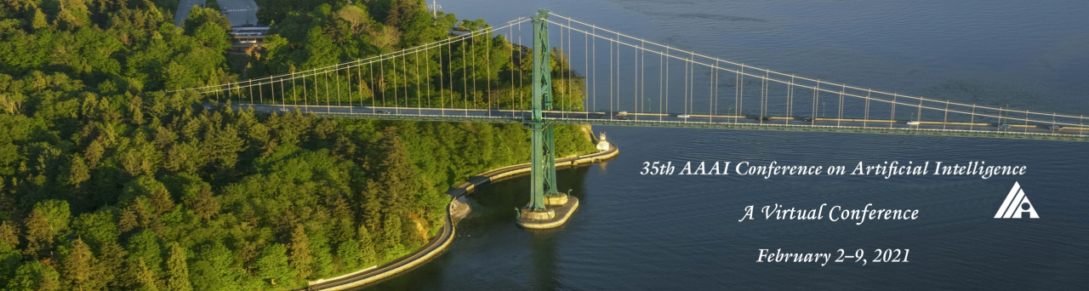
Knowledge-aware Coupled Graph Neural Network for Social Recommendation
The Thirty-Fifth AAAI Conference on Artificial Intelligence (AAAI-21)
Sponsored by
the Association for the Advancement of Artificial Intelligence
influencing AI’s development throughout the world
Theoretical
applied AI
Researchers
practitioners

Slide 4
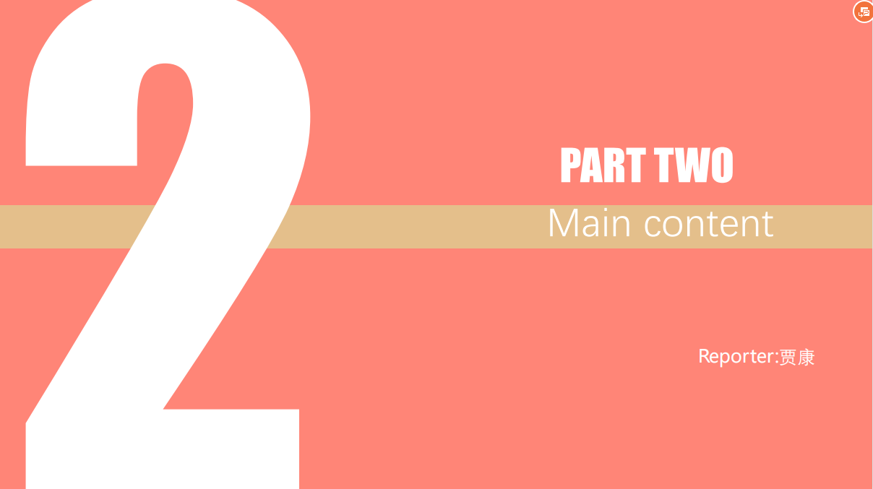

Slide 5
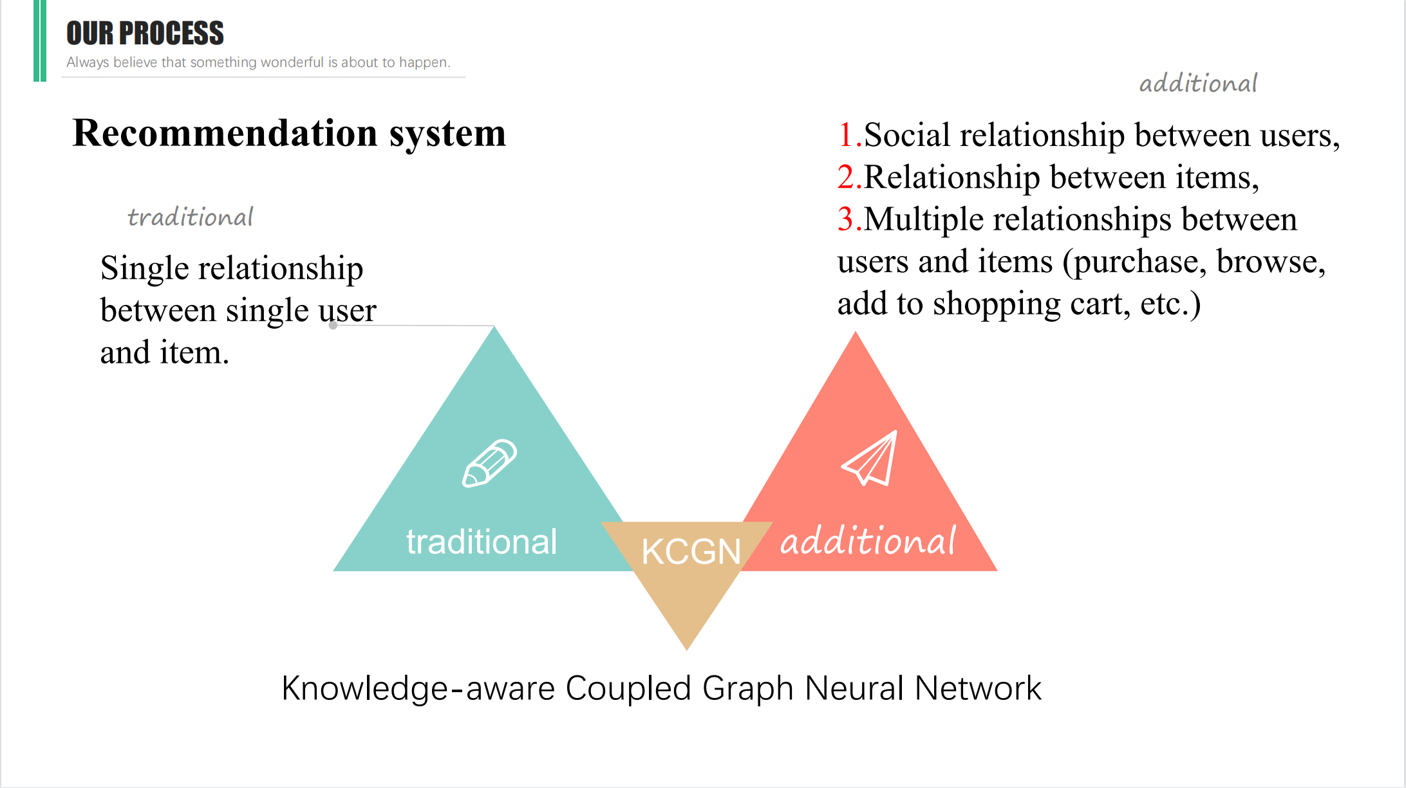

Slide 6
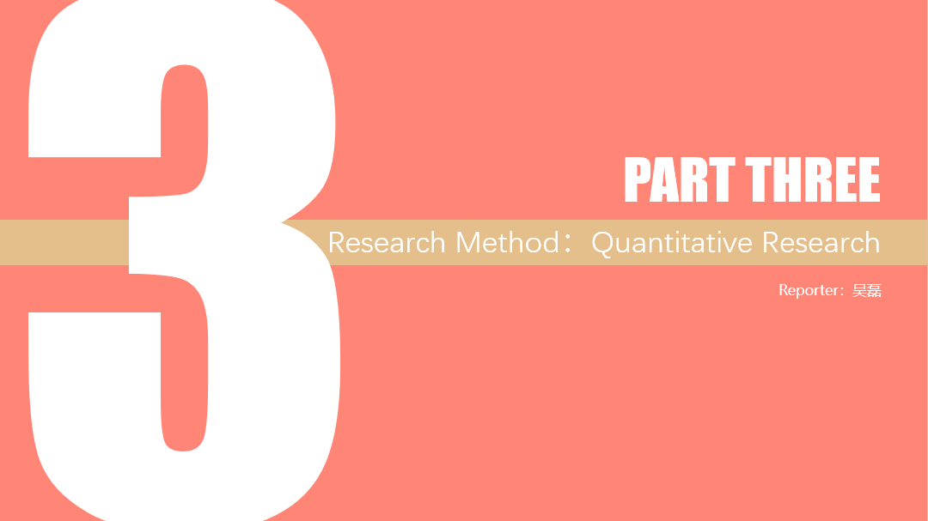

Slide 7
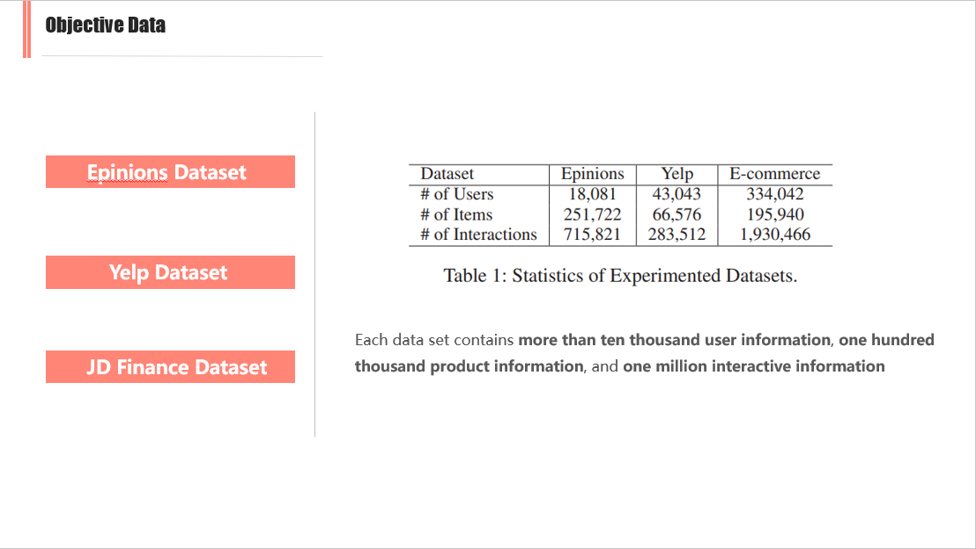

Slide 8
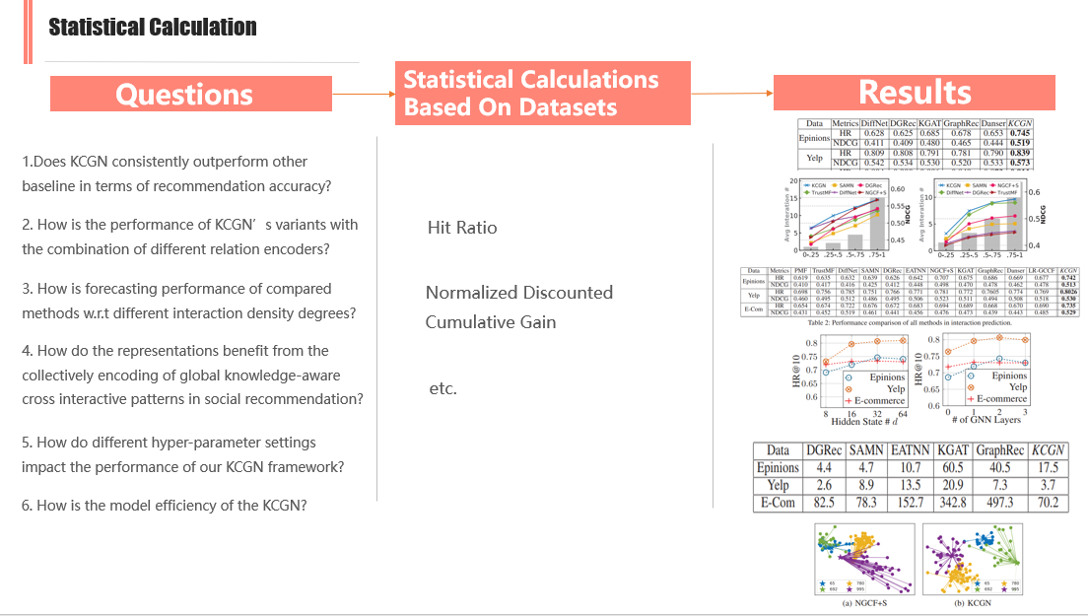

Slide 9
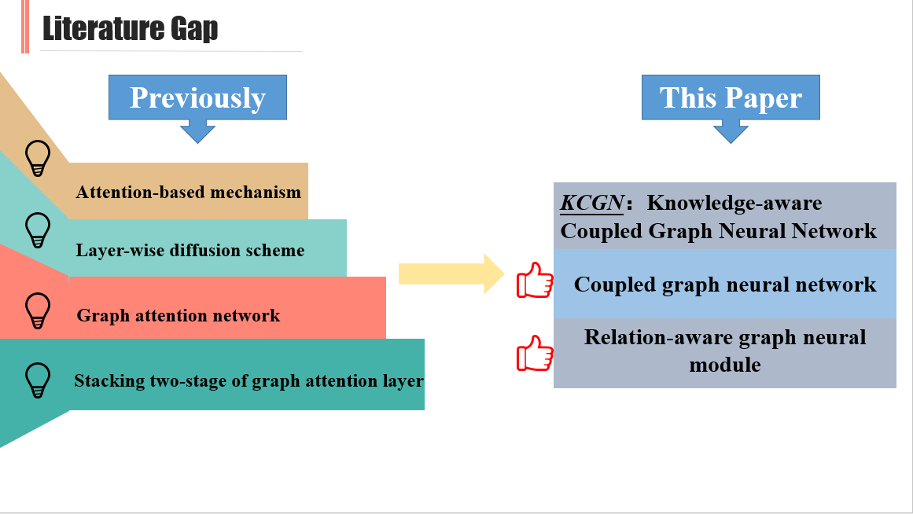

Slide 10


Slide 11
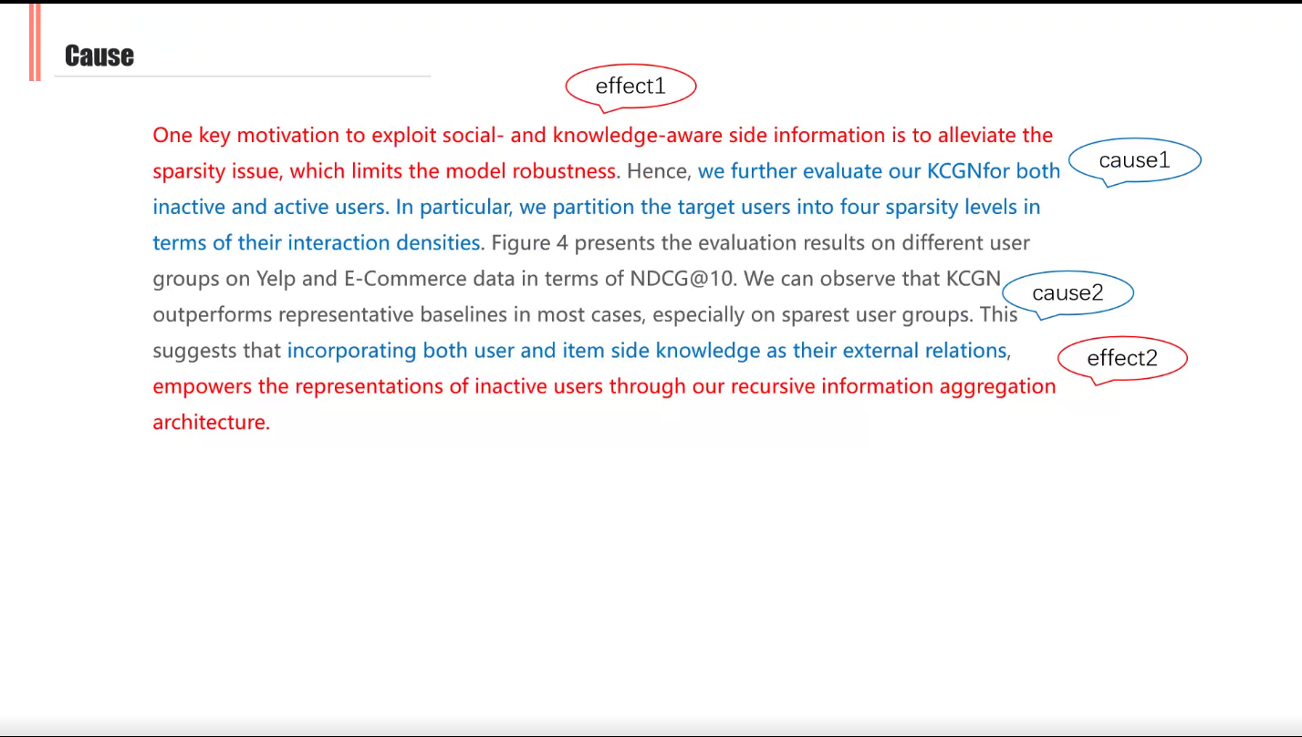

Slide 12
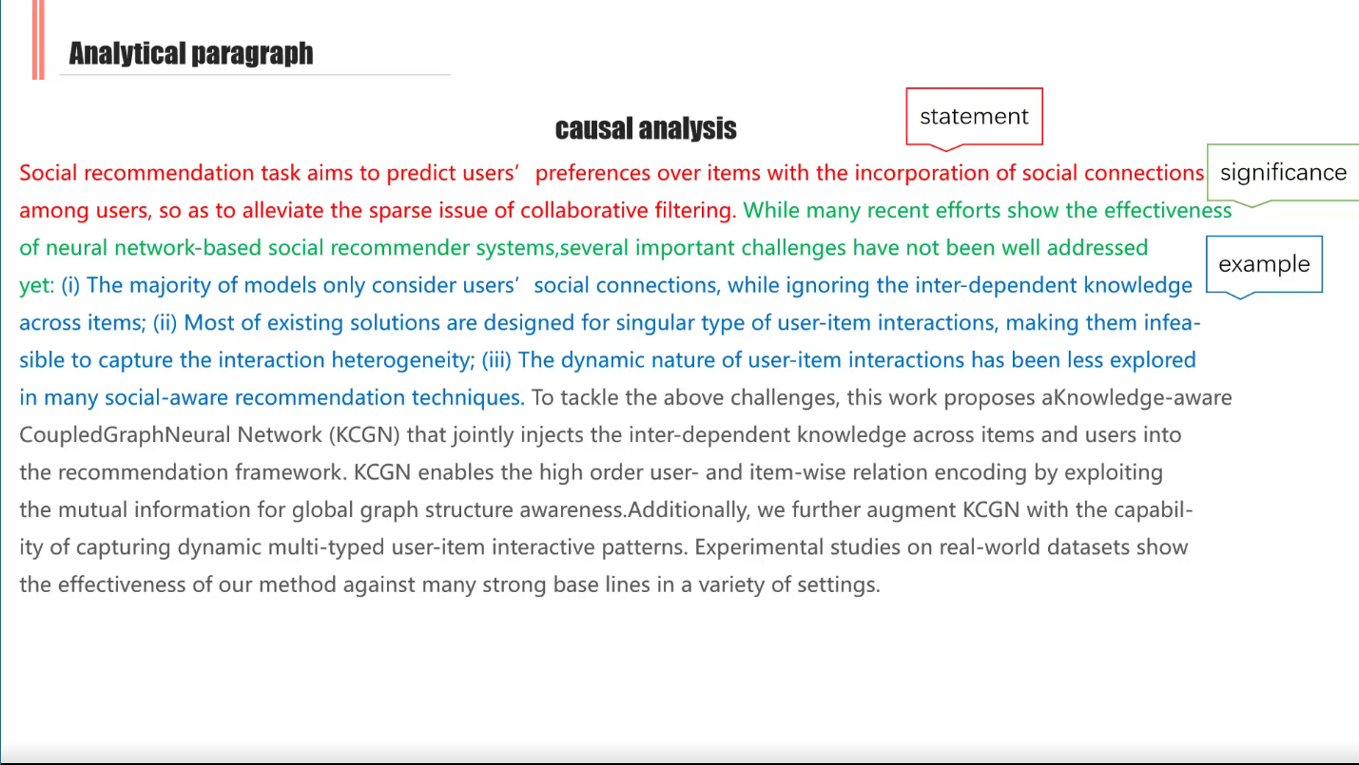

Slide 13
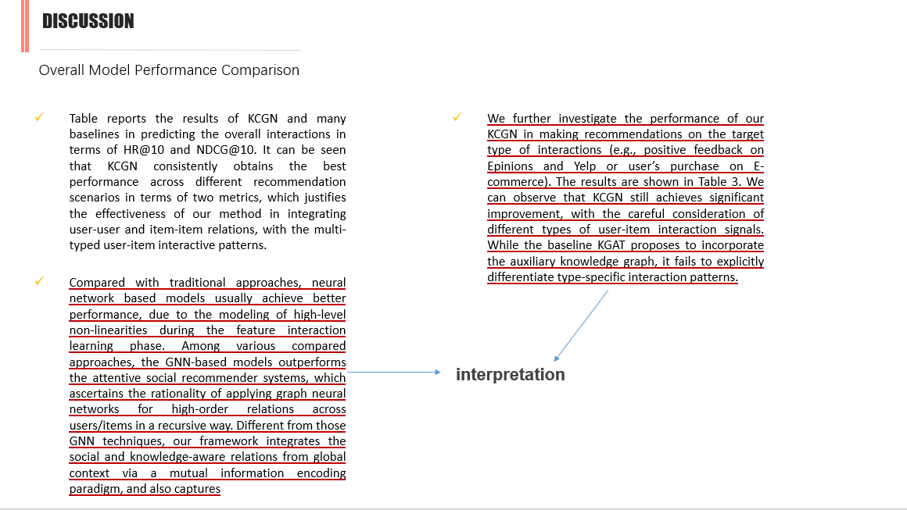

Slide 14
DISCUSSION
Related Work
Social-aware Recommender Systems. Deep learning has been revolutionizing recommender systems and many neural network models have been proposed for social recommendation scenario (Yin et al. 2019; Chen et al. 2020a). For example, attention mechanisms are introduced to learn the influences between users, such as SAMN (Chen et al. 2019a) and EATNN (Chen et al. 2019b). It is worth mentioning that several recent efforts explore the GNNs for incorporating social relations into the user-item interaction encoding (Wu et al. 2019b; Fan et al. 2019; Wu et al. 2019a; Xu et al. 2020). Different from these methods, KCGN focus on fusing the heterogeneous relations from different aspects (social, item knowledge and temporal), to boost the performance.
Graph Methods for Recommendation. Many recent efforts have been devoted to exploring insights from GNNs for modeling collaborative signals in recommender systems. For example, inspired by the graph convolutional operations, PinSage (Ying et al. 2018) and NGCF (Wang et al. 2019c) aim to aggregate high-hop neighboring feature information over the user-item interaction graph. Several subsequent extensions have been developed to revisit the graphbased CF effects, such as LightGCN (He et al. 2020), LRGCCF (Chen et al. 2020b) and KHGT (Xia et al. 2021). Motivated by these works, we propose a new knowledge-aware graph neural architecture for social recommendation.
interpretation

Slide 15
DISCUSSION
Conclusion
In this paper, we propose KCGN, an end-to-end framework that naturally incorporates knowledge-aware item dependency into the social recommender systems. KCGN unifies the user-user and item-item relation structure learning with a coupled graph neural network under a mutual informationbased neural estimator. To handle the dynamic user-item interaction heterogeneity, we design a relation-aware graph encoder to empower KCGN to maintain dedicated representations of multi-typed interaction signals with the incorporation of temporal information. Through extensive experiments on real-world datasets, we demonstrate that KCGN achieves substantial gains over state-of-the-art baselines.
interpretation

Slide 16
Introduction
In recent years, social recommendation which aims to exploit users’ social information for modeling users’ preferences in recommendations, has attracted significant attention (Liu et al. 2019). As has been stated in many socialaware recommendation literature (Wu et al. 2019a; Chen et al. 2019b), social influences between users have high impacts on users’ interactive behavior over items in various recommender scenarios, such as e-commence (Lin, Gao, and Li 2019) and online review platforms (Chen et al. 2020a). Hence, researchers propose to incorporate social ties into the collaborative filtering architecture as side information to characterize connectivity information across users.
The most common paradigm for state-of-the-art social recommender systems is to learn an embedding function, which unifies user-user and user-item relations into latent representations. To tackle this problem, many studies have developed various neural network techniques to integrate social information with the user-item interaction encoding as constraints. For example, attention-based mechanism has been utilized to aggregate correlations among different users (Chen et al. 2019a,b). Furthermore, inspired by the recent advance of graph neural architectures, several attempts are built upon the message passing frameworks over the user-user social graph. For example, social influence is simulated with layer-wise diffusion scheme for information fusion (Wu et al. 2019a). GraphRec (Fan et al. 2019) employs the graph attention network to model the relational structures between users. To enable the modeling context-aware social effects, DANSER (Wu et al. 2019b) stacks two-stage of graph attention layer for distinguishing the multi-faceted social homophily and influence.

