Slide 1

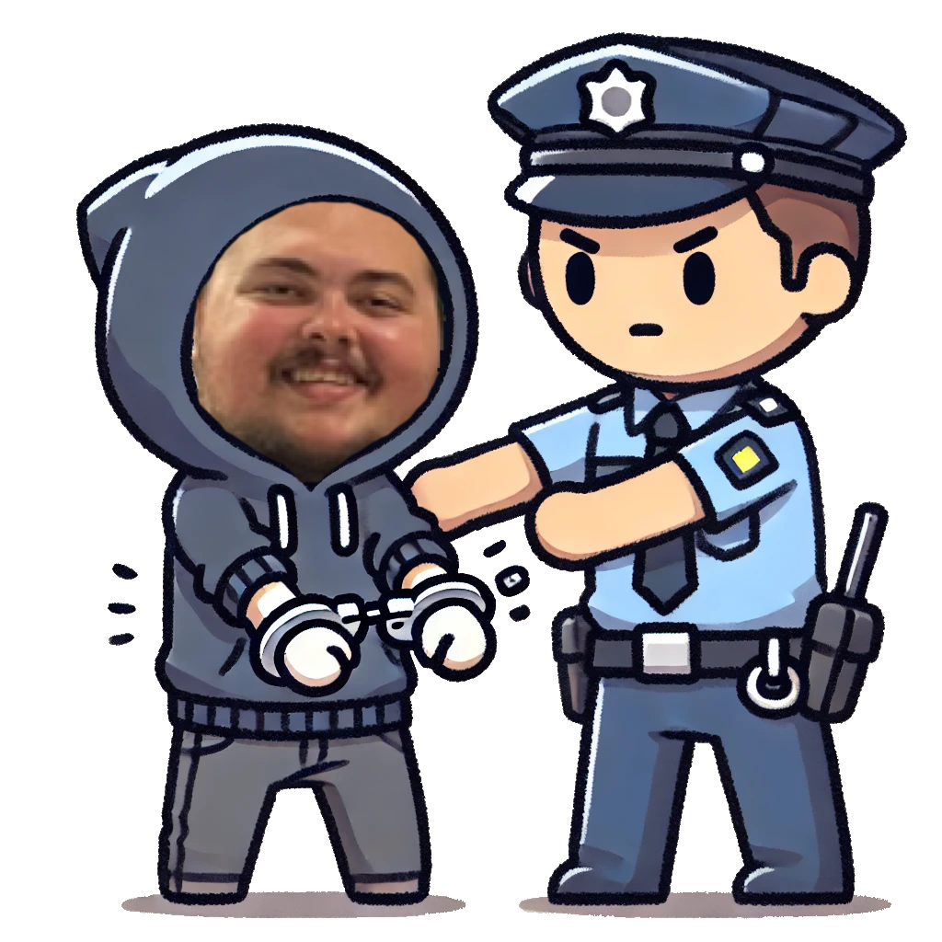
Hacking the Hackers
How Cyber Criminals get caught

Slide 2

Common mistakes
Honey Pots & Traps
These are often fake systems or documents designed to lure attackers in and log information about the attackers. If it looks too easy you might be caught
Bad Operational Security
Even the best hackers make mistakes these mistakes can lead investigators right to the attacker. That data leak doesn't need to be on reddit.
Malware signatures
All attackers write code in different ways, this can be used to track down who wrote the malware and sometimes lead back to the hacker.
I'm David Tennant and I hacked DOGE

Slide 3

The FBI vs 'Sabu'
Hector Xavier Monsegur aka 'Sabu' was a key member of Lulzsec, and was said to be the leader of the group. He later turned on the group preventing 300 future attacks
Lulzsec was a hacking group formed as an offshoot of anonymous devoted to causing chaos and attacking targets for fun. Targets such as.
The CIA
PlayStation Network
News Corporation Limited

Slide 4

Ethical Hacking Takeaways
Remember even the best hackers make mistakes, Understanding these mistakes makes us better at our profession.
Good Operational Security is never too much hassle
Don’t Do Illegal shit, There are plenty of people out there who get paid to find you if you do.

