Slide 1

How the MoD Sold National Security for £35 on eBay
“The Gaffer”

Slide 2
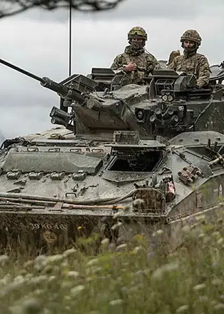
Agenda
Introduction
Why is our data wanted
The Big Reveal
The MoDs Response
The Bigger Picture
What we can learn (apparently)

Slide 3
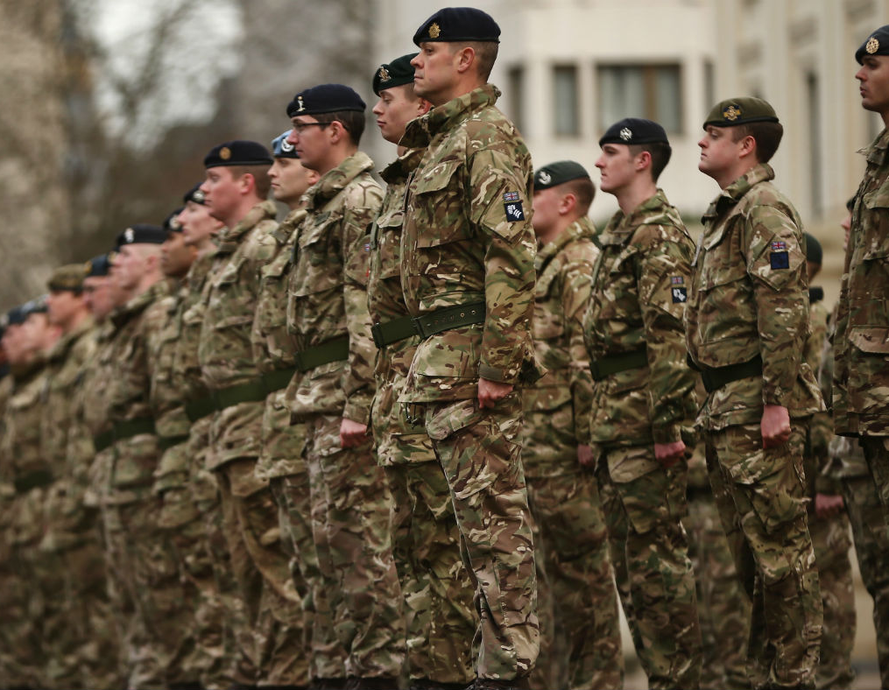
Introduction
In military intelligence, we’re always warned about the risks of cyber espionage, state-sponsored hackers, and insider threats… but no one ever thought the real danger would be… eBay.
Rule #1: Don’t trust the MoD
Rule #2: Don’t cry to us when you did…
Notes:
And I know what you're thinking… "Surely this was just an old laptop hard drive, nothing important?“
Wrong. It contained details on UK military personnel, operations, and equipment

Slide 4

Why is our data wanted?
HMNB Clyde
Located just outside of Glasgow
Home to the Royal Navy Submarine Fleet
Home to 43 Commando (Units)
Home to the Trident CASD
Home to STATE SECRETS
HOME TO SPIES
HOME TO THE ENEMY
Notes:
Chinese Blueprint theft
Table leg USB
Naughty…

Slide 5

The mods response
"Now, how do you think the Ministry of Defence reacted? Did they:”
A) Activate a high-priority national security response?
B) Track down the buyer immediately and recover the files?
C) Say ‘Oops’ and hope no one noticed?
Notes:
What was revealed, surely nothing bad right?

Slide 6
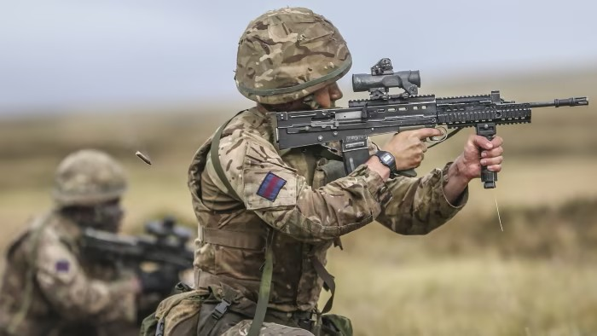
The mods response
If you guessed C, congratulations—you understand British military bureaucracy.
Their actual statement?
“We take security very seriously.”
No, you don’t. If you did, national secrets wouldn’t be on eBay next to second-hand PlayStations.
Notes:
What was revealed, surely nothing bad right?

Slide 7
The bigger picture
"And if this was just a one-off mistake, maybe we could forgive it. But, ladies and gentlemen… this was not an isolated incident."
2000s was a golden age for MoD losing things.
In 2008 alone, three laptops containing classified data were stolen from MoD offices.
One was found left in a taxi.
Another incident? An entire Royal Navy database went missing—they still don’t know where it is.

Slide 8

Lessons learned?
"Now, we’re constantly being told about the importance of cybersecurity: strong passwords, encryption, multi-factor authentication… but clearly, back in 2008, the MoD’s cybersecurity policy was:”
“Hope for the best.”
“If it’s lost, just don’t tell anyone.”
“Blame the junior officer.”
Notes:
"And that, ladies and gentlemen, is the story of how the UK’s national security was sold for the price of a Nando’s meal. God save the Queen… I mean, King. Thank you."

Slide 9
Lost and found
"The MoD losing a hard drive wasn’t a one-time event. Losing sensitive data is basically a British military tradition."
2008: MoD laptop with classified intelligence on Al-Qaeda—stolen from a car boot.
2017: RAF accidentally left a Top Secret document in a pub.
2019: A worker at a military base sold a missile system manual on eBay.
2021: Secret MoD files about UK military operations in Afghanistan were found at a bus stop in Kent.

Slide 10
Data protection – How to guide (MoD)
Use a password no one will guess, like ‘123456’ or ‘password’
Store classified files in the ‘Secret Stuff’ folder on your desktop
Forget to encrypt your hard drive, but make sure to put a ‘DO NOT OPEN’ sticker on it
If you lose it, don’t worry—just say ‘We take security very seriously’ and move on

Slide 11

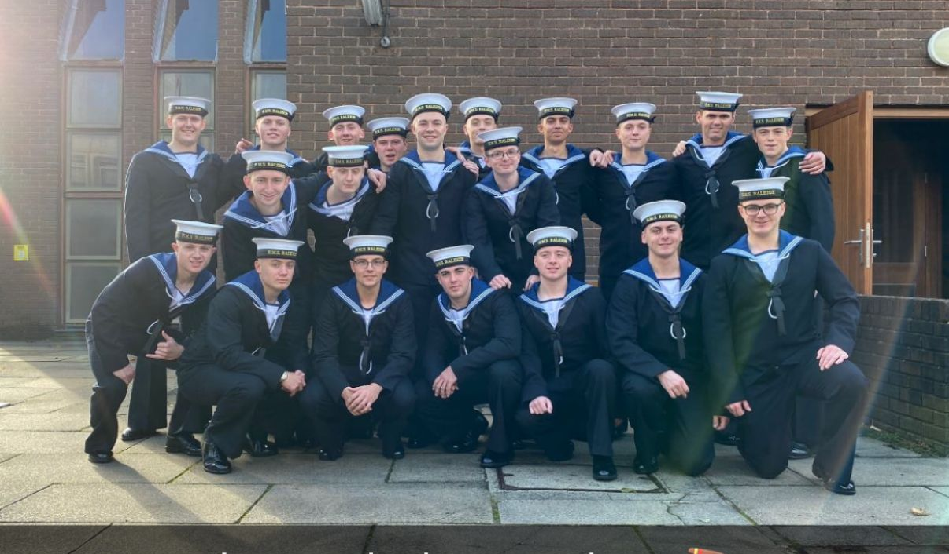
Thank you
“The Gaffer”

