Slide 1
Observability
By Charlie

Slide 2
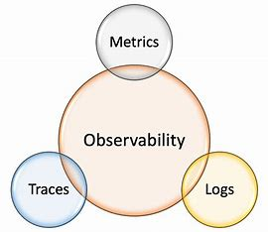
What is Observability?
Observability is the process of understanding the internal state of a system by analyzing its external outputs.
Measures a systems current state based on the data it generates through logs, metrics, traces, and events
Deals with “unknown unknowns”
Not just about what is happening but why it is happening
Critical in modern distributed architectures, such as serverless systems or microservices

Slide 3
Monitoring
Collects predefined metrics that identifies whether systems are functioning properly
Used to manage performance and can provide ongoing information
Reactive- only responds to preconfigured alerts and events
Focuses on the utilization and stability or resources
Responds only to known issues or thresholds
Deals with “known-unknowns”

Slide 4
APM
Application performance monitoring
Toolset for tracking application health
Ensures optimal application performance and rapid identification of user-impacting issues
End-User Experience Monitoring (measuring performance from the user’s perspective)

Slide 5
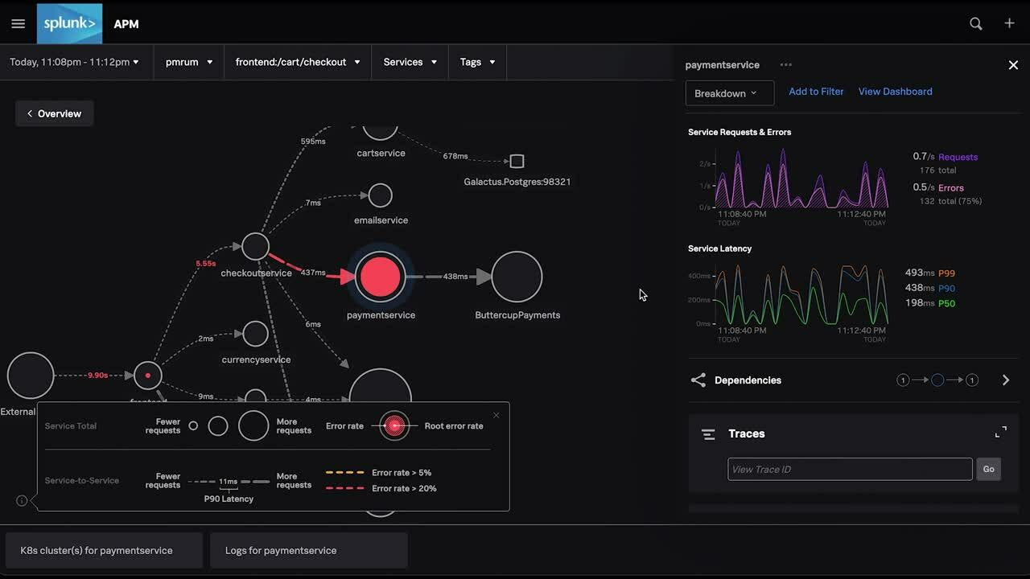

Slide 6
Telemetry data
The automatic measurement and wireless transmission of data from remote sources
Sensors that monitor Physical and electrical data measure things such as voltage, temperature, pressure etc.
Startup and Processing times, crashes, user behaviour and resource use, are used to assess the state of a system
This data is then sent for real-time monitoring and analysis
Gaining insights into application performance from the user's point of view

Slide 7
Telemetry data
There are three main pillars of Telemetry data:
Collection: Metrics, logs, traces, events
CPU usage percentage, memory consumption, or request latency.
Timestamped records of events
Delays in services when a user requests travels from a web page to a database
Transmission: Data sent to central systems
Analysis: Insights derived for optimization and troubleshooting

Slide 8
Advantages of Observability
Offers control over dynamic environments
Helps provide superior control over unpredictable/dynamic networks and systems, whereas traditional monitoring may fall short
Issues can be proactively addressed, even if those problems were unanticipated/defined during system design
Great at debugging, optimizing performance, and incident response
Easily Scalable

Slide 9
Top observability platforms
Splunk observability cloud
Dynatrace
IBM Instana
Azure Monitor
SolarWinds Observability

Slide 10
Future of Observability
Organisations are starting to integrate AIOps (Artificial Intelligence for IT Operations) into Observability platforms
Focus on Cost-Efficiency and Security
Multi-cloud and cross platform architectures

Slide 11

This is just the tip of the iceburg…

Slide 12
In summary…
Observability ensures that organisations can understand, monitor, diagnose and resolve issues and unexpected problems in complex and dynamic environments.
unlike monitoring, observability proactively addresses the tools and techniques to answer why a system is behaving the way that it is.
Observability is becoming critical in modern architectures that are complex, ensuring organisations reliability, improving troubleshooting efficiency and maintaining optimal performance across dynamic systems

Slide 13


Thank you for listening!

