Slide 1

PERSISTENCE

Slide 2
COMPULSORY DON’T DO ILLEGAL SHIT

Slide 3



WHAT IS PERSISTENCE?
Persistence put simply is maintaining access to a system once you have gained access to the system.
Establishing good persistence is crucial during an attack to be able to go back to the target and look for more information/flags.
There are a large variety of techniques for gaining persistence and it is very much dependent on the target.

Slide 4
Command and Control
Command and Control (C2) is step 6 in the Lockheed Martin Cyber Kill Chain.
C2 simply means being able to manage your sessions.
Metasploit (One of the main focuses of this talk) has session handling as a part of its exploits (exploit/multi/handler)
Specialised C2 software exists for more advanced usage and custom payloads
Examples include Cobalt Strike, Sliver, Havoc, and Mythic
Each C2 framework will have its own way of generating payloads, these are usually highly customisable to help evade EDR detection.
Notes:
C2s are more indepth than this, would need a full talk to themselves probably. This is good enough for the purpose of today

Slide 5
TOOL – MSFVENOM
MSFVenom is a payload generator used in conjunction with the Metasploit framework.
Using a MSFVenom payload will allow for a meterpreter session to be used instead of a standard remote shell.
While a payload itself is not a full persistence technique being able to generate payloads quicky is useful to have in a live environment.
Example command
Notes:
Msfvenom – program name
-p payload selection
LHOST – IP address of attacker machine
LPORT – Port to connect to on attacker machine
-f - Format
> payload.exe – defaults to stdout > redirects it to the file.

Slide 6
TOOL – Veil
Veil is a payload generator used in conjunction with the Metasploit framework.
Veil works in a similar way to msfvenom, however it attempts to obfuscate the payload to help avoid detection.
There are two main versions of Veil: Veil Framework and Veil Evasion. Veil Evasion is now deprecated (See links slide at end for latest version)
Example command
Notes:
Msfvenom – program name
-p payload selection
LHOST – IP address of attacker machine
LPORT – Port to connect to on attacker machine
-f - Format
> payload.exe – defaults to stdout > redirects it to the file.

Slide 7
WINDOWS PERSISTENCE
Persistence on windows is worryingly easy to get as there are a multitude of different ways.
Some methods require administrative permissions and some do not.
The ones that do not are less powerful and give you less control however it will give you more time to find a privilege escalation vulnerability.
The following are not all inclusive and there will be a links page at the end with some resources on persistence if you’re interested.

Slide 8



WHERE TO HIDE YOUR PAYLOADS?
Plain sight – Always a valid option. Could disguise the payload as a document or a text file and have it function in the exact way it should just with some added malware. How to do this is a whole different talk I will leave to someone else.
Windows Folder – One of the places your average person doesn’t go. They see a large amount of scary looking files and just leave them alone. Sneaking an exe or a DLL in here would be quite easy. Downside is you need administrator permissions.
AppData – hidden folder by default. Again most standard users don’t look here very often and even if they do if your payload has a fairly subtle name then it is highly unlikely it will be removed.

Slide 9
METHOD 1 – WINLOGON HELPER DLL (MITRE T1547)
This is triggered every time a user logs in, out, shutdown, accesses the lock screen etc making it a very powerful target
Requires administrator level cmd or Powershell access so good for after a privilege escalation vector has been exploited.
Pros:
Payload executed with SYSTEM level privileges on next logon
Cons:
Requires administrator permissions

Slide 10
METHOD 2 - SHORTCUT MANIPULATION (MITRE T1023)
Windows shortcuts contain a reference to software installed on the system or to a file location. This is useful as your payload can hide as a shortcut and can be placed in the start-up file for a specific user.
C:\Users\%username%\AppData\Roaming\Microsoft\Windows\Start Menu\Programs\Startup
Pros:
No administrative privileges required
Very few people check this specific folder for start-up items
Cons:
Requires a specific user to login
Gives you a non administrative shell if the pwned user is not an administrator.

Slide 11
SHORTCUT MANIPULATION CONTINUED
A few different tools are available.
C2 frameworks Empire and PoshC2 have this functionality built in
lnk2pwn is a common tool used to generate these shortcuts (It is a GUI though…)
LNKUp is a similar tool written in python and can also be used to generate these shortcuts. A added bonus of this tool is that it can be used to steal NTLM hashes and Environment variables as well as execute commands.
Example:

Slide 12
METHOD 3 – SCREENSAVER HIJACKING (MITRE T1546)
Quite a fun one this but it is quite rubbish compared to other methods.
Administrator permissions are not required for this.
.exe or .scr extensions can be used which increases the stealth of this technique (scr being the screensaver extension)

Slide 13


LINUX METHODS
Linux methods are less interesting in my humble opinion, but we still need to know them.
Some techniques require root privileges, some do not.

Slide 14
WHERE TO HIDE YOUR PAYLOADS (LINUX)
/tmp file – standard location. Most users have rwx on that folder so it is a good place to put them. Commonly checked however.
Hidden folders in user areas – go through a users file system and find a nice looking directory tree. Add a . to the front of your payload and the folder it is contained in. A clever directory name could be an elipses (…) as in a ls –la the top two are . and .. making … quite difficult to spot instantly.
Always good to go through the other parts of the file system to look for places which may have rw access that are rarely looked at.

Slide 15

METHOD 1 – SSH KEYS (MITRE T1098.004)
If your target has SSH open this is perfect.
You can generate your own key using ssh-keygen tool (preinstalled in kali)
You can then add the contents of your public key to the authorized_keys file.
You can add this to any user but when you connect you will authorize as that user, if you can add it as root then that is the best outcome.
chmod 700 /^USER^/.ssh && chmod 600 /^USER/.ssh/authorized_keys

Slide 16

SSH KEYS CONTINUED
Pros:
Cons:
If SSH is already setup this is quite stealthy as you do not need to have malware floating around the system
Allows for continued persistence beyond a password change
If public key authentication is disabled in the config file then this will not work (root is needed to change the options of this)
If a user does not have a .ssh file and one suddenly appears this could be suspicious.

Slide 17


METHOD 2 – CREATING PRIVILEGED LOCAL ACCOUNT (MITRE T1136.001)
Every Linux system can make new accounts, so this is a guaranteed method.
Root privileges are required to create new user accounts, however. This could either be a root account or a sudoers account. Either works.

Slide 18
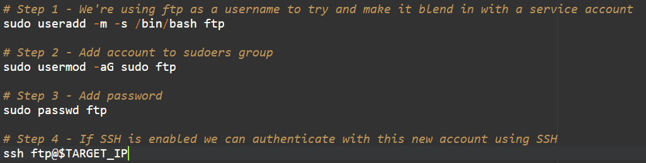
CREATING A PRIVILEGED ACCOUNT STEPS

Slide 19


PRIVILEGED LOCAL ACCOUNT CONTINUED
Pros:
Cons:
Gives you sudo access without using the root account or an existing users account. This means your command history won’t be sitting in someone elses .bash_history file
Allows for maintained access if the original entry point or password was changed
A root user can remove the account fairly easily.
On servers with a small number of accounts this is quite easy to spot.

Slide 20
METHOD 3 - .BASHRC MANIPULATION
This method does not require SSH to be installed/enabled which increases the convenience slightly.
For this purpose we will use a netcat reverse shell, quite easily you could set this up to run a msfvenom payload instead if you prefer.
.bashrc runs whenever the user logs in, either physically or by SSH if that is an option on the particular target.

Slide 21

.BASHRC MANIPULATION STEPS
1) Open .bashrc in an editor of your choice (vim)
2) Add bash code to trigger your payload or reverse shell e.g.
3) On the attack machine run a listener e.g.
4) when the user next logs in the command will run and connect you to the target

Slide 22

.BASHRC CONTINUED
Pros:
SSH not required
Netcat is installed by default on most Linux distros
.bashrc file is rarely read and is a large file so hiding the code isn’t too difficult
Cons:
You need to wait for a user to login before the code is executed
The listener needs to be running at the time of login else the connection is refused.
Netcat transmits all commands and data in plain text so if there is network monitoring on your target anything you are doing can be seen.

Slide 23
METHOD 4 – CRONJOBS (MITRE T1053.003)
A cronjob is a time-based service that runs applications, scripts, and other commands on a specific schedule.
This means we can setup a cronjob to periodically try to connect to our listener.
This method is similar to the .bashrc manipulation except it doesn’t require a user to be logged in for the payload to execute.

Slide 24
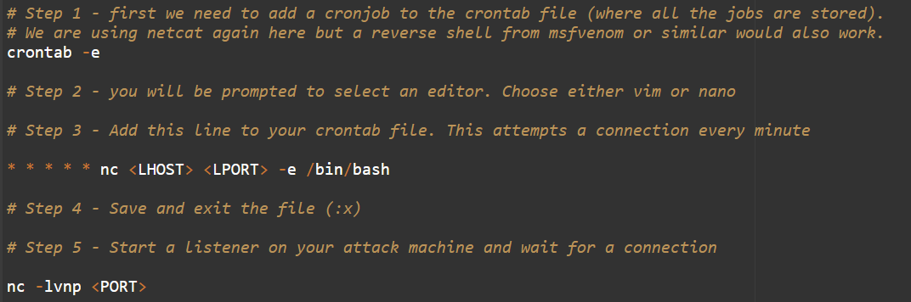
SETTING UP A CRONJOB
Notes:
Field names for cron format
Minute
Hour
Day of month
Month
Day of week
Values can be comma separated
An asterisk means all possible values
In this command we are saying to run this every minute of every hour of every day of every day of the month in every month and every day of the week
https://www.ibm.com/docs/en/db2oc?topic=task-unix-cron-format

Slide 25
CRONJOBS CONTINUED
Pros: Connection can be retried as often or as little as you want meaning your listener doesn’t have to be running 24/7
Can run any scripts from a cronjob
Cons:
If cron is not enabled on the system then this will not work without enabling it (required root)
Can sometimes be temperamental.
Notes:
https://crontab-generator.org/

Slide 26




UNIVERSAL METHOD – METASPLOIT PERSISTENCE
Metasploit has a persistence module built into it. If you can get a meterpreter shell this is perfect.
Metasploit provides multiple different ways of getting persistence, including some of the above.
https://www.infosecmatter.com/metasploit-module-library/
Easy enough to find a module that will suit your purpose

Slide 27
METASPLOIT PERSISTENCE
Pros:
Simplifies the process of persistence massively
Cons:
Requires a meterpreter session to perform.

Slide 28
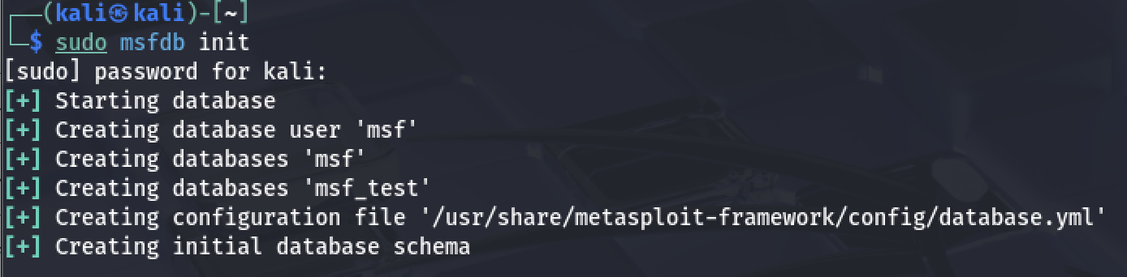
Metasploit Commands
Start the Metasploit Database, this is not a necessary step but a large number of the features within Metasploit rely on the database. Better to have it initialised than not.
Notes:
Run

Slide 29
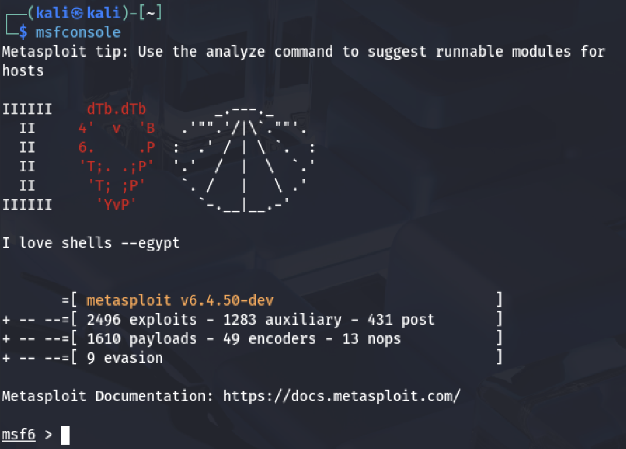
Metasploit Commands
Now we can start the Metasploit console itself, this is where we will be running the majority of our commands from. ~ Also got to love the little messages
Notes:
Msfconsole
Search
Use
Run
Rhosts
Options

Slide 30
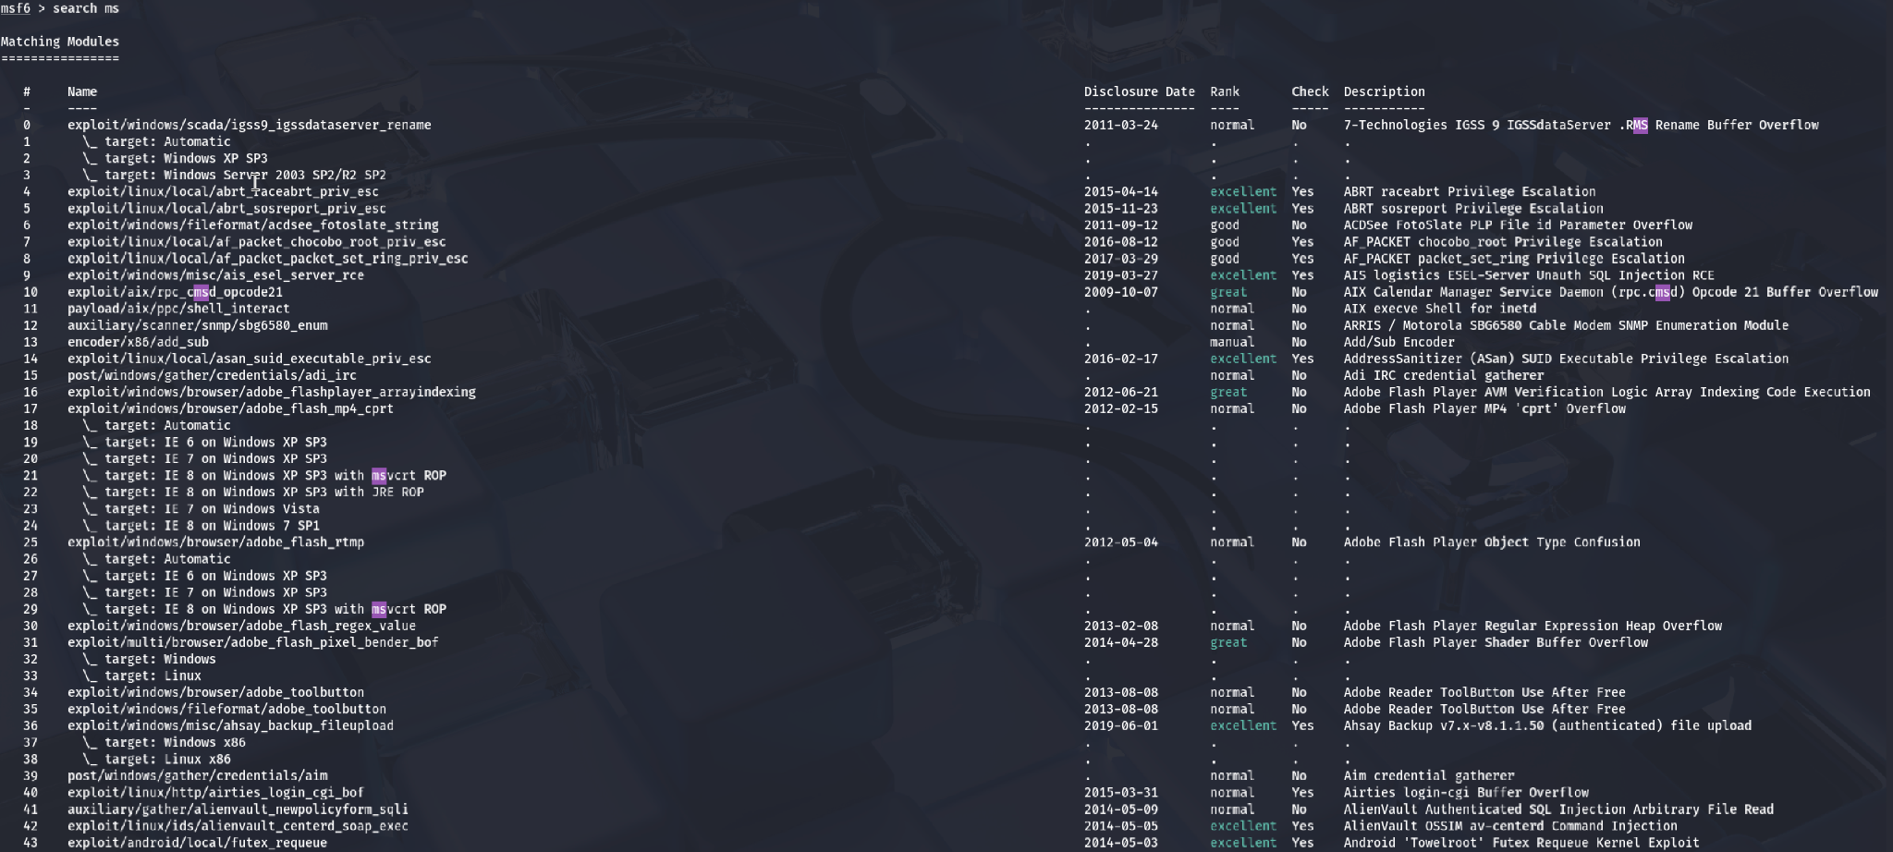
Metasploit Commands
Moving onto the fun part, time to find our exploit. Based on your reconnaissance on the target you should have some idea of what the system is vulnerable to (remember Google is your friend here). Using the ‘search’ command within MSF we can look for payloads to use on the target.
Notes:
Search
Use
Run
Rhosts
Options

Slide 31
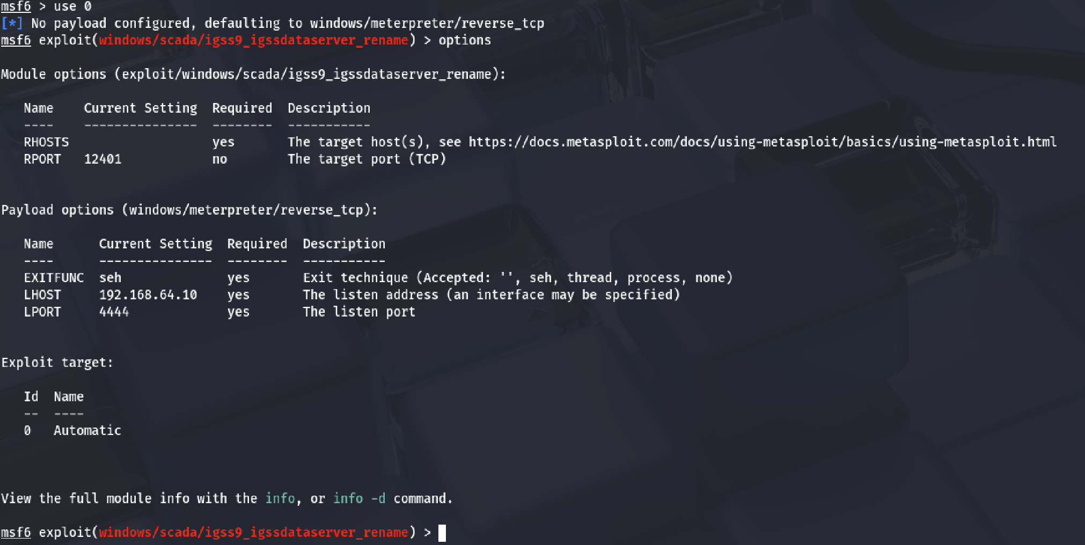
Metasploit Commands
Amazing we have found a bunch of exploits but now what. Well lets pick one. Typing in ‘use’ followed by the id number of the payload you want should set it within MSF. Now we can look at the ‘options’ we can set for that specific payload.
Key options to remember are:
RHOST - the machine you are attacking
LHOST - your local machine
Notes:
Search
Use
Run
Rhosts
Options

Slide 32
Metasploit Commands
All the hard work is done, we have set up the entire environment and are ready to attack but how do we?
Fear not Metasploit has the very commands you are looking for, choose from either:
run (boring)
exploit (now you’re a hacker)
Now you’ve got the basics. This really is only scratching the surface though.
Notes:
Search
Use
Run
Rhosts
Options

Slide 33


Your turn!
https://tryhackme.com/room/blue
Notes:
https://tryhackme.com/room/blue

Slide 34

ANY QUESTIONS?

Slide 35
LINKS:
Lnk2pwn - https://github.com/it-gorillaz/lnk2pwn
LNKUp - https://github.com/Plazmaz/LNKUp
Msfvenom - https://www.offensive-security.com/metasploit-unleashed/msfvenom/
Metasploit Module List: https://www.infosecmatter.com/metasploit-module-library/
Linux techniques references:
https://www.linode.com/docs/guides/linux-red-team-persistence-techniques/
https://www.pluralsight.com/guides/user-and-group-management-linux
https://www.ibm.com/docs/en/db2oc?topic=task-unix-cron-format
https://www.cyberciti.biz/faq/how-do-i-add-jobs-to-cron-under-linux-or-unix-oses/
Windows:
https://pentestlab.blog/methodologies/red-teaming/persistence/
Veil - https://github.com/Veil-Framework/Veil
MITRE links are on individual slides

