Slide 1


Slide 2

Announcements
Week 3/4 Taster session
Gradcracker books
Next week guest talk – DRESS UP
Memberships

Slide 3


DMU
Hacking Society
Linux Fundamentals

Slide 4




DMUHACKERS
D0nt d0 1ll3gal sh1t
please..

Slide 5

Linux
Linux is an open-source operating system
There are different distributions – Debian, arch, etc
Kali is Debian-based
Kali is mainly used for cyber security purposes
Comes pre-installed with over 600 tool
https://www.kali.org/tools/

Slide 6
Knowing how to use tools
Flags are the options to modify behaviour of a command
(-) for single letter flags
(ls –l –a) can be (ls –la)
(--) for long-form flags
--help or –h for summaries of how tools and its flags are used
man <command> – shows the manual for the tool (man cat)
Notes:
Using – can sometimes be used to combine multiple short flags (ls –la)
Generally –help is better to use as some tools will not accept –h

Slide 7
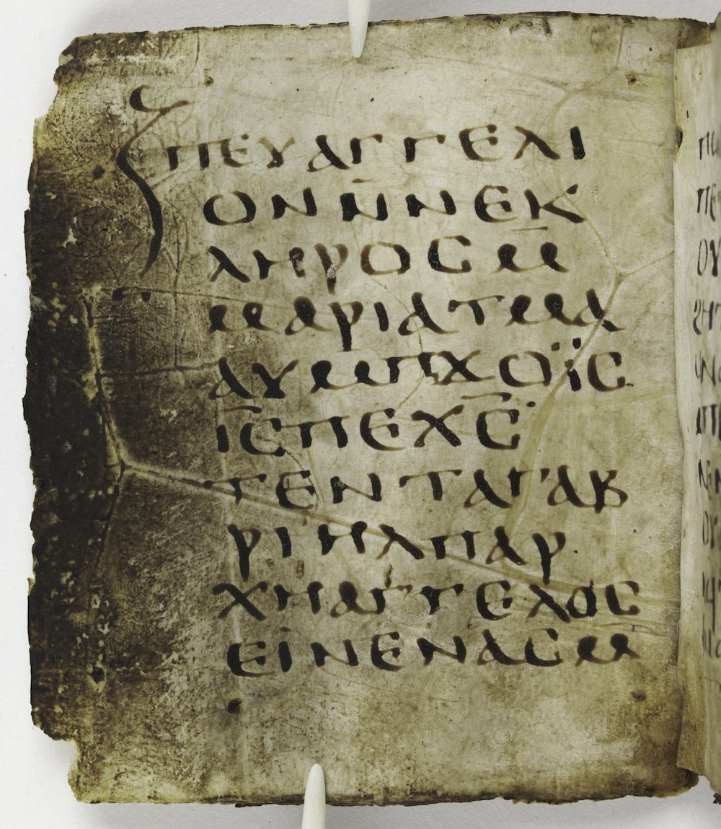
Linux commands
cd – change directory (cd dir, cd ..)
pwd – print working directory
ls – list contents of the current directory
cat <filename> – shows a files contents
whoami – displays the username of the current user
id – display info on user id and groups
mkdir – make directory
touch – create an empty file
cp – copy – (cp <filename/directory> <destination>)
rm – remove – (rm <filename/directory>)
rmdir – to delete empty directories
Notes:
Pwd – where you are in a system (downloads, documents, etc)
Ls – list
Cp and rm – to copy or remove directories you need -r

Slide 8
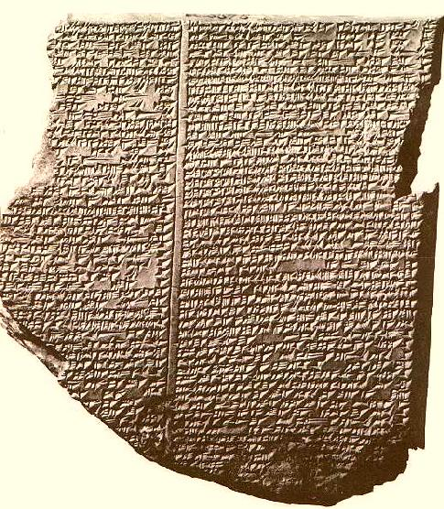
Linux commands
strings - print strings of printable characters
curl - transfers data to and from a URL
find - searches for files
grep - search for specific words, phrases, or patterns
less - displays content one page at a time
head - shows first lines of a file
tail - shows only last lines of a file
clear - clears terminal screen
Notes:
curl - used to print pages source code, send requests to a page - test requests, check what a web server returns
find - -name, -iname, use * to find partial names, can find based on content within file with grep, find based on file type (-type)
less - if checking a really long file, allows you to go forward and back through a file, pages, not having to scroll
head and tail - show first and last 10 lines by default, can be changed using flags and options

Slide 9

Pipelining and Redirection
> Using this puts the output of a command into a file
  Overwrites a file if it exists, creates a file if it doesn’t
>> Using this will get the data appended to the file, rather than rewriting
< Takes the input from a file instead of the keyboard (sort < names.txt)
| Pipelining takes the output from the first command and uses it as an input for the next command (cat file.txt | grep “word”)

Slide 10

To install tools
sudo apt update
sudo apt full-upgrade -y
sudo apt install <package_name>
sudo apt update && sudo apt full-upgrade –y
The (&&) just means it will do the next command straight after, if the first command was successful, so you only write the one line and it does both
sudo allows an authorised user to run a tool with elevated privileges
Notes:
Update – updates the list of packages
Full-upgrade – actually installs and upgrades the packages

Slide 11

To install python-based tools
For newer versions of kali
You’ll need to install pipx
pipx install <package_name>
Once it’s installed you can use the tool as normal
Examples of python tools:
Volatility3 – forensics tool
Pwntools – CTF framework – made to make exploit writing faster

Slide 12
To install tools from github
git clone <url>
Examples:
XXStrike

Slide 13
Wordlists
Wordlists are useful for brute-forcing, password cracking, directory fuzzing
Use with johntheripper, hydra, ffuf
/usr/share/wordlists

Slide 14
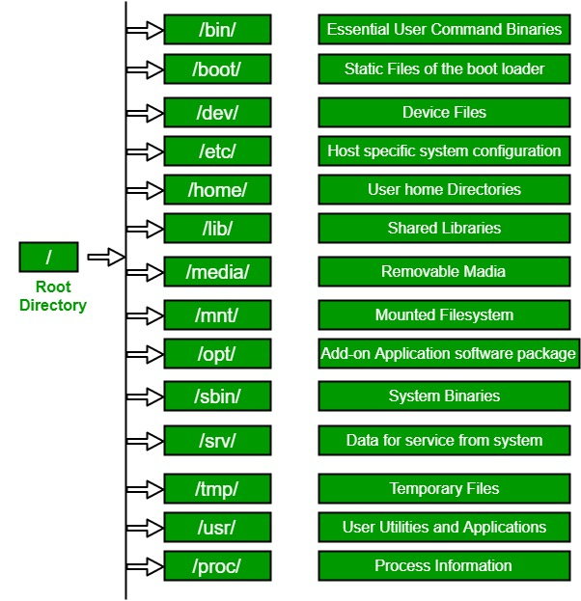
Structure
Notes:
bin - user binaries, basic commands
Boot – files needed to boot
Dev – device files, represent hardware
Etc – plain text config files, root privilgeses needed
Mnt – mount points, to mount filesystems or devices
Opt – optional 3rd party software packages
Sbin – binaries required by the os for management
Srv – used to store data for servers - running a website from the box, the html files will go to /srv/www or /srv/http
Proc - info about running processes, like CPU - If you wanted to see PID you could do command ps, then use the PID to look for the proc/file

Slide 15

Structure
Important to understand
For threat detection or incident response
So, looking in logs (/var/log)
Or for signs of persistence (cron jobs in places they shouldn’t be)
Backdoor accounts created (/etc/passwd or /etc/shadow)
Notes:
Cron jobs – scheduled jobs – repeated cron jobs in /tmp may be malicious

Slide 16

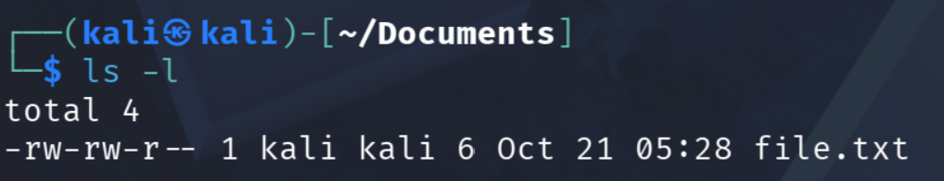
Permissions
Each file/directory has its own set of permissions
If we use ‘ls –l’ we see the files permissions
Notes:
U – Person who owns the file
G – a group of other users who have access to the file
O – everyone else who has access to the system

Slide 17

Permissions
First character shows whether it’s a file (-) or directory (d)
The rest of the characters
First 3 = owner (u)
Next 3 = group (g)
Last 3 = others (o)
R – read permissions
W – write permissions
X – execute permissions
Notes:
U – Person who owns the file
G – a group of other users who have access to the file
O – everyone else who has access to the system

Slide 18
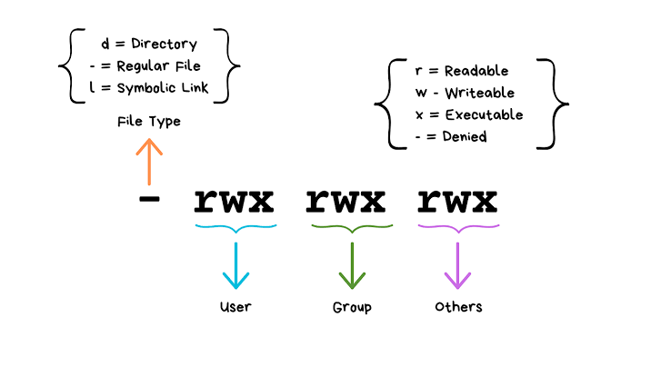
Permissions
Notes:
Update – updates the list of packages
Full-upgrade – actually installs and upgrades the packages

Slide 19
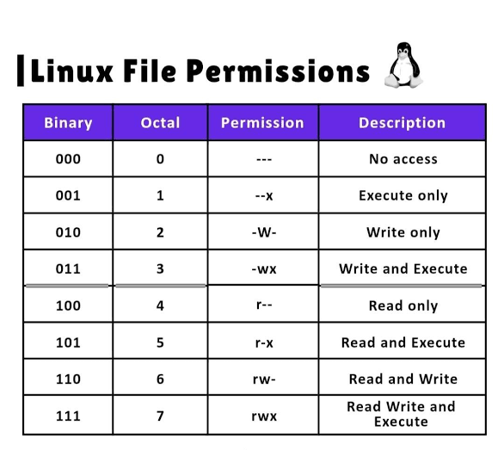
Changing Permissions
chmod
  chmod u+x
  chmod g-r
  chmod ugo+x or chmod a+x
  chmod 760
  chmod 777
chown
  chown <newowner> <file>
  chown <userid> <file>
  chown <user:group> <file>
Notes:
Chmod 777 would give full access to everyone

Slide 20

Text Editors
Nano – Easiest to use
Vi/vim - different modes (normal, insert, visual, command)
Good luck exciting Vim and Vi :D

Slide 21

Other Tips
When writing passwords, the passwords won’t be shown
To copy – ctrl+shift+c
To paste – ctrl+shift+v
Interrupt a process – ctrl+c
Tab - autocomplete
Up arrow – go through command history

Slide 22
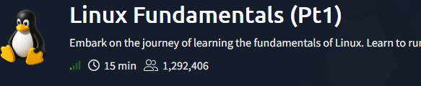
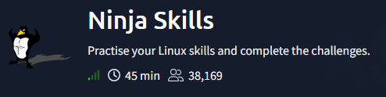
Practical
Part 1:
https://tryhackme.com/room/linuxfundamentalspart1
Part 2:
https://tryhackme.com/room/ninjaskills

