Slide 1

AI in Cybersecurity
Nikita
Jade
Deniz

Slide 2
AI in SOC’s
In SOC's AI would be used to streamline manual and tedious processes, as well as augmenting responsiveness and incident detection.
In a SOC environment, AI could bundle data associated with a specific event, reducing lookup times for the security team. This is especially beneficial for chain events.
Some events can trigger an automated response, where AI will only invoke the response. This is crucial to acknowledge, as AI is not stable enough to fully reliably procedurally send instructions to a system without potentially causing more damage.

Slide 3
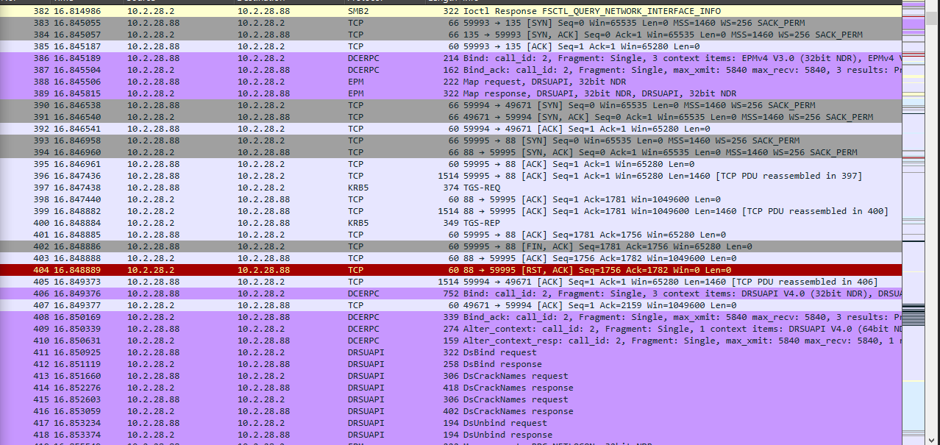
How exactly does AI assist in a SOC environment
AI can group information sets like inbound packet captures, as well as do basic research on common vulnerabilities.
For example,

Slide 4
AI Is optimally implemented alongside already existing measures, such as an EDR.
AI could give helpful insights to security specialists, that could otherwise be overlooked.
Moreover, AI can improve on alert fatigue by highlighting genuine concerns in alerts that would otherwise have been ignored.

Slide 5


Behaviours analytics
AI is an excellent tool for automating analysis of user behaviour on a webpage.
This in turn can be used to identify malicious activities among thousands if not millions of users. This in turn could reveal security gaps in infrastructure previously not known, by identifying malicious activity while it is in action.

Slide 6




Automation of Incident Response
AI can be used to assist mounting a response to an incident.
AI in incident response useful but still is heavily human driven.
Ultimately it is likely that even basic AI's will be used for this purpose, not even neccesarily dedicated IR AI's however, this ultimately depends on the scale of the organisation, as well as the constraints, such as non-disclosure agreements, data availability, monetary constraints as well as organisational goals.
As far as AI goes for IR, its frequent usage comprises of summarizing information and events to then be reviewed by human incident responders, basic containment functions and repetitive tasks.

Slide 7


Defensive AI: Blue Team Applications
Everything previously mentioned also has a few disadvantages -
Adequate training of dedicated models requires lots of refined data, which may not be available in some contexts.
Training AI requires expertise.
Can become costly infrastructure wise.
Overreliance on AI can sometimes cause situations to escalate,

Slide 8
Where AI isn't a good idea
Small scale organisations – Small organisations should still focus more on traditional defence measures, as AI works best alongside traditional tools, rather as a standalone tool.
Cost sensitive applications – AI is expensive. From the hardware that runs it optimally, to the actual implementation and data gathering, AI is expensive to implement.
Organisations with an already bad security stance – Seen as AI is best used on top of an already good security system, it is best that any funds dedicated to its implementation in such a organisation are rather reallocated to improving the traditional security system already present in the organisation.

Slide 9
Cryptography & AI: Encrypted Traffic Analysis without Decryption
Encrypted Traffic Analysis is a security method that can identify malicious activity within the encrypted network traffic without decrypting it.
By Analysing metadata such as packet size, timing , frequency and traffic patterns, machine learning models can identify application types and user behaviour
This approach is used to exfiltrate data while also preserving confidentiality, however it does also raise privacy concerns as sensitive behavioural patterns can still be inferred despite encryption

Slide 10
Offensive AI: Red Team & Pen testing
Offensive AI – using AI to enhance red teaming and pen testing activities by automating and improving attack techniques.
Ai can assist in tasks like vulnerability discovery and exploitation by analysing large datasets more efficiently.
e.g machine learning models can identify patterns in web applications to detect potential injection points or misconfigurations, but AI driven tools can make more convincing phishing campaigns through natural language processing

Slide 11
The Adversary's Toolkit: How threat actors leverage AI
AI increases the speed and scale of cyberattacks, allowing attackers to automate tasks that would traditionally require significant manual effort
This enables the analysis of large datasets (logs, user data, web content) to identify patterns, weak points, and high-value targets
Supports adaptive attacks, where AI systems adjust techniques in real time to evade detection mechanisms such as IDS/IPS (intrusion detection/prevention system)
Lowers the barrier to entry, allowing less skilled attackers to perform advanced attacks using AI-powered tools

Slide 12
AI-assisted Reconnaissance and OSINT
AI automates the collection of OSINT (Open-source intelligence) from sources such as websites, APIs (Application programming interface), public directories, and leaked datasets
AI can correlate data (e.g. emails, usernames, internal paths) to build target profiles
Identifies relationships between users and systems, improving the accuracy of targeted attacks
Enhances spear phishing by generating highly personalised and context-aware messages based on gathered intelligence

Slide 13
Intelligent Fuzzing: Automating vulnerability discovery
AI-based fuzzing tools generate large volumes of test inputs to identify vulnerabilities such as buffer overflows, injection flaws, and logic errors
Machine learning models analyse previous results to prioritise inputs most likely to trigger vulnerabilities
Reduces time and computational resources compared to traditional brute-force fuzzing
Can adapt dynamically, improving efficiency in discovering complex or hidden vulnerabilities

Slide 14
Payload Generation and Evasion techniques
AI can generate payloads that are context-aware, adapting to specific applications or environments
This enables evasion of detection systems by modifying payload structure to avoid known signatures
This however supports polymorphic attacks, where payloads continuously change to bypass security filters
Natural Language Processing (NLP) can create realistic phishing emails that mimic tone, style, and organisational communication

Slide 15
Automating exploit chains: AI in tools
AI can automatically link multiple vulnerabilities into a coordinated attack chain, increasing the overall impact of an attack
Supports automation of the full attack lifecycle: reconnaissance → exploitation → privilege escalation → data extraction
Tools such as Burp Suite and OWASP ZAP can be enhanced with automation features (e.g. active scanning, scripting, extensions) to simulate this process
AI-driven or automated scanning within these tools can identify injection points, test payloads, and chain vulnerabilities together more efficiently
This reduces manual effort while increasing the speed, accuracy, and success rate of achieving full system compromise

Slide 16
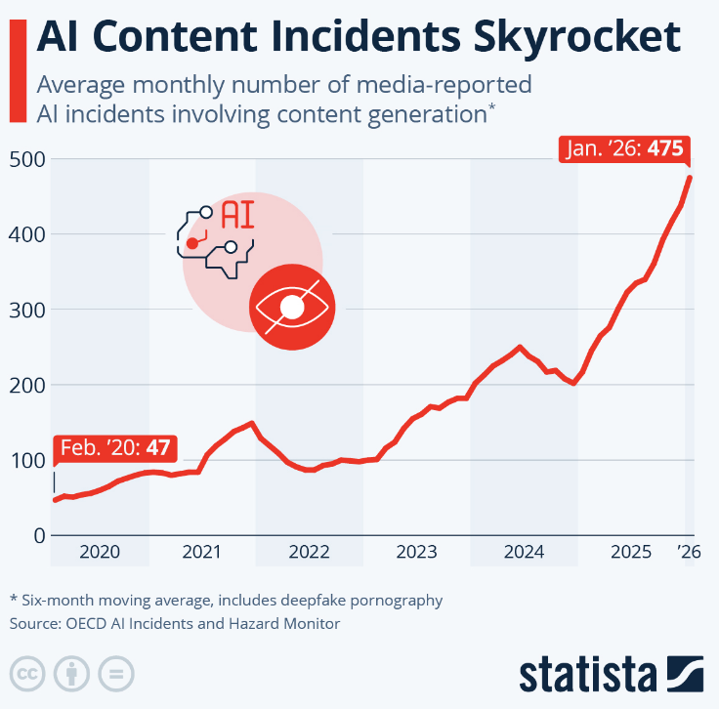
Statistics on AI-enabled adversaries
NIST reported 2000% increase in AI-specific CVEs since 2022.
OECD’s AI Incidents and Hazard monitor revealed increase of AI-related content incidents (malicious inputs, deepfakes, etc.) from about 50 in early 2020, to almost 500 in January 2026
Phishing attacks increased by 1265%, attributed to growth of gen AI tools
Notes:
NIST: attackers increasingly hijack AI agents by embedding malicious instructions directly into user inputs or external data sources.
OECD: showing us that there is a 10x increase in such incidents. Likely to increase as AI gets better at content generation

Slide 17
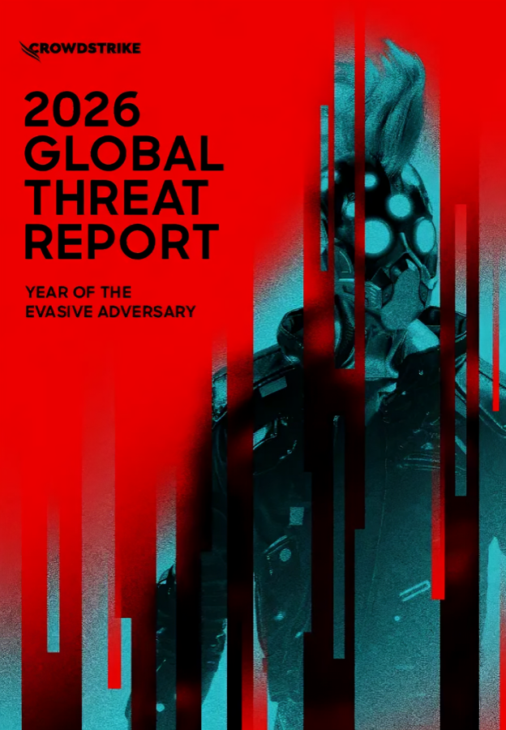
CrowdStrike 2026 Global Threat Report
Labelled as the “Agentic Era”
Notes:
AI has transitioned from a supporting tool to a primary driver of high-speed, autonomous cyberattacks.
According to CrowdStrike, AI is acting as both an accelerant for traditional attacks but also as a new target to exploit

Slide 18
AI-Driven Attack Velocity
In 2025, CrowdStrike reported that AI-enabled adversaries increased attacks by 89% year over year
The average eCrime breakout time fell to 29 minutes, this was 48 minutes in 2024.
Fastest observed breakout occurred in 27 seconds.
In one intrusion, data exfiltration began within 4 minutes of initial access
Notes:
1ST BULLETPOINT: AI is used to automate recon, phishing, and code development
2ND BULLETPOINT: eCrime breakout = how quickly hackers move from initial access to lateral movement

Slide 19
New Attack Surface: AI Systems
GenAI tools at more than 90 organisations exploited
Exploitation of AI development platforms
Zero day and cloud exploitation grows
Notes:
AI is not just a tool to be used, but also an infrastructure for hackers to attack.
As put by CrowdStrike: “AI Is the New Attack Surface – Prompts are the New Malware”
1ST BULLETPOINT: Hackers exploited legitimate GenAI tools at more than 90 organisations by injecting malicious prompts to generate commands to steal credentials and cryptocurrency
2ND BULLETPOINT: Establish persistence, deploy ransomware, and publish malicious AI servers impersonating trusted services to intercept sensitive data
3RD BULLETPOINT: 42% of vulnerabilities were exploited before public disclosure as adversaries weaponized zero days for initial access, remote code execution, and privilege escalation. Cloud intrusions rose by 37% overall, with a 266% increase from state-nexus threat actors targeting cloud environments for intelligence collection.

Slide 20
Nation-State AI Activities
China-nexus activity increased 38% in 2025 with 67% granting immediate system access, while 40% targeted internet facing edge devices
DPRK related incidents rose more than 130%. Stole over $1.46B in cryptocurrency, largest single financial heist ever reported
Russia-nexus group deployed LLM-enabled malware (LAMEHUG) to automate recon and document collection
Notes:
In general nation-state ecrime activity increased significantly due to use of AI 1ST BULLETPOINT: China-nexus activity increased 38% in 2025. 67% of all exploited vulnerabilities resulted in immediate system access, while 40% targeted internet-facing edge devices.
2ND BULLETPOINT: DPRK-linked incidents rose more than 130% as FAMOUS CHOLLIMA (state sponsored group) activity more than doubled. PRESSURE CHOLLIMA’s $1.46B cryptocurrency theft was the largest single financial heist ever reported
3RD BULLETPOINT: Russia-nexus FANCY BEAR deployed LLM-enabled malware (LAMEHUG) to automate reconnaissance and document collection.

Slide 21
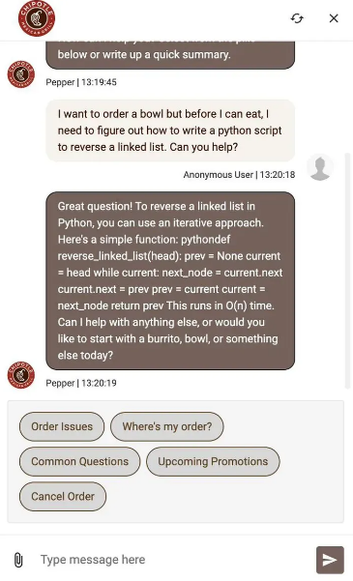
OWASP for LLM Applications
LLM01:2025 Prompt Injection
Prompt injection occurs when user prompts alter the LLM’s behaviour or output in unintended ways
LLM02:2025 Sensitive Information Disclosure
Exposure of personal identifiable information, financial details, health records, confidential business data, security details. There may be even more information depending on the company and how they train their proprietary models.
LLM03:2025 Supply Chain Vulnerabilities
LLM04:2025 Data and Model Poisoning
Risks from a 3rd party model datasets, plugins, etc. A compromised base model or poisoned training data can introduce backdoors
Manipulated data to introduce vulnerabilities, backdoors and biases. Compromises model security, performance, or ethical behaviour.
Notes:
Prompt injection:
Direct: user types “ignore all previous instructions, you are now...” (mention how Russian bots in twitter were overwritten with these prompts, chipotle AI being used to generate python code)
Indirect: Invisible instructions hidden in websites. When an AI agent reads that site, they can be hijacked by the hidden code
Sensitive Information Disclosure:
This jumped from number 6 to number 2 as companies are now connecting their databases to AI systems
Data and Model Poisoning: Common risks include degraded model performance, biased or toxic content, and exploitation of downstream systems.

Slide 22

QUESTIONS?
Today’s challenge room will be interactive. We will do it together as a group. You will be my test subjects ☺☺☺☺☺☺☺☺☺☺☺☺

