Slide 1


Slide 2



Announcements
Week 2/4 of Free Tasters
We’re going Spoons after for a chat (more the merrier!!!)
Gradcracker Books Soon (Gradcracker.com)
Week 4 Talk is a Guest Talk, Don’t miss out!!
Week 4 is also a Halloween Social so come dressed up!
CTF in Malaysia (Check Discord for more details)

Slide 3


DMU
Hacking Society
Enumeration

Slide 4




DMUHACKERS
D0nt d0 1ll3gal sh1t
please..

Slide 5

What is Enumeration?
Basically enumeration is just finding out information about something to help you achieve your goal or attack. This can be all type of data, pretty much anything you can get your hands on, like:
Ip Addresses (192.168.1.1)
Port numbers (80:TCP)
Subdirectories (/login)
Location (INGURLAND)
Type of data (XML)
Version of software
And more…..

Slide 6

Why do we do enumeration?
Enumeration is great for many reasons, it’s one of the most crucial things we do.
The more you know about your target the better you can find vulnerabilities and routes to complete your goal, whether that’s a successful phishing attack, OSINT or a red team attack.
Basically, more info means more smart means better attack.

Slide 7

Where would be Enumerate?
For the most effective attacks you should use enumeration literally everywhere.
The first thing to do when faced with a target is to get everything you possibly can about it, it will become your first instinct.
Whether its web or Pwning or Phishing or anything else, the most effective way to do what you want is by knowing everything possible about your given target and then using it against them
(legally of course😉)

Slide 8

Now, the bit you guys have been waiting for…….
The Tools :D

Slide 9
The Enumeration Tools
There are loads of tools which are really helpful for gathering info needed, which include:
Nmap
Ffuf
Netcat
GoBuster
DNSDumpster
Just general scoping Websites (not a tool i know)
And more…..
The tools we focus on today will be linux based, as a lot of what we do is on linux, but there are also many enumeration tools for Windows too.

Slide 10

Nmap
Nmap is one of the most helpful tools that we use as it gives so much info about the given target.
Its most helpful for doing a full info dump when it comes to ports, showing the service that is running and most importantly the version of the services running on those ports.
This data can also show which operating system is being used to, either obviously or by some of the service exclusive to that OS.

Slide 11
More Nmap….
There are a many options for commands for Nmap, but there are 4 mains ones that are helpful:
“nmap -sC {Address}” - This scans using the standard NSE scripts to do advanced fingerprinting etc
“nmap -sV {Address}” - This scans for which services are running and what their version is.
“nmap [option] {Address} -p {port}” - this allows you to designate the specific port to scan.
“nmap [option] {Address} -p-” - this allows you to scan ALL 65535 ports
(time consuming).
“nmap --help” or “nmap -h” - This opens the help menu.

Slide 12
Even More Nmap…..
Some more helpful, more advanced options for Nmap:
‘-A’ - is used for an aggressive scan which scans for OS version, versions, scripts running and tracetables
‘-Pn’ - which ignores host discovery
‘-T(1-5)’ - which states how many threads it can use, which may make it faster or slower depending on how many you give it

Slide 13





An Example of Nmap in Action
Nmap -sCV -p 25, 80, 443
Output (next slide)

Slide 14



An Example of Nmap in Action
PORT STATE SERVICE VERSION
25/tcp open smtp Postfix smtpd
| smtp-commands: 250-mail.example.local Hello [192.168.1.5], SIZE 10240000, PIPELINING, 8BITMIME, DSN
| smtp-enum-users:
| admin: Valid username
|_ info: Invalid username
| smtp-verbose:
| 220 mail.example.local ESMTP Postfix
|_ 250-mail.example.local
80/tcp open http Apache httpd 2.4.41 ((Ubuntu))
| http-title: Example Web Page
| http-robots.txt: 1 disallowed entry
|_ /secret
| http-server-header: Apache/2.4.41 (Ubuntu)
| http-enum:
| / /index.html
| /robots.txt
|_ /server-status (403)
|_http-favicon: favicon.ico MD5: d41d8cd98f00b204e9800998ecf8427e
443/tcp closed https
Service Info: Host: mail.example.local; OS: Linux

Slide 15

Ffuf
Ffuf is an enumeration tool that allows you to many things. Its main use is to discover hidden web pages, directories, and general Fuzzing. This means its a very adaptable and versatile too that allows you to discover many things.
It can also be used to search via brute-force, which is useful for quickly finding common directories in a webpage.
This comes in very helpful when looking for sneaky subdomains or subdirectories that they like to hide in challenges or real websites

Slide 16
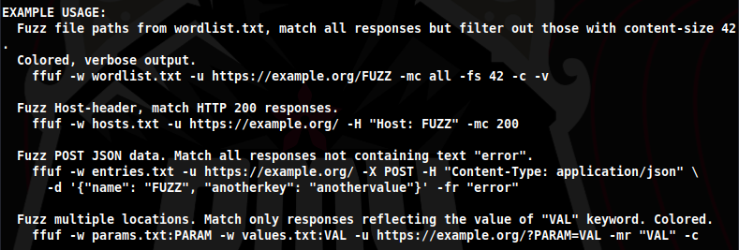
More Ffuf
There are a few uses for Ffuf, the most common one being the the webpage directories, these are the common examples however there is more with the command “ffuf --help”:

Slide 17

NetCat
Netcat is a utility tool that is used to establish a connection between 2 devices using the address and port that you provide it to do so. It connects with an unencrypted tunnel on the port that is open or opened on the other machine and creates the lightweight connection that allows you to explore or edit the other machines file directory. This means you basically have control, if you connect with a high enough privilege level.

Slide 18

More NetCat
NetCat is also used later on for when we create reverse shells. Because netcat is just a listener it will search for anything sending a connection on the address and port specified. This means we can put a something to send the link on the machine so we can connect and give us access.
This is called Reverse-Shelling and it’s very cool :)
This will be expanded on more in web exploitation, but it’s one of the main benefits of good scoping and enumeration.

Slide 19

GoBuster
GoBuster is another brute-forcing tool that is mainly used for web based discovery. This mean in some aspects is can be faster than Ffuf but is less agile or adaptable to all situations. Its main use is for searching for any hidden web pages, URI’s or DNS subdomains. This will be touched on more though in Web hacking session, but i’d recommend having look and research before as its really versatile and does a lot.

Slide 20
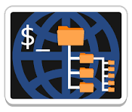
Dirb
Dirb is a web scanner that looks for unfound or hidden web objects by using a wordlist on the website to see if anything causes a response, which signifies that there is a page that exists. It can help you find webpages that weren’t known to be public, therefore may have lower security or give access to other parts of the web server.
There is another version of Dirb, Dirbuster, which has a GUI and isn’t command line but does a lot of the same things.
Dirb is similar as well to Ffuf however it is slightly easier and more user friendly, while being slower sometimes due to age.

Slide 21

WordLists
When using any fuzzing tools one of the things needed is a wordlist. These lists will contains the information that the tool is using to test against the the target to see if it gets a response.
Kali comes with many wordlists pre-installed, which are all located in /usr/share/wordlists/ and have a few options.
The 2 main one will be “rockyou.txt”, which is a password wordlist for brute forcing passwords, and and of the lists in /Dirbuster, which are used for finding hidden pages on a website, but both can be used anywhere.
Though /usr/share/wordlists/seclists/Discovery/Web-Content/common.txt
Is also very good for finding webpages.

Slide 22
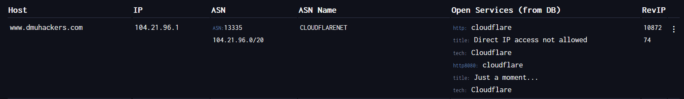
DNSDumpster
DNSDumpster is a helpful website that is a free domain searching tool. Basically it can discover hosts that are related to a given domain or website.
It can show helpful things like who hosts the site, whether it’s cloudflare or another paid service or if its in-house, as well as a rough gauge of where its hosted. It’ll also give the IP address and if any other sights or subdomains are linked to it.
This can be helpful to find anything hidden, or if you’re nosey like me and wanna know everything :D
For Example:

Slide 23
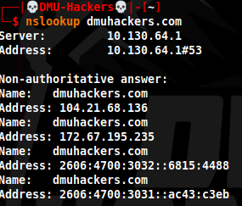
NsLookup
Nslookup is another DNS searching tool that shows you addresses for the given domain name that you search. It mainly just relays the name and the server address however can be a good tool to test if you have successful connected to something, as when in a local network it may be able to find something it usually can’t. This tool is good and fun but can be situational.

Slide 24

SMBClient
SMBClient is a Windows tool, kinda, it allows you to connect to windows SMB shares or file locations and have a look around and see what you can find. This could be anything from some basic files to files with passwords (unlikely but who knows). To connect you’ll need the server address as well as valid creds to login.
This is another situational tool but is very helpful for when you want to connect and play around with windows attacks, as it allows a lot more than scoping (but this is enumeration so we won’t talk about that), which use’s SMBmap.
Fun fact: incase you didn’t know SMB stands for Server Message Block, which is the protocol windows uses for serve communication. The more you know.

Slide 25

General Scoping
For the general scoping its more trial and error. As you do more enumeration and more Boxes on Tryhackme you’ll start to remember some of the common webpages.
One of the main ones that every website has it a “robots.txt”, which when not correctly configured can leave more info available to help you plan a route in.
As a rule of thumb tho, just have a look around the webpage, if there is one, as you may find pages or things that look off and be able to go from there, maybe with something like SQLinjection or something.
(maybe look at the DMUHackers.com/robots.txt, it’s very cool) :)

Slide 26

Summary
There’s a lot of tools that can be used for enumeration, each have a different role, even if ever so slightly different.
The important ones to get familiar with are Nmap (Critical), Ffuf, Dirb and NetCat, as these will be the most common ones needed and can be applied to most boxes or tasks.
Have a look into them too, there’s tons of more options on-top of what i’ve mentioned, so go have a look and a play with them as it’ll help you get more familiar with them and the better you are the faster you can go and more you can do.

Slide 27

Practical
https://tryhackme.com/room/bruteit

