Slide 1
data location
data bounding box
resulting grid geometry
grid origin location

Slide 2
primary data in point set
secondary data grid
primary data in point set
vertical
case for MM1
case for MM2
horizontal

Slide 3
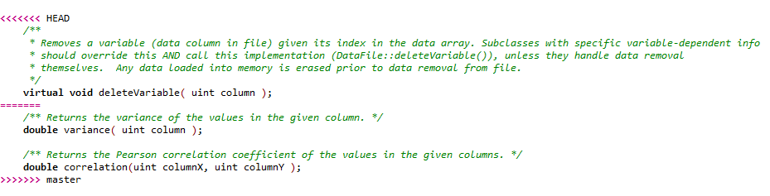
Part in your local branch
Part coming from remote or the other branch

Slide 4
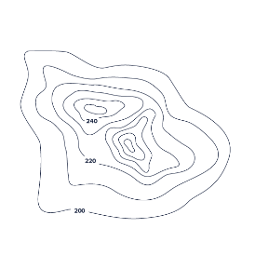
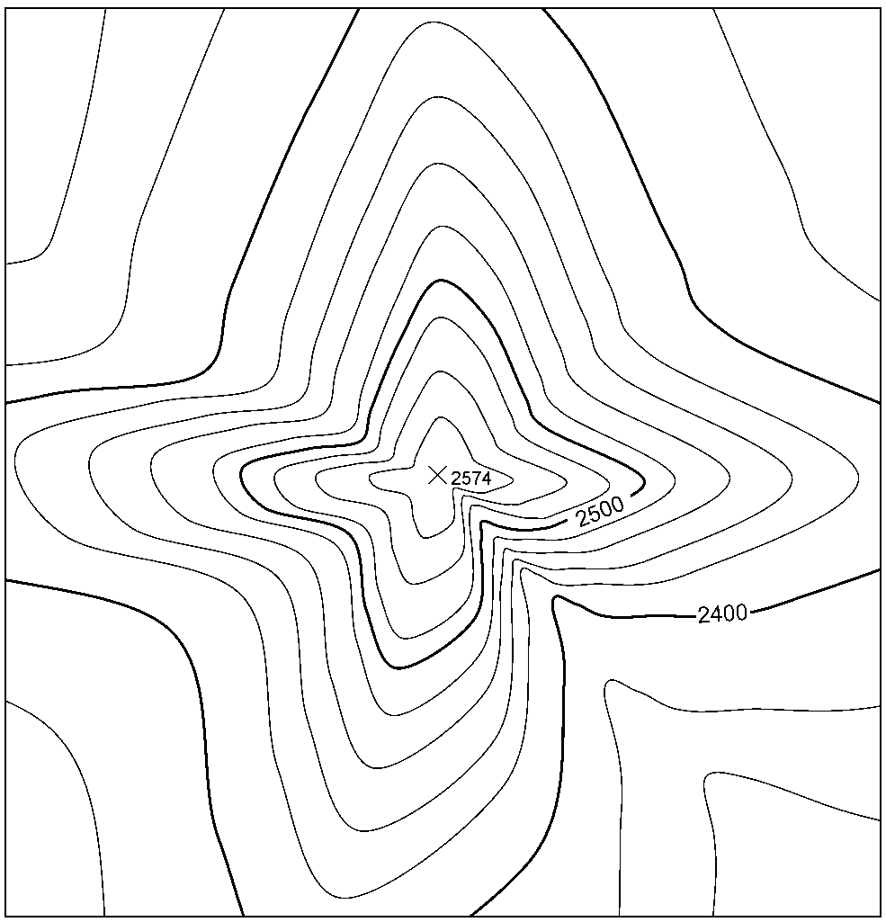
Theorem of
Convolution
Data grid
phase grid (φ)
FFT
real part grid (a)
||z|| = z ∙ z* =
(a+bi)(a-bi)=
a²+b²
imaginary part grid (b)
Covariance
grid
RFFT
zeroes grid (zero phase)
Desired
structure
SVD Analysis
Filtered structure
φ (must be entirely zeroed)
FFT
magnitude grid (|z|)
RFFT
Fourier Integral
Method

Slide 5
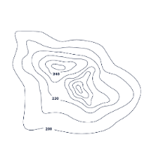
φ zero
M
||z|| = z ∙ z* =
(a+bi)(a-bi)=
a²+b²
variographic
map
real part (a)
RFFT
FFT
imaginary part (b)
phase (φ)
m geological
factors
(variographic structures)
SVD
φ zero
n fundamental
factors
Objective function
√
Σ
m
RFFT
FFT
m
g₁ = a₁₁f₁ + a₁₂f₂ + ... + a_{1n}f_{n}
g₂ = a₂₁f₁ + a₂₂f₂ + ... + a_{2n}f_{n}
...
g_{m} = a_{m1}f₁ + a_{m2}f₂ + ... + a_{mn}f_{n}
[a]_{mn}
value
M_{g}
magnitude (|z|)
[w]_{mn}=[0]_{mn}
[a] = A^{Ɨ}B+(I-A^{Ɨ}A)[w]
optimization step
otimization loop
update paramaters [w]

Slide 6
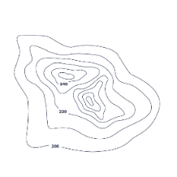

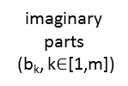
M
n fundamental factors
m geological factors
imaginary
parts
(b_{k}, k$∈$[1,m])
g₁ = a₁₁f₁ + a₁₂f₂ + ... + a_{1n}f_{n}
g₂ = a₂₁f₁ + a₂₂f₂ + ... + a_{2n}f_{n}
...
g_{m} = a_{m1}f₁ + a_{m2}f₂ + ... + a_{mn}f_{n}
Cov_{k} (z_{k}) =‖z_{k}‖
= z_{k} ∙ z_{k}* =
(a_{k}+b_{k}i)(a_{k}-b_{k}i)
= a_{k}²+b_{k}²
*
FFT
m
m
m
m
real parts
(a_{k}, k$∈$[1,m])
m
m
[a]_{mn}
m
zero φ
RFFT
[w]_{mn}=[0]_{mn}
[a] = A^{Ɨ}B+(I-A^{Ɨ}A)[w]
m
update parameters [w]
* SVD or spectrum partitioning
m varmaps
optimization step
optimization loop
N045E
m
objective function
a
ellipse
fit
Marching
Squares
m
b
m
m
m
m sets of elipses with
geometric parameters
m sets of
isocontours
discard malformed
isocontours

Slide 7
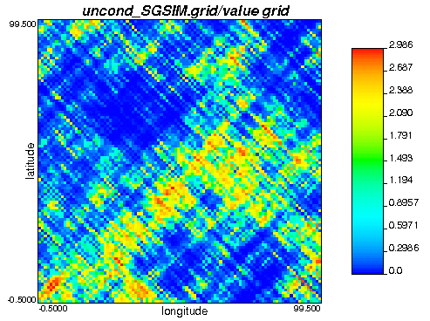
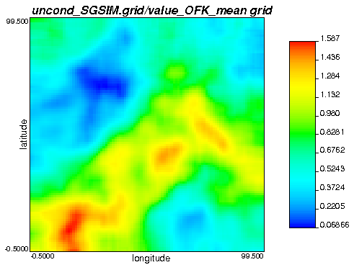
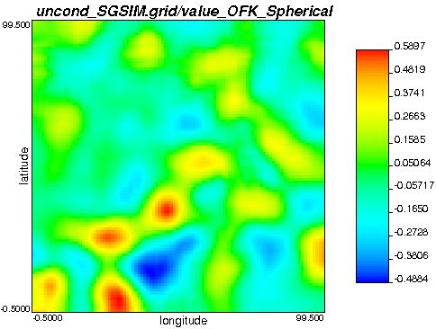
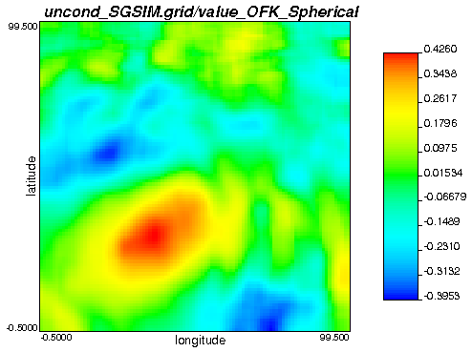
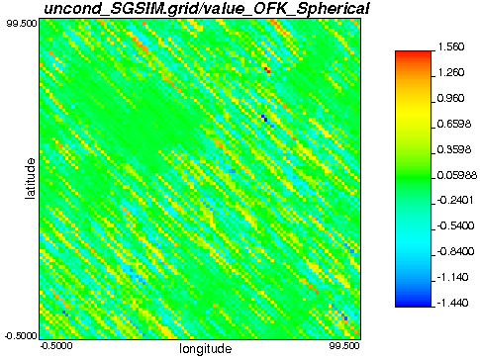
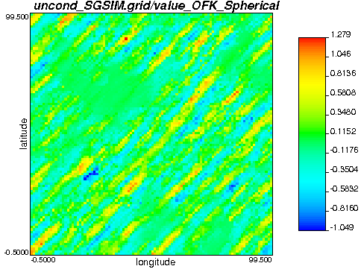
Parameters for vmodel
********************************
START OF PARAMETERS:
10570390.out
1 40
0 0 0.5
4 0
1 0.25 0 0 0
20 20 1
1 0.25 0 0 0
50 50 1
1 0.25 135 0 0
10000 1 1
1 0.25 45 0 0
10000 5 1
MEAN
Sph 20 x 20
Sph 50 x 50
Sph 10,000 x 1
@ N135E
Sph 10,000 x 5
@ N045E

Slide 8
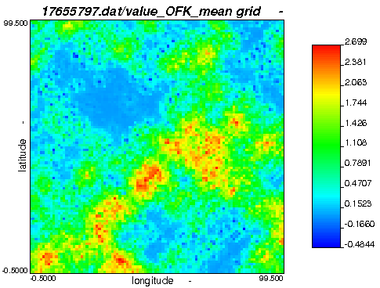
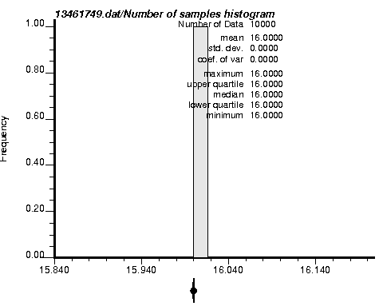
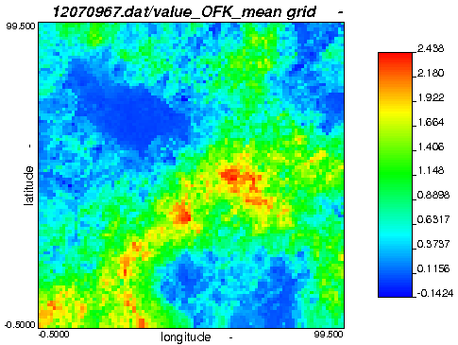
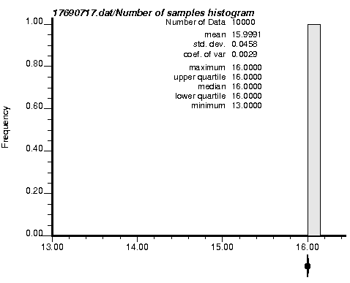
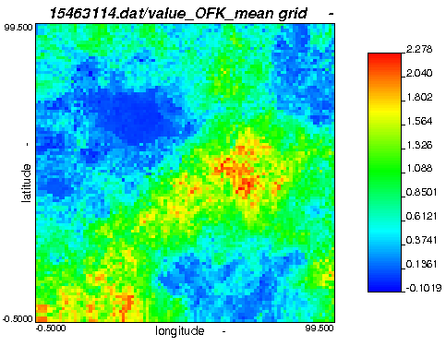
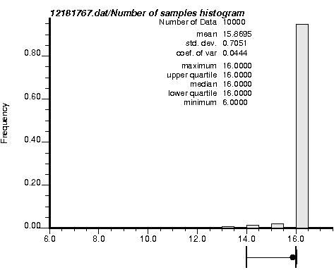
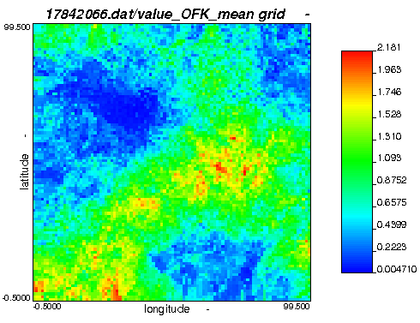
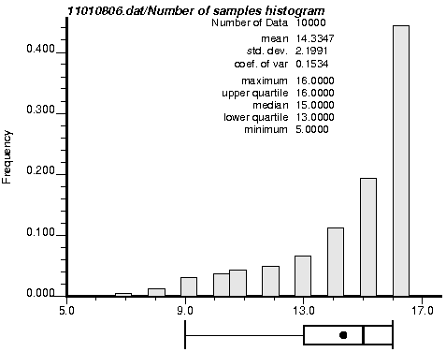
sample
spacing:
0.0
sample
spacing:
2.0
sample
spacing:
3.0
sample
spacing:
4.0

Slide 9
