Slide 1
data location
data bounding box
resulting grid geometry
grid origin location

Slide 2
primary data in point set
secondary data grid
primary data in point set
vertical
case for MM1
case for MM2
horizontal

Slide 3
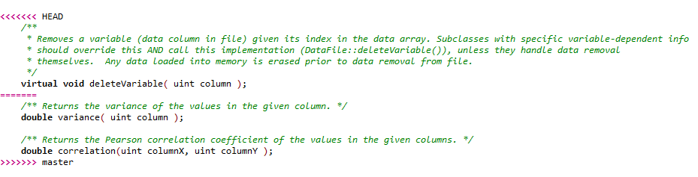
Part in your local branch
Part coming from remote or the other branch

Slide 4
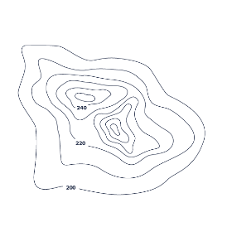
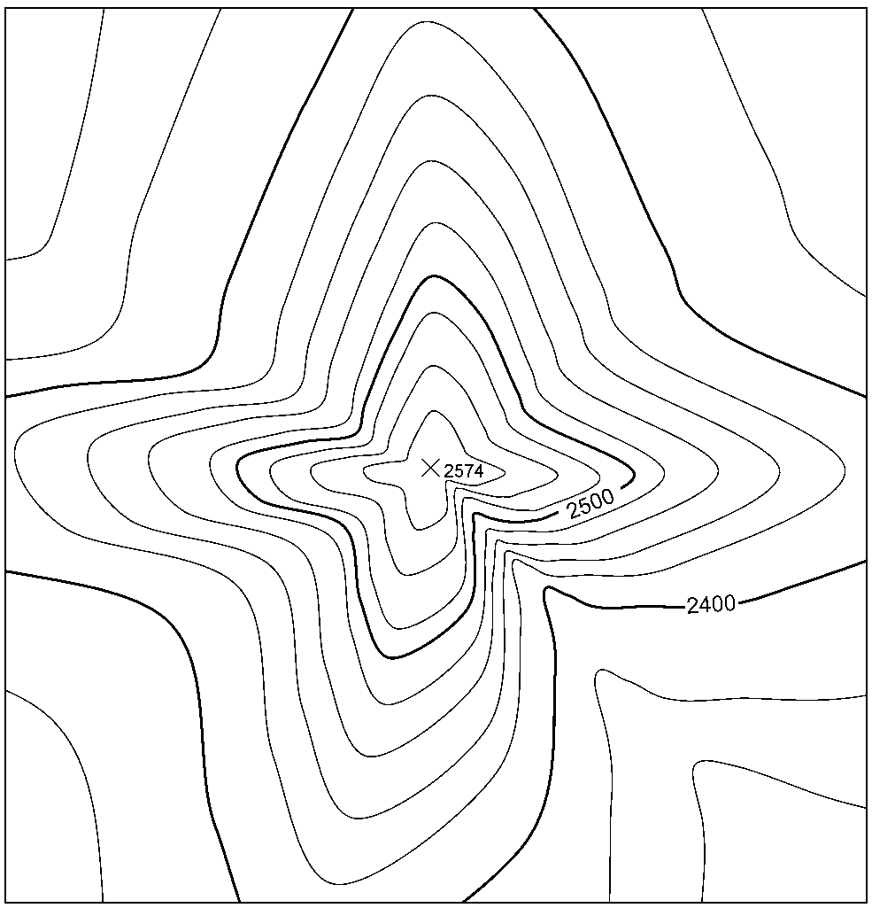
Theorem of
Convolution
Data grid
phase grid (φ)
FFT
real part grid (a)
||z|| = z ∙ z* =
(a+bi)(a-bi)=
a²+b²
imaginary part grid (b)
Covariance
grid
RFFT
zeroes grid (zero phase)
Desired
structure
SVD Analysis
Filtered structure
φ (must be entirely zeroed)
FFT
magnitude grid (|z|)
RFFT
Fourier Integral
Method

