Slide 1

Data Security And Privacy Protection
Group 1:

Slide 2
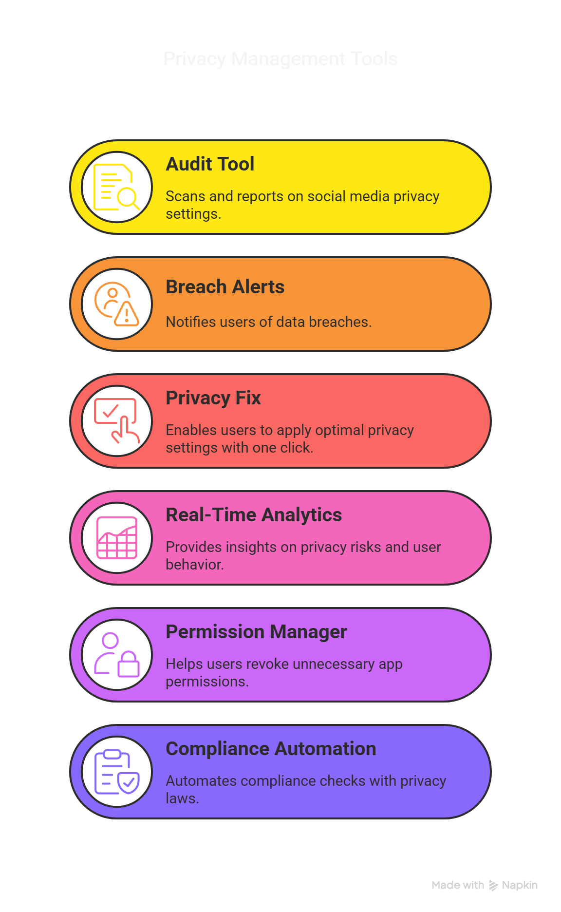
We are creating a set of easy-to-use tools that help protect user privacy and data for both individuals and organizations. These tools will monitor for any security threats in real-time, help businesses stay compliant with privacy laws, and make it simple for everyone to manage their privacy settings across different platforms.
Objective

Slide 3
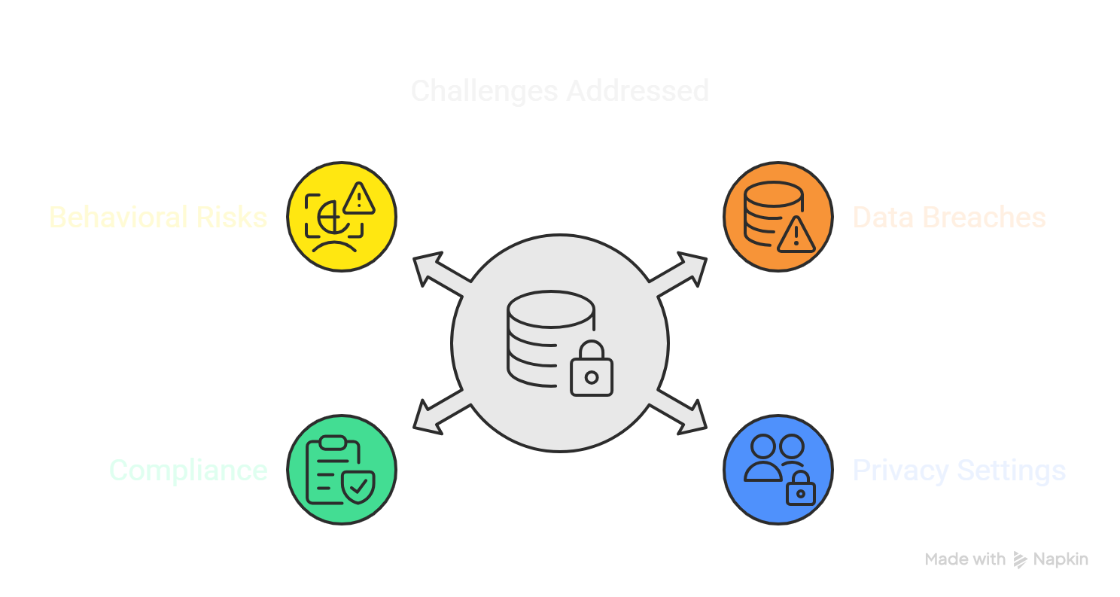
We are creating a set of easy-to-use tools that help protect user privacy and data for both individuals and organizations. These tools will monitor for any security threats in real-time, help businesses stay compliant with privacy laws, and make it simple for everyone to manage their privacy settings across different platforms.
Problem Statement

Slide 4

Tools Used
Azure DevOps was used to implement and manage the Scrum framework for the development and execution of the Data Security and Privacy Protection project

Slide 5
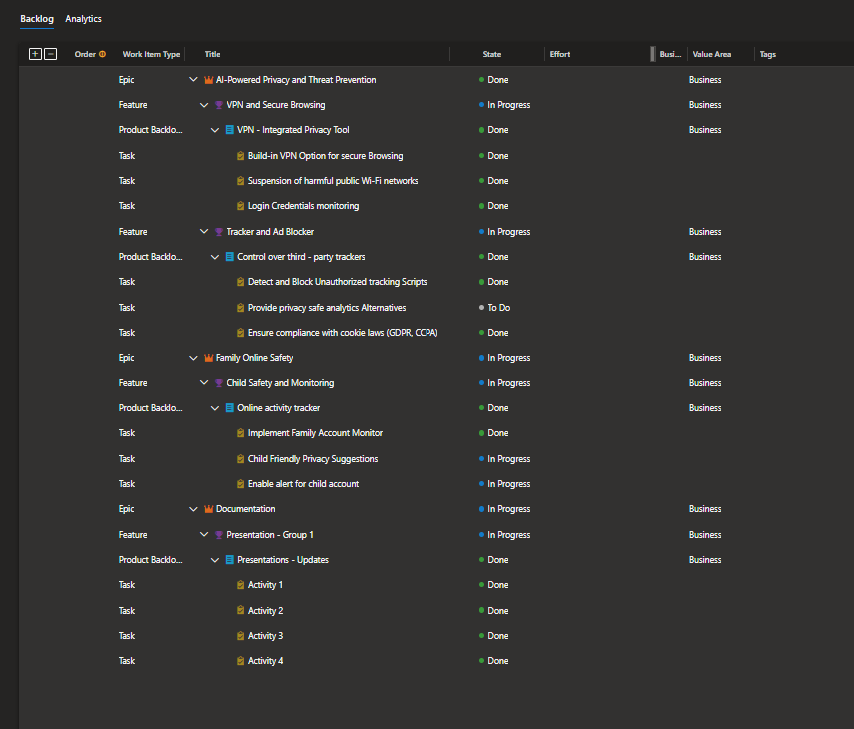
Product Backlog:
Agile Implementation Using Scrum:

Slide 6
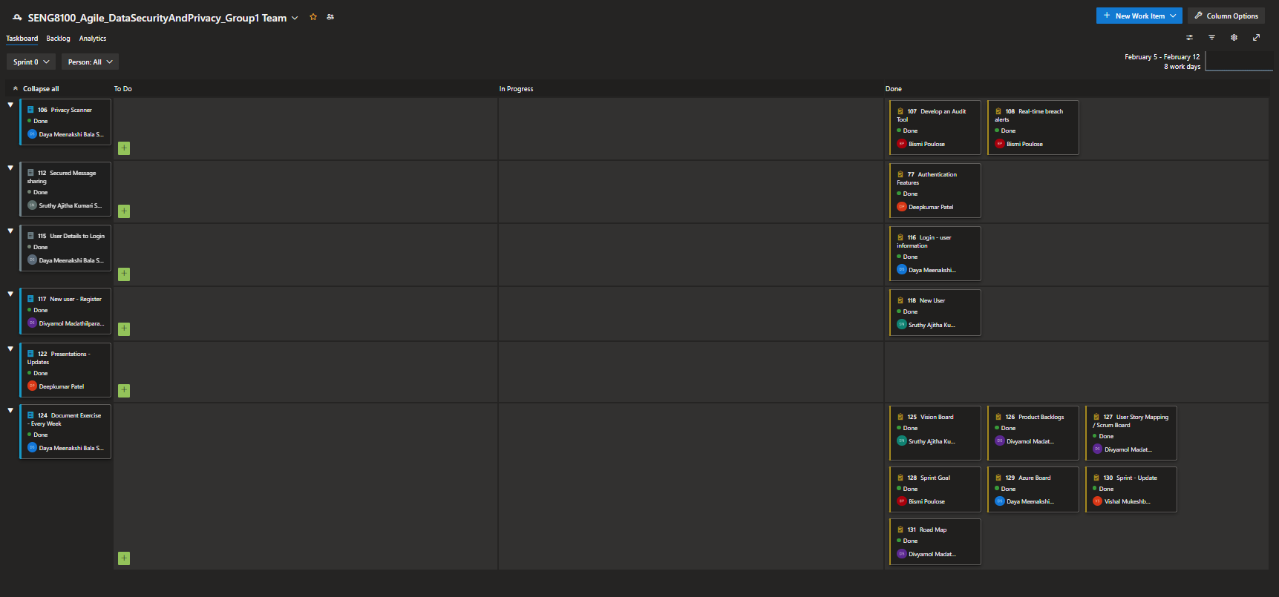
Product Backlog:
Agile Implementation Using Scrum:

Slide 7
Use of Azure DevOps Boards:
1. Task and Progress Tracking:
Azure DevOps Boards helped track all tasks and monitor progress in real-time, ensuring visibility into each phase of the project.
2. Sprint Planning and Retrospectives:
Sprint Planning: Defined clear goals for each sprint, prioritized tasks, and allocated resources effectively.
Retrospectives: Reviewed each sprint to identify improvements and optimize future processes.
3. Workflow Organization and Collaboration:
Enabled seamless workflow organization and collaboration between developers, testers, and stakeholders, ensuring efficient task management.

Slide 8

Machine Learning Solution Overview
Problem it Solves and Its Relevance: Modern computer networks face constant cyber threats, such as unauthorized access, data breaches, and DoS attacks. Traditional manual monitoring methods are ineffective and time-consuming. This solution uses machine learning to build a Real-Time Breach Alert System, detecting malicious activity and notifying users immediately, ensuring proactive security.

Slide 9
Model Selection and Performance
Initial Attempt – Isolation Forest (Unsupervised):
Accuracy: 38%
Recall (Attack): 7% Poor performance, could not learn from labeled data.
Final Model – Random Forest (Supervised):
Accuracy: 94%
Precision (Attack): 96%
Recall (Attack): 92%
F1-Score (Attack): 94% Random Forest with SMOTE achieved excellent performance, reliably detecting attacks.

Slide 10
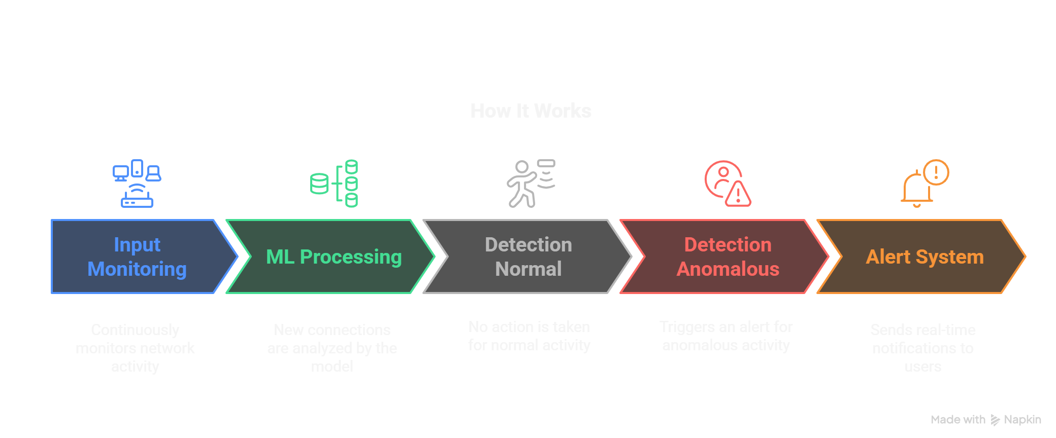
Integration with the Prototype

Slide 11
Live Demonstration of the Working Prototype

Slide 12
Challenges and Lessons Learned
Challenges:
Imbalanced Dataset: The dataset contained many more normal connections than attacks, which required techniques like SMOTE to balance the data.
Model Performance: The initial Isolation Forest model performed poorly (38% accuracy) and couldn’t detect attacks effectively, which led to a switch to the Random Forest model.
Real-Time Processing: Ensuring that the model could process network traffic and generate alerts in real-time was a technical challenge, particularly when integrating the system with the app.
Lessons Learned:
Data Quality and Balance: The importance of having a balanced dataset and handling imbalances to improve model accuracy.
Model Selection: It's crucial to test different algorithms and find the best model suited for the problem at hand. Random Forest provided better results compared to the unsupervised Isolation Forest.
Real-Time Integration: The complexity of integrating machine learning models into live systems requires careful consideration of performance and latency.

Slide 13
Suggested Future Enhancements
1. Expand Dataset and Features:
Include more attack types and increase the diversity of data to improve model robustness.
2. Implement Deep Learning Models:
Explore deep learning techniques (e.g., Neural Networks) for potentially better performance in detecting complex attack patterns.
3. Integration with More Security Tools:
Extend the breach detection system to integrate with firewalls, intrusion detection systems (IDS), and other security tools for more comprehensive protection.
4. Real-Time Model Updates:
Implement continuous learning where the model updates itself periodically as new attack patterns are detected to adapt to emerging threats.
5. User Interface Enhancements:
Improve the user interface for better visualization of alerts, network activity, and security trends, making it more user-friendly.

